Slide 1
These slides accompany Service 1
There are explanatory notes for the leader in the Global Relationship Worship Resource Pack, which you can download from the Methodist Church website.
You can edit and delete slides depending on which materials you have selected.
You can insert hymn lyrics if you have the appropriate CCLI licence for your church or venue.

Slide 2
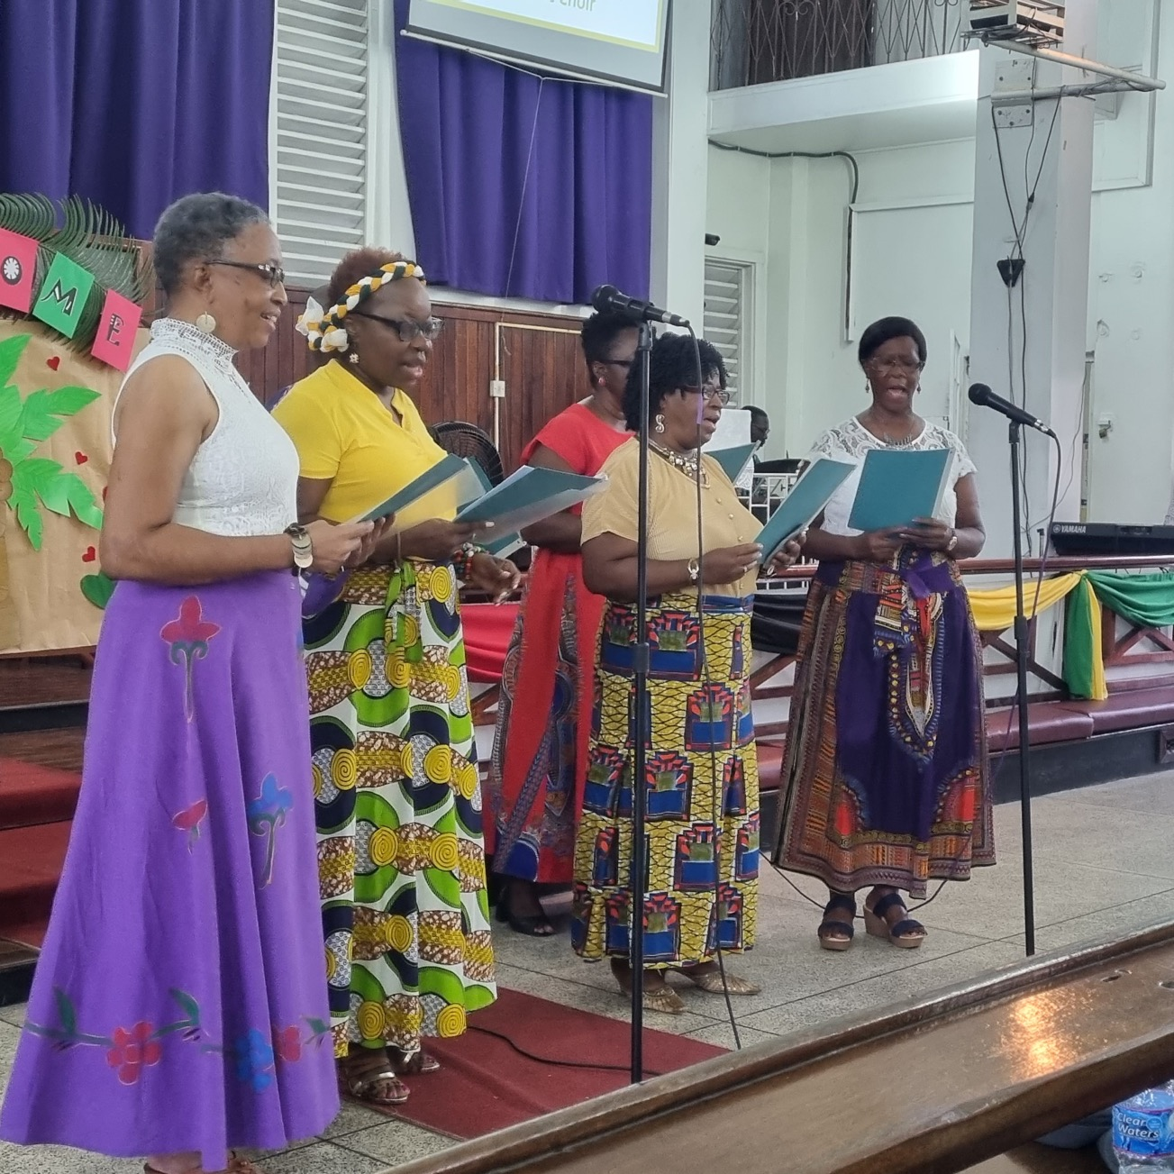
The Greatest Commandment Worship for the presidential theme 2022/2023

Slide 3
CALL TO WORSHIP
“Dear friends, let us love one another, for love comes from God. Everyone who loves has been born of God and knows God.”
I John 4:7

Slide 4
HYMN
Choose from:
God is love: his the care (StF 403 or H&P 220) God is love: let heaven adore him (StF 103 or H&P 36)

Slide 5
PRAYERS OF PRAISE AND CONFESSION (1 OF 3)
Prepared by Sheila Norris, Partnership Coordinator for Asia-Pacific
Loving God,
We praise you for your love which created the universe
We praise you for your love which sent Jesus to live and die for us
We praise you for your love which gives your Holy Spirit to strengthen and encourage us.
Loving God,
Thank you for the times when we feel surrounded by your love
Thank you for the people who show your love to us
Thank you for the opportunities we have to show your love to other people.
Loving God,
We are sorry that we do not always love you with all our hearts and souls and minds
We have worshipped you on Sunday, but forgotten about you during the week
We have been quick to ask you for what we want, but slow to thank you for what you give us
We have promised to serve you, but put ourselves first.

Slide 6
PRAYERS OF PRAISE AND CONFESSION (2 OF 3)
Prepared by Sheila Norris, Partnership Coordinator for Asia-Pacific
Loving God,
We are sorry that we do not always show your love to other people
We have thought and said unkind things
We have kept things for ourselves instead of sharing
We haven’t noticed when other people are left out.
Loving God,
Forgive us.
Forgive us for the opportunities we have missed to share your love.
Forgive us for the times we have forgotten that you love each person equally, and that your love includes ourselves, the people we like, and the people we don’t like, because each person is our neighbour.

Slide 7
PRAYERS OF PRAISE AND CONFESSION (3 OF 3)
Prepared by Sheila Norris, Partnership Coordinator for Asia-Pacific
Help us to know that we are loved by you, and that you do forgive us when we say sorry, and help us to try to do better.
Fill us with your love, and help us to show that love to other people every day through kind words and gentle, helpful actions.
We pray in the name of Jesus, the Lord of love.
Amen

Slide 8
READING
“Hear, O Israel: The Lord our God, the Lord is one. Love the Lord your God with all your heart and with all your soul and with all your strength. These commandments that I give you today are to be on your hearts. Impress them on your children. Talk about them when you sit at home and when you walk along the road, when you lie down and when you get up. Tie them as symbols on your hands and bind them on your foreheads. Write them on the doorframes of your houses and on your gates.”
Deuteronomy 6:4-9

Slide 9
AN AFRICAN CANTICLE (1 OF 2)
All you big things, bless the Lord.
Mount Kilimanjaro and Lake Victoria,
The Rift Valley and the Serengeti Plain,
Fat baobabs and shady mango trees,
All eucalyptus and tamarind trees,
Bless the Lord.
Praise and extol Him for ever and ever.

Slide 10
AN AFRICAN CANTICLE (2 OF 2)
All you small things, bless the Lord.
Busy black ants and hopping fleas,
Wriggling tadpoles and mosquito larvae,
Flying locusts and water drops,
Pollen dust and tsetse flies,
Millet seeds and dried dagaa,
Bless the Lord.
Praise and extol Him for ever and ever.

Slide 11
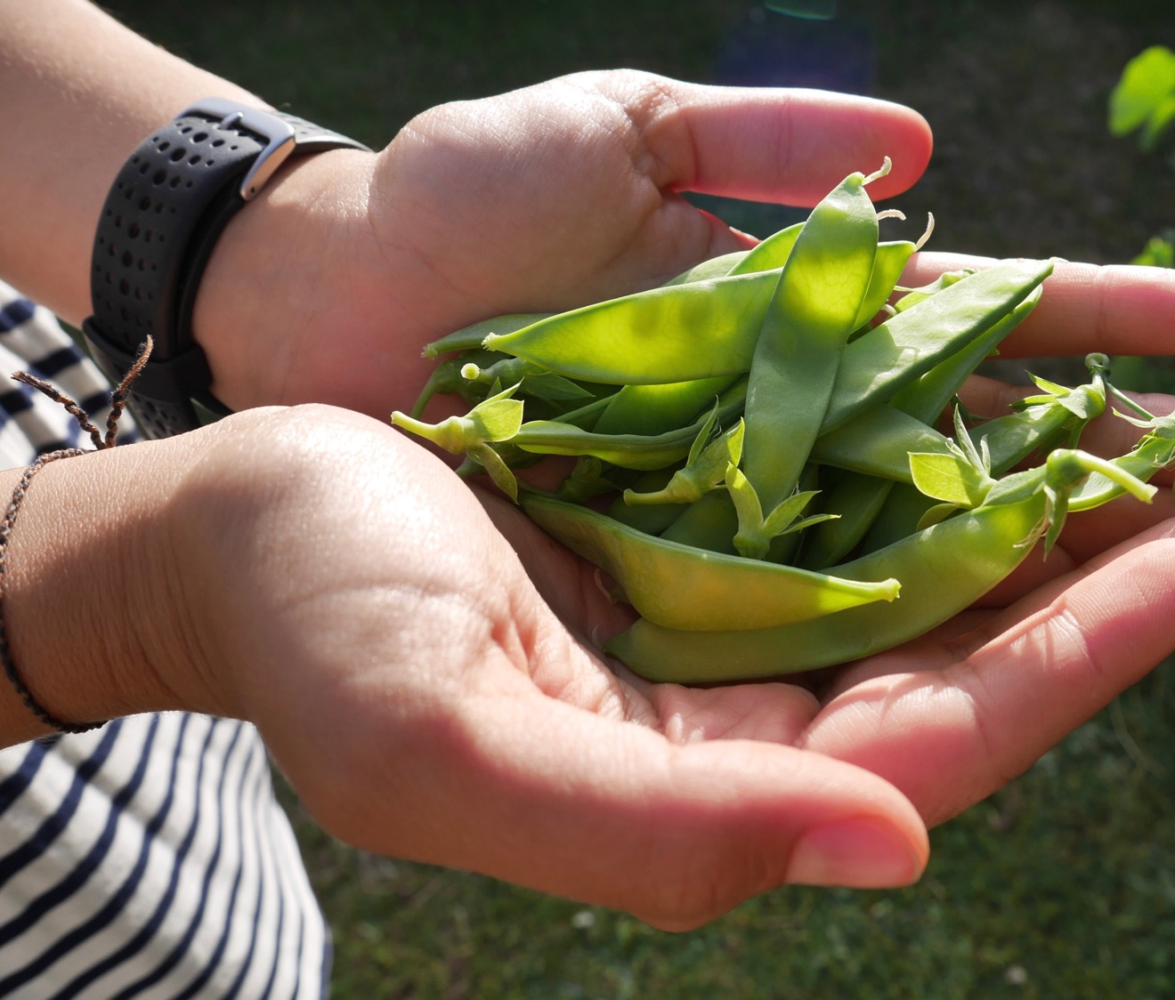
ALL-AGE TALK
Fruits of the continent/fruits of the Spirit

Slide 12
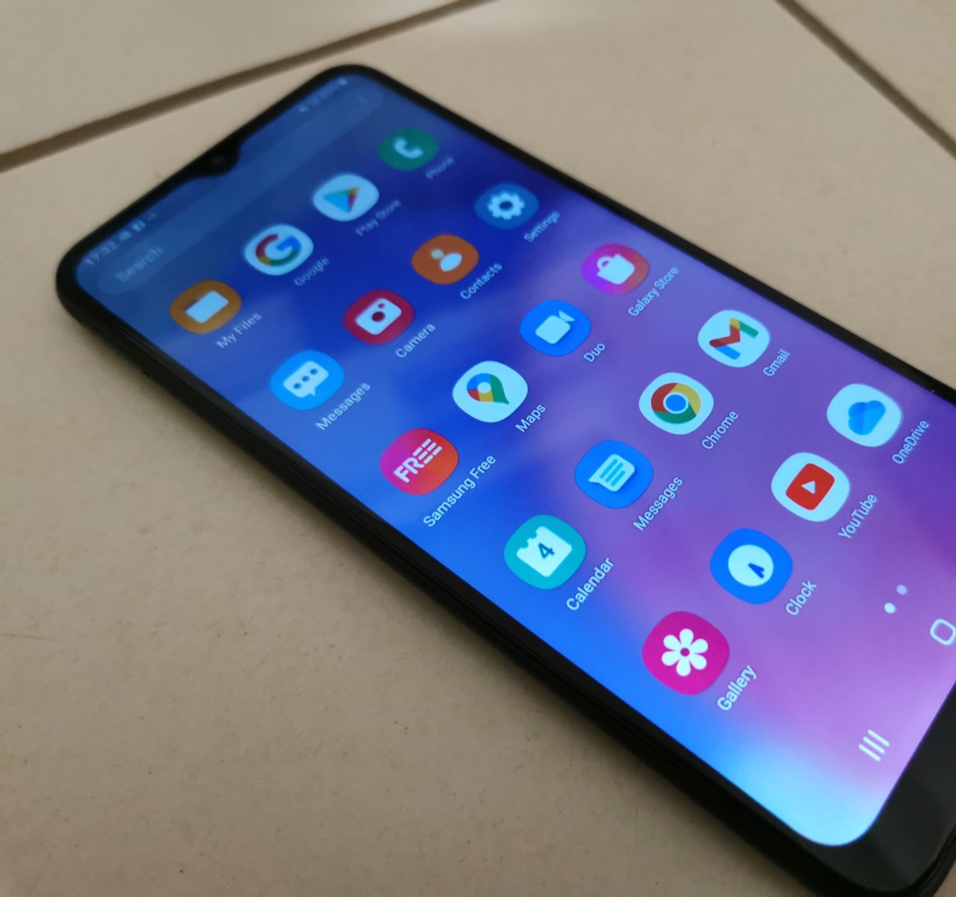
ALL-AGE TALK
Trade and
injustice

Slide 13
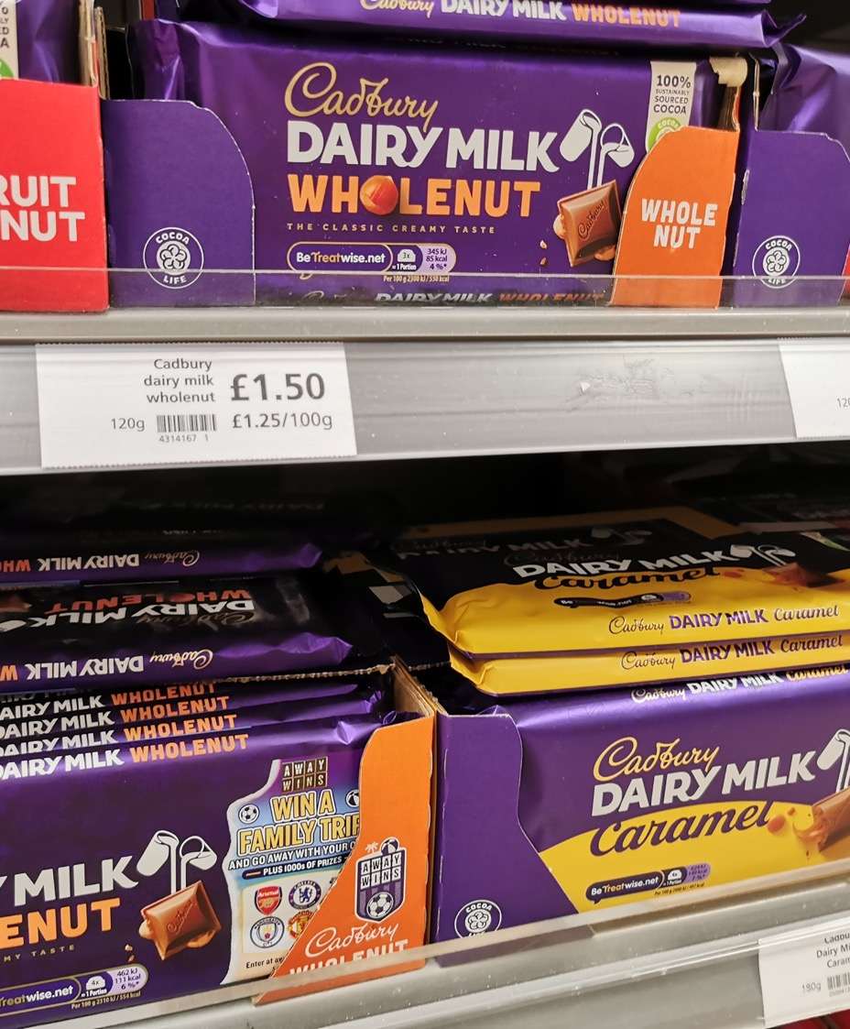
ALL-AGE TALK
Trade and environment

Slide 14
ALL-AGE TALK
Culture and community

Slide 15
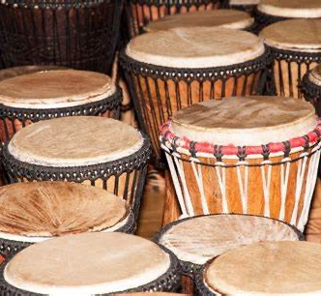
ALL-AGE TALK
Worship/love of God and the other

Slide 16
HYMN
Choose from:
Jesu, Tawa Pano (StF 27) Jesu, Jesu (StF 249 or H&P 145)

Slide 17
READING (1 OF 2)
Galatians 5:13-26
“For you were called to freedom, brothers and sisters; only do not use your freedom as an opportunity for self-indulgence, but through love become slaves to one another. For the whole law is summed up in a single commandment, ‘You shall love your neighbour as yourself.’ If, however, you bite and devour one another, take care that you are not consumed by one another.
Live by the Spirit, I say, and do not gratify the desires of the flesh. For what the flesh desires is opposed to the Spirit, and what the Spirit desires is opposed to the flesh; for these are opposed to each other, to prevent you from doing what you want. But if you are led by the Spirit, you are not subject to the law.

Slide 18
READING (2 OF 2)
Now the works of the flesh are obvious: fornication, impurity, licentiousness, idolatry, sorcery, enmities, strife, jealousy, anger, quarrels, dissensions, factions, envy, drunkenness, carousing, and things like these. I am warning you, as I warned you before: those who do such things will not inherit the kingdom of God.
By contrast, the fruit of the Spirit is love, joy, peace, patience, kindness, generosity, faithfulness, gentleness, and self-control. There is no law against such things. And those who belong to Christ Jesus have crucified the flesh with its passions and desires. If we live by the Spirit, let us also be guided by the Spirit. Let us not become conceited, competing against one another, envying one another.”
Galatians 5:13-26

Slide 19
ALL-AGE TALK
Ese ne Tekrema

Slide 20
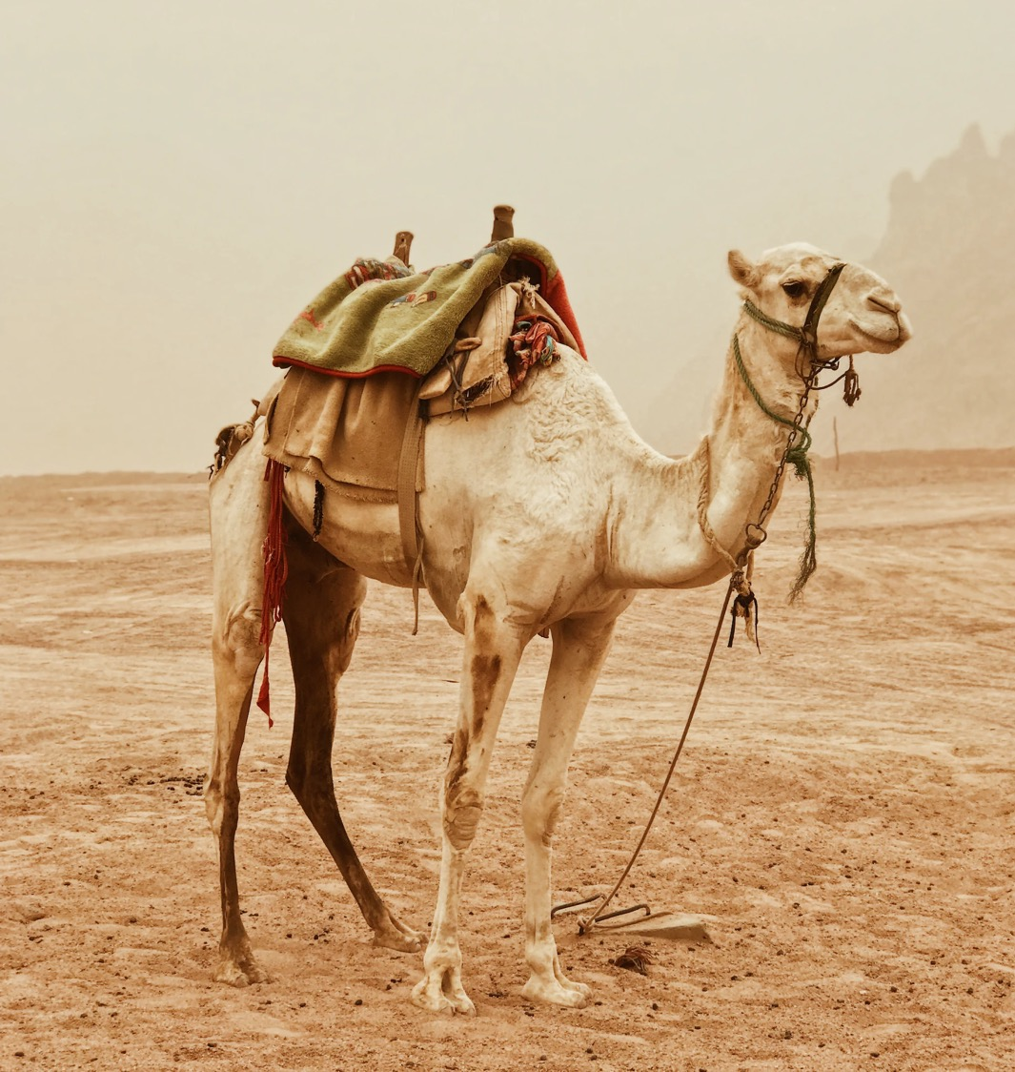
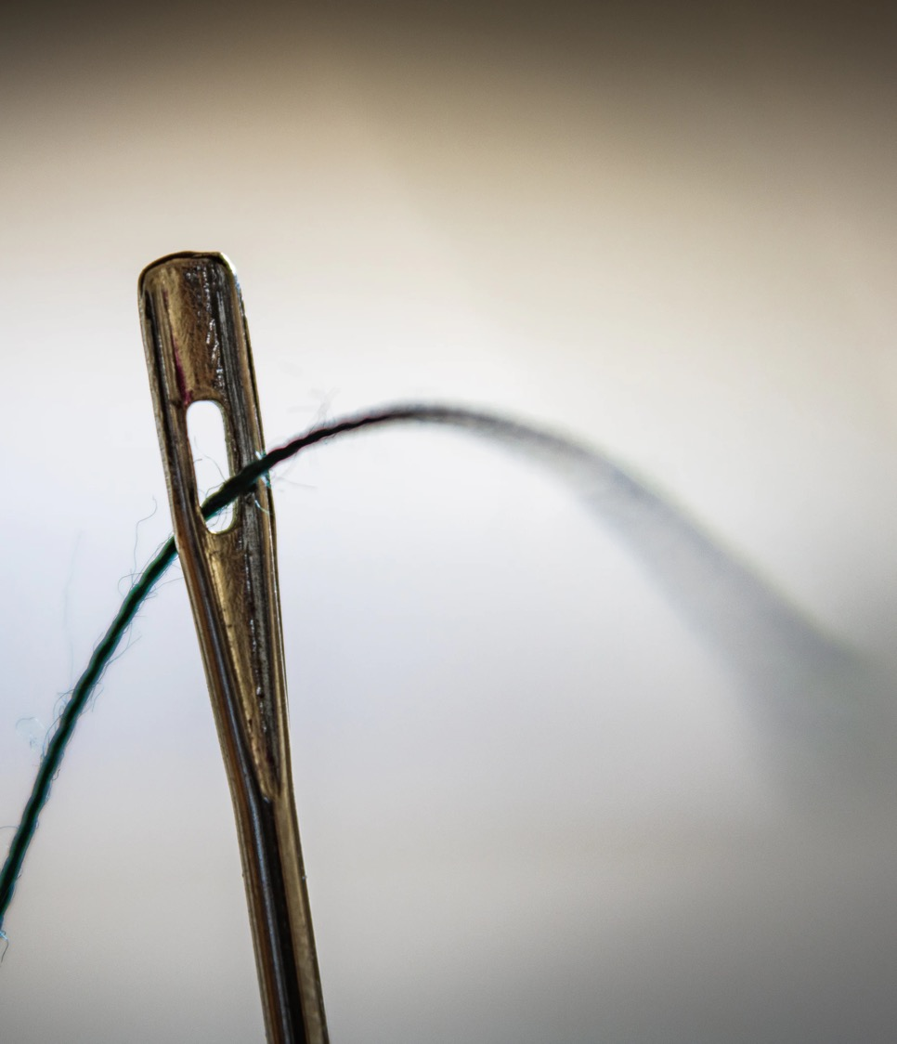

Slide 22
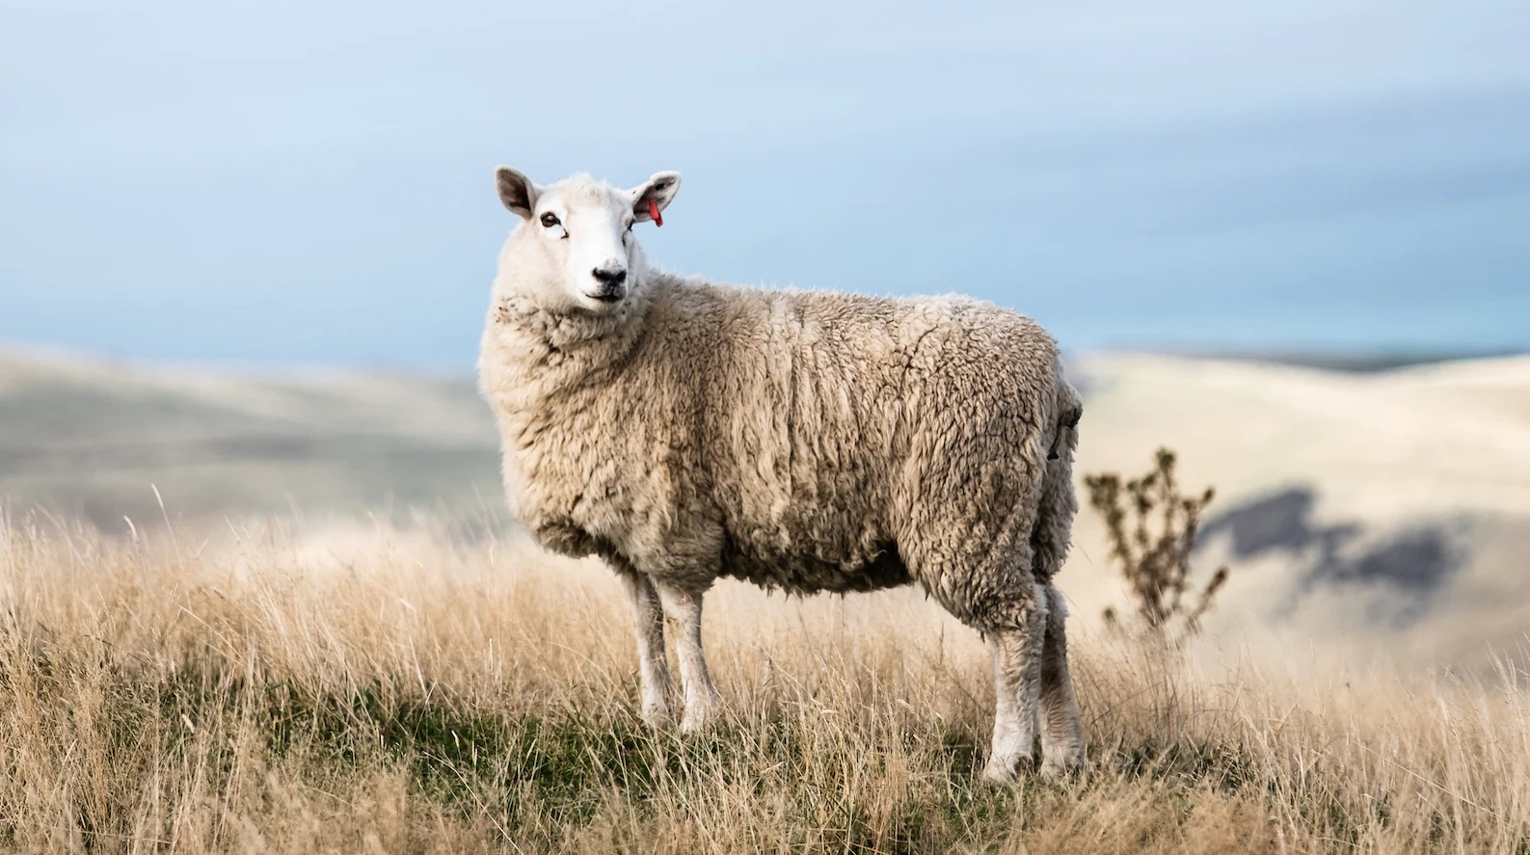

Slide 23
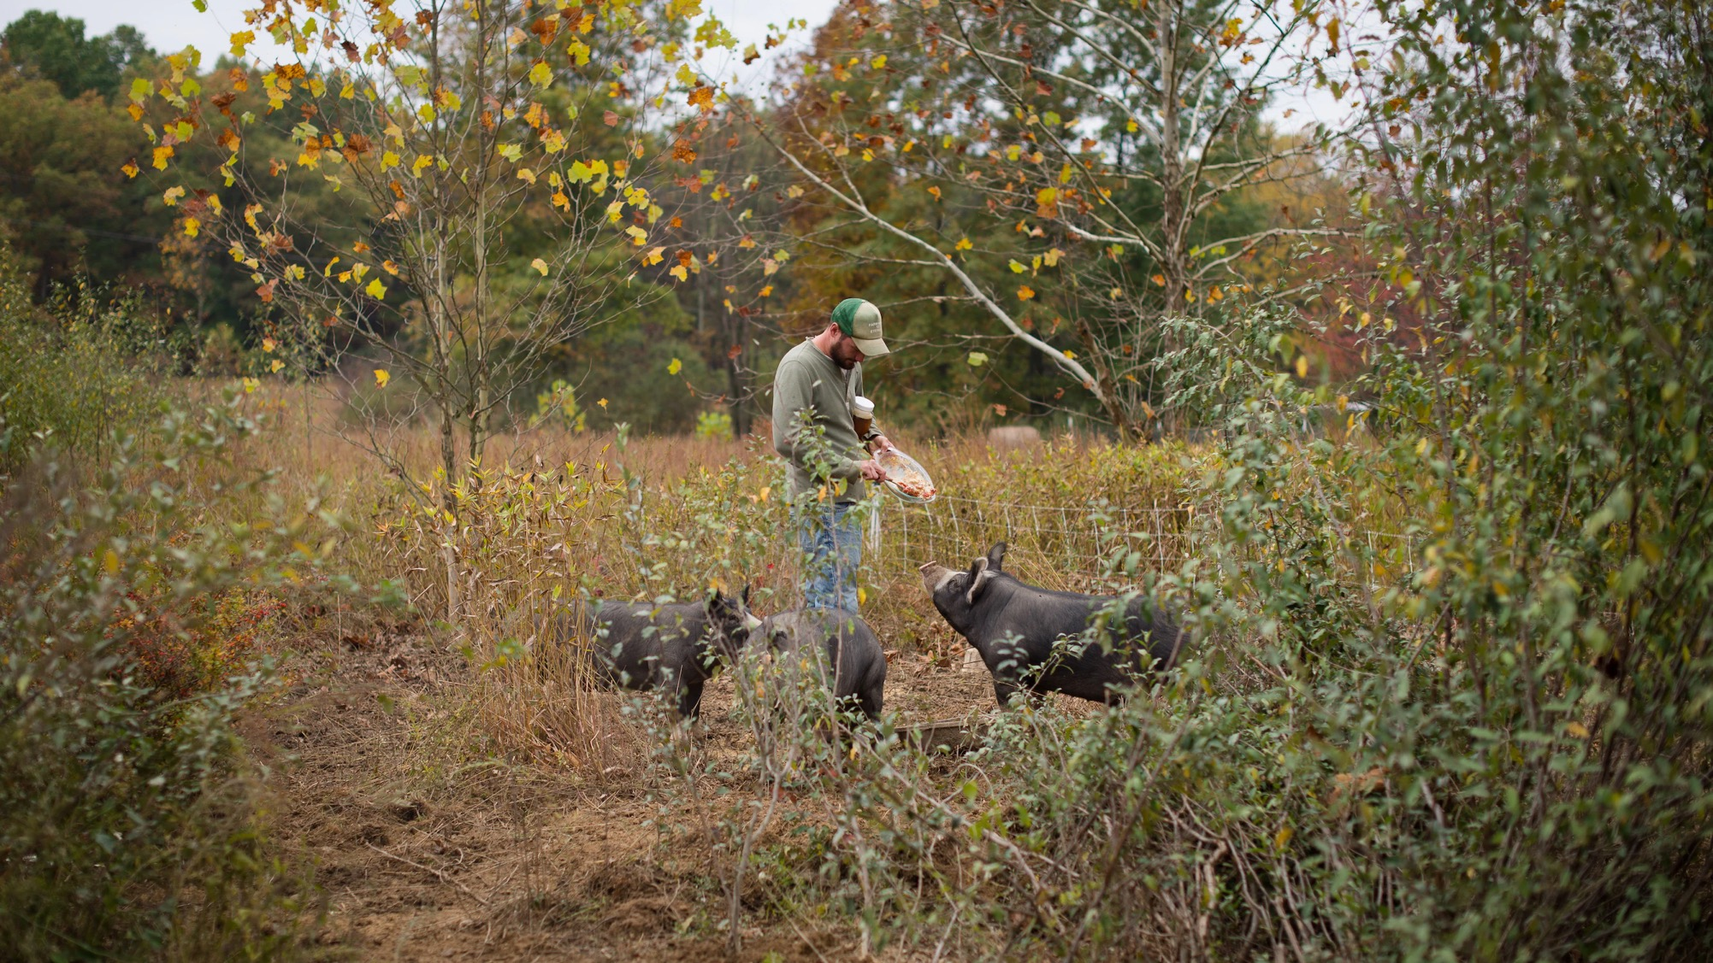

Slide 24
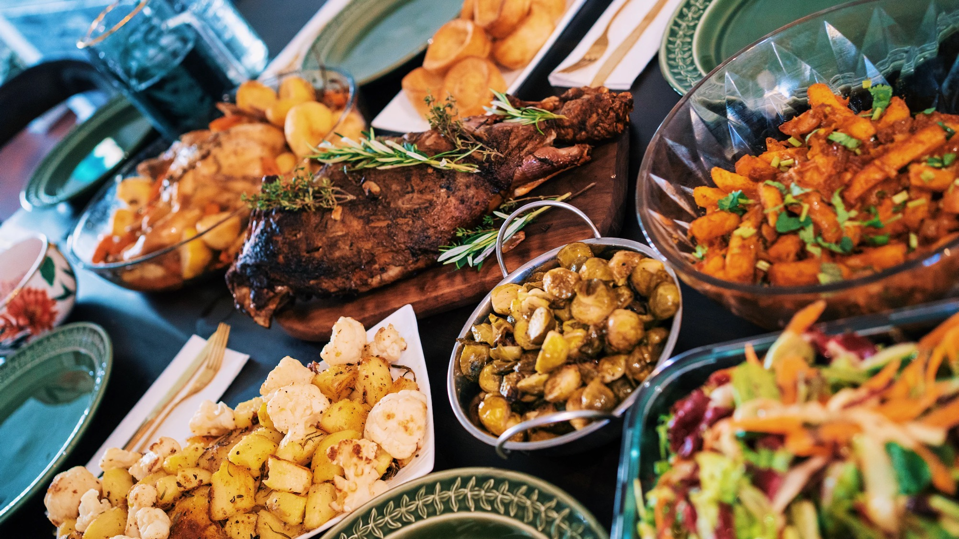

Slide 25
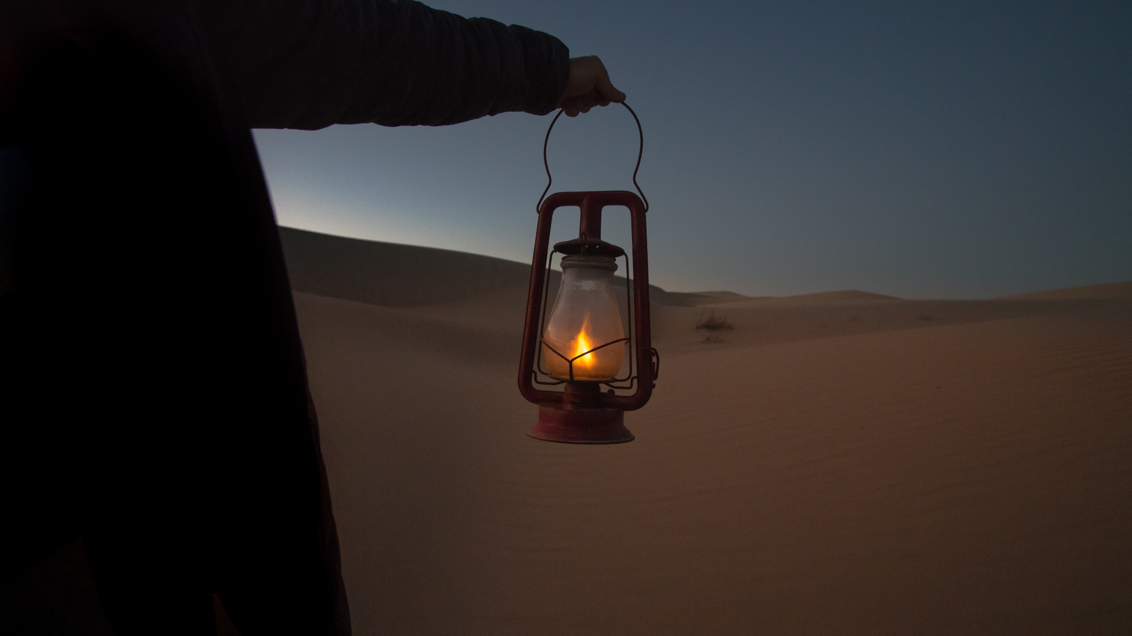

Slide 26
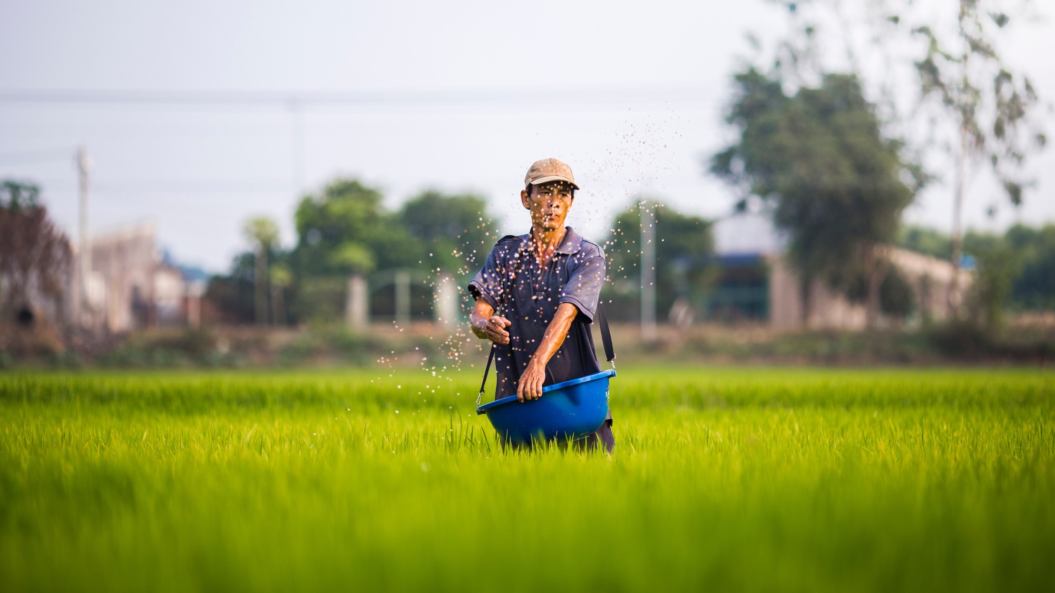

Slide 27
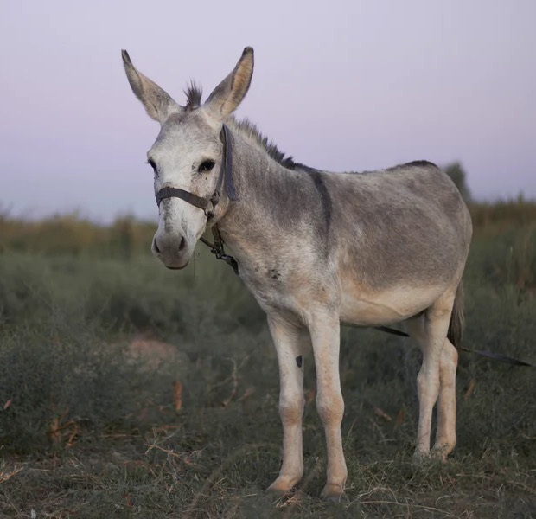
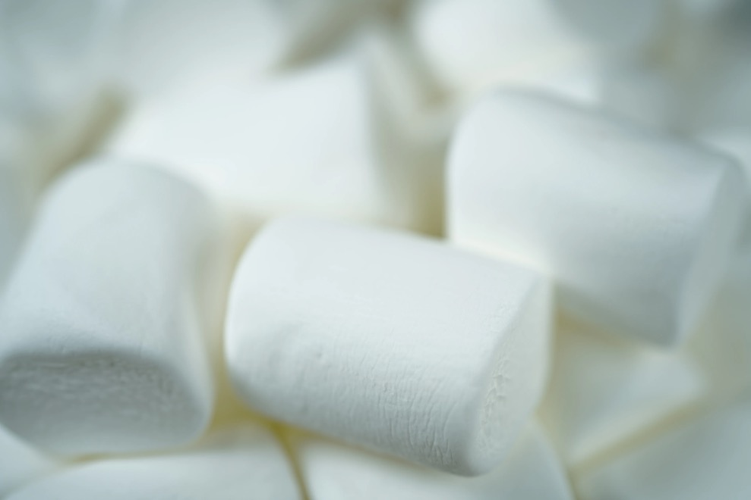

Slide 29
HYMN
Choose from:
Brother, sister let me serve you (StF 611)
What shall our greeting be? (StF 691 or H&P 806)

Slide 30
READING
When the Pharisees heard that he had silenced the Sadducees, they gathered together, and one of them, a lawyer, asked him a question to test him. ‘Teacher, which commandment in the law is the greatest?’ He said to him, ‘“You shall love the Lord your God with all your heart, and with all your soul, and with all your mind.” This is the greatest and first commandment. And a second is like it: “You shall love your neighbour as yourself.” On these two commandments hang all the law and the prophets.’ Matthew 22:34-40

Slide 31
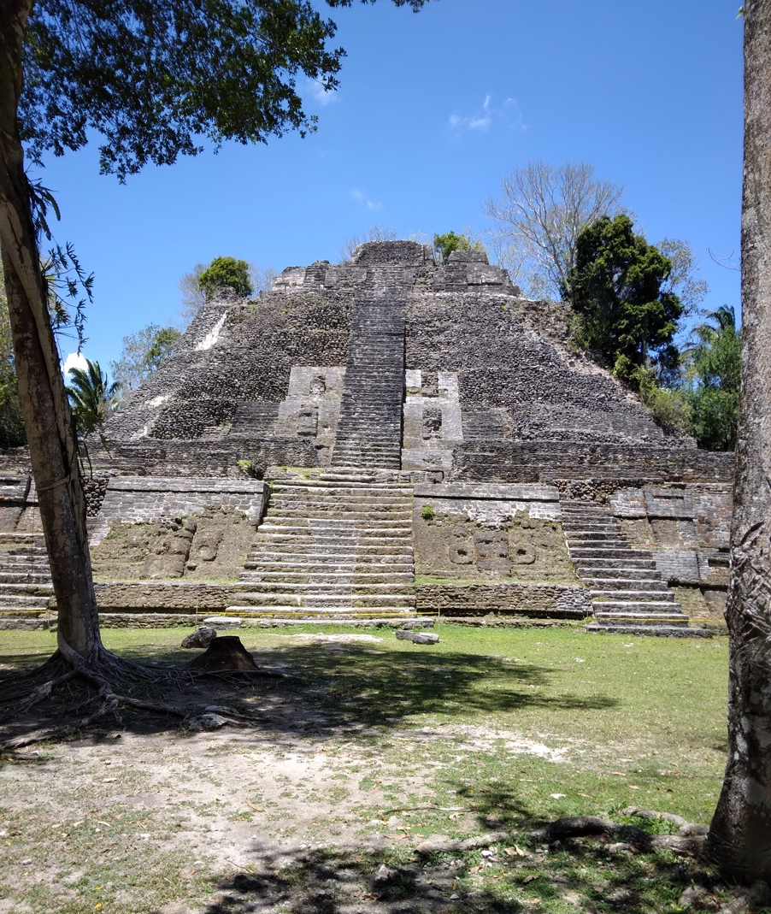
Sermon

Slide 32
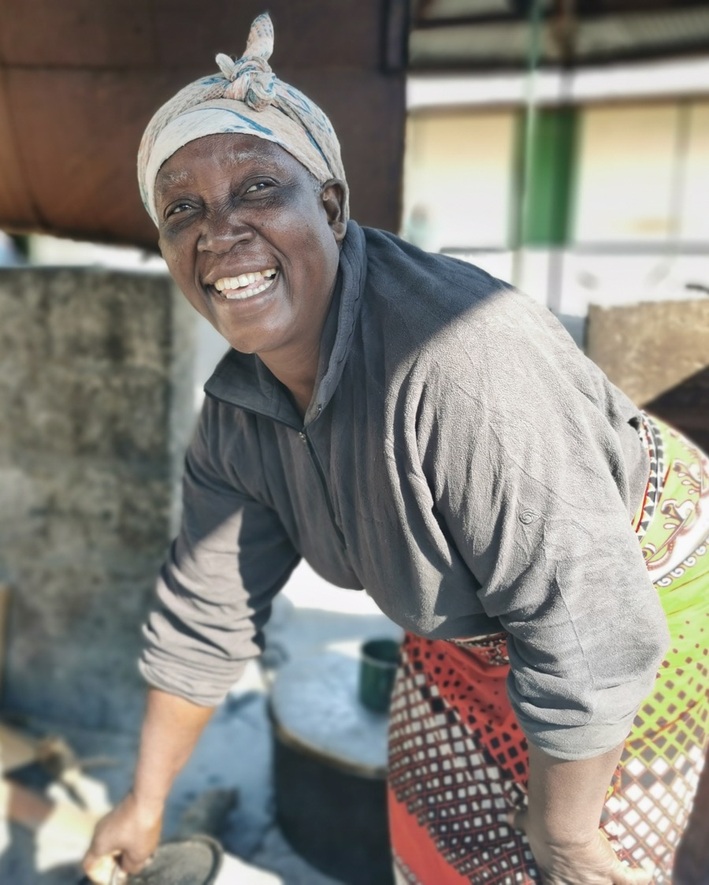
Sermon

Slide 33
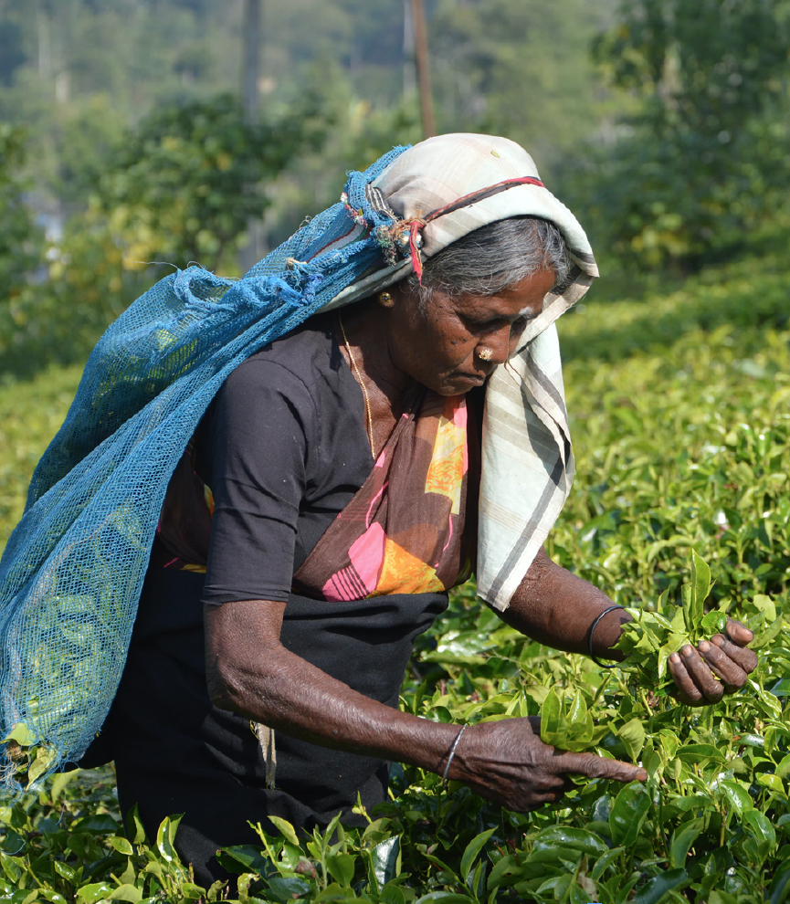
Sermon

Slide 34
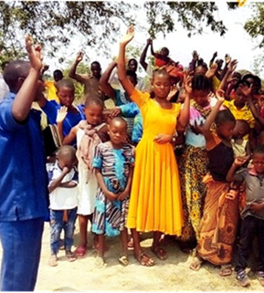
Sermon

Slide 35
HYMN
Choose from:
When I needed a neighbour (StF 256) Love divine (StF 503 or H&P 267)

Slide 36
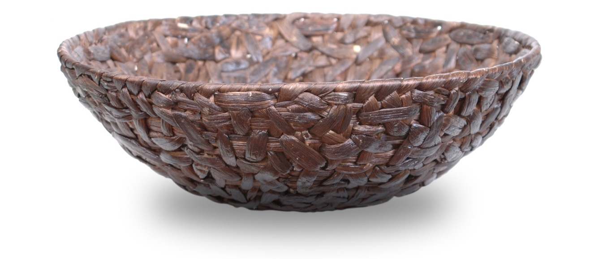
OFFERING

Slide 37
PRAYERS OF INTERCESSION
 |  |  |  |  |  |  |  |  |  | N
 |  |  |  |  |  |  |  |  |  | E
 |  |  |  |  |  |  |  |  |  | I
 |  |  |  |  |  |  |  |  |  | G
 |  |  |  |  |  |  |  |  |  | H
 |  |  |  |  |  |  |  |  |  | B
 |  |  |  |  |  |  |  |  |  | O
 |  |  |  |  |  |  |  |  |  | U
 |  |  |  |  |  |  |  |  |  | R
 |  |  |  |  |  |  |  |  |  | S

Slide 38
HYMN
Choose from:
Will you come and follow me? (StF 673) Lord Your/Thy Church on Earth (StF 410 or H&P 774)

Slide 39
BLESSING FROM THE METHODIST CHURCH IN SINGAPORE
May God’s love strengthen you, as together we seek to love God by loving our neighbours.
Amen.

Slide 40
GLOBAL RELATIONSHIPS AND THE WORLD MISSION FUND
Methodists have always shared God’s love and their faith with those they meet and work alongside across the world.
For more information visit: www.methodist.org.uk/global-relationships

Slide 41
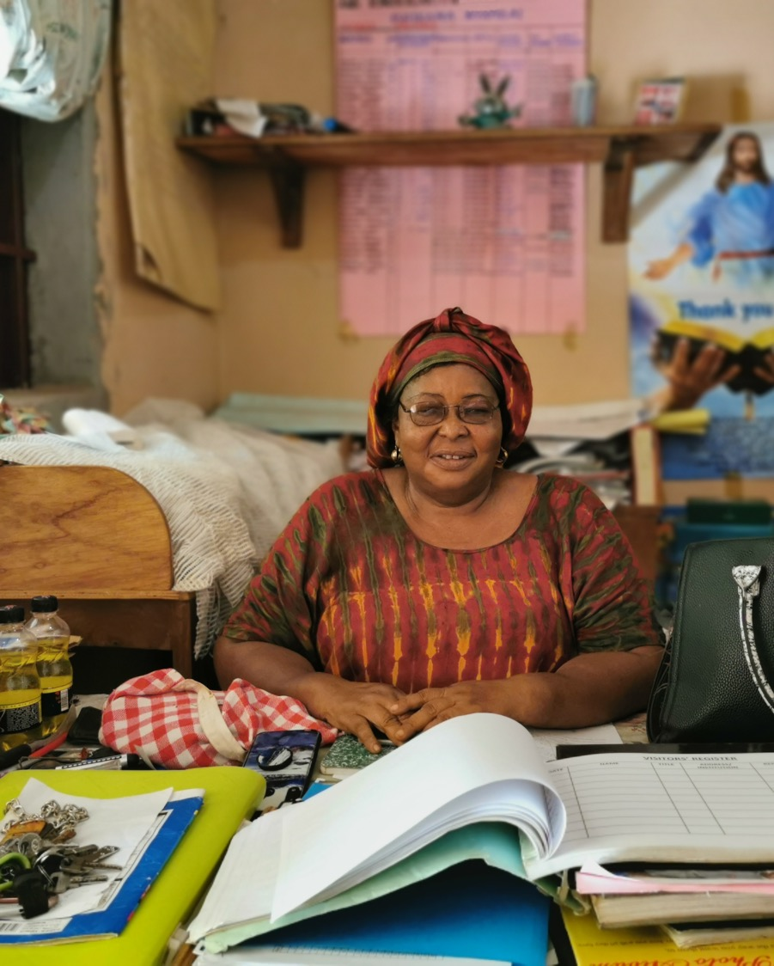
THE GAMBIA
The World Mission Fund supports the Methodist Church The Gambia to carry out its educational ministry. This Methodist School in Brikama continues to leave a legacy of Methodism in education, ecumenicalism and interfaith relationships.

Slide 42
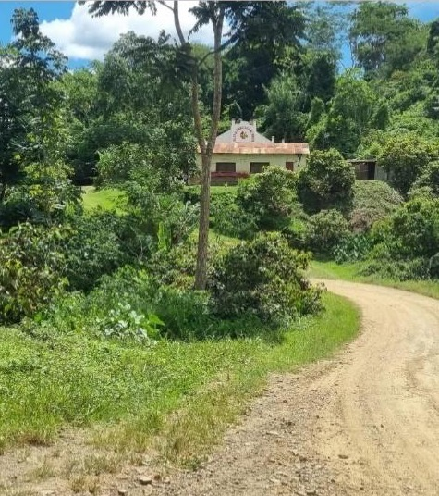
BOLIVIA
The World Mission Fund supports the Evangelical Methodist Church in Bolivia in distributing medicine, school uniforms, school equipment and smartphones to vulnerable communities affected by Covid-19.

Slide 43
SRI LANKA
The World Mission Fund supports the Methodist Church, Sri Lanka in providing food and medical supplies for families affected by the economic crisis in Sri Lanka, as rising prices and shortages make essential goods, such as food, cooking gas and medicine, harder and harder to obtain.

Slide 44
HOW TO SUPPORT THE WORLD MISSION FUND
You can give online at:
www.justgiving.com/mcfworldmission/donate
You can also send a cheque
(made payable to 'Methodist Church World Mission Fund') to:
Methodist Church World Mission Fund
Methodist Church House, 25 Marylebone Road
London NW1 5JR
Thank you very much – your generosity is greatly appreciated.
The Methodist Church. Registered charity no. 1132208. © Trustees for Methodist Church Purposes 2022.

