Slide 1
These slides accompany Service 2
A Local Arrangement Service
There are explanatory notes for the leader in the Global Relationship Worship Resource Pack, which you can download from the Methodist Church website.
You can edit slides and insert hymn lyrics if you have the correct CCLI licence for your church or venue.

Slide 2

God’s table: an invitation for all
Worship on the presidential theme 2021/2022

Slide 3
Welcome and call to worship
Welcome to worship today. We will be thinking about this year’s presidential theme, ‘God’s table: an invitation for all’, from a global perspective.
“How precious is your steadfast love, O God! All people may take refuge in the shadow of your wings. They feast on the abundance of your house, and you give them drink from the river of your delights.”
Psalm 36:7-8 (NRSV)

Slide 4
Hymn
Choose from:
The Lord’s my shepherd, I’ll not want
(StF 481)
Give me joy in my heart
(H&P 492)

Slide 5
Prayers of praise and confession [1 of 7]
A prayer prepared by Revd Sonia Hicks, the President of the Conference
Let us pray:
Holy God, you invite us, with all of creation, to praise and adore you. You call us to witness to your grace and mercy, your love and goodness. We acknowledge your loving kindness, which accompanies us through life.

Slide 6
Prayers of praise and confession [2 of 7]
Almighty God, we are astounded by your creative genius which we can see in each flower that unfolds, in every crawling and creeping thing. The whole world is full of your glory. We praise you, O God.
We acknowledge you Jesus Christ, our Saviour and our friend. You are the visible likeness of the invisible God. In your life and death, we see the greatness of God's love for us.

Slide 7
Prayers of praise and confession [3 of 7]
We see clearly how amazing our God is. The Godhead humbles itself and draws near in the Son, so that we can see how majestic and how marvellous is the God of all the earth. We praise you, O God.
We acknowledge you Holy Spirit who weaves the love of God into our hearts. You who shows us the imprint of God's presence day by day.

Slide 8
Prayers of praise and confession [4 of 7]
Holy Spirit you compel us to cry “Abba Father” as we are overcome with joy and laughter, with pain and sorrow. In every season of our lives, we sense the Spirit's guidance. We praise you, O God.
God the Father, God the Son and God the Holy Spirit be with us in worship we pray.
Amen.

Slide 9
Prayers of praise and confession [5 of 7]
Loving God, you invite each of us into your presence. Forgive us when we limit that invitation to others. Forgive us when we fail to see others are you see them: children of the living God.
Forgive us when we think that our ways of thinking and being are the only ways.

Slide 10
Prayers of praise and confession [6 of 7]
Forgive us when we insist that others need to change, to adjust, but that we can remain the same.
Forgive us for stubborn hearts and unbending wills.
O God, we forget that you are always willing to meet us on the road to repentance. You journey with us and, in doing so, show us where change is possible.

Slide 11
Prayers of praise and confession [7 of 7]
We see this in the way that Jesus journeyed with his disciples even as they continued to misunderstand the nature of true servanthood. May the Holy Spirit help us to remove the logs of selfishness from our hearts. May we know that only you can cleanse us, heal us and restore us.
Celebrating your forgiveness and welcome, we ask this in the name of Jesus Christ, who is our Lord and our Saviour.
Amen.

Slide 12
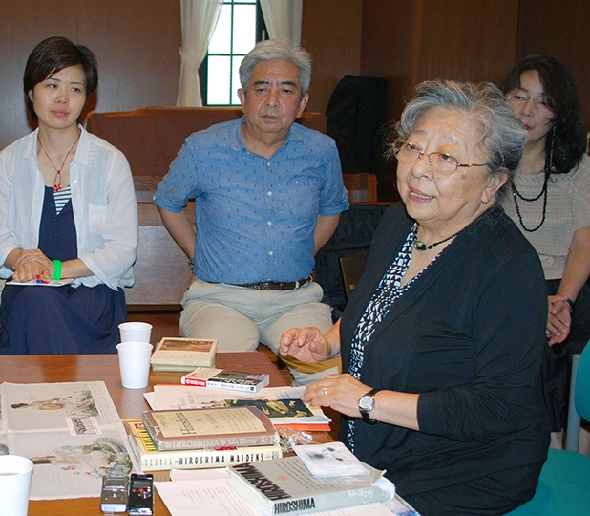
First (all-age) address
A story of forgiveness from Barbara Easton, the Vice-President of the Conference
Koko Kondo's story

Slide 13
Hymn
Amazing grace - how sweet the sound
(StF 440 or H&P 215)

Slide 14
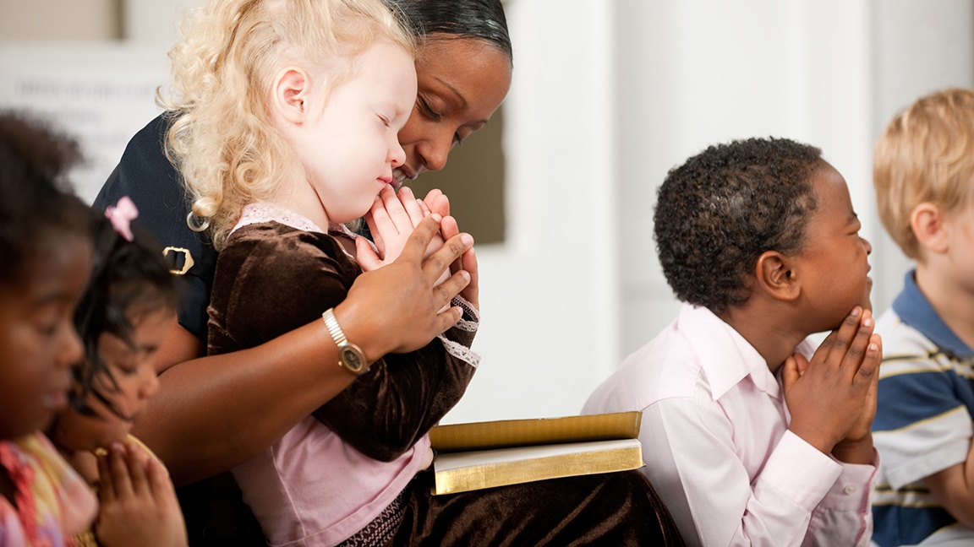
Junior Church begins

Slide 15
Reading
Deuteronomy 26:5-13

Slide 16
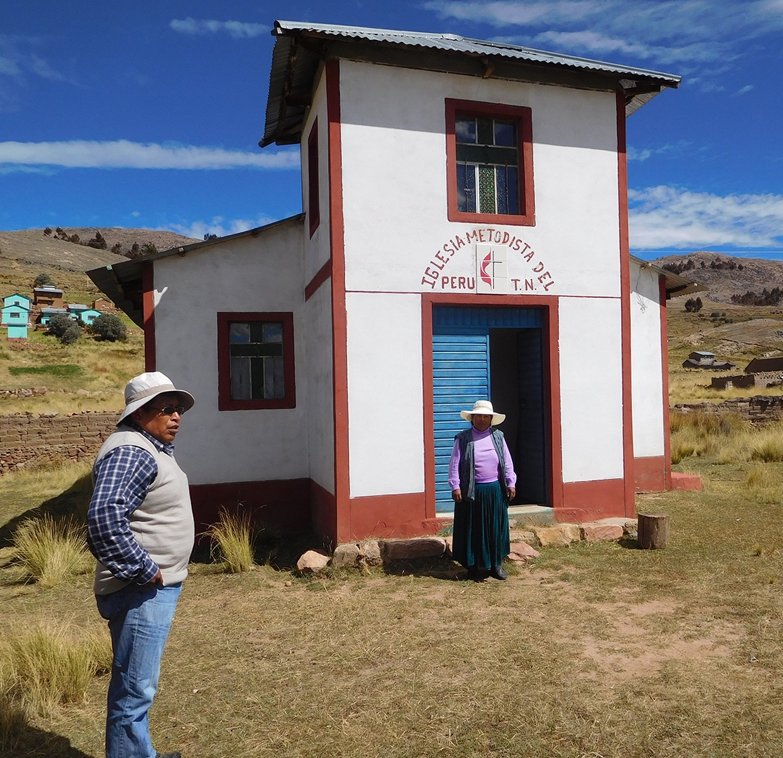
First reflection
The presidential theme this year is, ‘God’s table: an invitation for all’.
Hear a reflection from Barbara Easton, Vice-President of the Conference, from her recent online visit to the Methodist Church in Peru.

Slide 17
Hymn
Lord, your church on earth is seeking
(StF 410 or H&P 774)

Slide 18
Reading
Mark 2:13-22

Slide 19
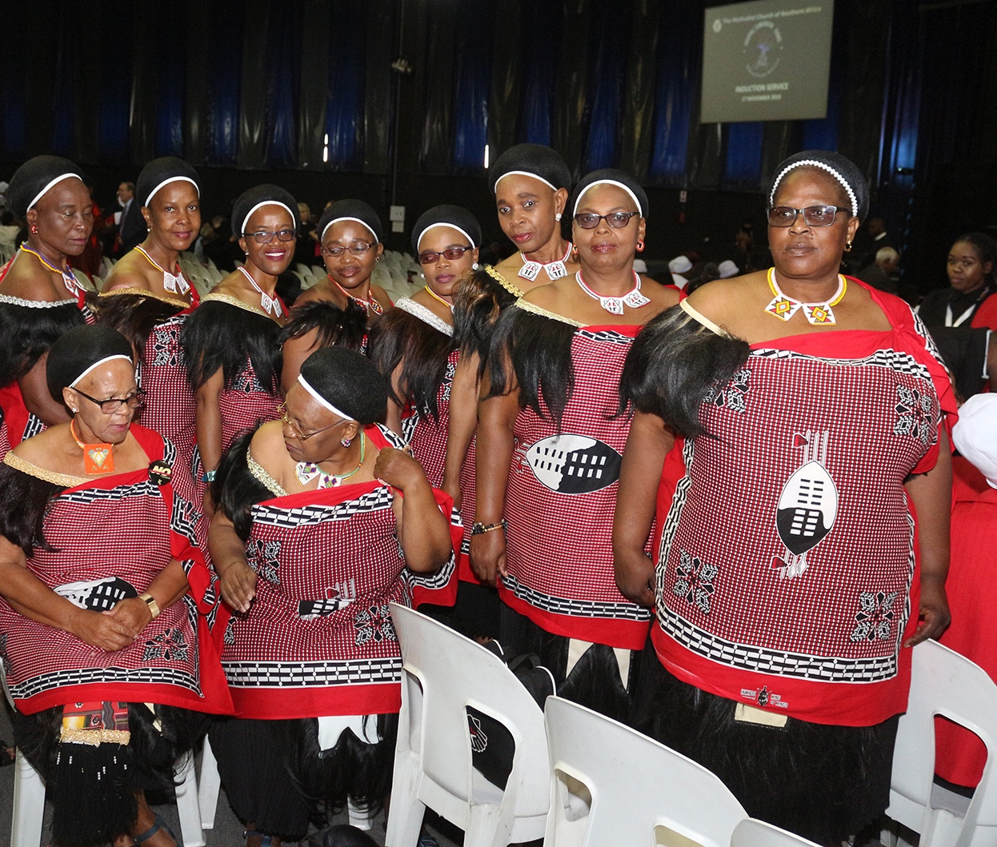
Second reflection
Hear a reflection from the Revd Sonia Hicks, President of the Conference, from her recent virtual visit to the Methodist Church in South Africa.

Slide 20
Hymn
Choose from:
Let love be real, in giving and receiving
(StF 615)
Christ, from whom all blessings flow
(H&P 764)

Slide 21
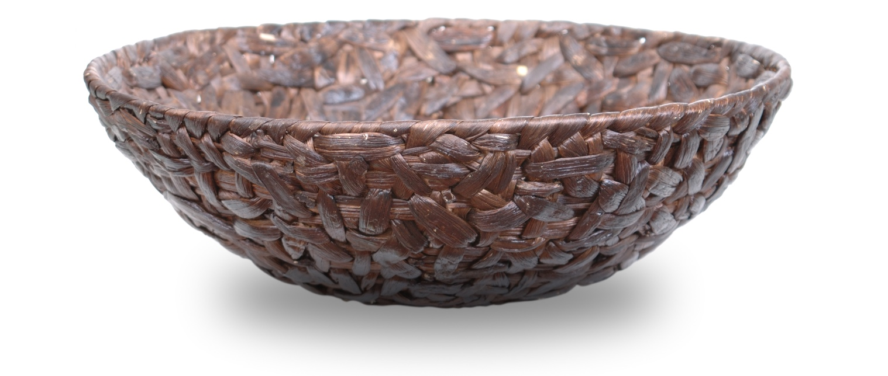
Offering

Slide 22
Prayers of intercession and the Lord’s Prayer
Prepared by the Revd Sonia Hicks, President of the Conference
Let us pray together for the world
When you hear:
‘O God, who invites us’
would you please respond by saying,
‘May all find a place at your table’

Slide 23
Prayers of intercession and the Lord’s Prayer
Almighty God, we pray for the world,
for its peoples and its governments.
We pray for your peace in every corner of the globe.
We pray for your justice as we interact with one another
and that its effect can be seen in….
O God, who invites us
May all find a place at your table

Slide 24
Prayers of intercession and the Lord’s Prayer
We pray for the nation in which we live.
We pray for just laws so that we can live at
peace with one another.
We pray for groups denied a voice in our society
because they do not ‘fit in’.
May we be willing to speak up for such people
no matter what the cost.
O God, who invites us
May all find a place at your table

Slide 25
Prayers of intercession and the Lord’s Prayer
We pray for all who live in poverty.
We pray for all who never have enough on the table.
We pray for those who have no one to share a meal with.
Give us a heart for the needy.
May we never be content with widening gaps between rich
and poor, between the haves and the have-nots.
O God, who invites us
May all find a place at your table

Slide 26
Prayers of intercession and the Lord’s Prayer
We pray for those who are bereaved...
We pray for those who are coping with broken relationships, with unemployment, with life changes that have been thrust upon them.
We remember that Jesus wept at the tomb of Lazarus.
May we not be afraid to weep with those who are weeping in our churches and in our land.
O God, who invites us
May all find a place at your table

Slide 27
Prayers of intercession and the Lord’s Prayer
Finally, we pray for our own needs in a time of silence…
O God, who invites us
May all find a place at your table
O God, who issues the invitation and prepares a table where all may come, we ask these prayers in the name of Jesus Christ and through the power of the Holy Spirit.
Amen.

Slide 28
Prayers of intercession and the Lord’s Prayer
The Lord’s Prayer

Slide 29
Hymn
Choose from:
Sent by the Lord am I
(StF 239)
Be thou my vision
(H&P 378)

Slide 30
Global Relationships and the
World Mission Fund
Methodists have always shared God’s love and their faith with those they meet and work alongside across the world.
For more information visit:
www.methodist.org.uk/global-relationships
Notes:
[Note to the Leader: the following slides have a selection of the work the WMF supports and the final slide shows how to give money, if wished. You may want to show these slides before the offering if some of the offering is going to the WMF]

Slide 31
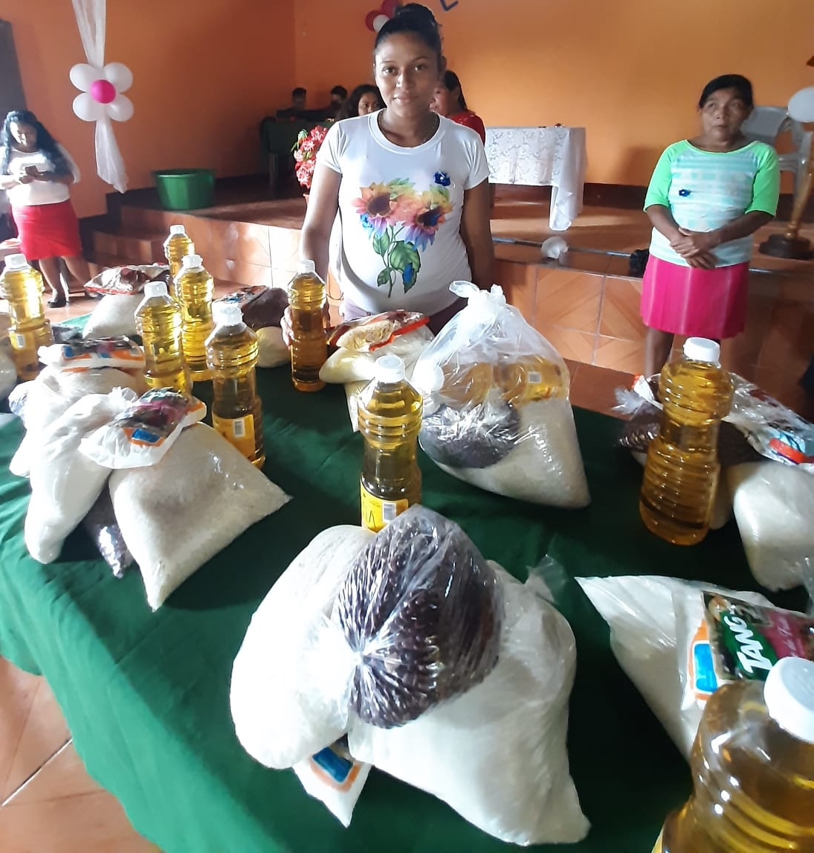
Nicaragua
The World Mission Fund supports the National Evangelical Methodist Church in Nicaragua. During the pandemic the church has been able to distribute essential food packages to 23 communities linked to their local churches.

Slide 32
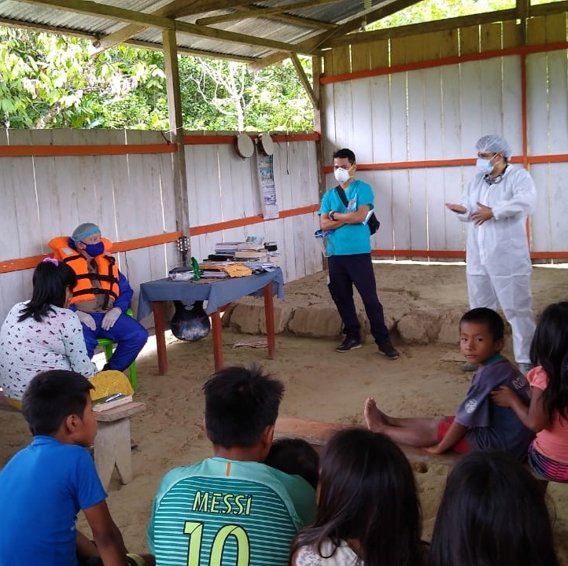
Peru
A General Grant from the World Mission Fund has enabled the Methodist Church in Peru to work with 43 indigenous communities to open nine community pharmacies, offering low-cost medicine and basic health consultation services. 50,000 people will benefit from this vital piece of work.

Slide 33
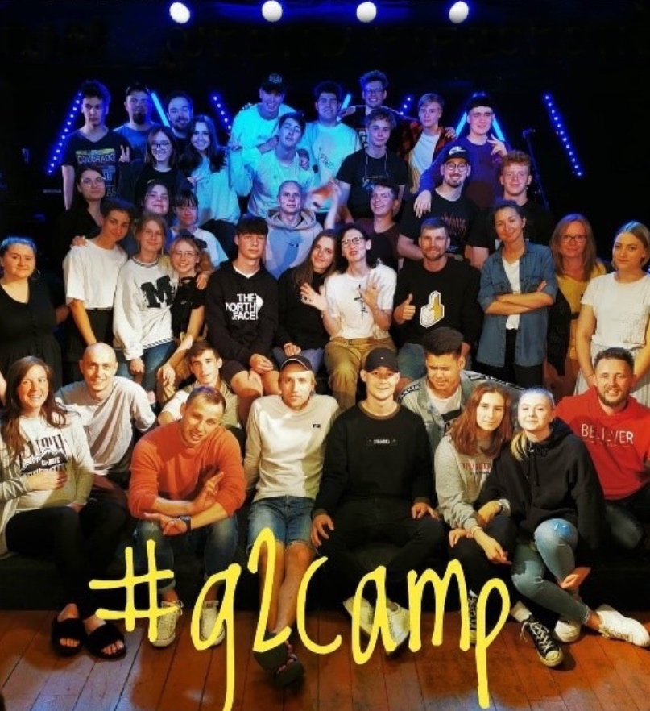
Estonia
The leader of the Estonian United Methodist Church Youth Board is Ele Paju, a National in Mission Appointment supported by the World Mission Fund. She has developed a youth team, teenage ministry and a youth camp. They are also developing young leaders through training.

Slide 34
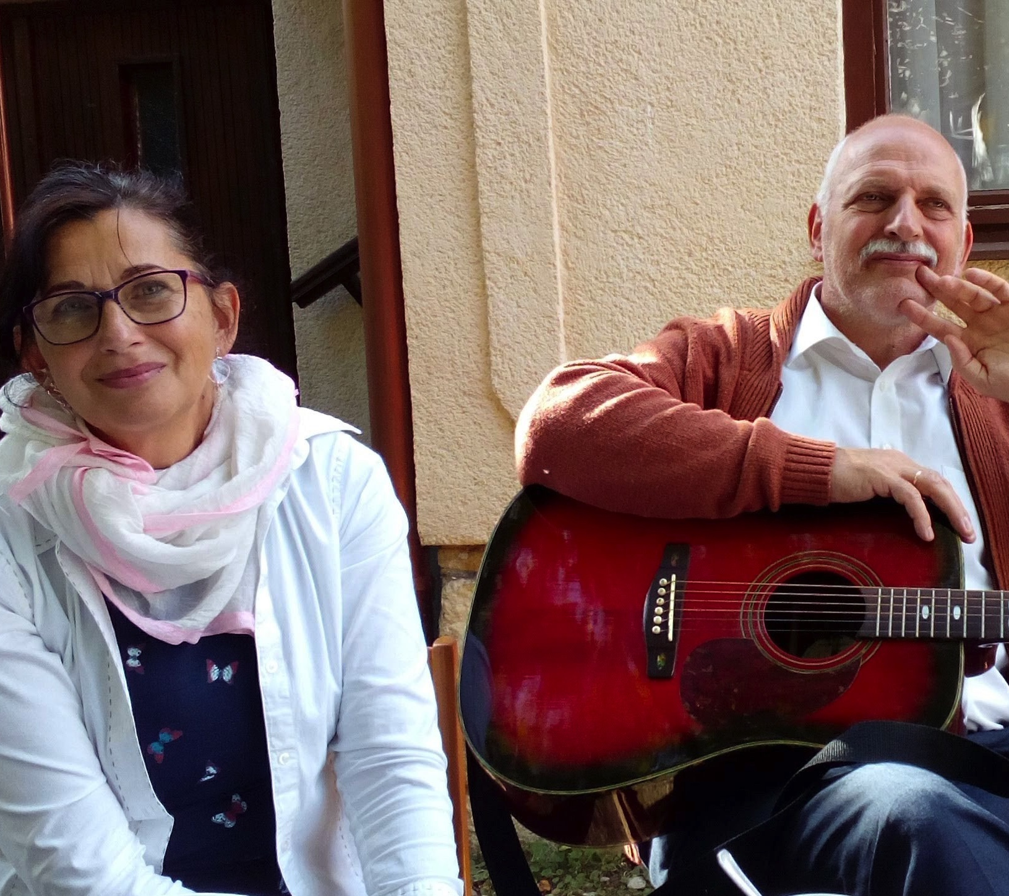
Hungary
Zoltán Kurdi has been pastor of the UMC in Hungary for 21 years. He and his wife Ericka work with members of the Roma minority who face extreme prejudice. This work in Hungary is supported by the World Mission Fund.

Slide 35
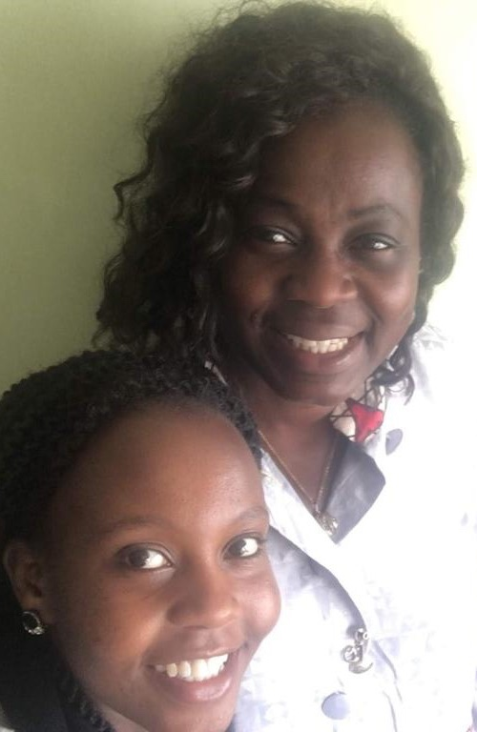
Kenya
The World Mission Fund supports the work of Intern Coordinator and Program Assistant, Jennifer Muthoki Mutua, as a National in Mission Appointment. Her work has seen growth in the Student Christian Movement of Tanzania and Uganda, and the revival of the Student Christian Movement of Kenya.
Jennifer is pictured bottom left, with Africa Partnership Co-ordinator Bunmi Olayisade.

Slide 36
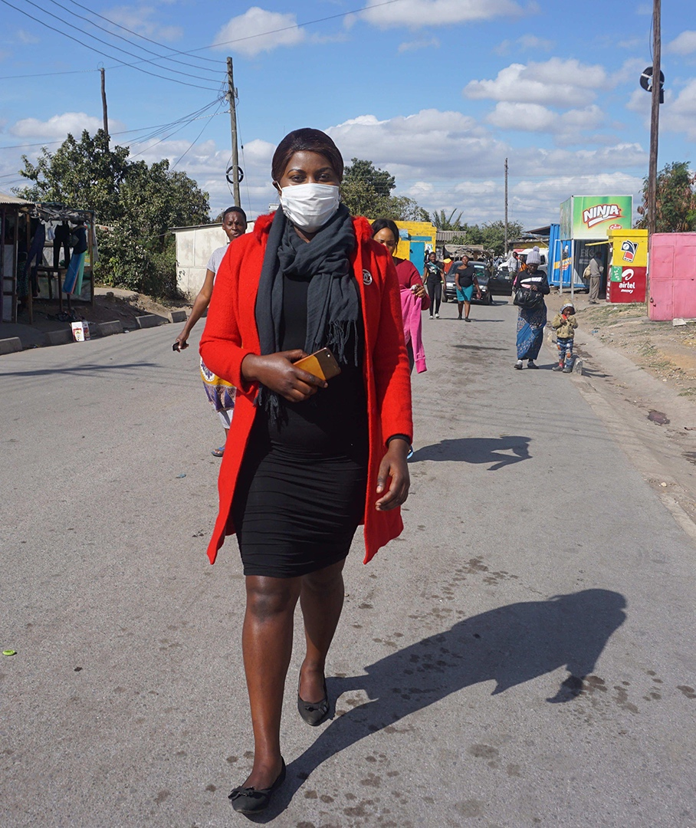
Zambia
United Church of Zambia Health Institutions have been supporting communities throughout the pandemic. Although sadly they have seen deaths, these have been numbered in tens, not hundreds or thousands. The World Mission Fund gave a grant for the purchase of medical and oxygen supplies for UCZ health centres.

Slide 37
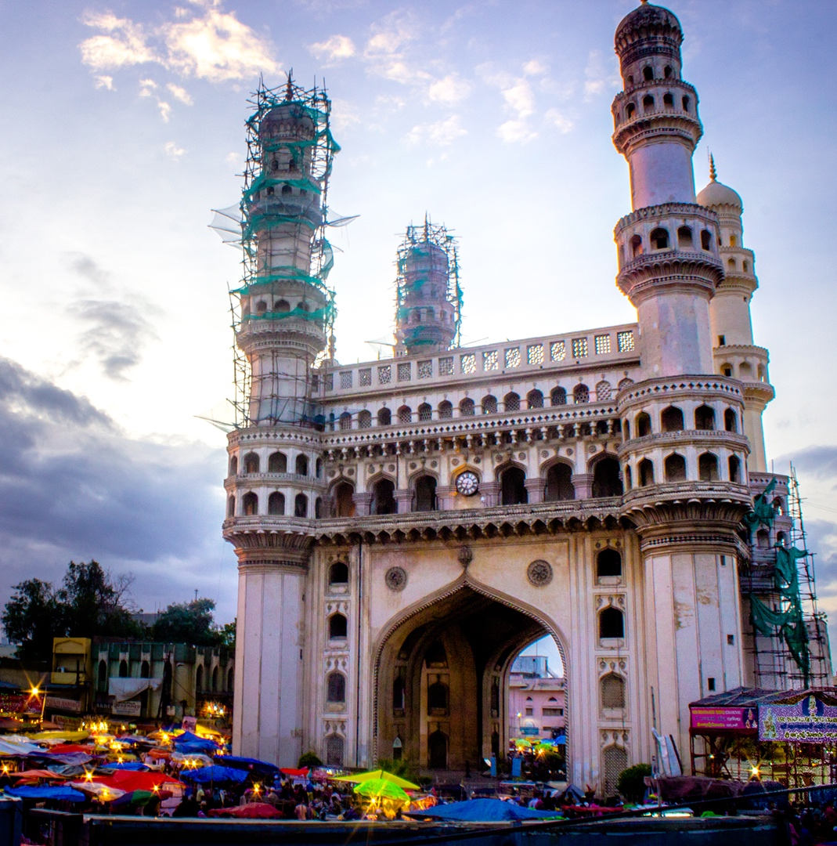
India
Based in Hyderabad, The Henry Martyn Institute (HMI) supports diversity and inclusion. It facilitates interfaith dialogue and peace building, transforming conflict situations and promoting inter-faith and multicultural harmony. It has also responded to the Covid-19 pandemic.

Slide 38


The World Mission Fund
The World Mission Fund helps over 100 Partner Churches
and organisations in Africa, Europe, Latin America, the Caribbean, Asia and the Pacific.
Junior Mission for All (JMA)
Children and young people raise funds for JMA. 80% goes to the World Mission Fund.
The Easter Offering also supports World Mission Fund, raising £38,000 in 2020.

Slide 39
How to support the World Mission Fund
You can give online at: www.justgiving.com/mcfworldmission/donate
You can also send a cheque
(made payable to 'Methodist Church World Mission Fund') to:
Methodist Church World Mission Fund
Methodist Church House, 25 Marylebone Road
London NW1 5JR
Thank you very much – your generosity is greatly appreciated.

