Slide 1
A guide to using these slides
For every session there is an introductory slide and a number of slides with images illustrating things from the service outlines. Remember: This is a ‘pick and mix’ resource, so you will need to choose which images to keep based on the parts of the outlines you are using.
If you wish to add additional slides (e.g. for lyrics or key points) there are two templates at the beginning of this presentation.
Take a look at the notes below each slide for further information about how to use each image.

Slide 2
Add a title here
Notes:
A slide for a title and text or image.
Text might include song lyrics, bullet point with your key notes summarizing your talk or sermon, or discussion questions.
Alternatively, click one of the icons to add an image, graph, video, etc

Slide 3
Notes:
A slide for text or image, without a title.
Click one of the icons to add an image, video, graph, etc.

Slide 4
Notes:
A Methodist Way of Life

Slide 5
Notes:
Session one: God loves you. Unconditionally. No strings attached. (See ‘background reflection’)
In response to this gift, there are twelve things that we do individually and together as we grow as followers of Jesus, which help us to worship God, serve others, be evangelistic, and learn and care together. None of this makes God love you any more – but they may help you realise how deeply you are loved by God.

Slide 6
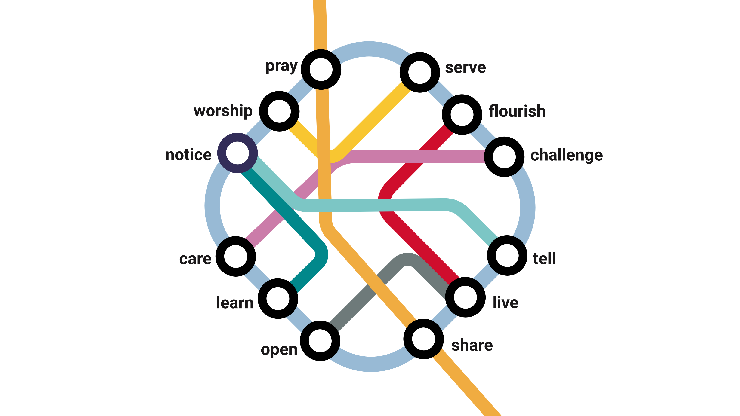
Notes:
Session one: The twelve stations of A Methodist Way of Life (See ‘background reflection’)

Slide 7
Notes:
Session one: The train journey parable (see ‘further notes’)
God longs to take you on the journey of a lifetime. Let's create a modern-day parable. Imagine that God's a train driver.

Slide 8
Notes:
Session one: The train journey parable – stage one (see ‘further notes’)
When we respond to God's love, it’s a bit like getting on the train. This can be scary, but nothing else in life is as satisfying. Staying where you are is an option, but you miss out on so much. What if you joined in with God’s adventure, what if you started a journey … not really sure what was going to happen or where you might end up next, with an open ticket for unlimited travel?
What’s important is deciding to get on the train, committing to the journey. There might be specific moments that stand out, like the day you first said 'Yes!' to Jesus. That's like stepping on to the train for the first time. Or maybe you’re just thinking about starting the journey now. But it’s also a daily commitment to keep travelling, in good times and bad.

Slide 9
Notes:
Session one: The train journey parable – stage two (see ‘further notes’)
But where does the train go? What does this journey involve? There’s a map – we call it A Methodist Way of Life. The train goes to twelve stations. It's good to visit them all because, each station is an opportunity to:
• encounter God,
• grow in maturity,
• step out in mission and action,
• be surprised by joy.
Each station on the way represents a different spiritual practice we might do, a different way we can encounter God. Some stations will be familiar to you, but some might be new.

Slide 10
Notes:
Session one: The train journey parable – stage three (see ‘further notes’)
We learn together between stations as we share stories and reflect on our encounters with God. Some people reflect in group conversation. Others prefer to journal. The Holy Spirit shapes and develops you, and you can become more like Jesus.

Slide 11
Notes:
Session one: The train journey parable – stage four (see ‘further notes’).
Stages four to six are intended for people in leadership, though can also be the responsibility of all disciples living in community and supporting one another.
Now, if you are involved in leading other disciples in any way, there are three more steps. As church leaders we’re on our own discipleship journeys. But we also play a role as companions to others. We journey alongside people who are exploring the network, particularly if they’re still deciding whether to get on the train.
We might be a tour guide, helping someone explore a different part of a familiar station or encouraging them to leave their familiar home station, so that they experience God in a new and different way. Perhaps we’re even sales people, telling people about the great features of a station they haven’t been to yet.

Slide 12
Notes:
Session one: The train journey parable – stage five (see ‘further notes’)
Of course, we can’t direct people to stations that don’t exist. So we might need to ‘construct stations’ or build new infrastructure, ensuring that our churches and circuits have opportunities for people to take part in all these activities. That might mean starting a new prayer group, or helping someone who is passionate about injustice to join up with a Circuit initiative. It might mean partnering with other churches, and organisations with particular expertise.

Slide 13
Notes:
Session one: The train journey parable (see ‘further notes’)
But what does it look life in real life? The next four slides offer suggestions of how different practices might be done by a church community, with one chosen in each of the four areas of Our Calling (because we don’t do everything at once).
Maybe like this – a group of people who gather in a chapel building, have Bible studies, coffee mornings and take part in protests against injustice.

Slide 14
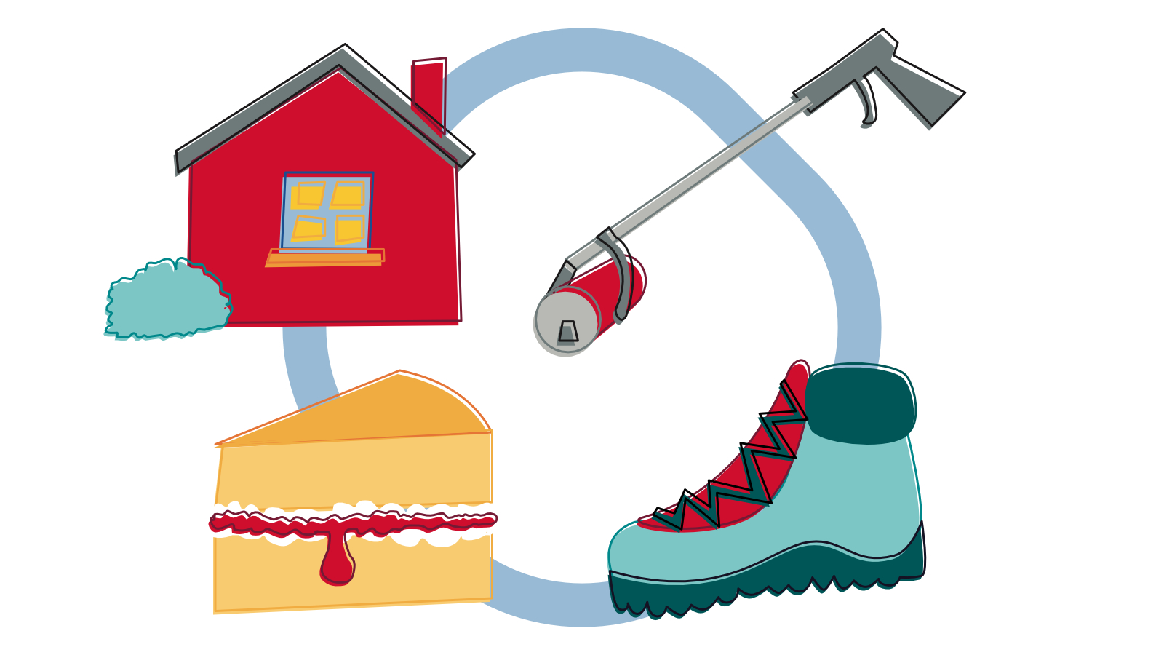
Notes:
Session one: The train journey parable (see ‘further notes’)
Maybe in a rural context people gather for worship in each other's homes, bake tasty cakes for the community, take part in walk-and-talk hikes, and join in litter picking.

Slide 15
Notes:
Session one: The train journey parable (see ‘further notes’)
It works in a digital context too. You can worship online, learn from podcasts (including our very own Hope and Anchor!), be a loving presence on social media, and take part in online petitions.

Slide 16
Notes:
Session one: The train journey parable (see ‘further notes’)
It also fits a pioneering context too. You might meet with people in a café, share food, tell stories and share ideas for caring for the environment.

Slide 17
Notes:
Session one: The train journey parable stage six (see ‘further notes’)
The discipleship journey is an exciting one, and deeply fulfilling. So we don’t want to limit the journey to people who are already travelling.
Each station in the network is an opportunity for new people to start their own journey. For one person, that might be sensing something spiritual in nature. For another, it might be wrestling with questions about evil in the world.
We want to ensure the stations (our activities and practices) are accessible to new people as well as experienced travellers. As leaders, we need to be able to support people in taking those first steps into the network, and exploring the journey God is taking them on.

Slide 18
Notes:
Session: Prayer (see ‘key themes’)
God loves spending time with you. Don't overcomplicate it. God is there and is a perfect listener.

Slide 19
Notes:
Session: Prayer (see ‘background reflection’)
The purpose of prayer is not to tick a box every day, but to live in communication with God. It’s not about technique or accomplishment, it’s about opening channels to listen and to ask for what we need. We all do this differently. Perhaps we need to learn how to listen more and ask more. Such communication is not a chore, but a delight.
Prayer rhythms can be at set times in the day, week, month, season and year. Praying daily may also begin with regularly reminding ourselves that God wants to communicate with us at every moment, because of God’s great love for us.

Slide 20
Notes:
Session: Prayer (see ‘further notes’)
Sunshine and Showers is a six-session course exploring some of the paradoxes that can make prayer seem hard. Rather than seeking to find simplistic answers, the course encourages participants to find peace in the mystery of prayer; to be able to pray despite the confusion. Could you explore the course at your church?

Slide 21
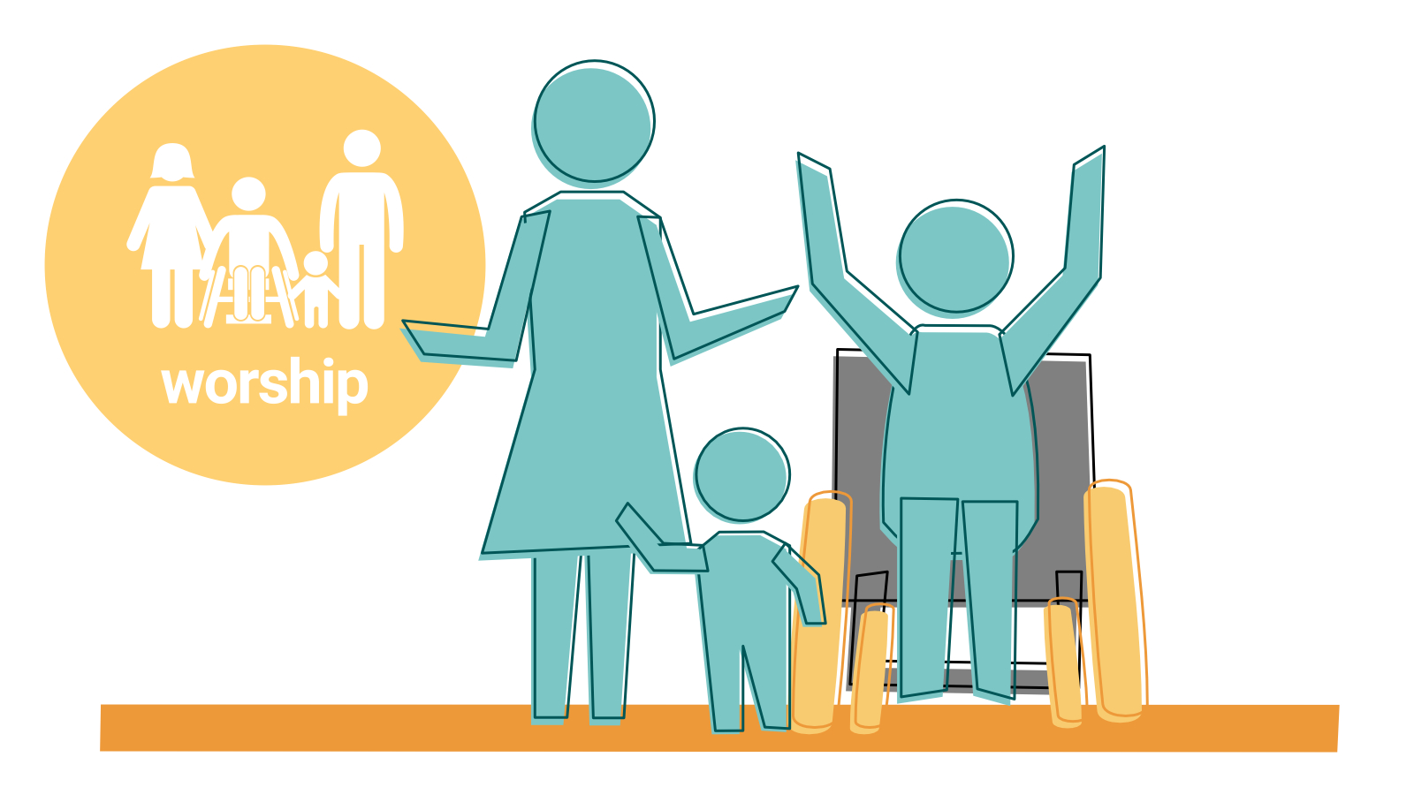
Notes:
Session: Worship (see ‘key themes’)
We worship with others regularly. God wants to refresh you. Worshipping with others helps to knit us into a faith community.

Slide 22
Notes:
Session: Worship (see ‘background reflection’)
Worship was at the centre of the practice of the Early Church but it may have looked quite different to our worship services today. Worship was a combination of time at the temple and domestic gatherings arranged around a celebration of the Last Supper. Luke tells us in Acts: “Day by day, as they spent much time together in the temple, they broke bread at home and ate their food with glad and generous hearts, praising God” (Acts 2:46). How does this compare or differ to your worship today?

Slide 23
Notes:
Session: Worship (see ‘creative activities’)
The Old and New Testaments both show a more diverse community than some people think. How diverse is your worshipping community?

Slide 24
Notes:
Session: Notice (see ‘key themes’)
We notice God in Scripture, and the world. God is near, and findable. But not completely.

Slide 25
Notes:
Session: Notice (see ‘background reflection’)
We can also notice God in science and nature, our relationships with others, in our work, in books, films, podcasts, and other leisure activities, and in world events.

Slide 26
Notes:
Session: Notice (see ‘background reflection’)
Have you ever played hide and seek with a child who is slightly too young to understand the rules? You stand in the middle of the room and say, “Where’s so and so?” and the child leaps out and enthusiastically cries “Here I am!” The child wants to be found. This is how God responds when we look for God. God wants to be found.

Slide 27
Notes:
Session: Notice (see ‘further notes’)
What is the Bible?

Slide 28
Notes:
Session: Tell (see ‘key themes’)
We tell of the love of God Your story matters. It's natural to want to pass on good news.

Slide 29
Notes:
Session: Tell (see ‘key themes’)
Speaking should always be accompanied by listening – allowing others to tell their story and allows us to notice God in them. Evangelism is not about us talking at other people, but forming meaningful relationships with others, and sharing our stories and experiences of God together.

Slide 30
Notes:
Session: Tell (see ‘background reflection’)
Speaking on behalf of God is arguably more important than ever in a society in which there is palpable anger about structural inequalities, systemic racism, and widespread fear for the future amongst many who are in a precarious economic or social position. In 2 Timothy 4:2 we are told: “proclaim the message; be persistent whether the time is favourable or unfavourable; convince, rebuke, and encourage, with the utmost patience in teaching”. Speaking prophetically in this way takes courage, whether it is ‘speaking truth to power’ or challenging our society and communities with truths which people would rather not hear. Telling of God’s love and challenging injustice are inextricably entwined together.

Slide 31
Notes:
Session: Live (see ‘key themes’)
We live in a way that draws people to Jesus. You be you. You are made in God's image, so let that shine out.

Slide 32
Notes:
Session: Live (see ‘further notes’)
Some Christians will talk about being “salt and light” or “God’s ambassadors”. Matthew 5:13-16 is quoted by many Christians to refer to how we reflect God in the world. It is worth noting that Jesus does not here refer to good works (see the session on the ‘Share’ commitment) but that you are “the salt of the earth” and “the light of the world”. This passage follows the Beatitudes, in which Jesus speaks of people’s heart-postures rather than their deeds (though these naturally follow). We are the “city built on a hill cannot be hidden” (Matthew 5:14); not just our activity but our very nature produces light that can be seen in every direction.

Slide 33
Notes:
Session: Share (see ‘key themes’)
We share our faith. You get to partner with God. God involves us in the task of bringing love and restoration.

Slide 34
Andy: Food offered at a meal (see metaphor on p41)
Notes:
Session: Share (see ‘background reflection’ and also Revd D T Niles quote in the ‘creative activity’)
Sharing faith can be a little like sharing food. When we share food with others we are respectful and mindful of their needs and preferences. A gracious host would never insist that food is eaten but would prepare and present food with care. It is intentionally offered, not just left on the side for someone to find (“have you ever tried…”) but also not forced upon people.

Slide 35
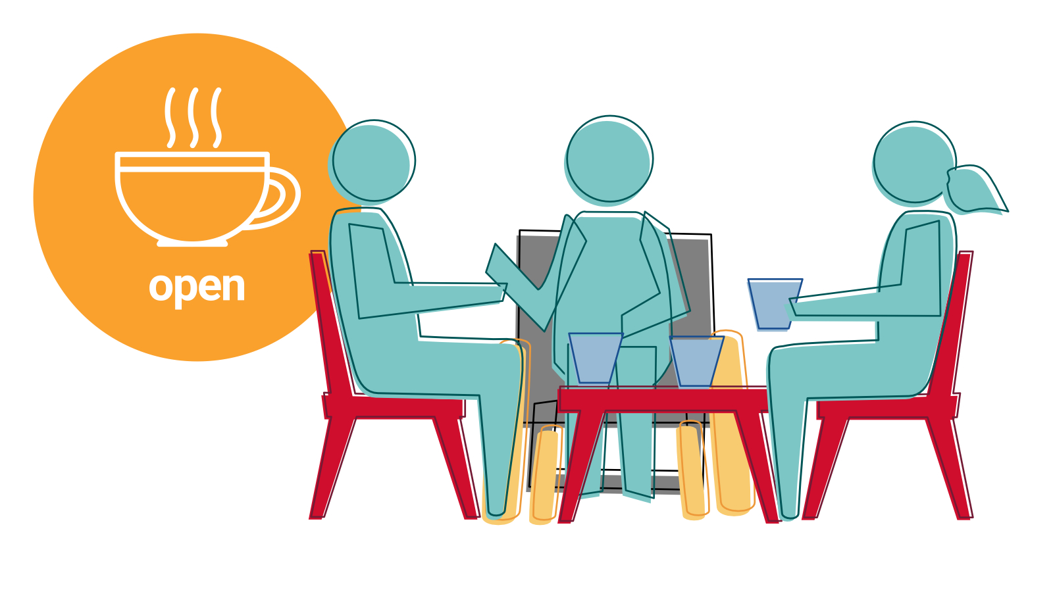
Notes:
Session: Open (see ‘key themes’)
We practise hospitality and generosity. God always gives a warm welcome. We meet God in relationship with people.

Slide 36
Notes:
Session: Open (see ‘background reflection’)
Hospitality and generosity have many forms: being open-hearted, open-homed, open-walleted, and open-minded.

Slide 37
Notes:
Session: Learn (see ‘key themes’)
We learn more about our faith. You can become like Jesus. You are not stuck where you are.

Slide 38
Notes:
Session: Learn (see ‘background reflection’)
Learning may include formal theological education, but we also learn through our day-to-day lives and encounters with other people. ‘Learning’ is not all about facts, we also learn through hearing stories and understanding the emotional journey of others, or through ‘doing’.

Slide 39
Notes:
Session: Learn (see ‘background reflection’)
A common idiom says that “changed hearts change minds”, yet post-modern Western communities often begin with the mind. We can learn through our actions – we learn how to care for others only by beginning to care for others, not reading a book about caring. We can learn by listening to the stories of other people, and understating their and our own emotional response. And we must leave room for doubt and questions.

Slide 40
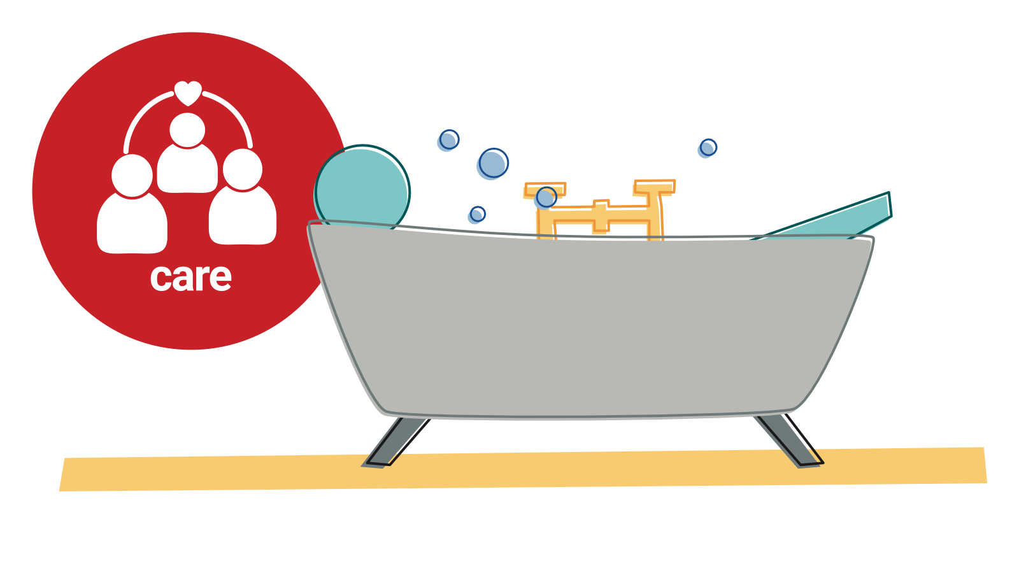
Notes:
Session: Care (see ‘key themes’)
We care for ourselves and those around us. It's all about love. Love for other people and yourself is what matters most.

Slide 41
Notes:
Session: Care (see ‘background reflection’ and ‘creative activity’)
We can think of many stories where caring for others has come at the detriment of caring for ourselves. We treat ourselves far more harshly than we ever treat others, at the disservice to ourselves and others. The stress bucket analogy is one used in mental health training. The levels of stress we can deal with have a limit, and most of the time we are able to manage the incoming stresses of work, relationships, health and money, as these are counterbalanced by the things we do to relieve stress – prayer, resting, exercise, socialising and, of course, a good night’s sleep.

Slide 42
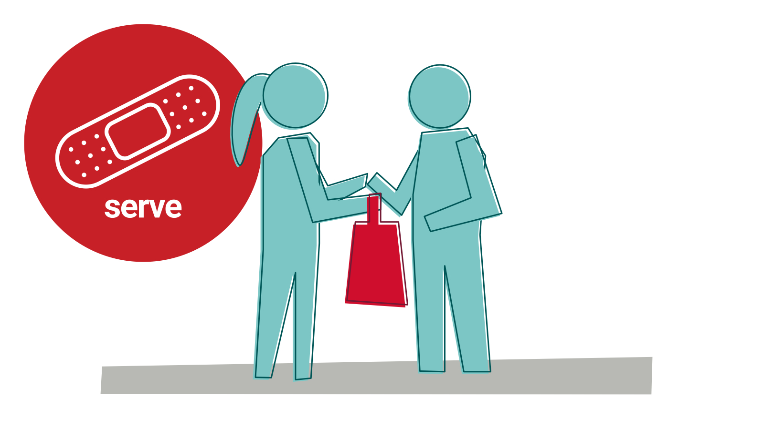
Notes:
Session: Serve (see ‘background reflection’)
We will help people in our communities and beyond.

Slide 43
Notes:
Session: Serve (see ‘background reflection’ and ‘discussion questions’)
Who is your neighbour? How do you serve them?
How do you serve people far away?

Slide 44
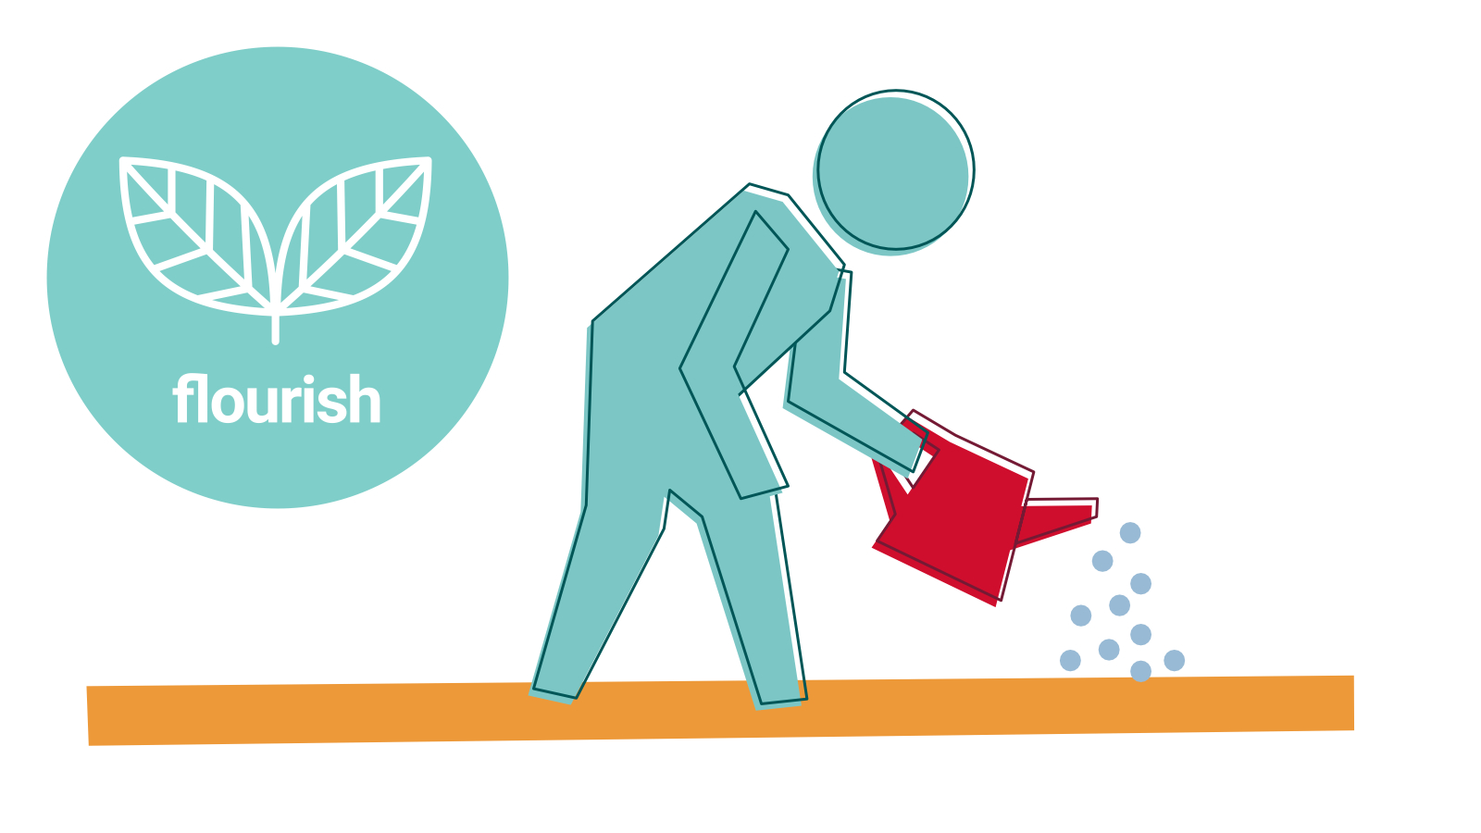
Notes:
Session: Flourish (see ‘key themes’)
We care for creation and all God's gifts. The earth is a gift from God. We are part of the earth too, lovingly woven from the same fabric.

Slide 45
Notes:
Session: Flourish (see ‘background reflection’)
The universe is an expression of God’s loving, creative nature. From the very beginning of the Bible to the very end, we see that creation is at the heart of God’s story. Throughout Scripture we are told that creation and everything within it remains God’s (eg Deuteronomy 10:14; Job 12:7-10). This is very different to many other ancient religious texts, where creation is often birthed out of violence, bodily secretions, or seems to be a completely unimportant afterthought in the stories of petty gods.

Slide 46
Notes:
Session: Challenge (see ‘key themes’)
We challenge injustice. God is a liberator. God always takes the side of people experiencing poverty and injustice.

Slide 47
Andy: It’s not fair graphic?
Also an illustratation of the fence metaphor (there is a link to one but a house style version would be nice)
Also, add the image now on the website (different placard)
Also, the river metaphor – but less important than the fence as it’s in ‘further info’
Notes:
Session: Challenge (see ‘background reflection’)
The cry of fairness can be related to two things – fair opportunities or fair outcomes. One common illustration of this difference is to imagine an adult and child trying to look over a fence. The adult is tall enough to look over, but the child is not. Fair opportunities treat all people equally – both people would be given a box to stand on.

