Slide 1
Telling the Story
11 July 17

Slide 2
Hurricane Matthew struck land in Haiti

Slide 3
On 4th October 2016

Slide 4
The ferocious winds ripped off roofs

Slide 5
Wrecked homes

Slide 6
Stripped trees of leaves

Slide 7
And branches

Slide 8
And the rain silted the rivers

Slide 9
We travelled by convoy

Slide 10
Stopping at Bois Neuf Malor

Slide 11
We met the leaders

Slide 12
And the children

Slide 13
Using the church as a yard

Slide 14
The school had sheltered the villagers

Slide 15
The government delivered water bags

Slide 16
And this was a filling point

Slide 17
We left them with some tennis balls

Slide 18
Re-roofed church but water damaged

Slide 19
Explaining to Sandra from WCR

Slide 20
The consequences of the devastation

Slide 21
Of houses

Slide 22
Being patched with tarps

Slide 23
Church above, school below and behind

Slide 24
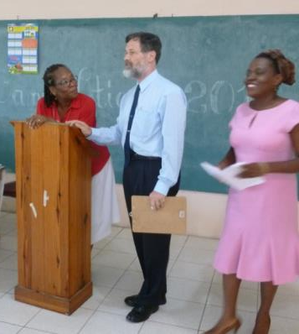
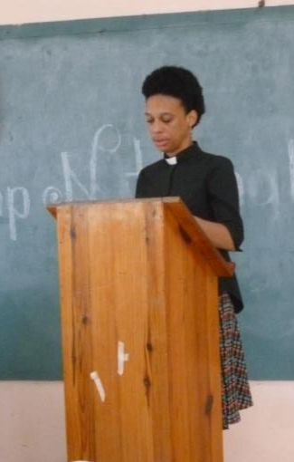
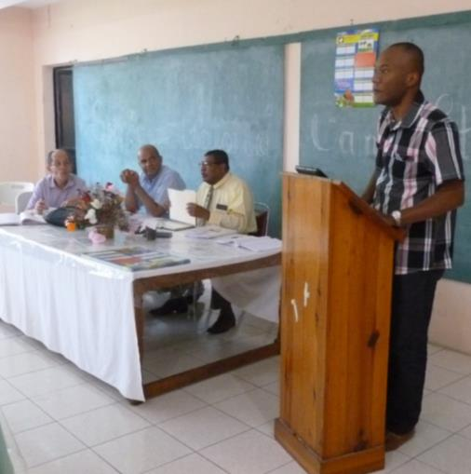
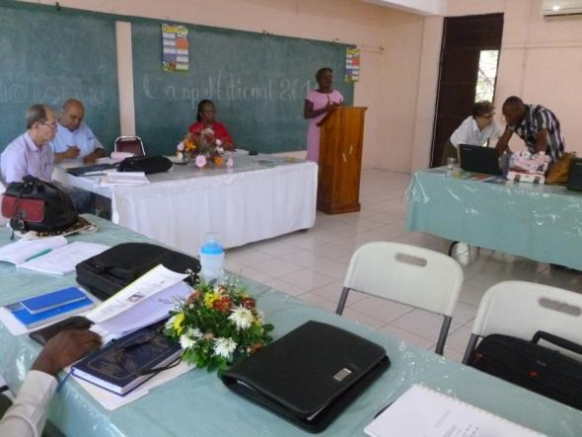
Previous to the visit

Slide 25
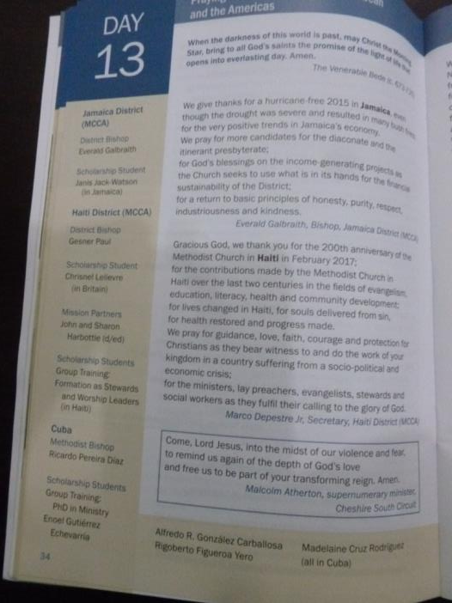
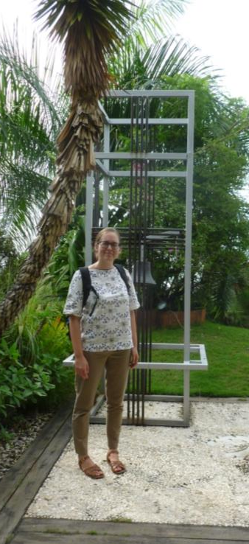
MCB responded - WCR and AWC

Slide 26
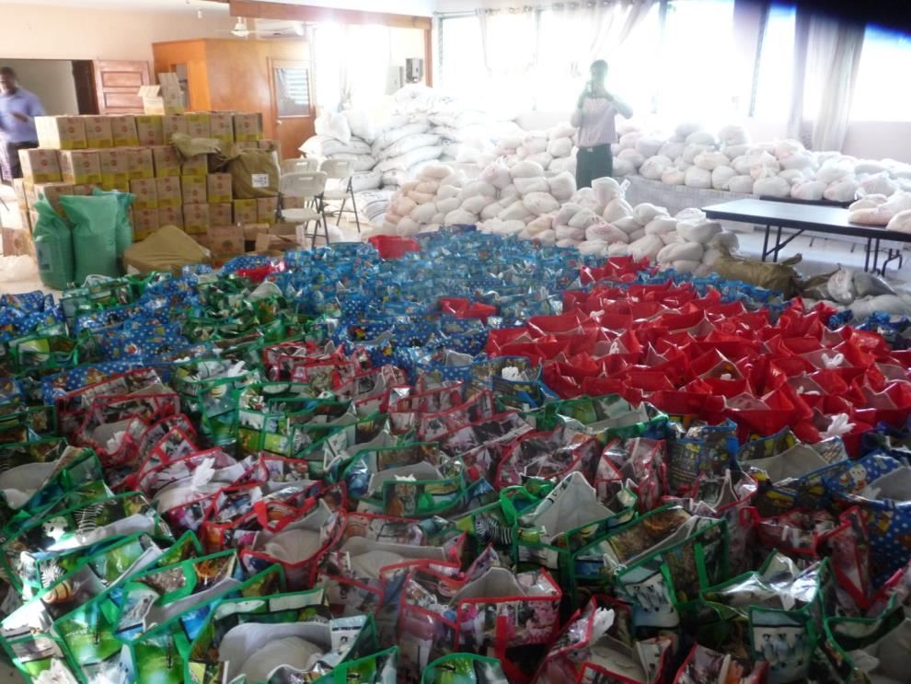
Christmas? No! EMH Supplies post Hurricane Matthew

Slide 27
Haitian youth packed boxes

Slide 28
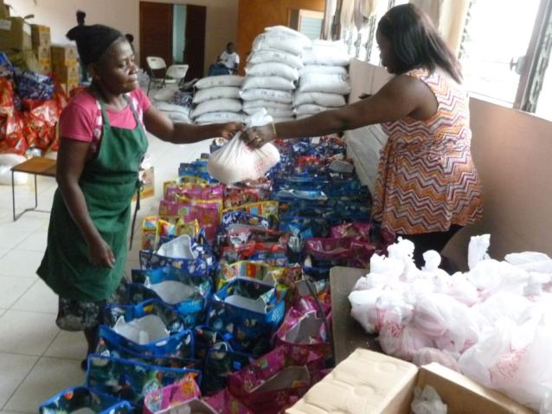
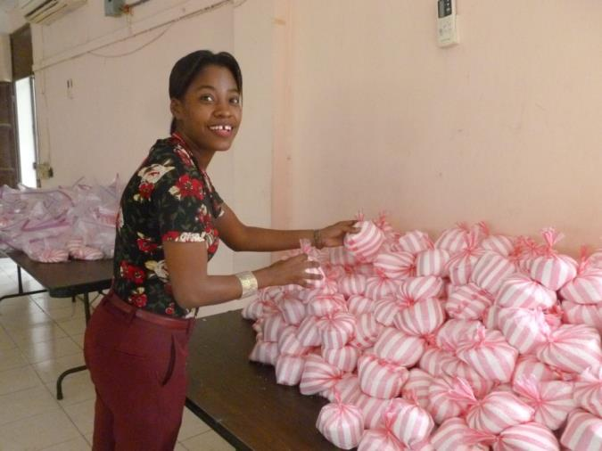
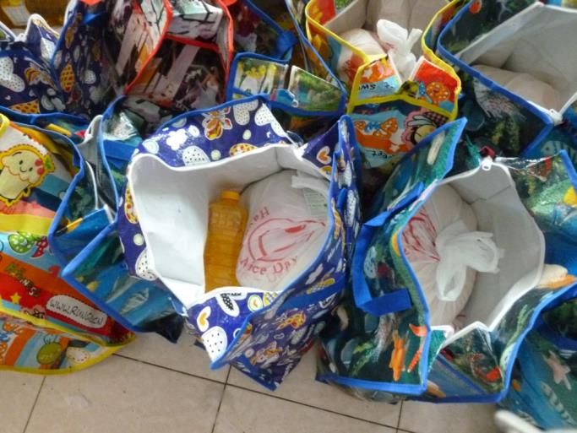
Of rice, sugar, oil and beans for 2000 families

Slide 29
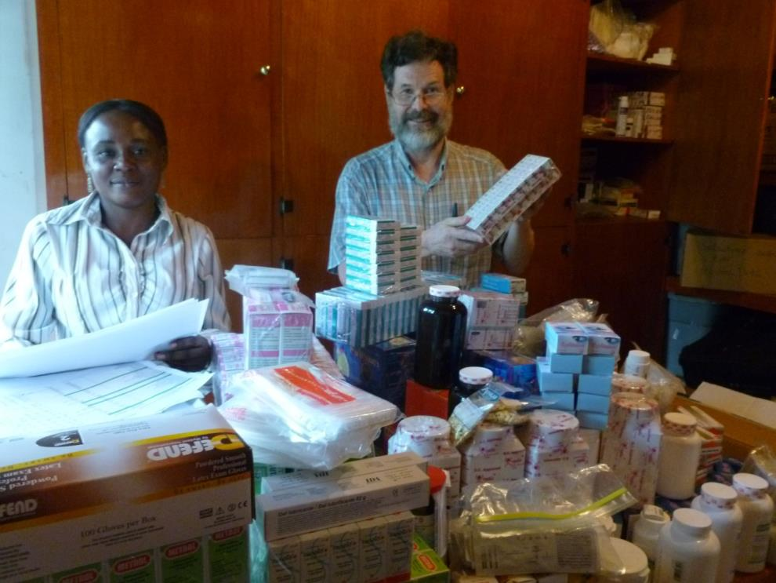
John and Vanette the storekeeper packed medications for clinics

Slide 30
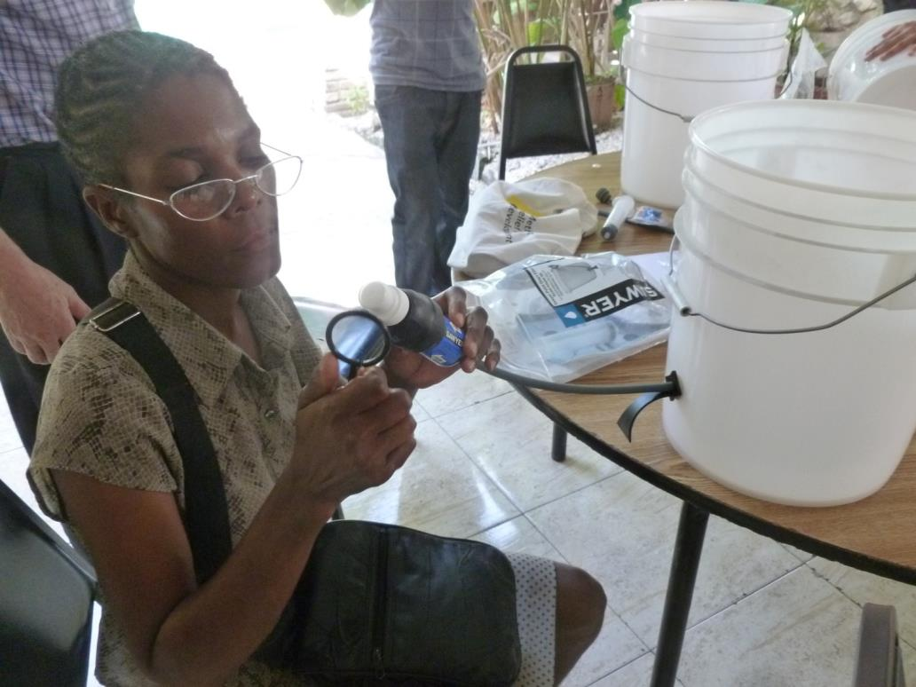
Aqua tabs then water filters were distributed

Slide 31
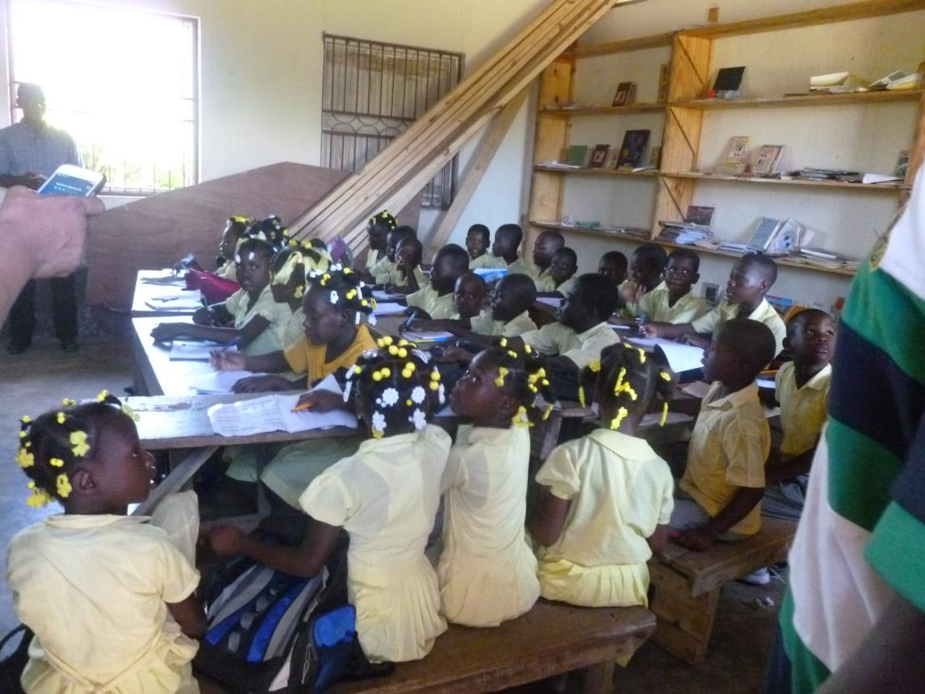
Money for wood for a new ceiling

Slide 32
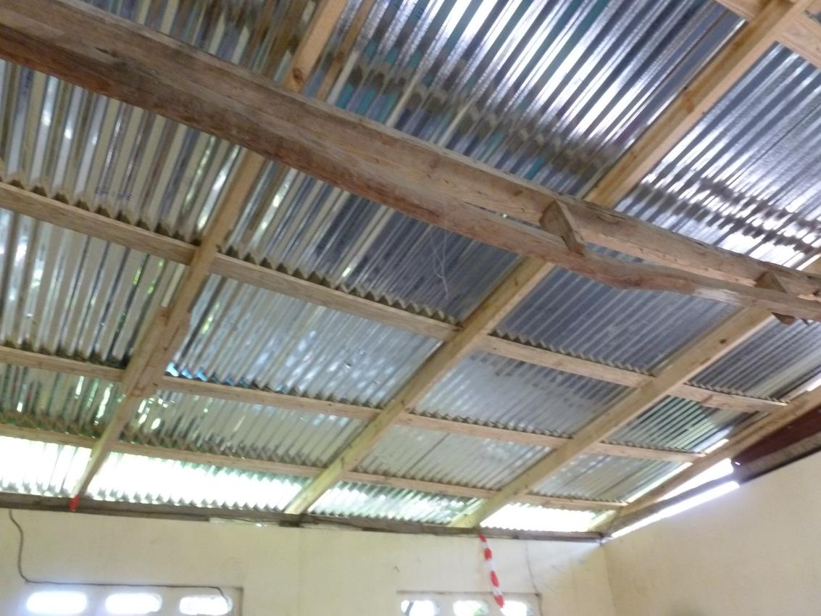
And zinc too

Slide 33
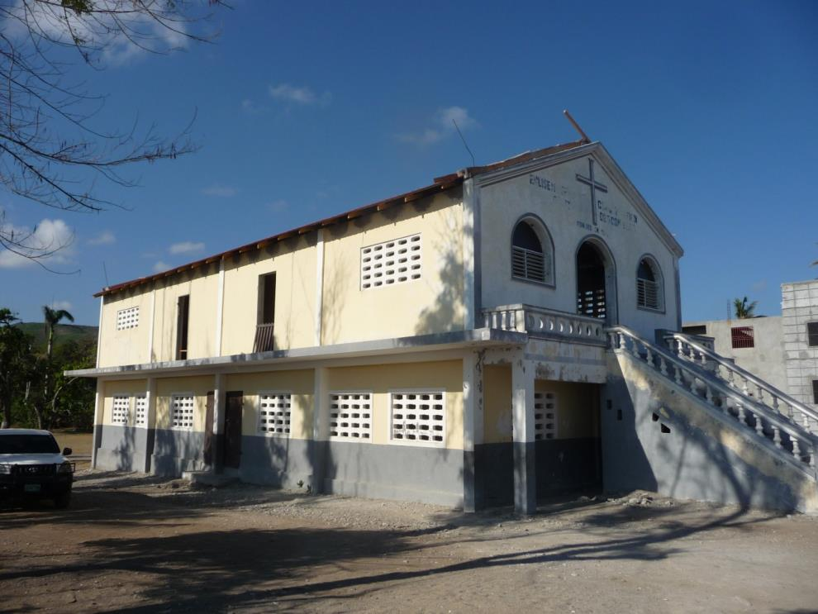
Roof replaced April 2017

Slide 34
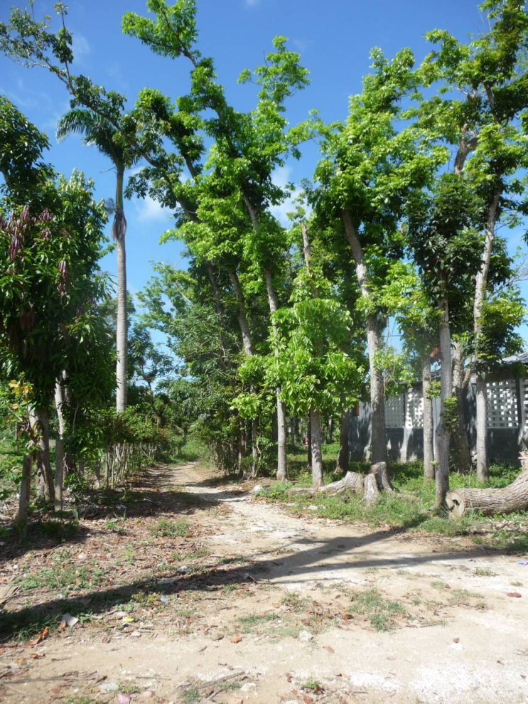
Signs
Of
Recovery

Slide 35
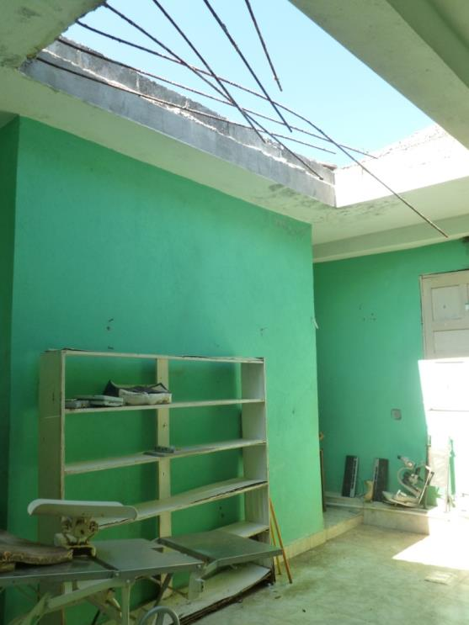
Gebeau clinic, Jeremie, without a roof

Slide 36
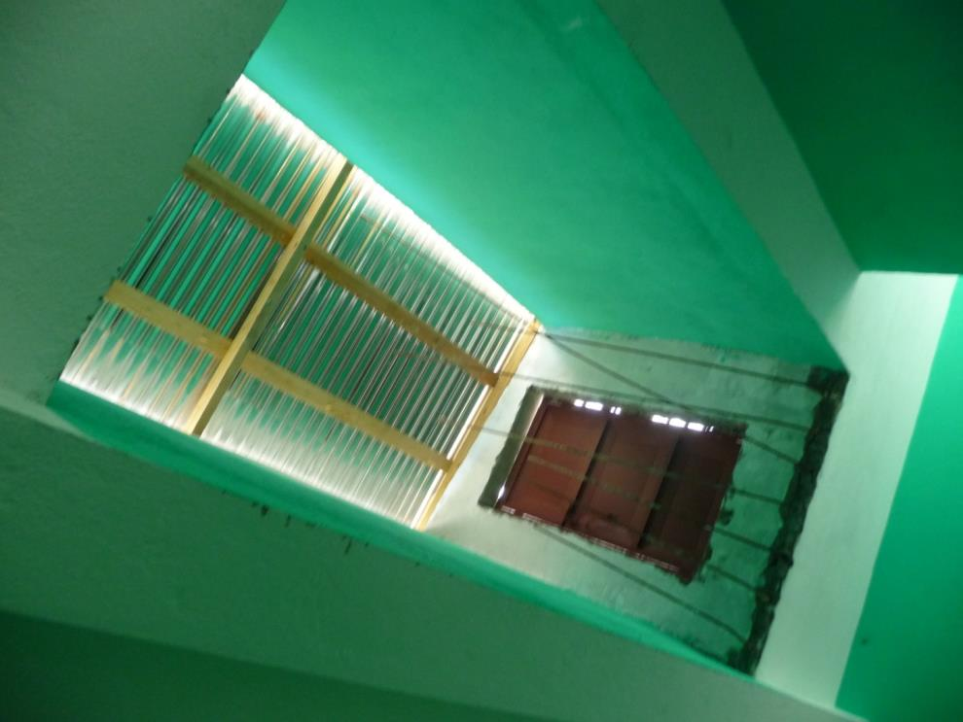
Temporary repair

Slide 37
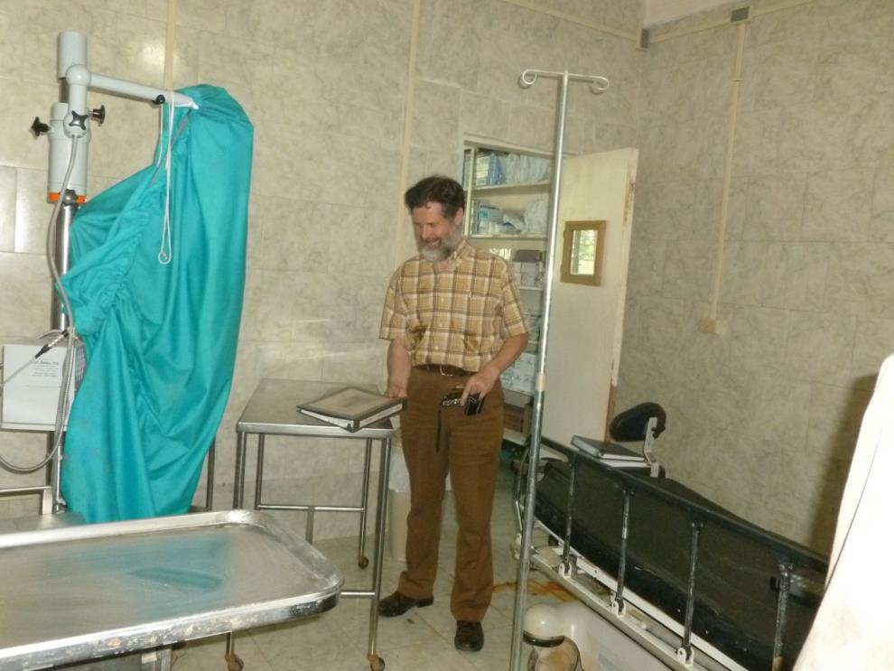
Assessing the damage

Slide 38
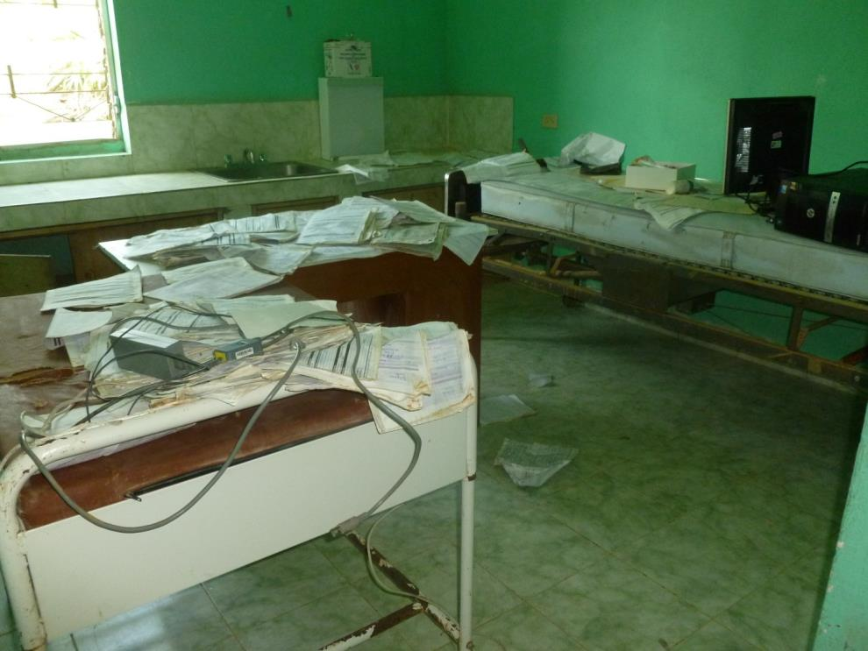
The river ran through

Slide 39
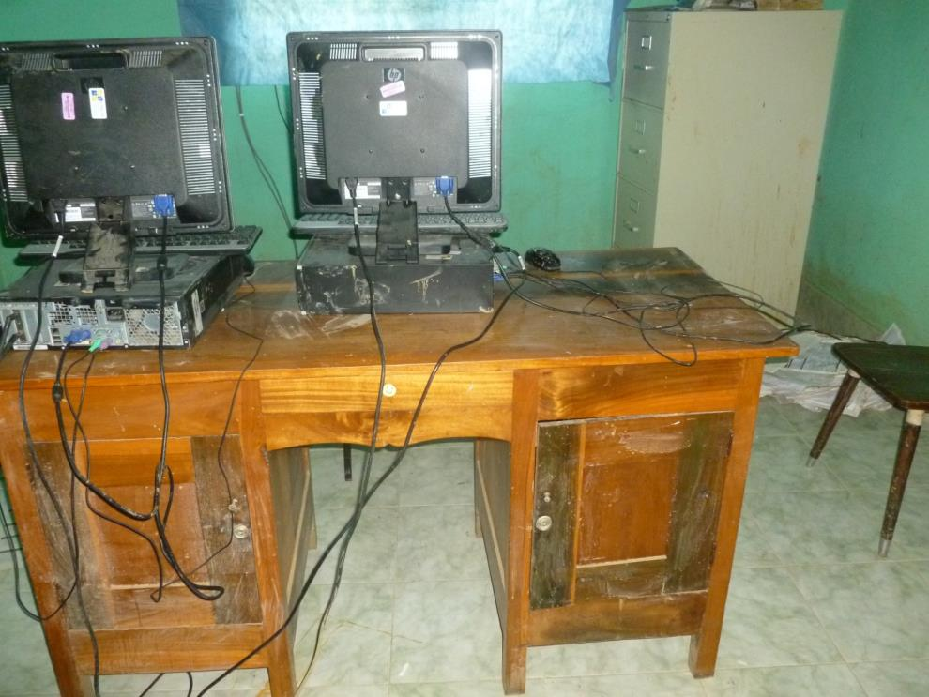
Wrecked clinic records

Slide 40
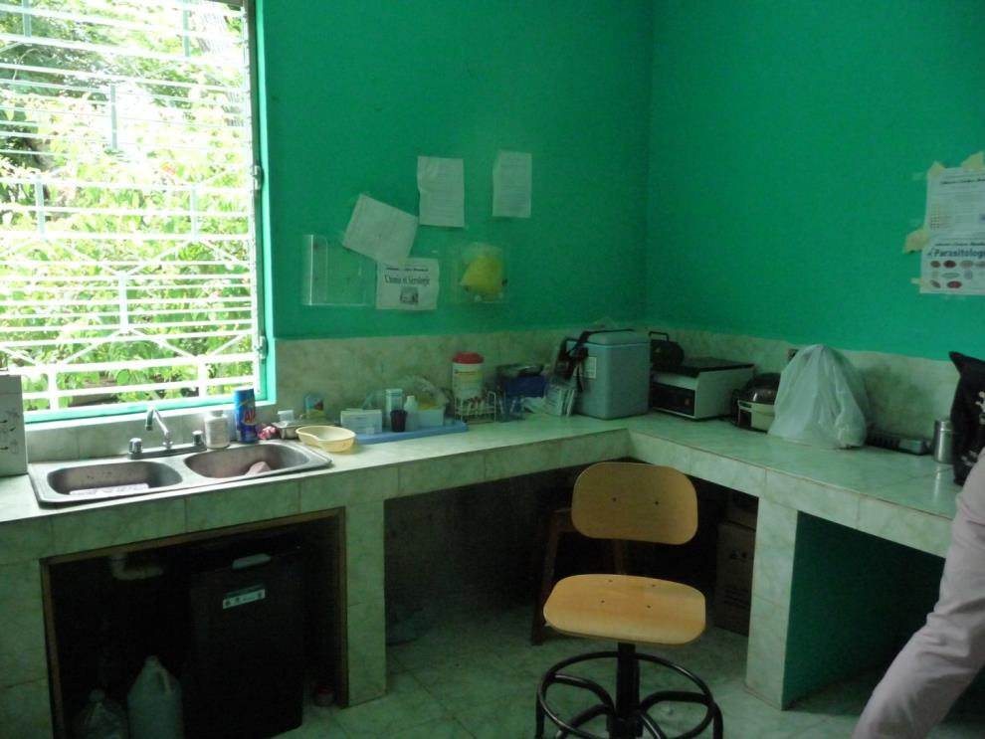
Now cleaned up for use

Slide 41
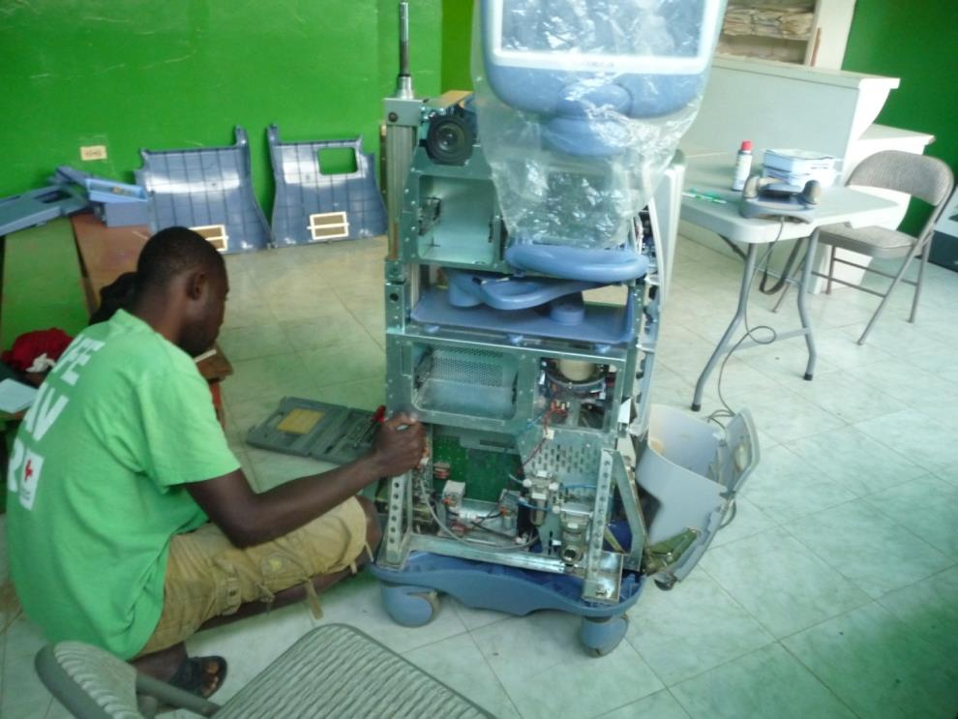
Repairing equipment

Slide 42
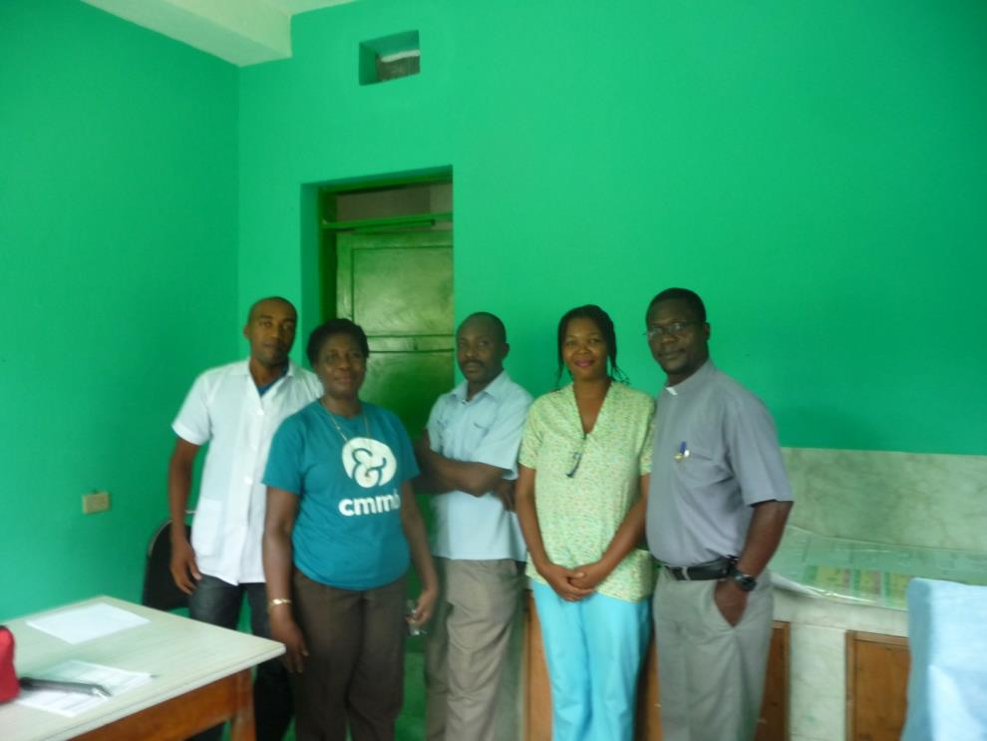
The Superintendent and staff

Slide 43
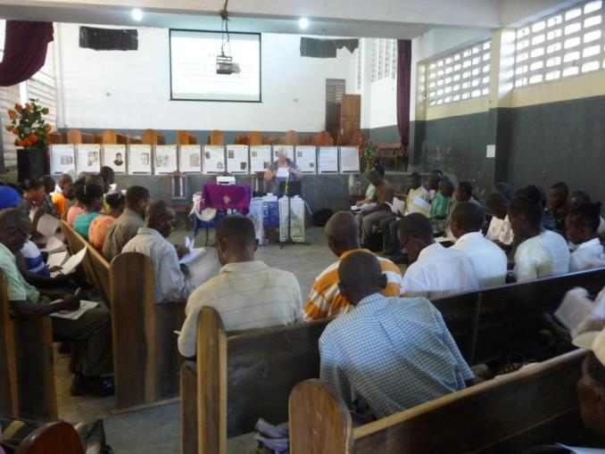
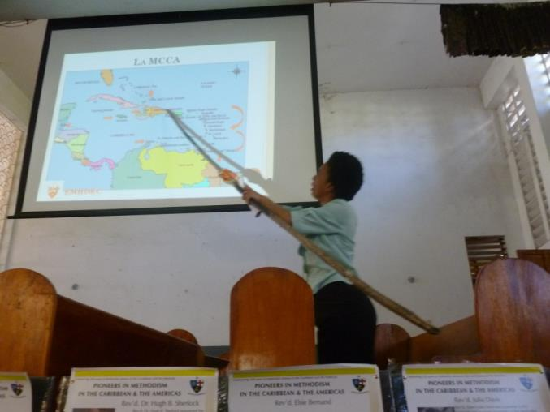
Resumed Training for Stewards

Slide 44
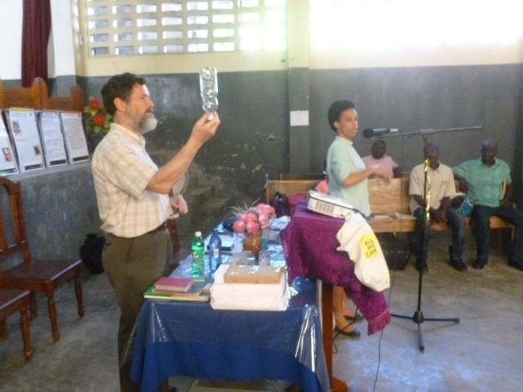
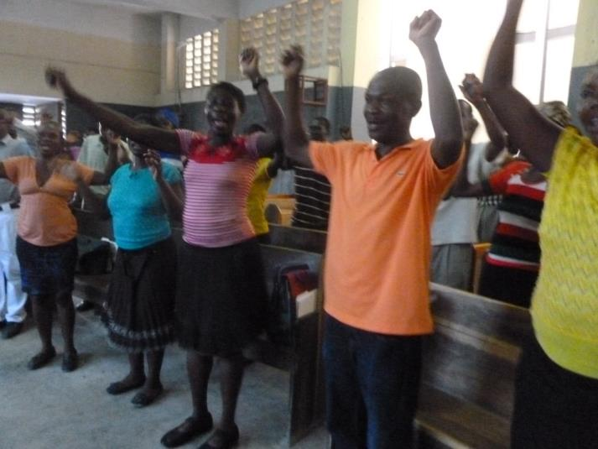
Using the SALT grant

Slide 45
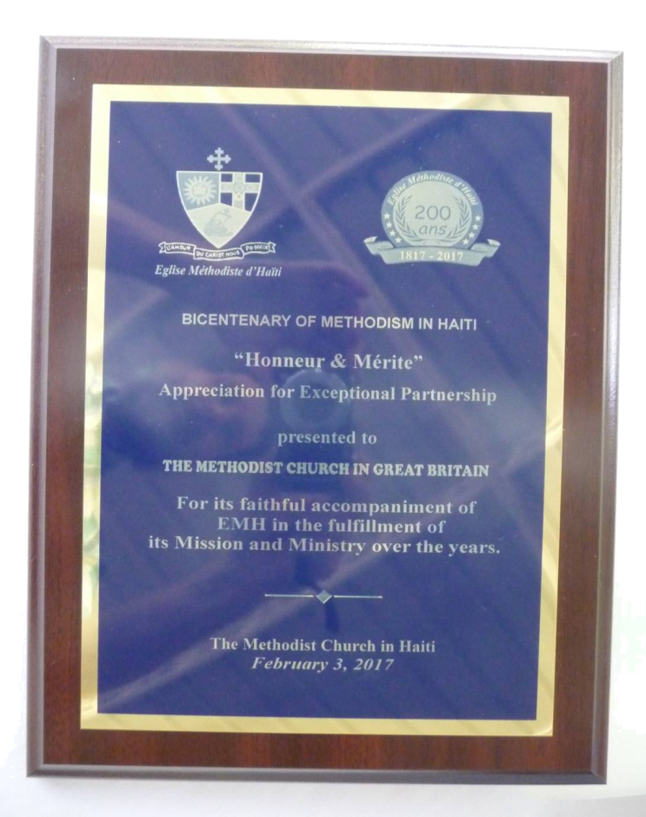
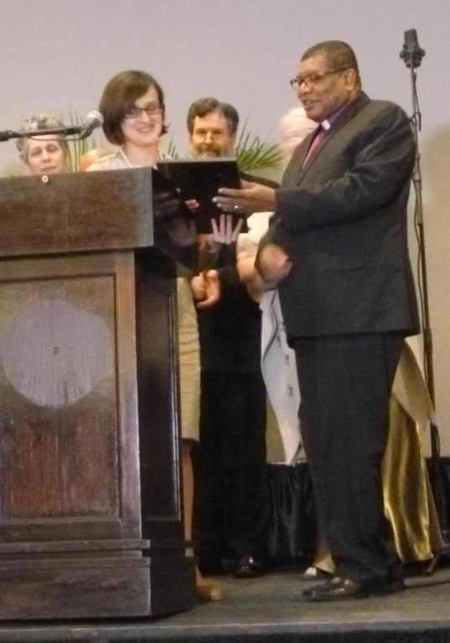
200 years of Methodism and Partnership

