Slide 1
Deepening your church’s culture of welcome

Slide 2
^{Deepening your}
^{church’s culture}
^{of welcome}
1) Creating a welcoming building
2) Being a welcoming people
3) Welcoming through inclusion

Slide 3
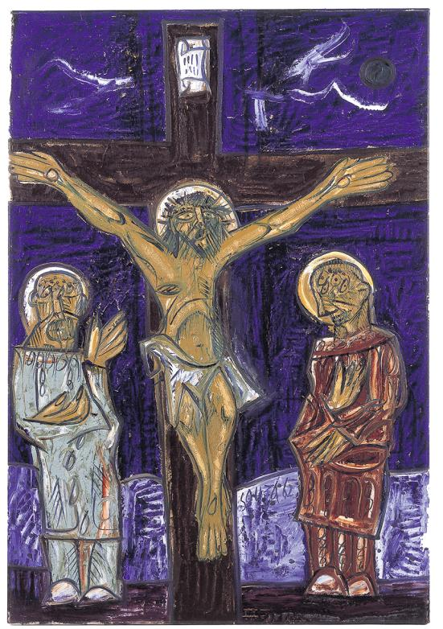
^{Deepening your}
^{church’s culture}
^{of welcome}
The crucifixion,
Francis N Souza (1924-2002).
Used by permission of the Trustees of the Methodist Modern Art Collection.
Notes:
Painting by Sophie Hacker

Slide 4
God of welcome, who sends your Spirit into our hearts, shape our lives to reflect your Son, to welcome the outsider, to greet the stranger, and to seek the lost, in the name of our Lord Jesus Christ. Amen.
^{Deepening your}
^{church’s culture}
^{of welcome}

Slide 5
Session 1 - Creating a welcoming building
The aim of Session 1 is to help participants reflect on the welcome communicated by the church building.
Outline of Session 1:
• Hospitality audit 1
• Your experience of welcome
^{Deepening your}
^{church’s culture}
^{of welcome}

Slide 6
Session 1 - Creating a welcoming building
Hospitality audit 1
• Complete the audit. ‘Score’ your church according to the note at the top of the sheet.
• Compare your scores with someone from the same church or explain some of your scoring to someone from another church.
^{Deepening your}
^{church’s culture}
^{of welcome}

Slide 7
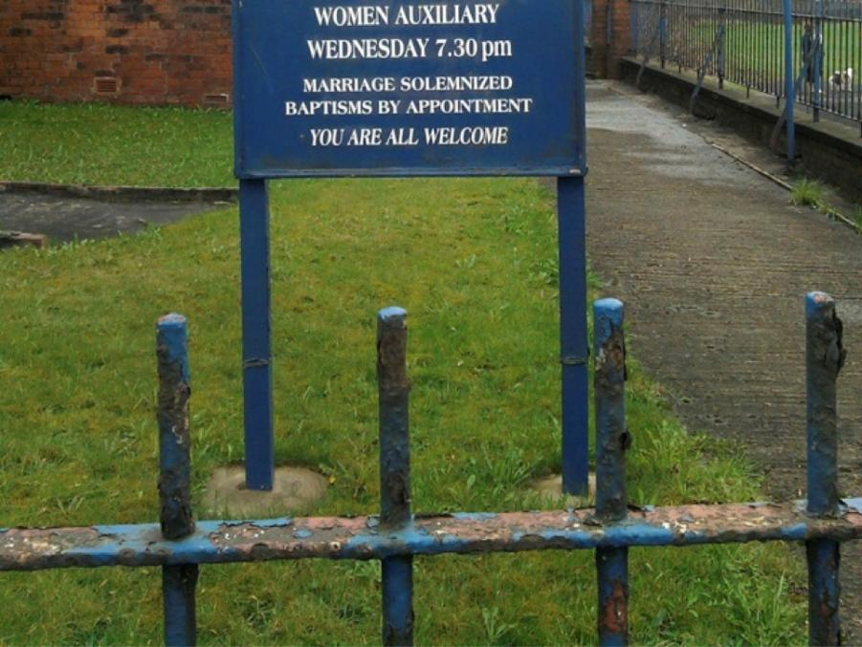
^{Deepening your}
^{church’s culture}
^{of welcome}

Slide 8
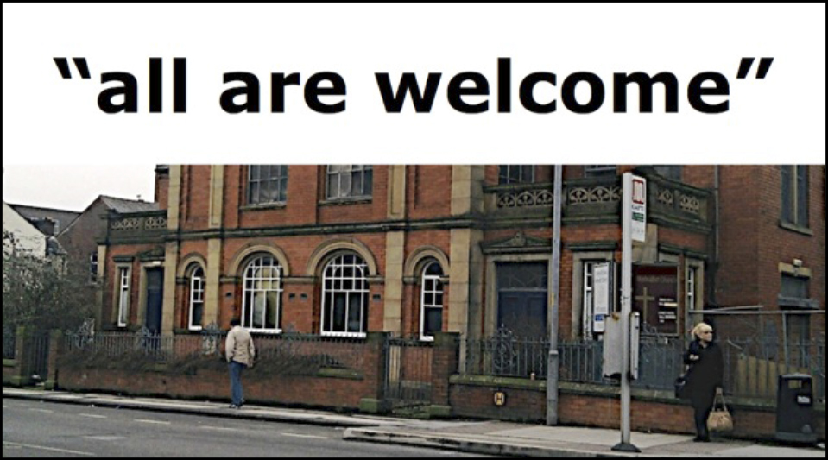
^{Deepening your}
^{church’s culture}
^{of welcome}

Slide 9
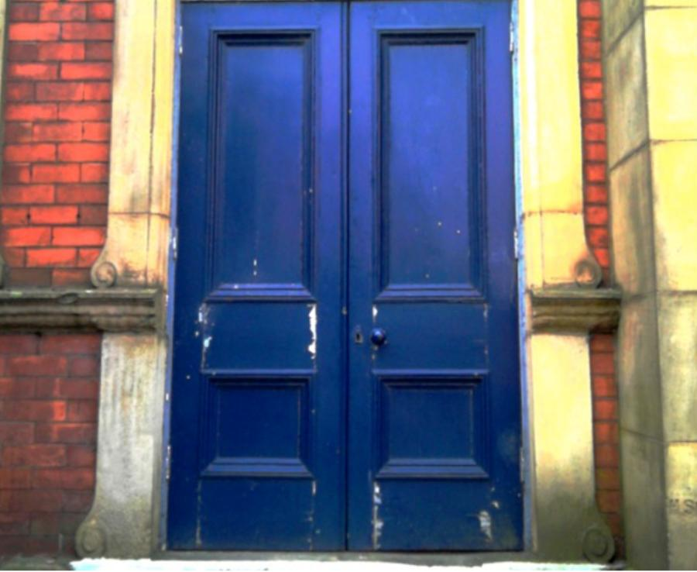
^{Deepening your}
^{church’s culture}
^{of welcome}

Slide 10
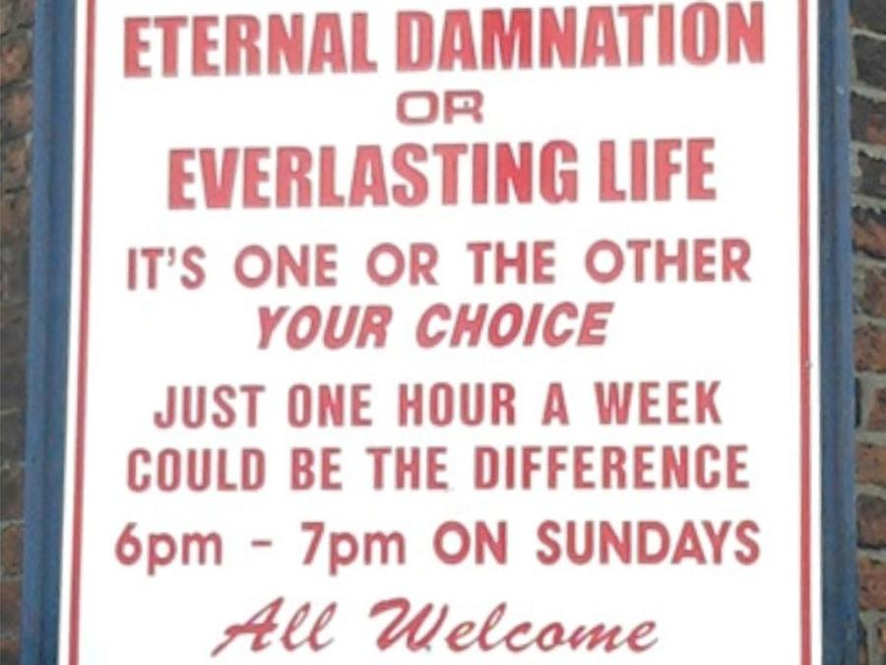
^{Deepening your}
^{church’s culture}
^{of welcome}

Slide 11
Session 1 - Creating a welcoming building
Your experience
• A good welcome – what made it good?
• A poor welcome – why was that?
^{Deepening your}
^{church’s culture}
^{of welcome}

Slide 12
^{Deepening your}
^{church’s culture}
^{of welcome}
Tea/coffee break

Slide 13
Session 2 - Being a welcoming people
The aim of Session 2 is to help participants to reflect on the need to create an environment where those who visit are warmly welcomed into the church community.
Outline of Session 2:
• Hospitality audit 2
• Imagining the experience of welcome
^{Deepening your}
^{church’s culture}
^{of welcome}

Slide 14
What's Your Welcome?
Play the ‘What’s your welcome?’ video

Slide 15
^{Deepening your}
^{church’s culture}
^{of welcome}
Session 2 - Being a welcoming people
Hospitality audit 2
• Complete the audit. ‘Score’ your church according to the note at the top of the sheet.
• Compare your scores with someone from the same church
or
explain some of your scoring to someone from another church.

Slide 16
^{Deepening your}
^{church’s culture}
^{of welcome}
www.cartoonchurch.com
Notes:
Image taken from www.cartoonchurch.com

Slide 17
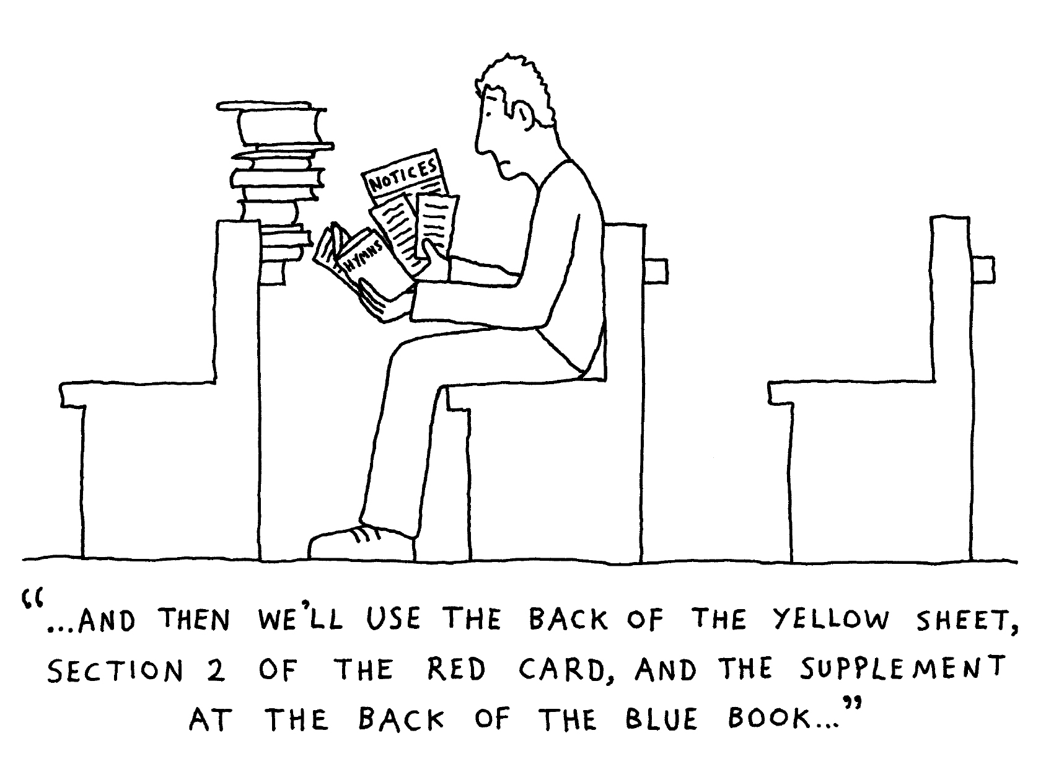
^{Deepening your}
^{church’s culture}
^{of welcome}
www.cartoonchurch.com
Notes:
Image taken from www.cartoonchurch.com

Slide 18
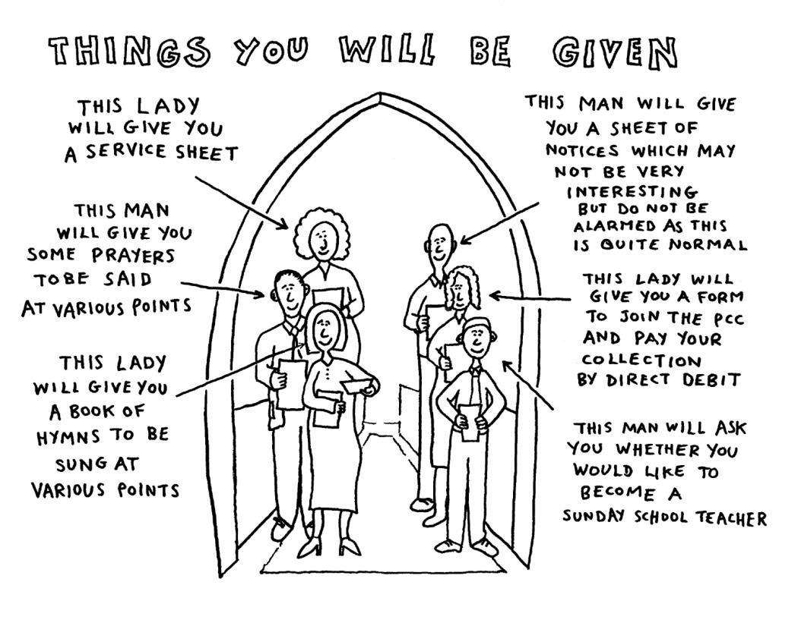
^{Deepening your}
^{church’s culture}
^{of welcome}
www.cartoonchurch.com
Notes:
Image taken from www.cartoonchurch.com

Slide 19
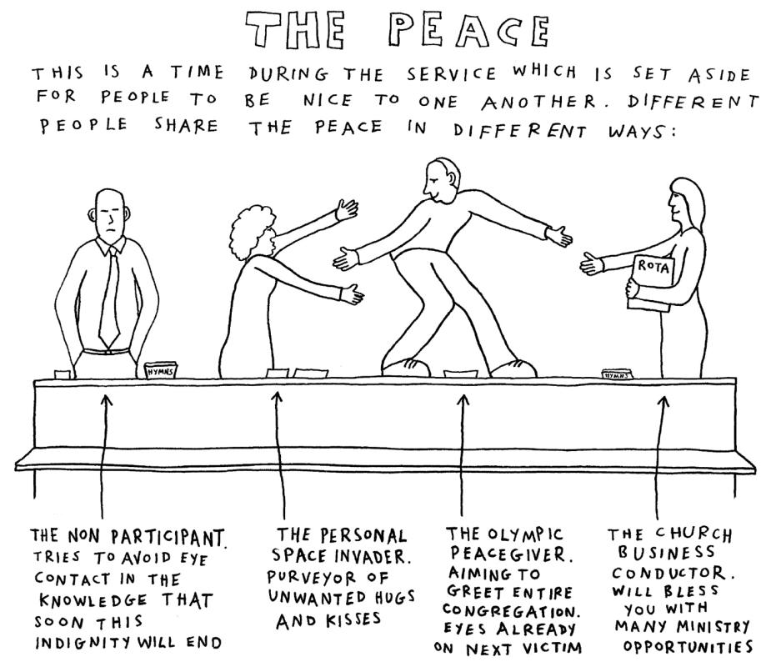
^{Deepening your}
^{church’s culture}
^{of welcome}
www.cartoonchurch.com
Notes:
Image taken from www.cartoonchurch.com

Slide 20
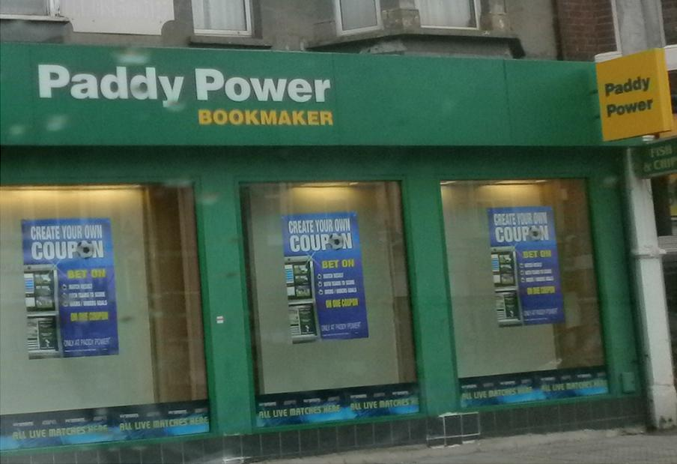
^{Deepening your}
^{church’s culture}
^{of welcome}

Slide 21
Session 3 - Welcoming through inclusion
The aim of Session 3 is to help participants reflect on ways to welcome visitors who are unfamiliar with the culture of church.
Outline of Session 3:
• The culture gap
• Creating inclusion in the church
^{Deepening your}
^{church’s culture}
^{of welcome}

Slide 22
What was Ram Gidoomal’s first experience of visiting a church?
Play the ‘Church Experience’ video

Slide 23
Why did Ram Gidoomal decide to return to church?
Play the ‘Church Attraction’ video

Slide 24
What advice does Ram Gidoomal give to churches engaging with other cultures?
Play the ‘Church Advice’ video

Slide 25
^{Deepening your}
^{church’s culture}
^{of welcome}
Session 3 - Welcoming through inclusion
Sunday School attendance, UK, 1900-2010
Notes:
Taken from Peter Brierley UK Church Statistics 2005-2015 (Tonbridge: ADBC Publishers, 2011). The section ‘British Society and the Sunday School Movement’ can be downloaded for free at www.brierleyconsultancy.com/images/CS4.pdf
[NB: Chart needs to be updated with data for 2010 – 5.1% of people attended Sunday School]

Slide 26
^{Deepening your}
^{church’s culture}
^{of welcome}
Session 3 - Welcoming through inclusion
The culture gap: less knowledge of faith
With every generation, people know less and less about the Christian faith...
A 2009 biblical literacy survey found that:
• fewer than 1 in 20 can name all the 10 Commandments
• 62% didn’t know the Parable of the Prodigal Son
• 60% couldn’t name anything about the Good Samaritan.
Notes:
‘National Biblical Literacy Survey’ Durham University Study (2009) (http://bigbible.org.uk/2009/07/knowledge-of-the-bible-is-declining-researchers-say)

Slide 27
Session 3 - Welcoming through inclusion
The culture gap: less knowledge of faith
• Belief in a personal God dropped from 57% of the population in 1961 to 26% of the population in 2000. During the same period, belief in a ‘spirit or life force’ rose from 22% to 44%.
^{Deepening your}
^{church’s culture}
^{of welcome}
Notes:
Data taken from:
• a Guardian article by Linda Woodhead, ‘Mind, body and spirit: it’s the de-reformation of religion’ (7th May, 2012), who cites her source as British Religion in Numbers. See www.guardian.co.uk/commentisfree/belief/2012/may/07/mind-body-spirit-dereformation-religion
• A 2003 MORI Social Research Interest poll, conducted for the BBC’s ‘Heaven and Earth’ show. See www.ipsos-mori.com/researchpublications/researcharchive/poll.aspx?oItemId=773

Slide 28
Session 3 - Welcoming through inclusion
The culture gap: less knowledge of faith
• A 2003 MORI survey gave participants a list of possibilities and asked them what best described them:
- 18% said that they were practising members of an organised religion
- 25% said that they were non-practising members of an organised religion
- 24% said that they were spiritually inclined but don’t really ‘belong’ to an organised religion
- 14% said that they were agnostic
- 12% said that they were atheist
- 7% said that they were ‘none of these’.
^{Deepening your}
^{church’s culture}
^{of welcome}

Slide 29
Session 3 - Welcoming through inclusion
The culture gap: church attendance
^{Deepening your}
^{church’s culture}
^{of welcome}
England | 1980 | 1985 | 1990 | 1995 | 2000 | 2005
Methodist Churches | 431,300 | 403,900 | 374,100 | 328,900 | 274,200 | 290,100
All Churches | 5,201,300 | 4,845,100 | 4,544,000 | 4,084,400 | 3,544,200 | 3,166,200
Percentage of population (all churches) | 11.1 | 10.2 | 9.4 | 8.3 | 7.2 | 6.3
Notes:
The data for Methodist Churches has been taken from Methodist Statistics for Mission, http://www.methodist.org.uk/ministers-and-office-holders/statistics-for-mission)
The data for ‘all churches’ is taken from BRIN, compiled from data in Religious Trends 3 and Religious Trends 7 www.brin.ac.uk/news/2011/church-attendance-in-england-1980-2005 Permission applied for.

Slide 30
Session 3 - Welcoming through inclusion
Scenario 1
Adult Care Services in your area have opened a residential home for adults with learning disabilities just down the road from your church. A small group of them have started coming to church with a couple of their carers. Their abilities vary, but some are unable to speak and one or two have mannerisms which others might find distracting, such as rocking in their seats and making gratuitous noises. What are the issues here? How can they be helped to feel welcome and be integrated into the life and worship of the church?
^{Deepening your}
^{church’s culture}
^{of welcome}

Slide 31
Session 3 - Welcoming through inclusion
Scenario 2
For the first time in your community an ecumenical service is due to take place at the Methodist church on Remembrance Sunday. The congregation of the local parish church will be attending. What needs to be considered and how can you plan for a warm welcome?
^{Deepening your}
^{church’s culture}
^{of welcome}

Slide 32
Session 3 - Welcoming through inclusion
Scenario 3
A Baptism is taking place during a morning service (one set of grandparents are very active members of the church). The baptism party includes a number of non-churchgoing friends of the family, including people of other faiths and young children. How can they best be welcomed, made to feel comfortable and helped to join in?
^{Deepening your}
^{church’s culture}
^{of welcome}

Slide 33
Session 3 - Welcoming through inclusion
Scenario 4
A special service has been arranged for Mission in Britain Sunday, to which Revd P has been invited to preach. Revd P is the chaplain to a big name football club, an interesting speaker and talented in his ability to use multimedia presentations to illustrate his message. A Thursday night youth club is also run at the church, and the young people who attend do not normally attend worship and have no church connections. How would you plan to involve the young people?
^{Deepening your}
^{church’s culture}
^{of welcome}

Slide 34
^{Deepening your}
^{church’s culture}
^{of welcome}
Complete action and feedback sheets

Slide 35
Deepening your church’s culture of welcome

