Slide 1
Strategy for Justice Dignity and Solidarity
Equality, Diversity and Inclusion Training Module

Slide 2
Strategy for Justice
Dignity and Solidarity
Module 1: Welcome: Working towards a fully inclusive Methodist Church

Slide 3
Introduction to the Equality, Diversity and Inclusion Foundation module - YouTube

Slide 4
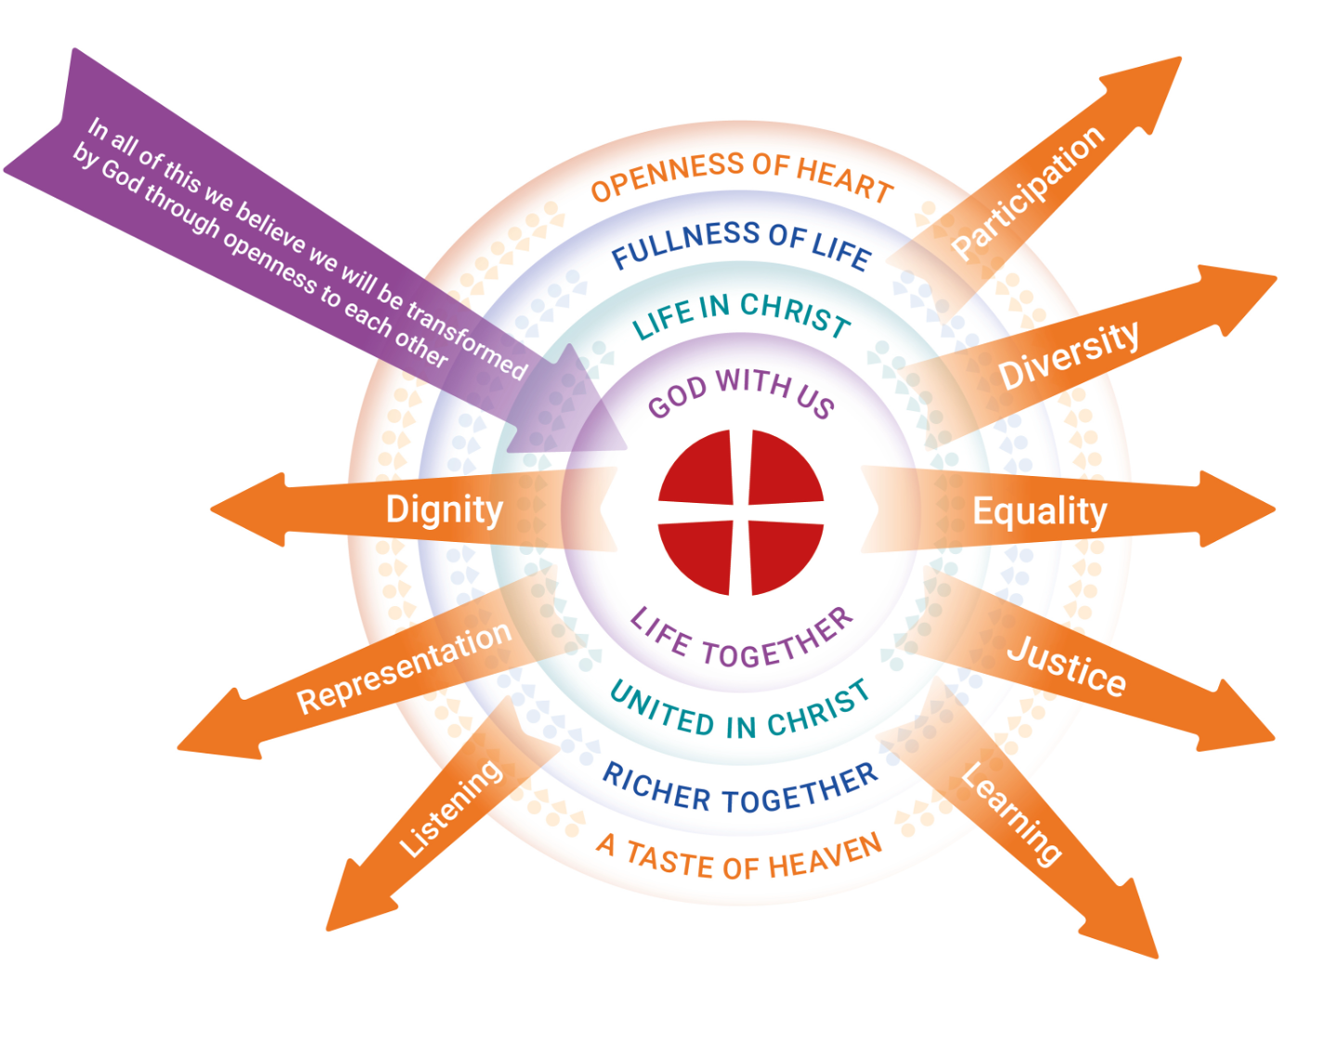
Vision for the
work
Strategy for
Justice, Dignity
and Solidarity:
working towards
a fully inclusive
Methodist
Church

Slide 5
Aim:
Affirm the Methodist understanding that Equality, Diversity and Inclusion is at the heart of the gospel
Objectives:
Understand that Equality, Diversity and Inclusion is key to the gospel
Know that the Methodist Church affirms that the gospel cannot be lived and shared without commitment to Equality, Diversity and Inclusion by all

Slide 6
Aim:
Knowledge of Equality, Diversity and Inclusion
Objectives:
Know the provisions of the Equality Act 2010 (for England, Scotland & Wales) regarding Protected Characteristics (and other equality legislation across the British Isles, Gibraltar and Malta)
Be able to recognise breaches of the Equality Act 2010 and other equality legislation
Be able to apply the principles of Equality, Diversity and Inclusion to any situation where people may be excluded from accessing the gospel living a full life within the church

Slide 7
Aim:
Self-awareness
Objectives:
Be able to recognise how the carrying out of our roles can impact on others’ experience of the gospel
Be able to listen to others without judgement
Recognise that we all need to continue to develop our understanding of Equality, Diversity and Inclusion issues as part of our continuing professional development

Slide 8
Aim:
Equipped for continuing Equality, Diversity and Inclusion learning beyond the EDI training module
Objectives:
Be able to continue personal Equality, Diversity and Inclusion development through self-directed learning
Know how to access professional training from external providers
Be able to read, and learn from, professional training material from external sources, whilst remaining true to the gospel

Slide 9
Aim:
Knowledge of Justice, Dignity and Solidarity: a Methodist approach to Equality, Diversity and Inclusion
Objectives:
Know and understand the basic content of the Strategy for Justice, Dignity and Solidarity (JDS)
Know the tools for ensuring implementation of Equality, Diversity and Inclusion included within the JDS strategy
Recognise the expectation that the JDS User Guide is to be used across the Methodist Church in Britain
Be able to use the Methodist Church Equality Impact Assessment

Slide 10
We invite you to pray:
God, we come to you and you welcome us. Some of us are tired and others are bristling with energy. Your love upholds each one of us.
God, we come to you and you welcome us. Some of us exploring doubts, and others filled with certainty. Your love inspires each one of us.
God, we come to you and you welcome us. Some of us at peace, and others itching with anxiety. Your love calms each one of us.
God, we come to you and you welcome us. Some of us knowing joy, and others in pain. Your love reaches out to each one of us.
God, we come to you and you welcome us. You search us, and you know us. Each of us fearfully and wonderfully made. Each of us bearing your image. Each of us celebrating your love!
Thank you God. Amen.
Liam

Slide 11
Strategy for Justice
Dignity and Solidarity
Module 2: Why is this important for the Methodist Church?

Slide 12
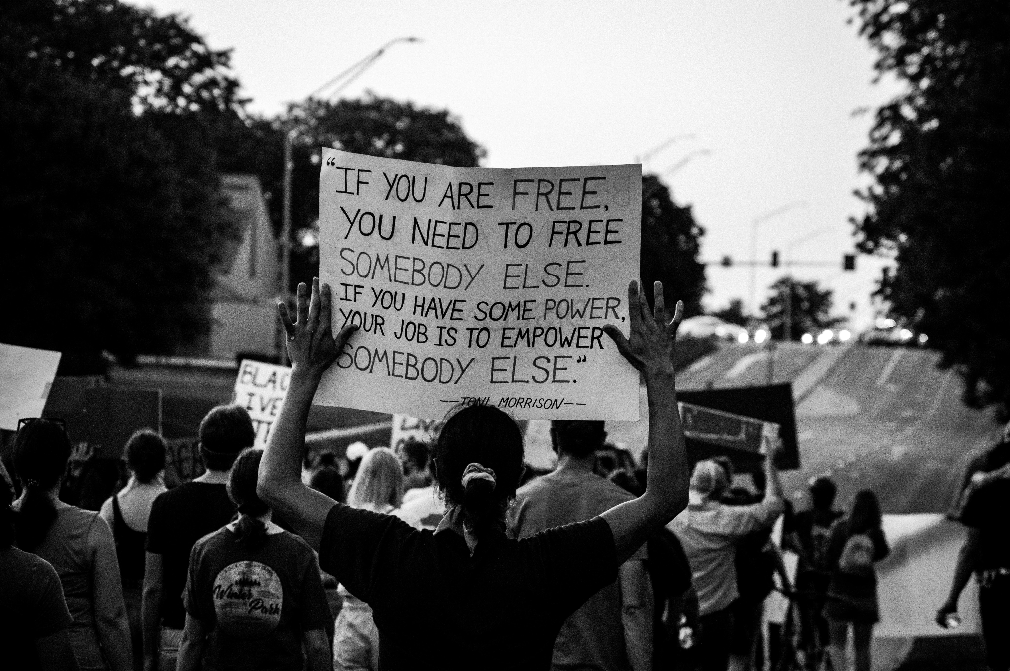
Photo by Kalea Morgan on Unsplash

Slide 13
"I feel part of a movement that is bravely lifting heads towards God, being given the chance to speak out against injustice and for my words to have been heard and understood. The nature of my heart has been felt, not the colour of my skin. For once in my UK Church life, I feel the warmth of hope in reality and not just silently in my heart."
(A Methodist in "Why does this matter")

Slide 14
Photo by Aaron Burden on Unsplash

Slide 15
What the church says:
Our unity is not found in our intrinsic nature, but through our common redemption in Jesus Christ.
God’s loving, transforming presence helps us to grow and become the people God intended, deepening our knowledge and love of God, and showing that love through the ways in which we live our lives.
Part of the Church’s mission is its commitment to social justice.

Slide 16
Module 2 quiz:
Question 1
Why is Equality, Diversity and Inclusion important to the Methodist Church? (select all that apply)
Part of the Church's mission is its commitment to social justice
Because Jesus told us to love one another ... as I have loved you
All humankind is made in God's image and is therefore worthy of dignity and respect
Our behaviour needs to bear witness to our beliefs

Slide 17
Module 2 quiz:
Question 2
Who needs to be committed to Equality, Diversity and Inclusion?
Everyone in the church
Equality, Diversity and Inclusion officers

Slide 18
Strategy for Justice
Dignity and Solidarity
Module 3: Methodism Today

Slide 19
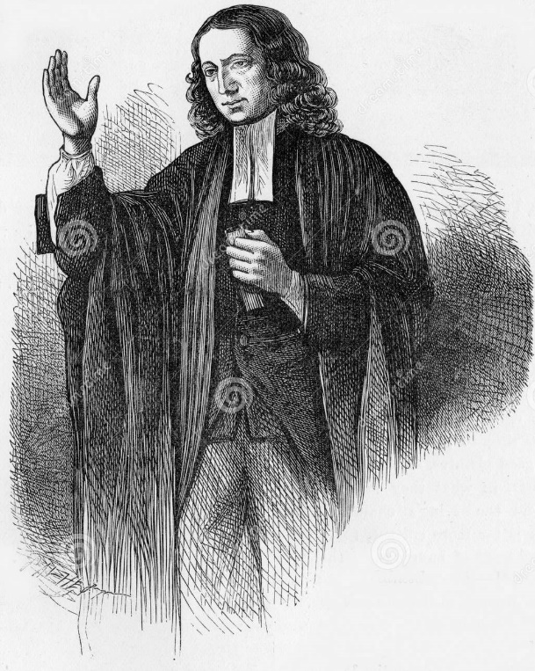
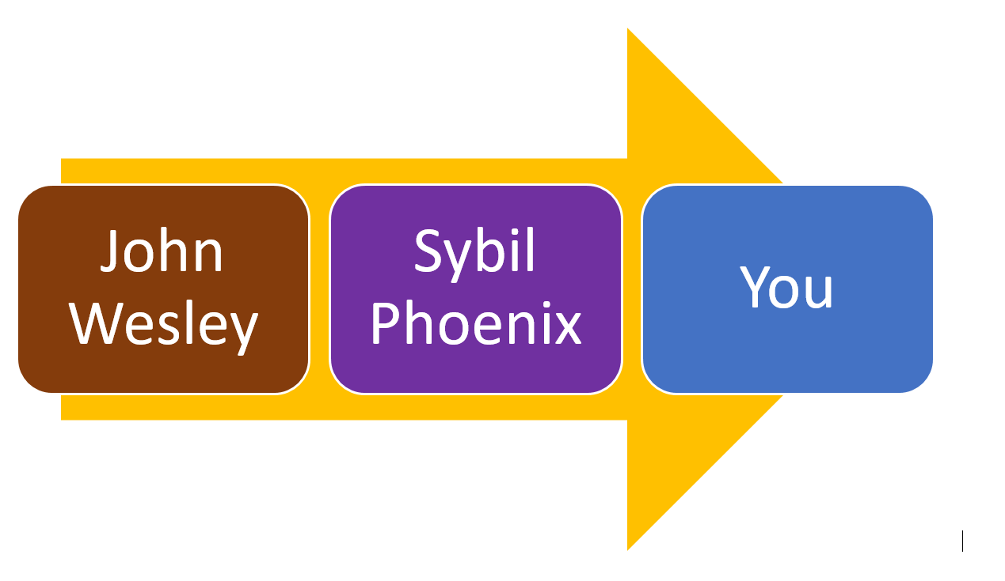
Image by Awcnz62 | Dreamstime.com on Unsplash

Slide 21
There has never been a perfect Christian community. Broken relationships, discrimination and exclusivity have all been part of the life of the Church. This is still true today. Tragically, there have been incidents of discrimination, coercive control and abuse of power which have not been challenged. Our Church falls a long way short of the interdependent Body of Christ we are called to be by God. Within the Church, some people are not accepted, respected and treated as equals. This must change.
JDS User Guide

Slide 22
The Methodist Church in Britain is a public organisation. This means there is equality legislation that applies to us and with which we must comply.

Slide 23
Going beyond equality legislation:
There are a range of groups of people who are not explicitly protected from discrimination and inequality by legislation. Yet we would not want them to experience injustice within the Methodist Church.
What other groups can face injustice in our Church?
Those who have experienced abuse
Those who have experienced childlessness
Those disadvantaged by social class or economic injustice
Those with less formal education
Those with carer status

Slide 24
Module 3 quiz:
These case studies are all real, anonymised examples of events that have occurred in the Methodist Church

Slide 25
Strategy for Justice
Dignity and Solidarity
Module 4: What sort of change are we committing to?

Slide 26
What sort of change are we committing to?
Structural Change
Cultural Change
Attitudinal Change

Slide 27
We invite you to pray:
Lord of all, forgive the narrowness of my vision; the hidden prejudices that lead me to dismiss others as unsuitable for your kingdom; the desire to claim you for my own and to shape you into an image that makes you a comfortable companion for me.
My only hope is in the transforming power of your love that can shatter my exclusive images of you, open me to the challenge of your voice and give me new understandings of the breadth, depth and reach of your love.
To you, all are of worth and all are called – even an imperfect disciple such as me. Amen.
Keith

Slide 29
Don't Put People in Boxes - YouTube

Slide 30
Questions for reflection
What visible traits of the Church's unity do you see where you are?
What traits do you see which are hampering everyone feeling this ‘oneness’ Jesus demonstrated in the Eucharist?

Slide 32
We Are The Church - YouTube

Slide 33
Photo by Aaron Burden on Unsplash

Slide 34
Casting Crowns - If We Are The Body - YouTube

Slide 35
We invite you to pause and pray:
Great God,
You have created all of us so uniquely. You give us all spiritual gifts that help us to make up the body of the church.
Help us not to let common cultural divides tear us apart in the church. Remind us that we all belong to you.
In the same way, remind us to celebrate the differences and uniqueness of the body of the church and that you have called people of all backgrounds to share your Gospel and to share about the hope of salvation.
Amen.

Slide 36
The labels we carry - YouTube

Slide 37
Consider 1 John 4:19: “We love because he first loved us.”
How can we make the Church into a place where people come and they do not receive negative labels, but experience the love of God?

Slide 38
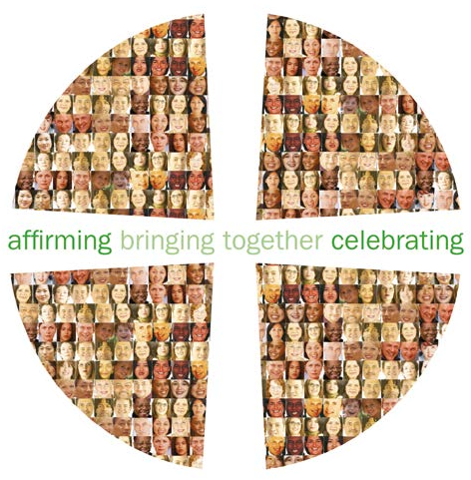

Slide 39
Critical Thinking - YouTube

Slide 40
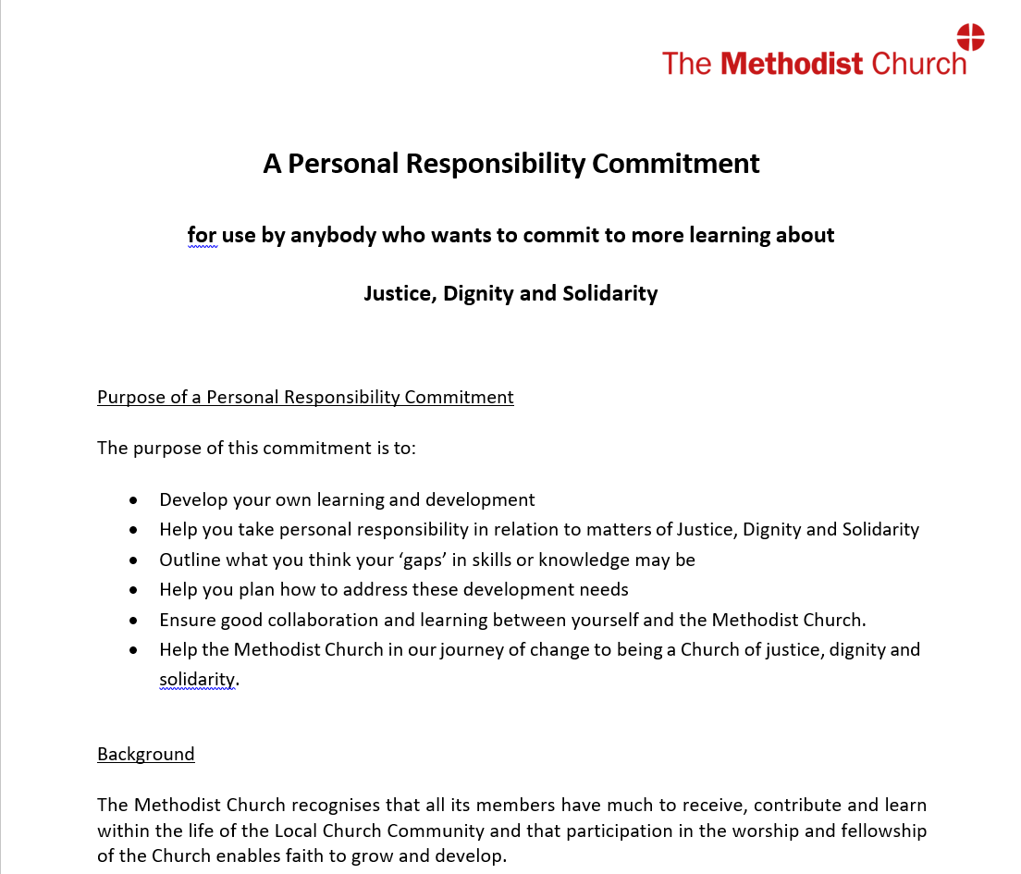

Slide 41
Above and Below the Line - Personal Responsibility - YouTube

Slide 42
We invite you to share this prayer to focus on what we can do to bring change:
God,
Grant us the Serenity to accept the things we cannot change,
the Courage to change the things we can,
and the Wisdom to know the difference.
Amen.

Slide 44
Strategy for Justice
Dignity and Solidarity
Module 5: What does the strategy recommend?

Slide 46
Affirmations Scheme - YouTube

Slide 47
Inclusive Language Guide - YouTube

Slide 48
Discrimination and Abuse Response Service - YouTube

Slide 49
Truth and Reconciliation Process - YouTube

Slide 50
Solidarity Circles - YouTube

Slide 52
Equality Impact Assessment - YouTube

Slide 54
Module 5 quiz:
Question 1
What is the Truth and Reconciliation Process?
A story of the history of racism and the Methodist Church
A review of a system or procedure within the Methodist Church, to listen to those who have experienced discrimination, acknowledge failures and transform systems
A restorative conversation between someone who has been discriminated against and the person who discriminated against them

Slide 55
Module 5 quiz:
Question 2
If you wish to report discrimination in the Methodist Church, do you need to make a formal complaint?
Yes
It depends on the type of discrimination experienced
No, you can also access the Discrimination and Abuse System, where you will receive support, including with making a formal complaint if you choose to do so

Slide 56
Module 5 quiz:
Question 3
Which of the following are possible advantages of completing an Equality Impact Assessment?
You will be better able to correctly allocate resources, such as time and budget, to meet the aims of your project
You will ensure you are catering to the needs of all
You will identify changes you need to make to ensure your project does not inadvertently lead to indirect discrimination
You will demonstrate to everyone, inside and outside the church, that you take equality and justice seriously, with actions as well as words

Slide 57
Module 5 quiz:
Question 4
Is the Strategy for Justice, Dignity and Solidarity all about fixing problems within the church?
Yes
Of course. Everything is terrible and must change now
No. Whilst elements of the strategy are aimed at identifying and fixing problems, the Affirmations scheme is about recognising and celebrating positive experiences within the church, and helping others to follow those examples

Slide 58
Strategy for Justice
Dignity and Solidarity
Module 6: Opportunities for Action. What next?

Slide 60
We invite you to pause and pray:
Inviting God,
Help us to see that every person has a place in your presence.
Forgive us when we try to limit our friendships to people who look like us, act like us, believe like us.
Through your Holy and transforming Spirit, move us from exclusion to inclusion, from formulators of fences to builders of bridges, from indifference to all-encompassing love.
In the name of Jesus Christ our Saviour.
Amen.
Sonia

Slide 61
?
Question Park

Slide 62
A closing prayer:
Most generous God, in your borderless kingdom all creation finds its home.
We thank you for your gracious and unconditional invitation to be part of your body.
Help us to pay attention to those whose voices are too weak to be heard and to those who live in the forgotten corners of our world.
We pray for all those who are excluded from the richness of your creation.
Help us to follow the movement of your Holy Spirit, ever reaching into the margins of our lives and communities.
Amen.
Paul

Slide 63
Registered charity no. 1132208
© Trustees for Methodist Church Purposes 2022

