Slide 1
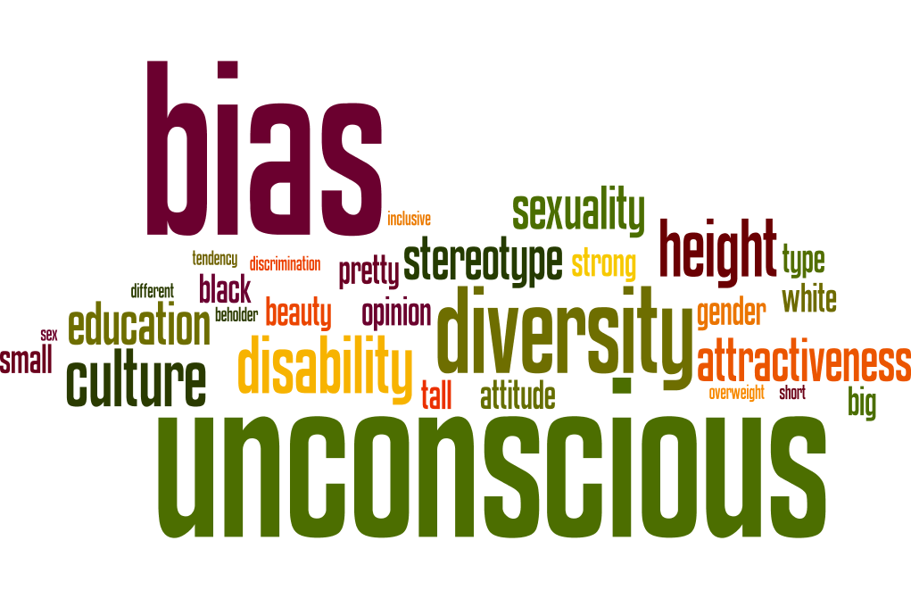
An introduction to unconscious bias

Slide 2
Section 1 and 2 Introduction and theology and an introduction to unconscious bias
Direct link to video (and the option to download)

Slide 3
Section 1 and 2 For reflection and conversation (4minutes)
How does the notion of unconscious bias relate to your understanding of being made in the image of God?
Share ways in which unconscious bias might prevent people from being fully included in the life of the Church and from being able to flourish.
Make a list of the characteristics which might elicit an unconscious response.

Slide 4
Section 3 Types of unconscious bias
Direct link to video (and the option to download)

Slide 5
Section 3 For reflection and conversation (4 minutes)
Reflect together on the types of bias and micro-aggression
Discuss what you notice about the types of bias and micro-aggression
How you might minimise the impact of micro-aggression?
Agree on your 3 top tips for minimising micro-aggression to share with the whole group

Slide 6
Section 4 The impact of unconscious bias and what we can do about it
Direct link to video (and the option to download)

Slide 7
Section 4 For reflection and conversation (4 minutes)
What can you do to become more aware of your own unconscious bias?
What can you do to minimise the negative impact from unconscious bias?
Thinking about the questions and issues that this session has raised for you, reflect on:
What does this mean for you in your role within the church?
What you will do now?

