Slide 1
Notes:
Session one: A Methodist Way of Life

Slide 2
Notes:
Session one: God loves you. Unconditionally. No strings attached. (See ‘background reflection’)
In response to this gift, there are twelve things that we do individually and together as we grow as followers of Jesus, which help us to worship God, serve others, be evangelistic, and learn and care together. None of this makes God love you any more – but they may help you realise how deeply you are loved by God.

Slide 3
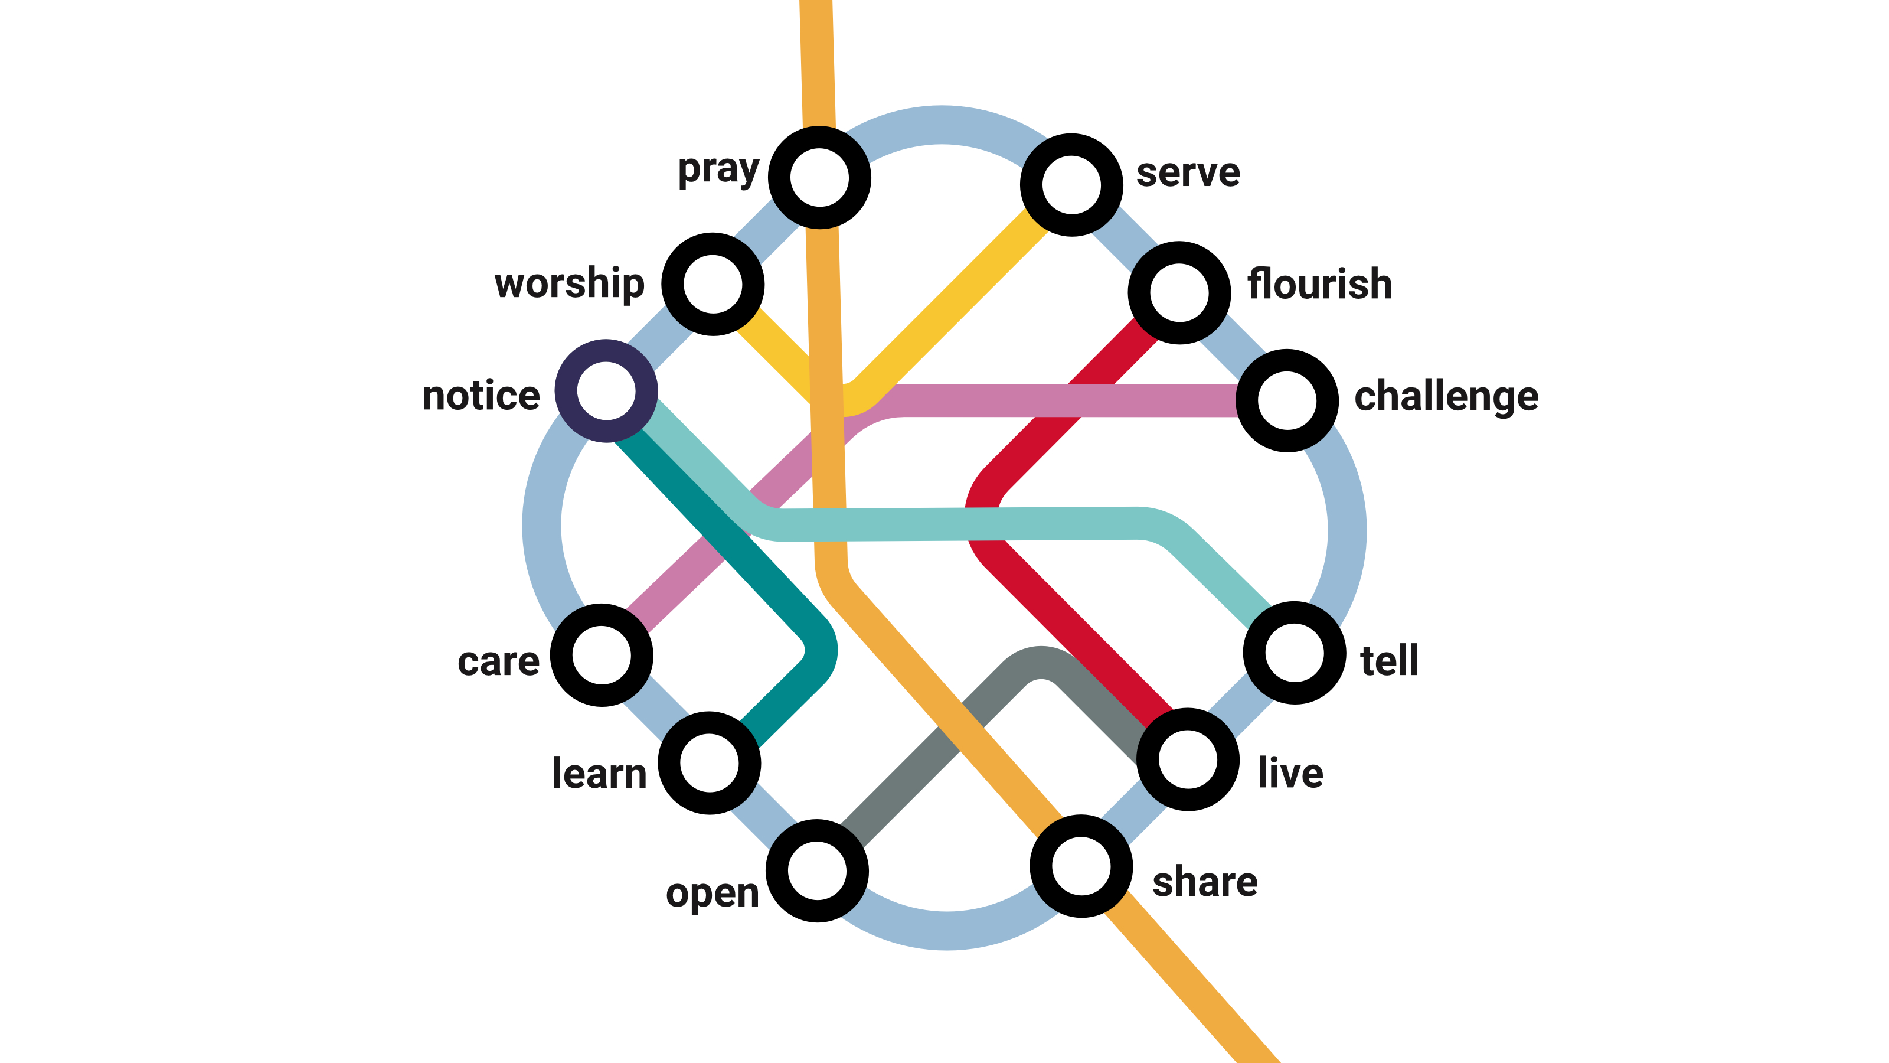
Notes:
Session one: The twelve stations of A Methodist Way of Life (See ‘background reflection’)

Slide 4
Notes:
Session one: The train journey parable (see ‘further notes’)
God longs to take you on the journey of a lifetime. Let's create a modern-day parable. Imagine that God's a train driver.

Slide 5
Notes:
Session one: The train journey parable – stage one (see ‘further notes’)
When we respond to God's love, it’s a bit like getting on the train. This can be scary, but nothing else in life is as satisfying. Staying where you are is an option, but you miss out on so much. What if you joined in with God’s adventure, what if you started a journey … not really sure what was going to happen or where you might end up next, with an open ticket for unlimited travel?
What’s important is deciding to get on the train, committing to the journey. There might be specific moments that stand out, like the day you first said 'Yes!' to Jesus. That's like stepping on to the train for the first time. Or maybe you’re just thinking about starting the journey now. But it’s also a daily commitment to keep travelling, in good times and bad.

Slide 6
Notes:
Session one: The train journey parable – stage two (see ‘further notes’)
But where does the train go? What does this journey involve? There’s a map – we call it A Methodist Way of Life. The train goes to twelve stations. It's good to visit them all because, each station is an opportunity to:
• encounter God,
• grow in maturity,
• step out in mission and action,
• be surprised by joy.
Each station on the way represents a different spiritual practice we might do, a different way we can encounter God. Some stations will be familiar to you, but some might be new.

Slide 7
Notes:
Session one: The train journey parable – stage three (see ‘further notes’)
We learn together between stations as we share stories and reflect on our encounters with God. Some people reflect in group conversation. Others prefer to journal. The Holy Spirit shapes and develops you, and you can become more like Jesus.

Slide 8
Notes:
Session one: The train journey parable – stage four (see ‘further notes’).
Stages four to six are intended for people in leadership, though can also be the responsibility of all disciples living in community and supporting one another.
Now, if you are involved in leading other disciples in any way, there are three more steps. As church leaders we’re on our own discipleship journeys. But we also play a role as companions to others. We journey alongside people who are exploring the network, particularly if they’re still deciding whether to get on the train.
We might be a tour guide, helping someone explore a different part of a familiar station or encouraging them to leave their familiar home station, so that they experience God in a new and different way. Perhaps we’re even sales people, telling people about the great features of a station they haven’t been to yet.

Slide 9
Notes:
Session one: The train journey parable – stage five (see ‘further notes’)
Of course, we can’t direct people to stations that don’t exist. So we might need to ‘construct stations’ or build new infrastructure, ensuring that our churches and circuits have opportunities for people to take part in all these activities. That might mean starting a new prayer group, or helping someone who is passionate about injustice to join up with a Circuit initiative. It might mean partnering with other churches, and organisations with particular expertise.

Slide 10
Notes:
Session one: The train journey parable (see ‘further notes’)
But what does it look life in real life? The next four slides offer suggestions of how different practices might be done by a church community, with one chosen in each of the four areas of Our Calling (because we don’t do everything at once).
Maybe like this – a group of people who gather in a chapel building, have Bible studies, coffee mornings and take part in protests against injustice.

Slide 11
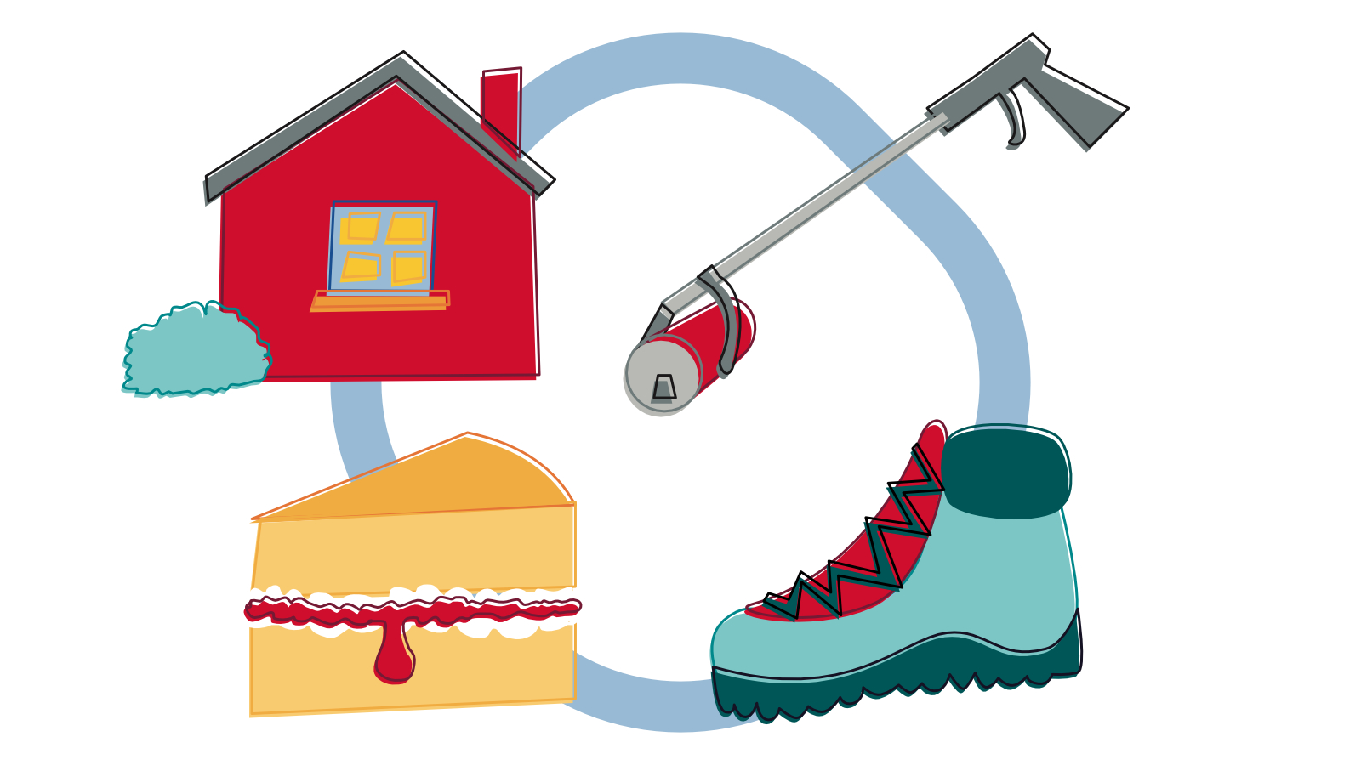
Notes:
Session one: The train journey parable (see ‘further notes’)
Maybe in a rural context people gather for worship in each other's homes, bake tasty cakes for the community, take part in walk-and-talk hikes, and join in litter picking.

Slide 12
Notes:
Session one: The train journey parable (see ‘further notes’)
It works in a digital context too. You can worship online, learn from podcasts (including our very own Hope and Anchor!), be a loving presence on social media, and take part in online petitions.

Slide 13
Notes:
Session one: The train journey parable (see ‘further notes’)
It also fits a pioneering context too. You might meet with people in a café, share food, tell stories and share ideas for caring for the environment.

Slide 14
Notes:
Session one: The train journey parable stage six (see ‘further notes’)
The discipleship journey is an exciting one, and deeply fulfilling. So we don’t want to limit the journey to people who are already travelling.
Each station in the network is an opportunity for new people to start their own journey. For one person, that might be sensing something spiritual in nature. For another, it might be wrestling with questions about evil in the world.
We want to ensure the stations (our activities and practices) are accessible to new people as well as experienced travellers. As leaders, we need to be able to support people in taking those first steps into the network, and exploring the journey God is taking them on.

