Slide 1
Notes:
A Methodist Way of Life

Slide 2
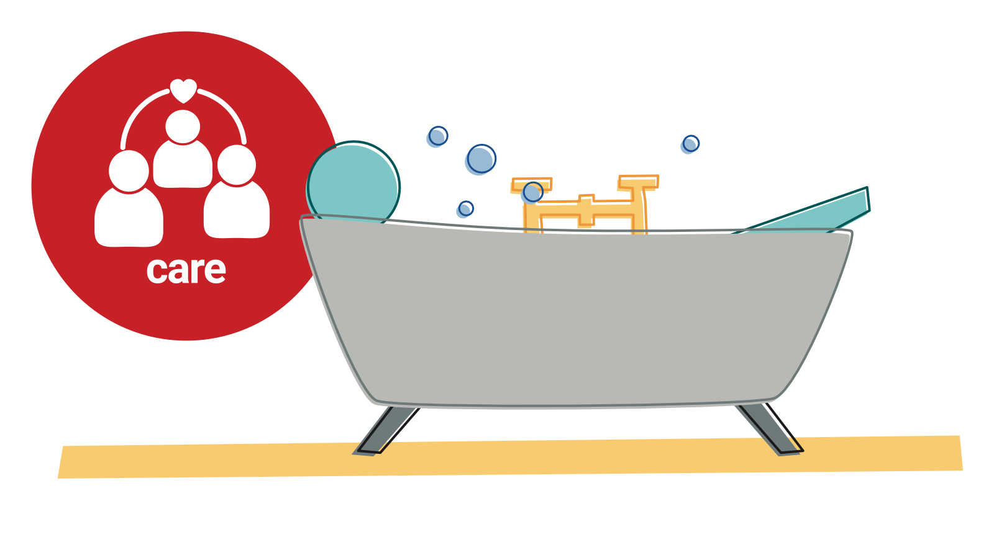
Notes:
Session: Care (see ‘key themes’)
We care for ourselves and those around us. It's all about love. Love for other people and yourself is what matters most.

Slide 3
Notes:
Session: Care (see ‘background reflection’ and ‘creative activity’)
We can think of many stories where caring for others has come at the detriment of caring for ourselves. We treat ourselves far more harshly than we ever treat others, at the disservice to ourselves and others. The stress bucket analogy is one used in mental health training. The levels of stress we can deal with have a limit, and most of the time we are able to manage the incoming stresses of work, relationships, health and money, as these are counterbalanced by the things we do to relieve stress – prayer, resting, exercise, socialising and, of course, a good night’s sleep.

