Slide 1
Notes:
A Methodist Way of Life

Slide 2
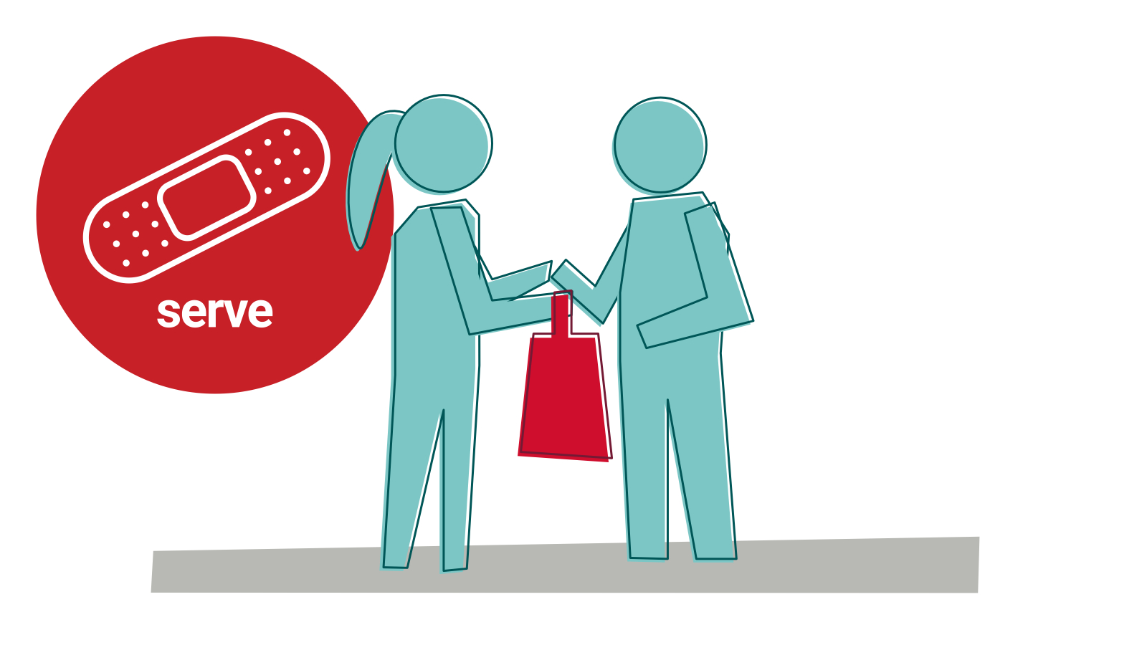
Notes:
Session: Serve (see ‘background reflection’)
We will help people in our communities and beyond.

Slide 3
Notes:
Session: Serve (see ‘background reflection’ and ‘discussion questions’)
Who is your neighbour? How do you serve them?
How do you serve people far away?

