Slide 1
Notes:
A Methodist Way of Life

Slide 2
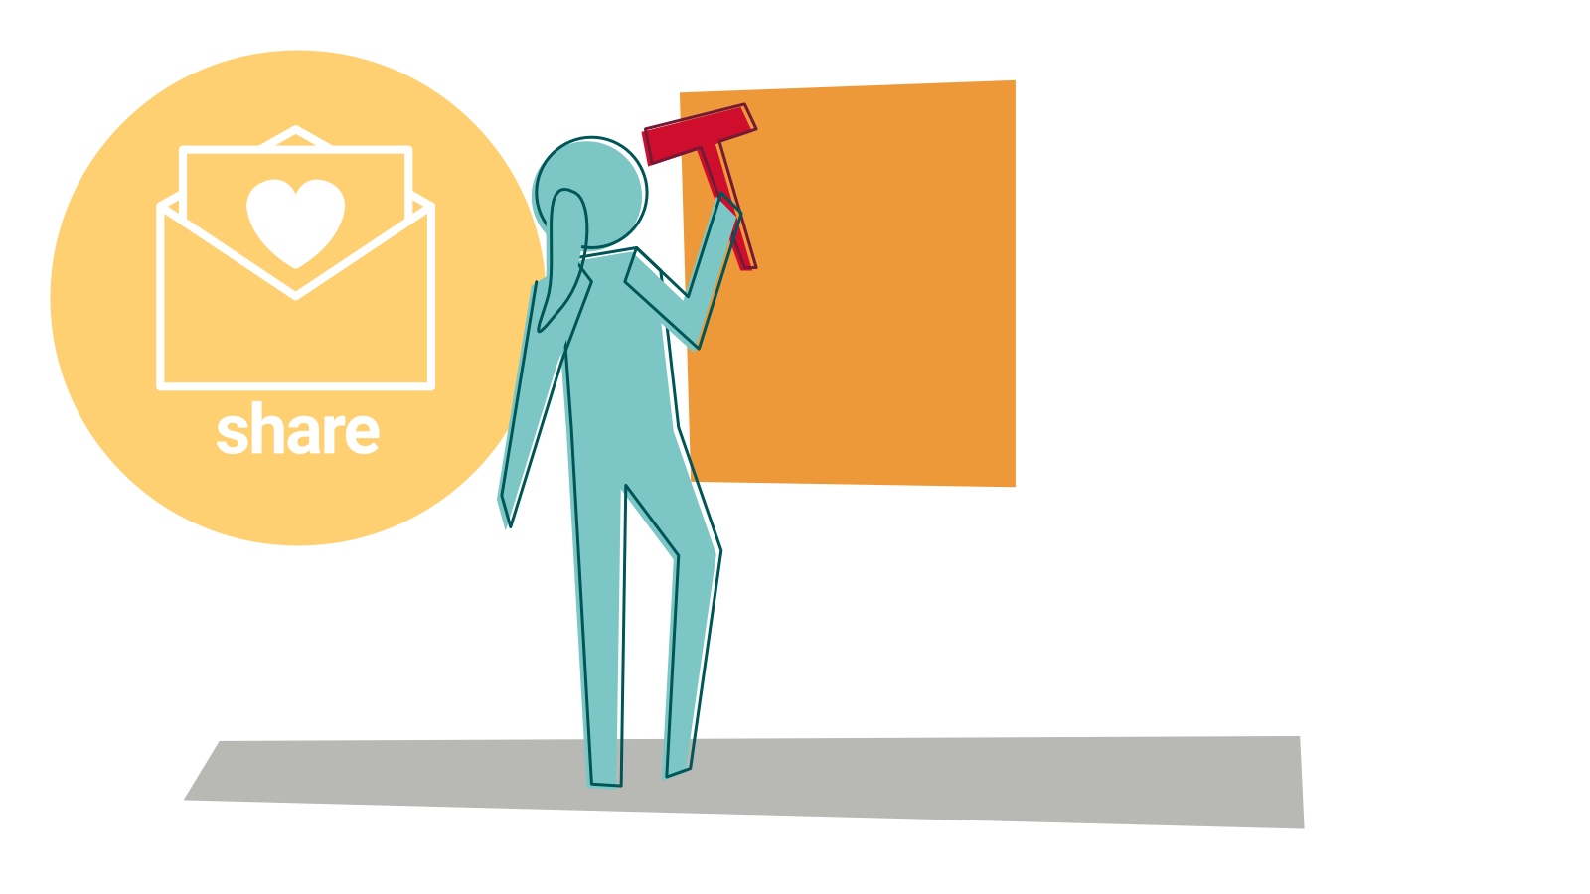
Notes:
Session: Share (see ‘key themes’)
We share our faith. You get to partner with God. God involves us in the task of bringing love and restoration.

