Slide 1
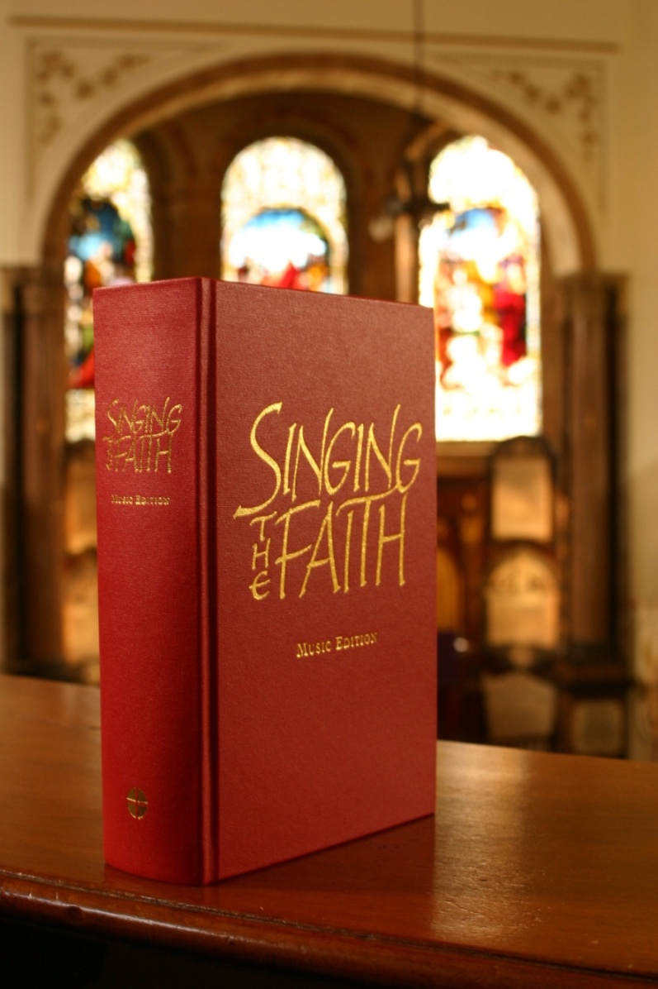
Singing the Faith
Your worship companion for the journey of Christian discipleship

Slide 2
At a glance
Provides a rich diversity of classic and contemporary worship materials – conveniently brought together all in one place.
Contains hymns and songs suitable for congregational singing and accessible to musicians of varying abilities.
Embodies the depth and breadth of Methodist theology today.
Encompasses a wide array of topics and themes, arranged within sections according to Christian experience.
Expresses the Christian faith through modern and traditional language.

Slide 3
Worship styles and traditions
Provides a rich diversity of worship materials – conveniently brought together all in one place.
Carefully balances classic and contemporary styles
The contents are drawn from a wide range of sources
Crosses ecumenical boundaries with material from, for example,
the Iona and Taizé traditions, as well as the world-wide Church
Includes liturgical settings, canticles and psalms
Notes:
The contents of Singing the Faith have been chosen from the extraordinary and sometimes bewildering variety of worship music now available. The Music Resources Group reviewed over one hundred collections published since 1983 (when Hymns & Psalms was launched), examined thousands of texts, and weighed the merits of each. Their long and thoughtful consideration ensures that you now have a collection that reflects the rich diversity of worship material available today – conveniently brought together all in one place.
Carefully balances classic and contemporary styles, including: Charles Wesley, Bernadette Farrell, Fred Pratt Green, Ruth Duck, Shirley Erena Murray, John Bell and Graham Maule, to Matt Redman, Tim Hughes, Stuart Townend, Keith and Kristyn Getty
The contents are drawn from a wide range of sources including Hymns & Psalms, Songs of Fellowship, Complete Mission Praise, Church Hymnary 4, Common Ground, The Source, Kidsource, Out of the Ark Music, Sing Glory, Songs for the New Millennium and others
Crosses ecumenical boundaries with material from, for example, the Iona and Taizé traditions as well as the world-wide Church – from Africa, North and South America, Asia and Australasia, as well as Europe
Includes liturgical settings, canticles and psalms

Slide 4
Musical arrangements
Contains hymns and songs suitable for congregational singing and accessible to musicians of varying abilities.
Well-known associations of texts and tunes have been preserved
Descants to a number of popular hymns have been provided
Over 100 new arrangements for modern songs and hymns have been made
Over 40 newly-composed tunes have been included with the aim of providing stylistic variety
Notes:
The guiding principle of the Music Resources Group has been to ensure that all items are suitable for congregational singing and that tunes are presented and arranged so that they are accessible to musicians of varying abilities while maintaining the integrity of the original composition.
Well-known associations of texts and tunes have been preserved
Descants to a number of popular hymns have been provided
Over 100 new arrangements for modern songs and hymns have been made
Over 40 newly-composed tunes have been included with the aim of providing stylistic variety

Slide 5
Theology
Embodies the depth and breadth of Methodist theology today.
The collection has been meticulously scrutinised by the Faith & Order Committee and Network on behalf of the Methodist Conference
The book expresses the core beliefs of the Christian faith and distinctive Methodist values and theology; particularly assurance, perfect love, social holiness and the emphases of Arminianism
The balance of the collection is towards hymns (old and new) that ensure a depth of theology appropriate for personal reflection, meditation and prayer.
Notes:
The hymns and songs have been chosen not just as instruments of worship but for the teaching they contain. They embody the depth and breadth of Methodist theology today.
The collection has been meticulously scrutinised by the Faith & Order Committee and Network on behalf of the Methodist Conference.
The book expresses the core beliefs of the Christian faith and distinctive Methodist values; particularly assurance, perfect love, social holiness and the emphases of Arminianism
The balance of the collection is towards hymns (old and new) that ensure a depth of theology appropriate for personal reflection, meditation and prayer

Slide 6
Topics and themes
Encompasses a wide array of topics and themes, arranged within sections according to Christian experience.
The collection touches upon Christian as well as human experience; from birth, death, work and marriage to calling, repentance and reconciliation
It contemplates abiding and contemporary world issues like peace, justice and care for the environment
In keeping with tradition, its topics and themes are arranged both for ease of use and guiding faith
Notes:
Singing the Faith adheres to the approach of its predecessors by containing:
“... all the important truths of our most holy religion, whether speculative or practical; yea, to illustrate them all, and to prove them both by Scripture and Reason: and this is done in a regular order. The hymns are not carelessly jumbled together, but carefully ranged under proper heads, according to the experience of real Christians, So that this book is, in effect, a little body of experimental and practical divinity.” (John Wesley’s preface to A Collection of Hymns for the Use of the People Called Methodists, 1779)
The collection touches upon a wide array of Christian as well as human experience; from birth, death, work and marriage to calling, repentance and reconciliation
It contemplates abiding and contemporary world issues like peace, justice and care of the environment
In keeping with tradition, its topics and themes are arranged both for ease of use and guiding faith

Slide 7
Language
Expresses the Christian faith through ancient and modern language.
Where it could be sensitively done in relation to the context and style of the hymn, gender exclusive language with reference to people has been replaced
‘Thee’ and ‘thou’ have been replaced where the usage is not rhyme-dependant and where such a change does not damage the overall quality of the hymn
Where an author has produced a definitive version of a text that is still in copyright, this has been used
Translations of non-English language hymns and songs have been provided
Notes:
Through its balance of the classic and the contemporary, Singing the Faith will enable you to express your faith through hymns, songs and psalms that use modern as well as traditional imagery and language. A particular focus of the Music Resources Group has been on providing material that will help you to express your faith in words that speak effectively to today’s society.
Where it could be sensitively done in relation to the context and style of the hymn, gender exclusive language with reference to people has been replaced
‘Thee’ and ‘thou’ have been replaced where the usage is not rhyme-dependant and where such a change does not damage the overall quality of the hymn
Where an author has produced a definitive version of a text which is still in copyright this has been used
Translations of non-English language hymns and songs have been provided

Slide 8
Singing the Faith Plus
Singing the Faith is more than a book. It is also a website for musicians and leaders of worship: www.methodist.org.uk/our-faith/worship/singing-the-faith-plus
At Singing the Faith Plus you will find unique indexes, suggestions, and articles to help you choose the right hymns and songs for your needs
You can share your own music, words and opinions, get to know other writers and musicians, and explore new material
To send your own material, ideas and stories for consideration by Singing the Faith Plus, email stfplus@methodistchurch.org.uk

Slide 9
Editions
Since 2011, the range of editions has continued to expand. Full details on www.methodist.org.uk/our-faith/worship/singing-the-faith-plus (‘All the Editions’)
Music
Music (presentation with soft leatherette cover)
Organ edition (in three volumes)
Words
Words (large print)
Words editions for tablets: Kindle and ePub versions
Braille (words only)
Electronic Words – for projection and production of service sheets
Piano Accompaniment CDs

Slide 10
Information and orders
www.methodist.org.uk/our-faith/worship/singing-the-faith-plus For news, events, indexes, articles, interviews and much more
Methodist Publishing:
Tel: 0845 017 8220
Email: resources@methodistchurch.org.uk
Web: www.methodistpublishing.org.uk
Notes:
Visit the dedicated website – www.singingthefaithplus.org.uk
Singing the Faith is published by Hymns Ancient & Modern on behalf of the Methodist Church in Britain. Methodist Publishing is acting as a point of contact for direct orders and enquiries from Methodist Churches. You can contact the customer services team on:
Tel: 0845 017 8220
Email: resources@methodistchurch.org.uk
Web: www.methodistpublishing.org.uk

