Slide 1
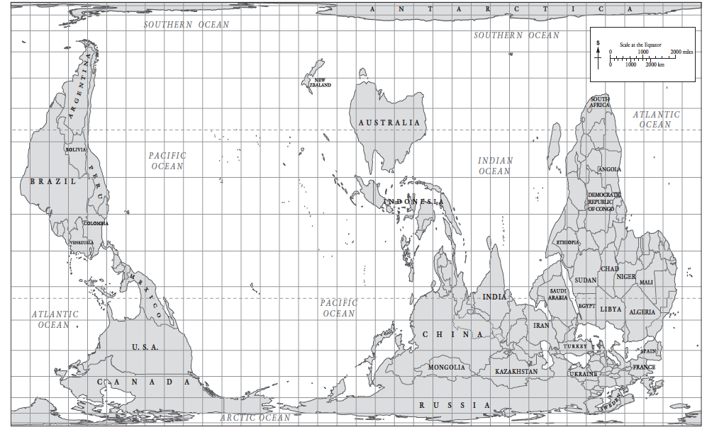
"Hobo-Dyer Projection Worldmap," in World History Commons, https://worldhistorycommons.org/hobo-dyer-projection-worldmap [accessed January 11, 2022] Map and caption printed in Northrop, Douglas, ‘Introduction: The Challenge of World History’, in A Companion to World History, Northrop, Douglas (ed), Chichester, 2012, p. 2

