Slide 1
Youth president visit to the Methodist Church in Zimbabwe With Megan Thomas (youth president) and Lynne Norman (Church and Community Development Officer) Thursday 20 November- Wednesday 3 December 2014
By Syntiche Dedji

Slide 2
Aims of visit
To allow the Youth President (Megan Thomas) to experience Methodism in a different context.
To build links with Children and youth in the Methodist Church in Zimbabwe, and to gain a better understanding of children and youth work in the Methodist Church in Zimbabwe and the similarities/ differences with children and youth work in the Methodist Church in Britain.
To gain an idea of what Methodism is like in Zimbabwe and how the Methodist Church in Zimbabwe (specifically the youth department) functions.
To visit one of the Methodist Church in Britain’s partner organisations (Matthew Rusike Children’s Home), and to gain an understanding of some of the ways in which they work.

Slide 3
Itinerary
Fri 21 Nov 2014 Arrival
Sat 22 Nov 2014 Relaxed lunch executive- We will meet with the Connexional youth council executive over lunch to outline the programme
Sun 23 Nov Service at Glenview
Afternoon Vavambi Y.A (To meet the young adults there)
Mon 24 Nov Travel to Byo via Great Zimbabwe (meet greater Bulawayo youth at Main Street, sleep at Lalani lodges)
Tues 25 Nov Hwange tour (National park) and sleep at Hwange national Park
Wed 26 Nov Tour vic falls and sleep at Victoria falls rest camp
Thurs 27 Nov Travel to Gweru (and visit the youth centre) and sleep@ Ndhlela centre
Fri 28 Nov Travel Pakame high school (and meet the students there) & Vungwi
Sat 29 Nov Travel to Harare and visit Chihota, one of their rural circuits, sleep there
Sun 30 Nov Service at Chihota and meet the youth
30 Nov Travel to MRCH
Mon 1 Dec Relax at Matthew Rusike, followed by farewell dinner with Harare youths at Borrowdale
Tues 2 Dec Departure

Slide 4
Arrival
We arrived in Harare on Friday 21 November exhausted, but excited, and were greeted at the airport by members of the Methodist Church in Zimbabwe Youth Department, by whom we were hosted. Although the Methodist Church in Zimbabwe gained autonomy in 1977, their youth department is slightly younger. They are due to celebrate their 25th anniversary in 2016.
We were met at the airport by Brenda, Youth President for the Methodist Church in Zimbabwe (MCZ), Bruce, who was at the time Treasurer of the youth department of MCZ, but who was voted in as vice- president during the course of our stay; Rev Vuta from the Chihota circuit , and Mr Tinashe, the Connexional driver.
During the ride to Matthew Rusike Children’s Home (MRCH), where we would be accommodated for the first three days of our stay, we were given a crash course in Shona, one of the main languages spoken in Harare. It was a journey filled with lots of laughter, and we all immediately got on. This is something that was to continue throughout the course of our visit, and which would also characterise our time in Zimbabwe.

Slide 5
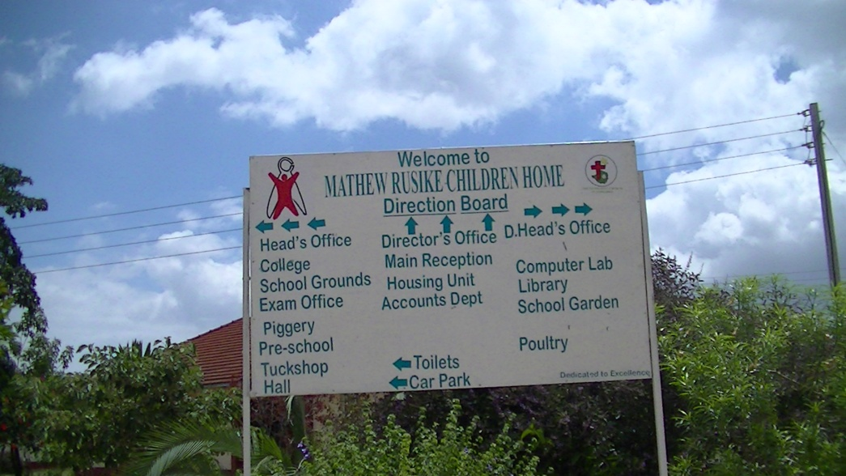
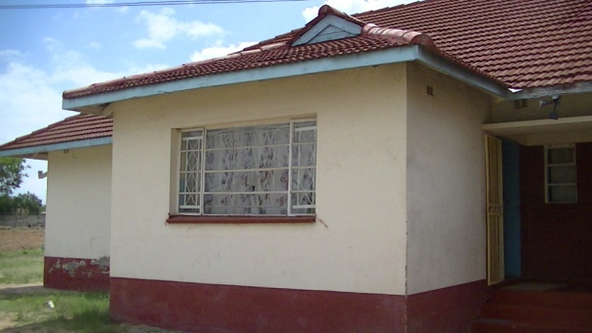
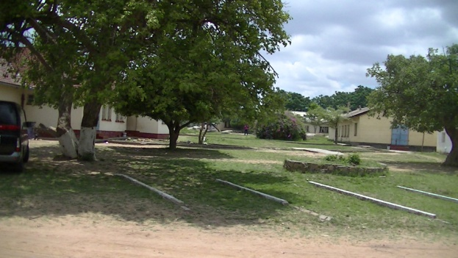
Matthew Rusike Children’s Home
At the MRCH we were greeted by Margaret Mawire, the director of the home. In Zimbabwe the polite way to address elders is by calling them mama or baba, (mother or father). True to this title, Margaret Mawire was a quiet motherly presence- gentle but firm. We heard numerous times both before and during our trip that the centre was in the best condition it had ever been. However, it had some basic needs, such as a need for running water and electricity. Each morning and evening the children fetched water from a nearby well, and an electric generator funded by a grant from MCB helped them cope with the erratic supply of electricity.
Despite these challenges the Home seemed well organised and ran smoothly. The children were well disciplined and respectful, and carried out their chores with no complaint- just singing! It was obvious from the way the children and young adults addressed Margaret Mawire that they had a lot of respect for her.

Slide 6
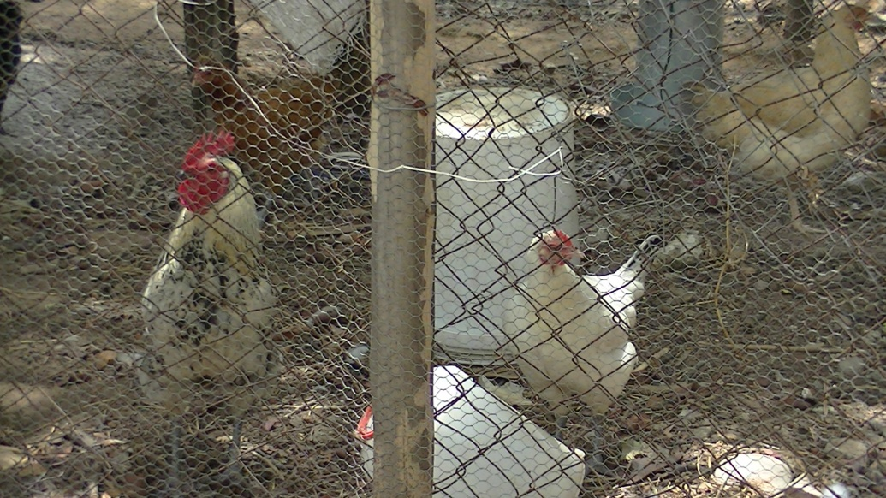
Matthew Rusike Children’s Home
Whilst touring the home, one of the house mothers informed us that they work very hard at MRCH to make sure the young people are prepared for adult life and for living independently. Therefore boys and girls alike are taught to cook, clean and do the laundry, in order to facilitate integration in the outside community when the time comes for them to leave.
Some of the projects carried out at the Matthew Rusike Children’s home include breeding pigs and chickens, and growing various vegetables such as greens, butternut squash, tomatoes, corn etc and herbs.

Slide 7
Glen View Methodist Church
On Sunday morning we went to Glen View Methodist Church where we had our first real experience of worship in a Zimbabwean Methodist church.
The congregation was predominantly female, the majority of whom were in uniform. The Women’s Fellowship was attired in red and white, and the Girls Christian Union in white and red. The boys Christian Union had white blazers and ties with their logo.
The service was lively, with a lot of singing and praise and worship, and a very impressive choir. We were especially impressed with the older ladies who were leading the dancing and singing at the beginning of the service. The main instruments used during the service were maracas, but the singing was so melodic that we did not even notice the lack of a piano or organ until the end of the service!

Slide 8
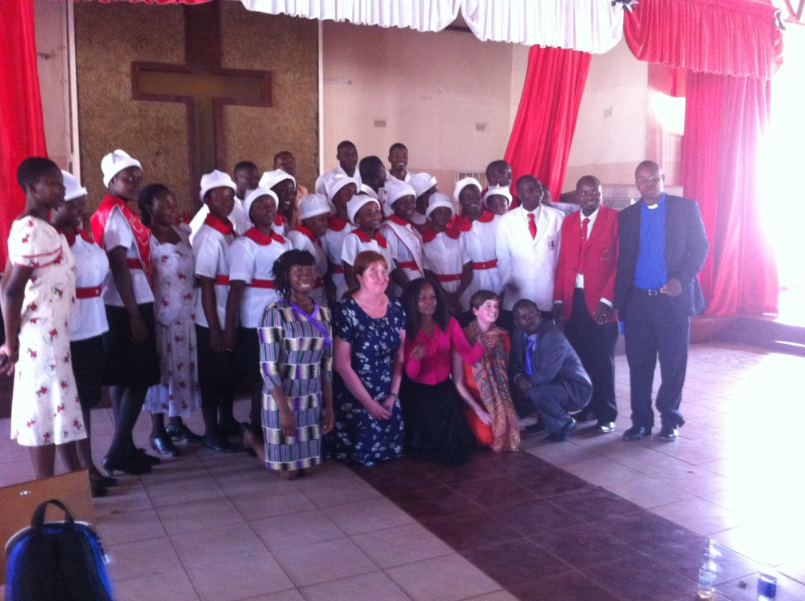
Glen View Methodist Church
During the course of the service we had the opportunity to introduce ourselves to the congregation, followed by a question and answer session at the end of the service with the church youth.
This was one of the highlights of the trip. We were all amazed to discover that young people in Britain had more in common with young people in Zimbabwe than we thought, especially in regards to the challenges faced by both groups.
We were told unemployment is one of the biggest problems currently faced by young people in Zimbabwe today. Although they have a literacy rate of over 90% (of which they are very proud), and the vast majority of those we met in the church were either graduates, studying at university or planning to attend university, at between 80-90%, the unemployment rate is nearly equally as high. Other challenges include peer pressure, drug abuse, reputation, and child trafficking.

Slide 9
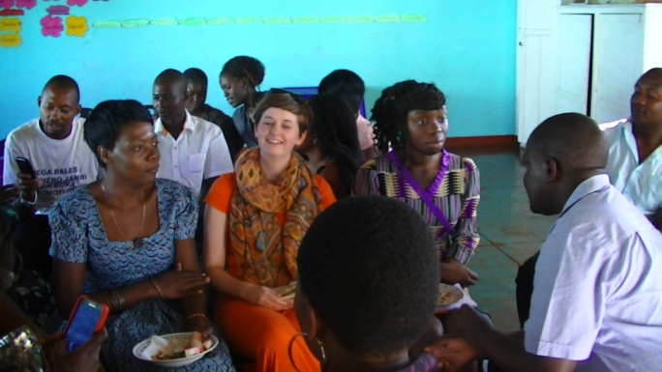
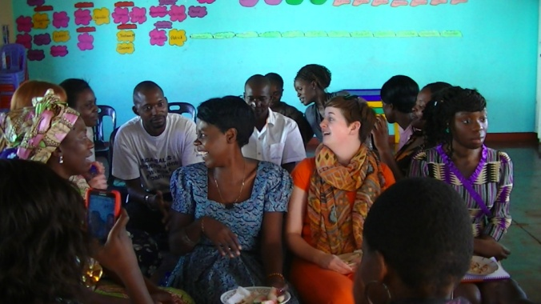
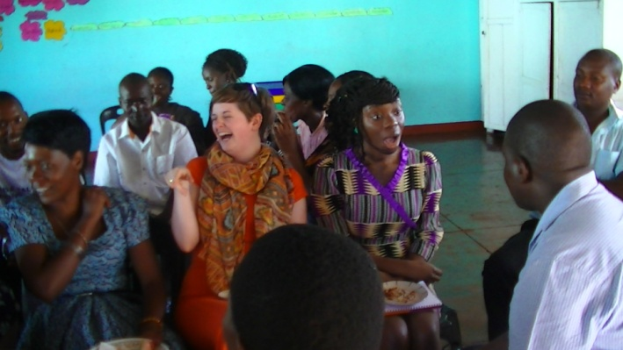
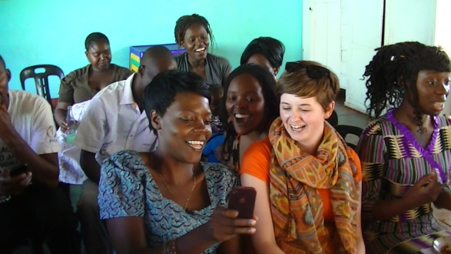
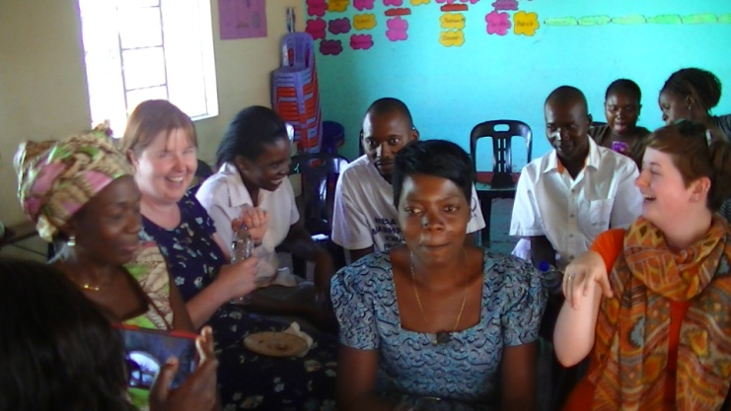
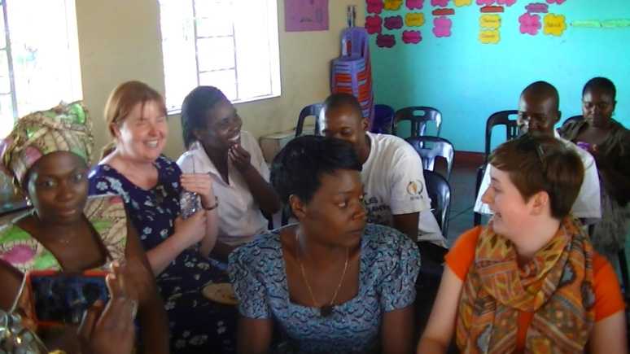
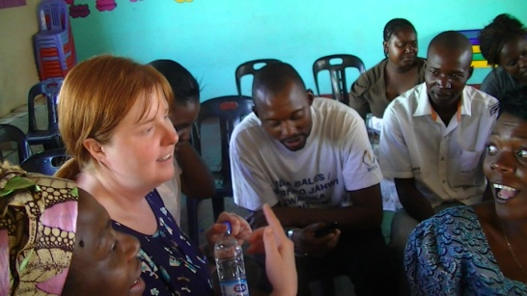
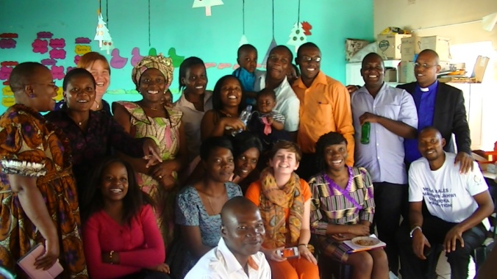
Vavambi Young Adults
The Vavambi Young Adults group, based in Mbare is a group of young adults comprised of people aged 23-35. The group was started because young people between these ages did not feel they had a place in the church; they went to church and then went home. Made up of predominantly young professionals, they did not feel as if any of the existing organisations for young people in the church catered to their needs. The group was started to fill this missing age gap. The formation of the group has caused some controversy with a few saying that they will destroy the other groups.

Slide 10
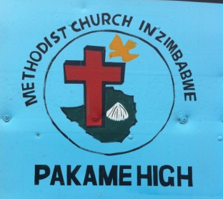
Pakame High School
The visit to Phakame High School was another of the highlights of the trip. Upon arrival, the headmaster and other faculty members were very excited to meet us. Apparently the students were in need of encouragement, and they had been told we were all amazing inspirational speakers and motivators! This was a bit daunting, especially when we entered the hall and were faced with over 400 students eagerly waiting to hear what we had to say.
Our presentation was delivered in the form of an interview. There were 7 questions which we answered in turn. The questions included, “How did you get to where you are now?” and “What are some of the challenges you have faced?”
Afterwards, we were given a tour of the school, which included a bakery where they make their own bread, the kitchen where they prepare unbelievable amounts of sadza, the poultry pens and the sewing rooms.

Slide 11
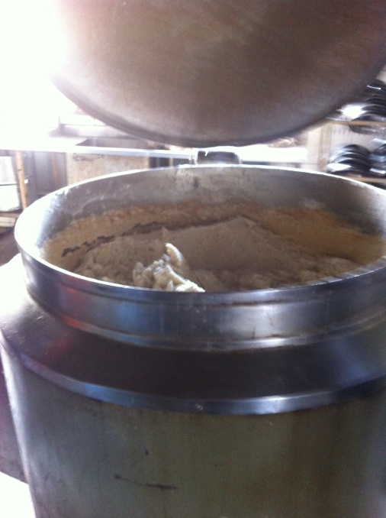
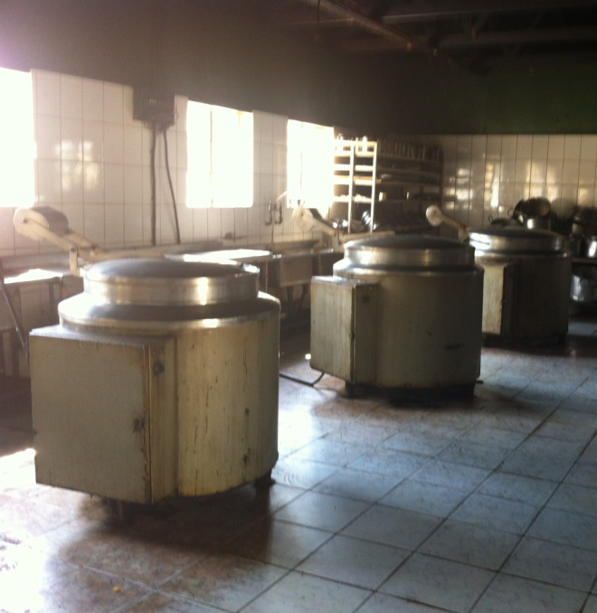
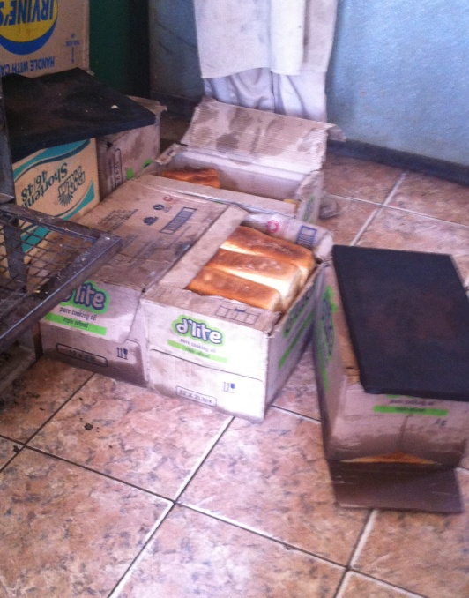
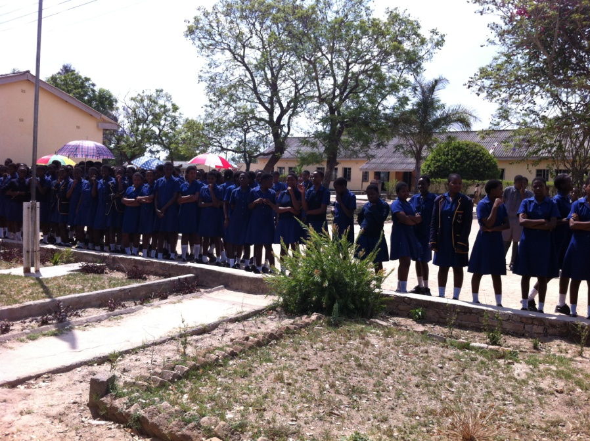
Huge vats of sadza
Boxes of freshly baked bread

Slide 12
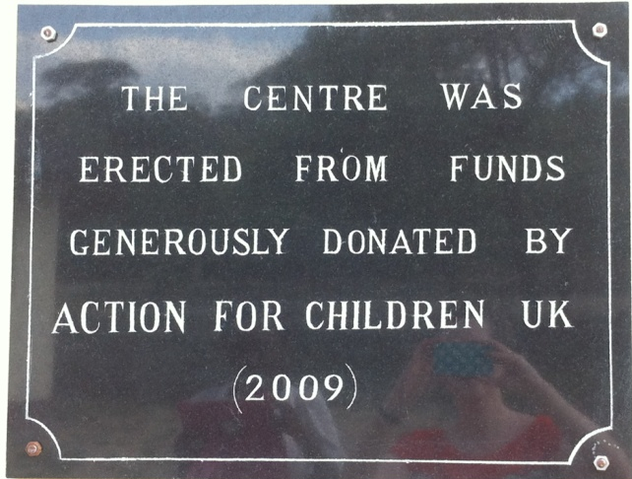
Matthew Rusike Satellite home
From Pakame we visited one of the Matthew Rusike satellite homes, a safe house situated in a very rural location, where vulnerable children thought to be at risk are taken.

Slide 13
The Youth Council
The Youth Council took place from Friday 29- Sunday 30 November at the Ndhlela Centre. The Ndhlela centre is a centre of hospitality which belongs to the youth department. They take room bookings, host conferences and also breed chickens. The centre should therefore be a source of income. However, during the youth council it emerged that the centre was facing financial problems. They owe a backlog of staff salaries, but are not making enough money to be able to pay them all. When we spoke to Noel about this in more detail it emerged they were in a bit of a catch 22. We thought this situation with the Ndhlela centre was very unfortunate as we felt they had a really great resource available to them, which utilised correctly, could be a great asset to the youth department.
During the Youth Council, amongst other things, all the Districts presented a report of the year and of the activities they carried out, the challenges they faced, and delivered a financial breakdown. The other districts then accepted/ discussed this report. I was impressed by this system of reporting as it promoted accountability, and made sure the districts were kept up to date with what was happening outside their district. It is also during the youth council that the calendar is drawn up for the year, with major youth activities that will take place in the various districts throughout the year. This is in order to avoid event clashes, hence allowing maximum attendance to events.
I was impressed by the youth council. It was very transparent and accessible. We were able to fully understand and participate in nearly all aspects of the youth council, to ask questions regarding their finances and to receive honest answers. This is something I felt would be hard to come by in the UK, where a lot of similar meetings can be quite opaque and it can be very hard for strangers to fully understand the proceedings.

Slide 14
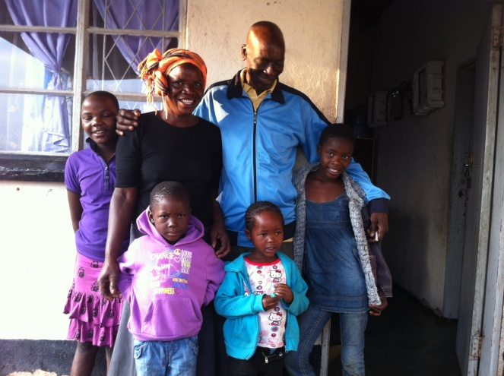
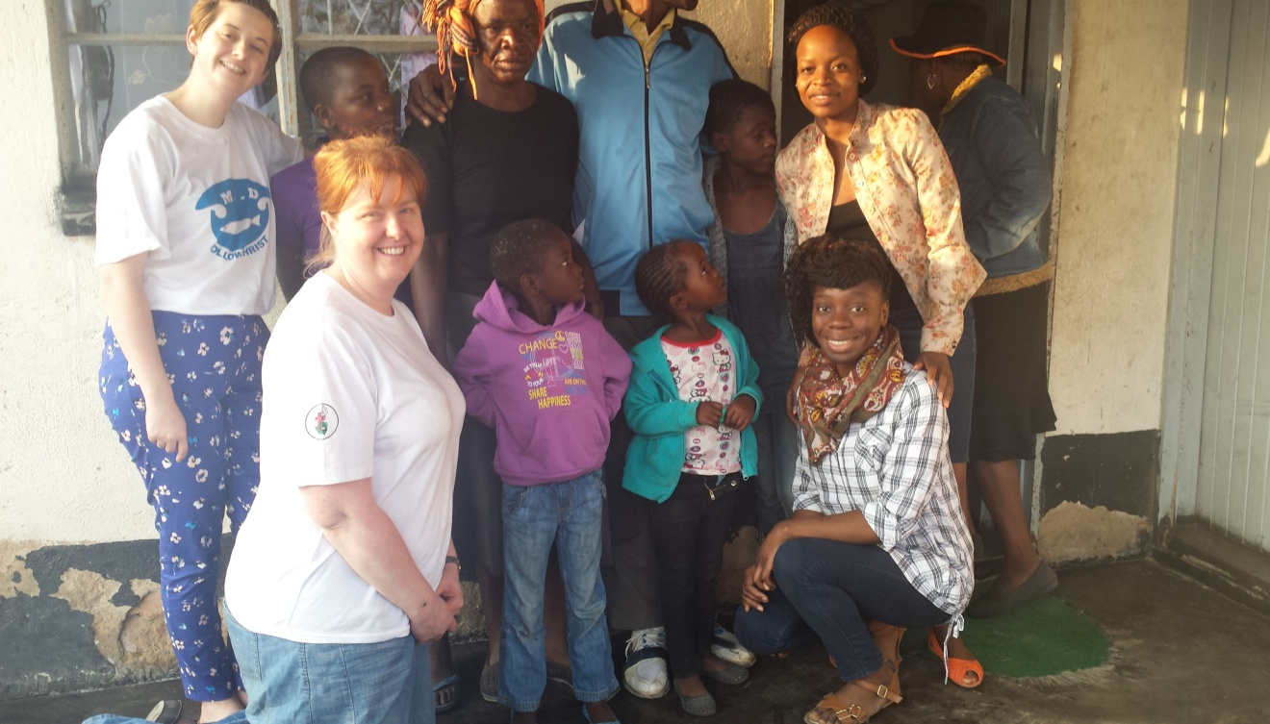
Chihota- Muda Village
Saturday 29 November we travelled to Chihota, a rural village not far from Harare, and stayed in Muda village. This was something we had all been a bit nervous about beforehand, as we did not know what to expect.
On arrival however, we were warmly greeted with singing and dancing, and soon settled in. We had a great evening speaking and laughing with our host family, and learning about traditions in rural households, learning how to cook sadza, and singing and dancing around the hut with drums and maracas. After dinner we all sat around the fire and listened to gogo (grandma) as she told us Zimbabwean folk tales, and then settled down to sleep on the floor of the hut.

Slide 15
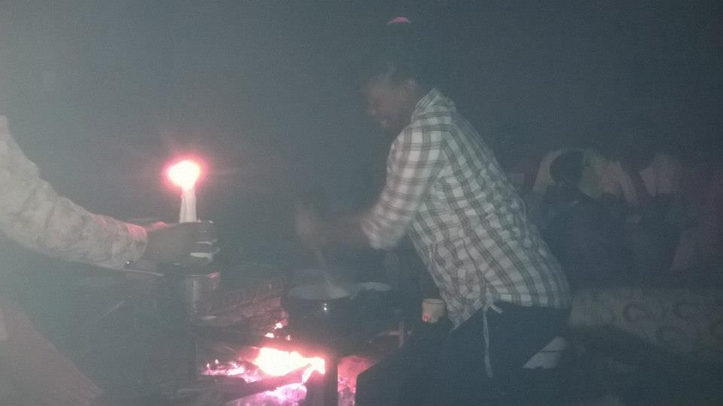
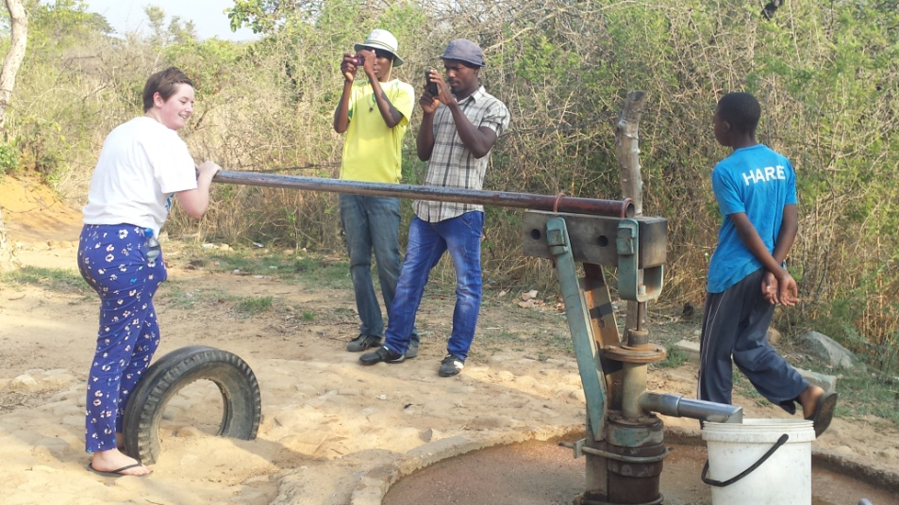
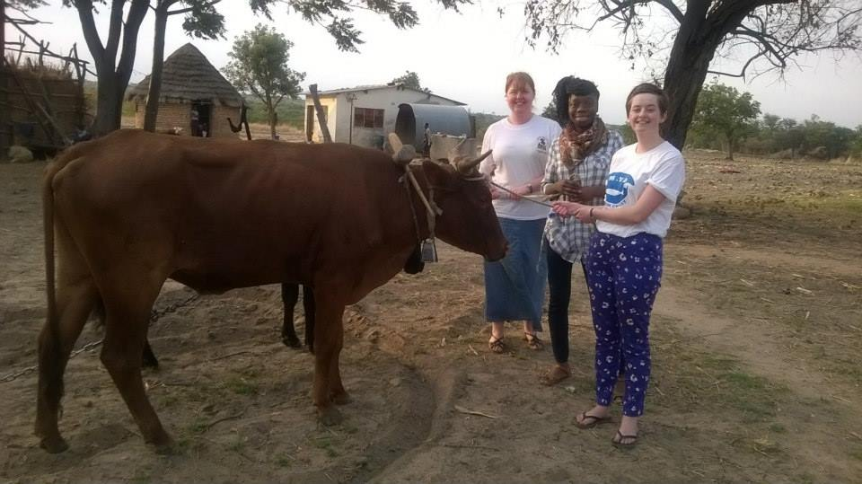

Slide 16
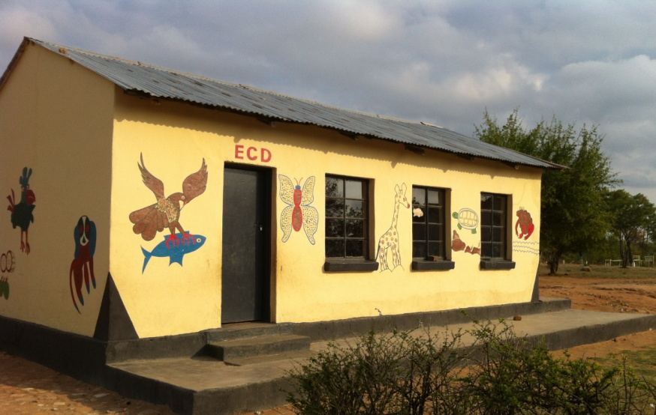
The following morning we were woken up at 5am (having been allowed to sleep in as we were guests), to go ploughing. We then pumped water from a well and went on a tour of the village which included their primary school (the children proudly pointed out which pictures they had drawn on the side of the school building), a secondary school in the process of being built, a church and a medical centre.
I don’t think I will ever forget my stay at Chihota. Especially one moment during the evening, when I just sat listening to the chatter and laughter around me, thinking about how this family so generously opened their homes to us, and then later listening to the folk tales. I felt it truly was a once in a lifetime opportunity which I was blessed to have experienced.

Slide 17
Final Reflections
Our time spent in Zimbabwe was full on and filled with lots of travelling. Travelling on bumpy roads, smooth roads, and no roads. We spent time with the Girls Christian Union, the Boys Christian Union, the Young Disciples, and the Young Adults. We saw breathtaking mountain views, sunsets, heard amazing singing, and danced. A lot. It was a time of new experiences, of excitement, admiration, of thankfulness, of humility and of worship. But one thing that was consistent throughout all of this was laughter and fellowship. And it is these two words that characterise for me, our visit to the Methodist Church in Zimbabwe. The welcoming and generous spirit of those we met is something that really touched me, challenging me to re-think how I welcome and relate to people here in the UK.
I was also marked by the confidence and freeness of young people in Zimbabwe, who were not at all afraid to stand up and preach, sing or dance. Their example taught me a lot about boldness, and gave new meaning to the term “being free in the Lord”.
We were genuinely sad to leave Zimbabwe and those with whom we had spent the past 14 days, because as Lynne so correctly said, we felt as if we had not only made friends, but best friends.

Slide 18
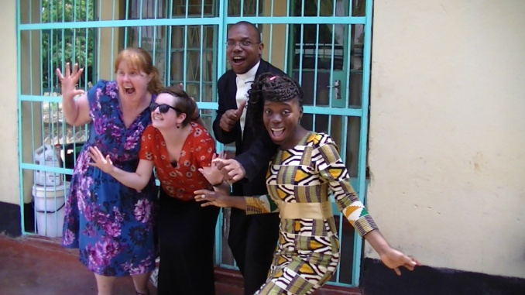
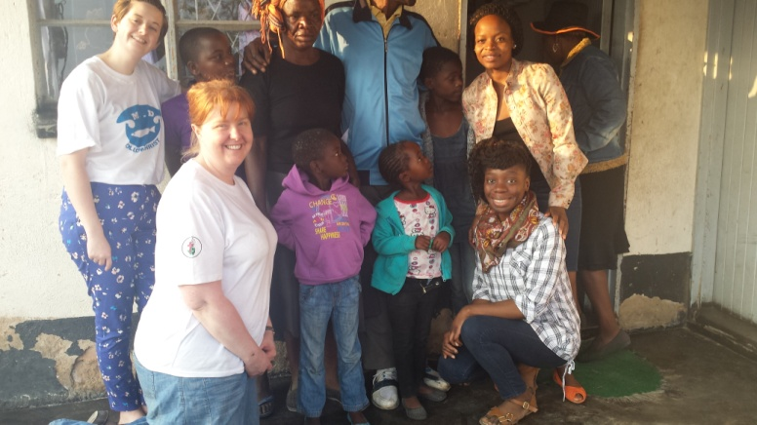
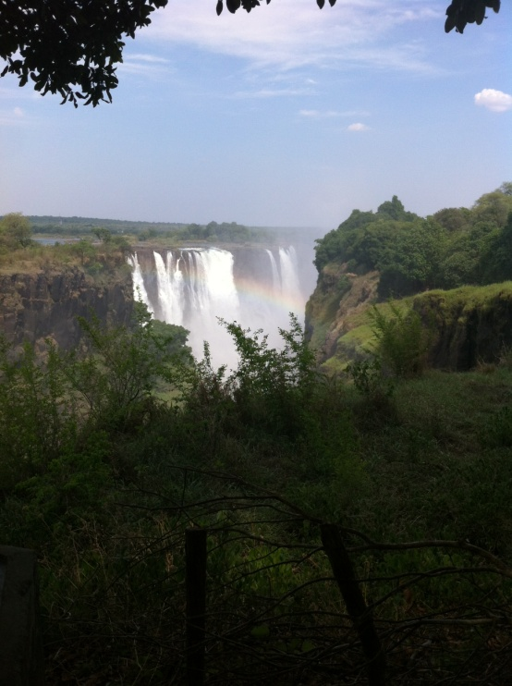
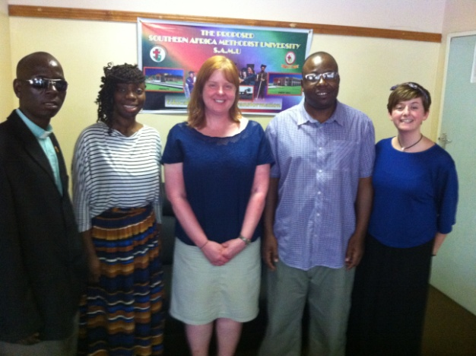
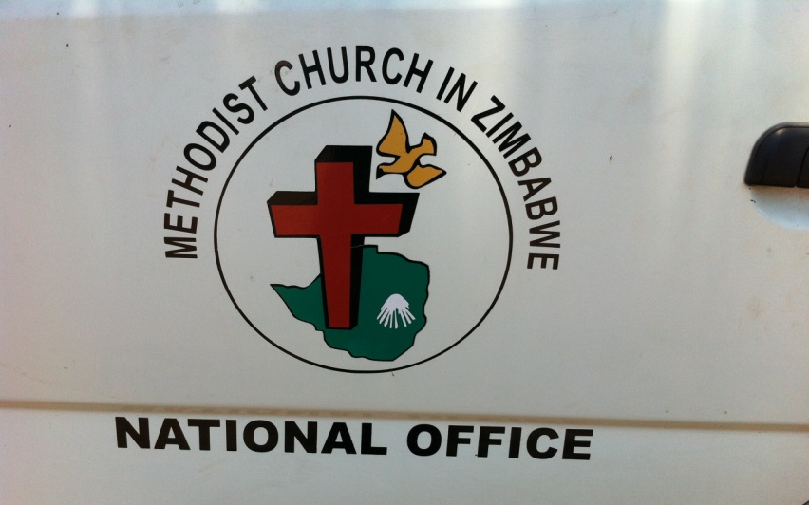
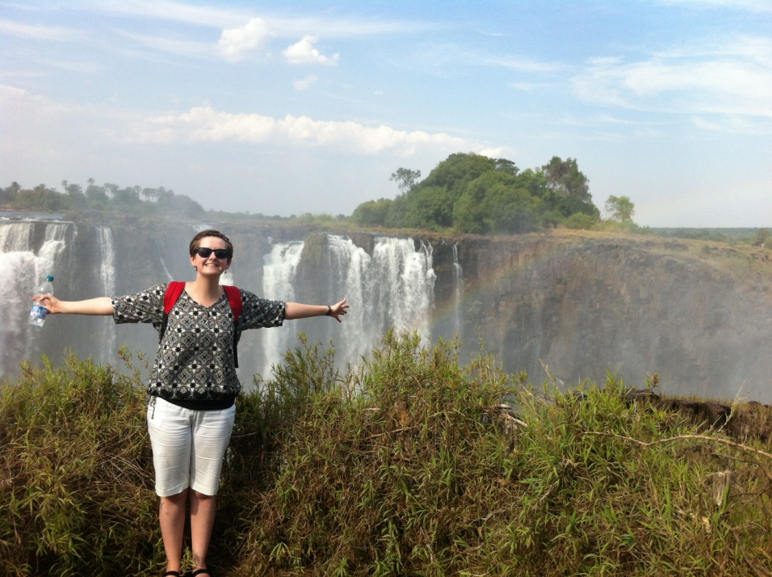
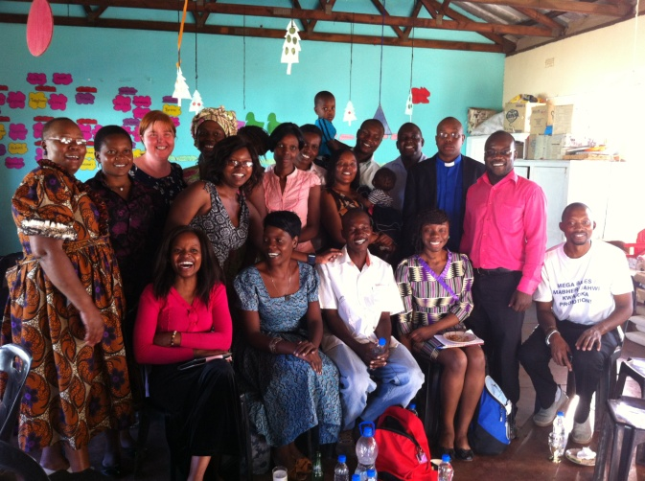
Notes:
Both Meg and Synt

