Slide 1
These slides accompany Service 2
A Local Arrangement Service
There are explanatory notes for the leader in the Global Relationship Worship Resource Pack, which you can download from the Methodist Church website.
You can edit slides and insert hymn lyrics if you have the correct CCLI licence for your church or venue.

Slide 2
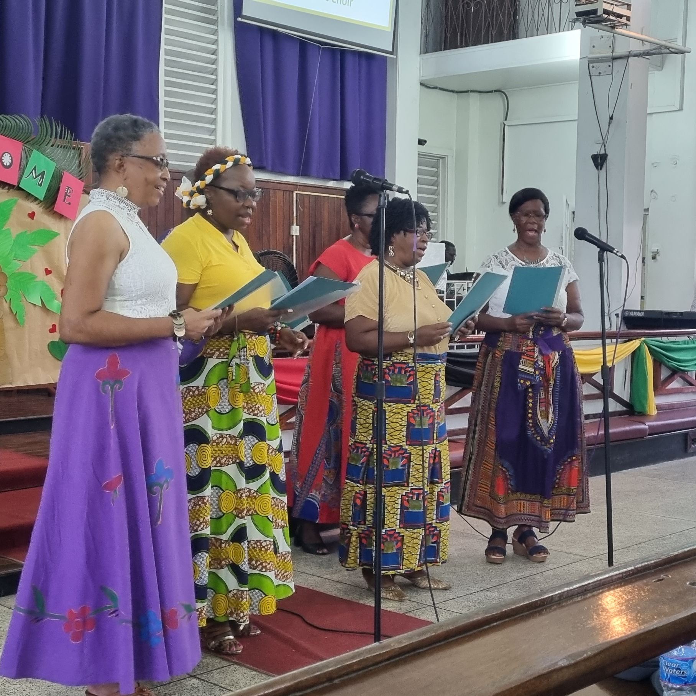
The Greatest Commandment Worship for the presidential theme 2022/2023

Slide 3
WELCOME AND CALL TO WORSHIP
Welcome to worship today. We will be thinking about this year’s presidential theme, ‘The Greatest Commandment’, from a global perspective.
In 1 Corinthians 13:13, it says: “And now faith, hope, and love abide, these three; and the greatest of these is love”.

Slide 4
HYMN
Give me joy in my heart (StF 76 or H&P 492)

Slide 5
PRAYERS OF PRAISE AND CONFESSION (1 OF 3)
A prayer of praise; let us pray:
Almighty Creator God
We come with our prayers of praise with all our heart.
With every beat of life within us we bring you praise, remembering the intricate way in which you have made us.
We come with our prayers of praise with all of our soul.
That which makes us, ‘us’ praises you Lord – our spirit is moved by your Spirit in a communion of praise.
We come with our prayers of praise with all of our mind.
Every thought and motivation we give to you and worship you through them, using our gifts and talents to bring you praise in all areas of our life.
We praise you. We love you with all that we are.
Amen.

Slide 6
PRAYERS OF PRAISE AND CONFESSION (2 OF 3)
A prayer of confession:
Lord God, parent, Son and Spirit,
As we draw near to you and we know that you are close, we come and confess.
We confess those times when our heart, our soul, our mind and our strength have not been used in praise of you.
When we have neglected our neighbours around us.
When we have spoken, thought and acted in ways that do not reflect the person of Christ whom we follow.
We are truly sorry.
Forgive us Lord.
(Silence)

Slide 7
PRAYERS OF PRAISE AND CONFESSION (3 OF 3)
Thank you, God, that as we come and confess our wrong to you, we are assured of forgiveness through your Son, Jesus Christ. That we can receive again the promised counsel of your Holy Spirit And live a life centred on and surrounded by you, Creator God. In the name of Christ we pray. Amen.

Slide 8
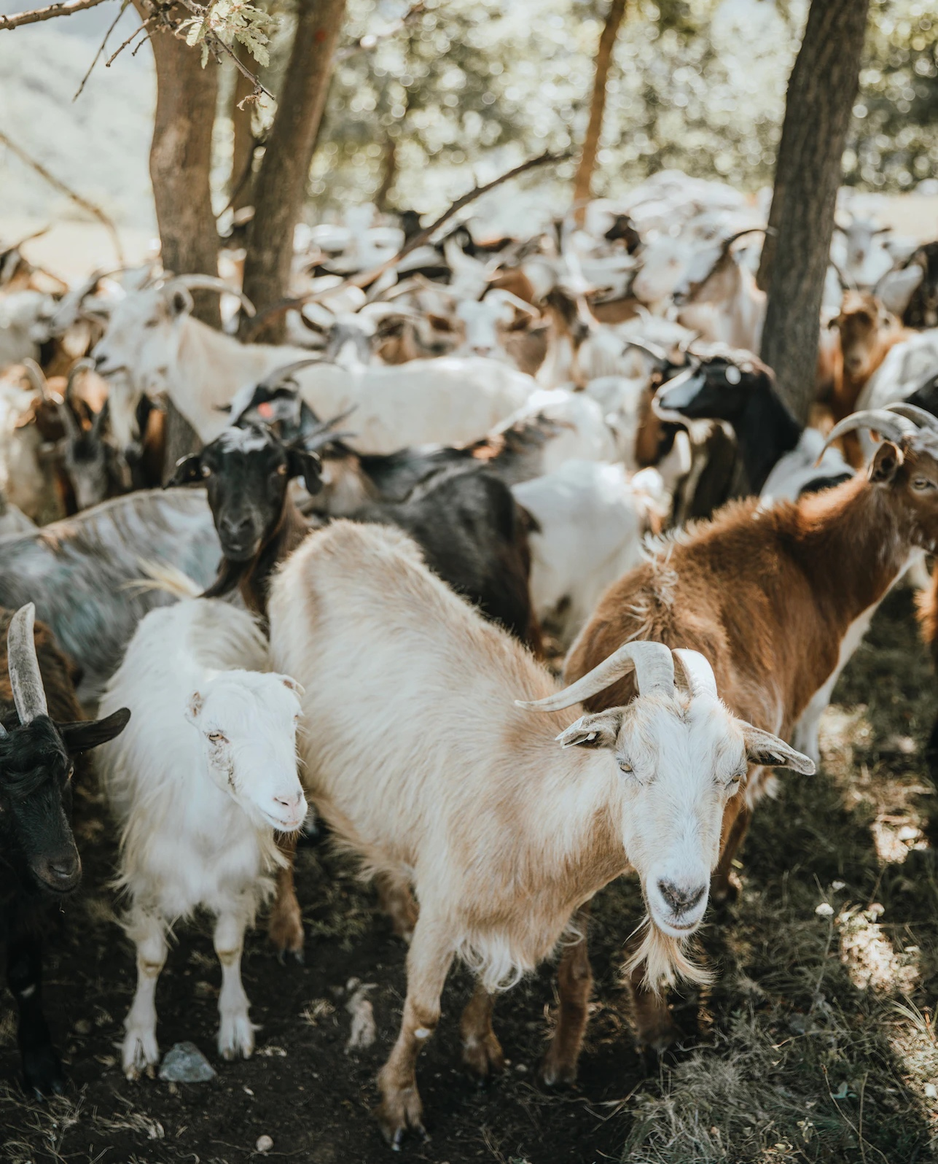
ALL-AGE TALK
A tale of smelly goats and a king

Slide 9
HYMN
Choose from:
God loves you and I love you (StF 614)
What shall our greeting be? (H&P 806)

Slide 10
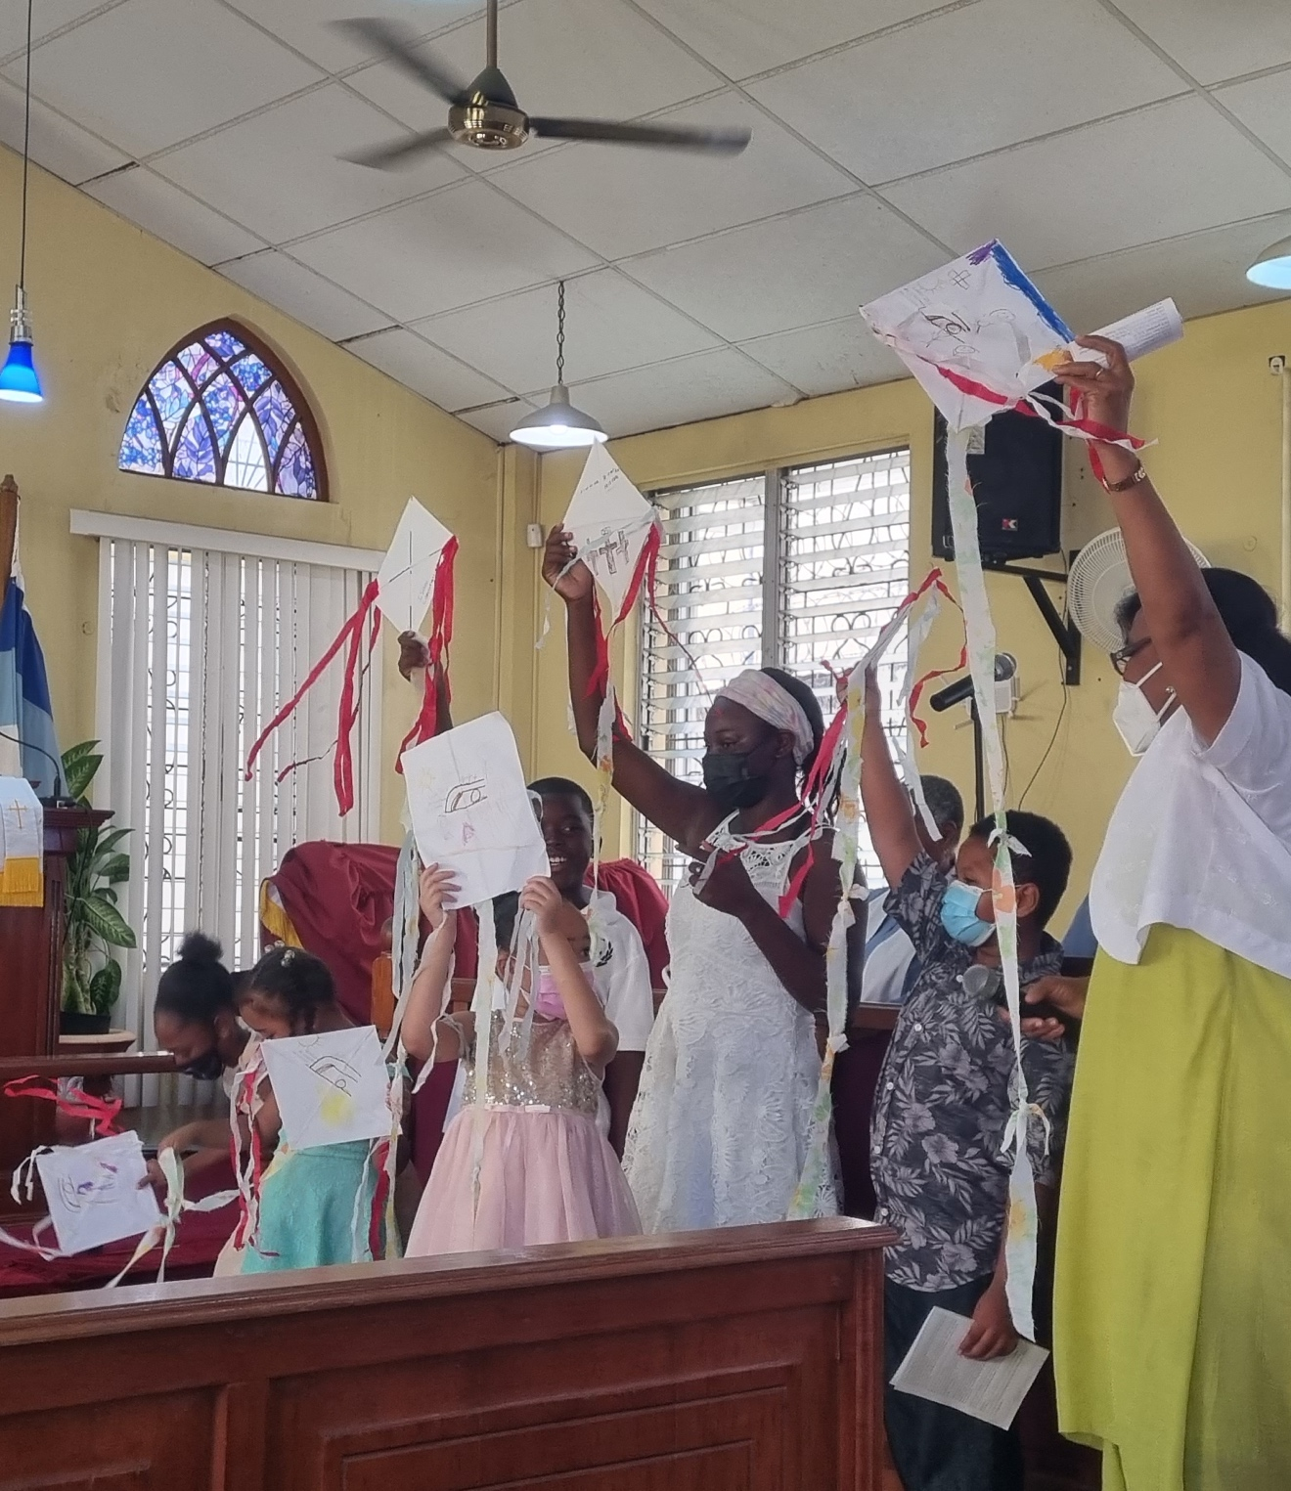
Junior church
begins

Slide 11
READING
When he arrived at the other side in the region of the Gadarenes, two demon-possessed men coming from the tombs met him. They were so violent that no one could pass that way. “What do you want with us, Son of God?” they shouted. “Have you come here to torture us before the appointed time?”
Some distance from them a large herd of pigs was feeding. The demons begged Jesus, “If you drive us out, send us into the herd of pigs.”
He said to them, “Go!” So they came out and went into the pigs, and the whole herd rushed down the steep bank into the lake and died in the water. Those tending the pigs ran off, went into the town and reported all this, including what had happened to the demon-possessed men. Then the whole town went out to meet Jesus. And when they saw him, they pleaded with him to leave their region.
Mark 8: 28–34

Slide 12
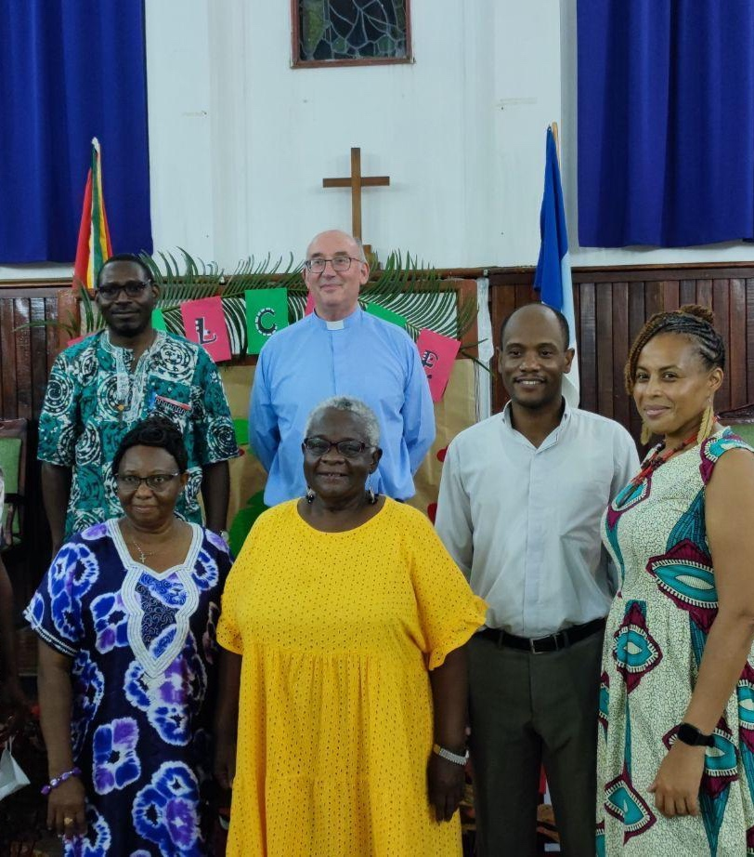
REFLECTION
The presidential theme this year is ‘The Greatest Commandment’. Hear a reflection from the President of the Methodist Conference, the Revd Graham Thompson, from his visit to Guyana.

Slide 13
HYMN
In Christ there is no east or west (StF 685 or H&P 758)

Slide 14
A SERIES OF REFLECTIONS FROM MISSION PARTNERS
Hear a series of reflections from some of our mission partners in Africa on the theme of ‘The Greatest Commandment’.

Slide 15
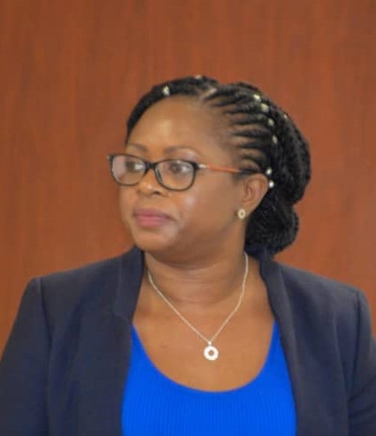
REFLECTIONS
Gina Oliver works as Methodist mission partner in Zambia, serving as Health Secretary for the United Church of Zambia.

Slide 16
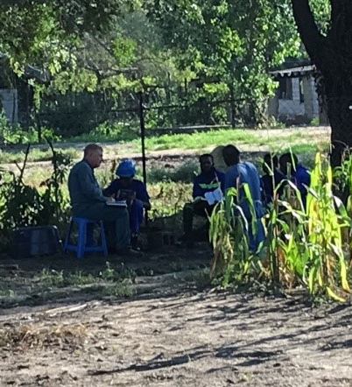
REFLECTIONS
Keith and Ida Waddell are mission partners in Mwandi, Zambia.

Slide 17
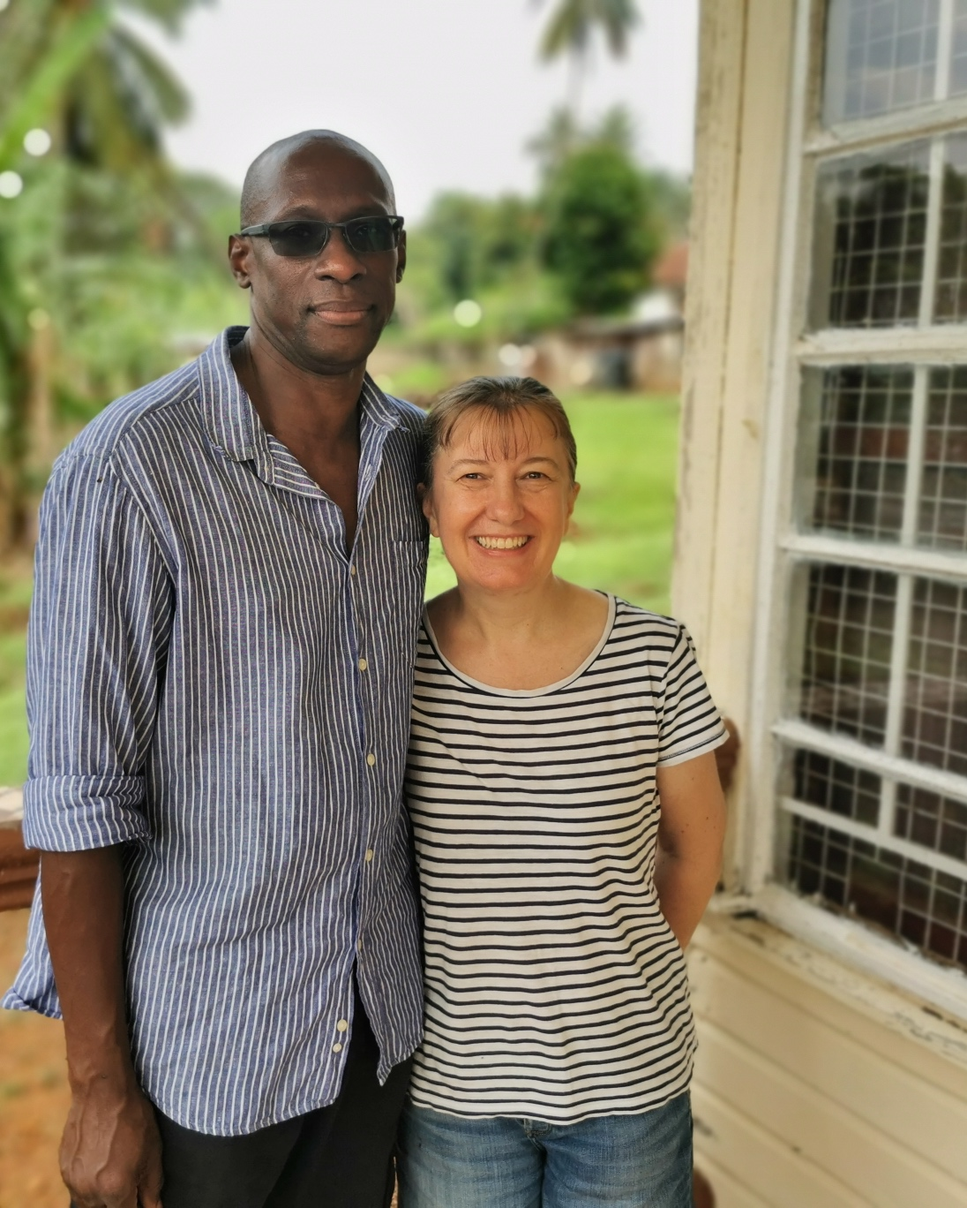
REFLECTIONS
The Revd Sylvester and the Revd Rachel Deigh are serving as mission partners with the Methodist Church Sierra Leone.

Slide 18
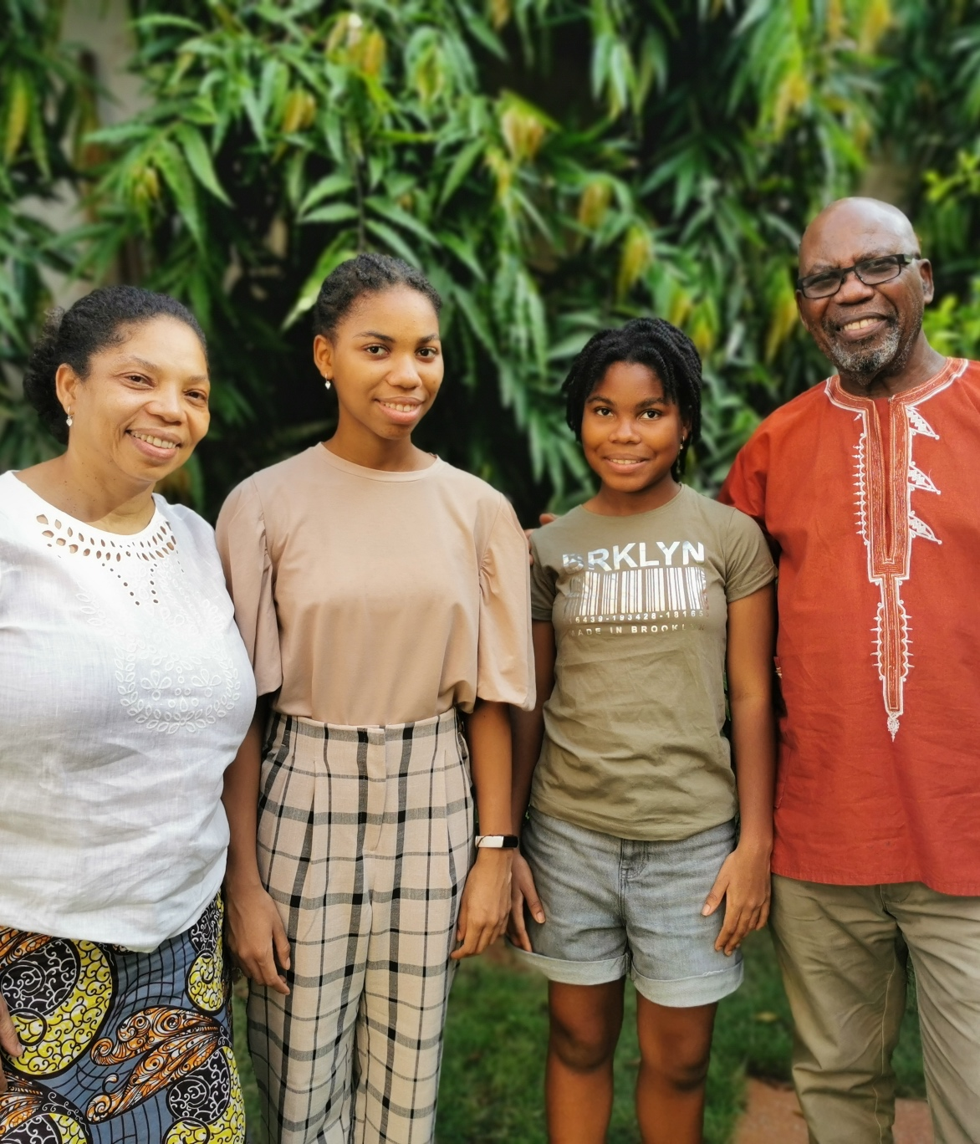
REFLECTIONS
Michael Tettey is a mission partner in Togo, West Africa, with his wife Joanna (also a mission partner) and their teenage daughters, Joelle and Janelle.

Slide 19
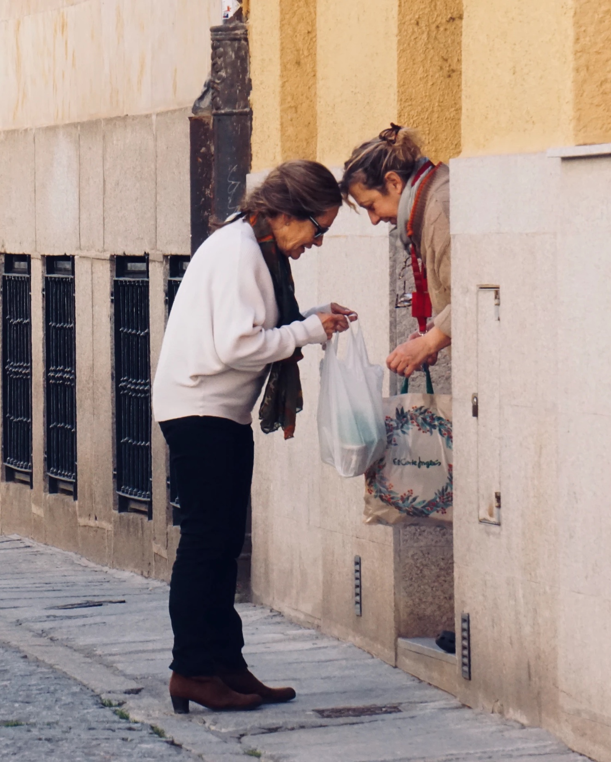
TESTIMONY
Testimony of God’s love through neighbourly kindness.

Slide 20
HYMN
Choose from:
When I needed a neighbour (StF 256)
Jesu, Jesu (H&P 145)

Slide 21
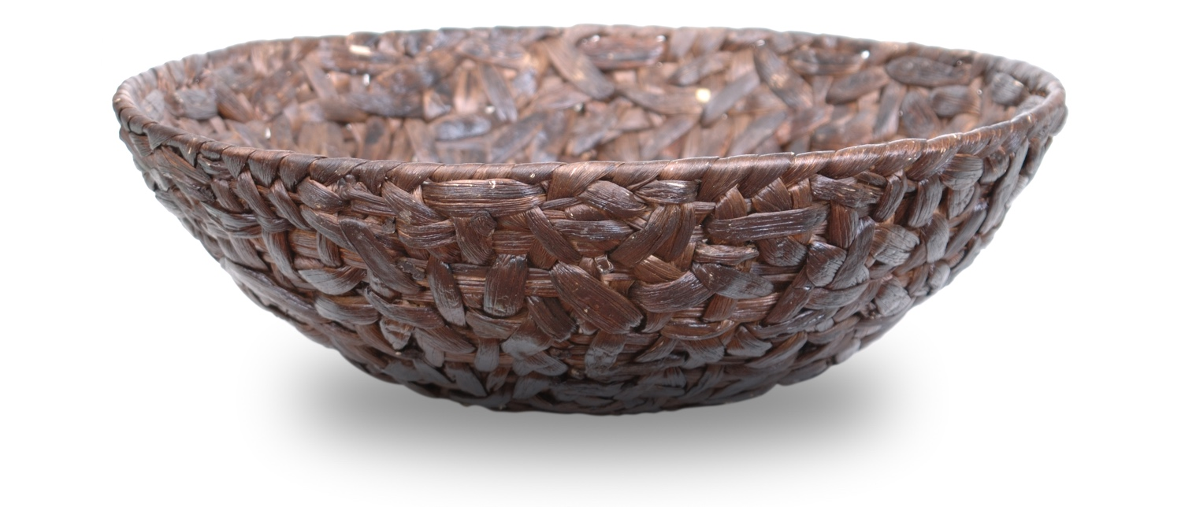
OFFERING

Slide 22
PRAYERS OF INTERCESSION AND THE LORD’S PRAYER
When you hear, “We pray”
Please respond by saying “Your kingdom come”

Slide 23
HYMN
The right hand of God (StF 715 or H&P 408)

Slide 24
BENEDICTION
May the grace of our Lord, Jesus Christ, the love of God, and the fellowship of the Holy Spirit, be with us all, evermore. Amen.

Slide 25
GLOBAL RELATIONSHIPS AND THE WORLD MISSION FUND
Methodists have always shared God’s love and their faith with those they meet and work alongside across the world.
For more information visit: www.methodist.org.uk/global-relationships

Slide 26
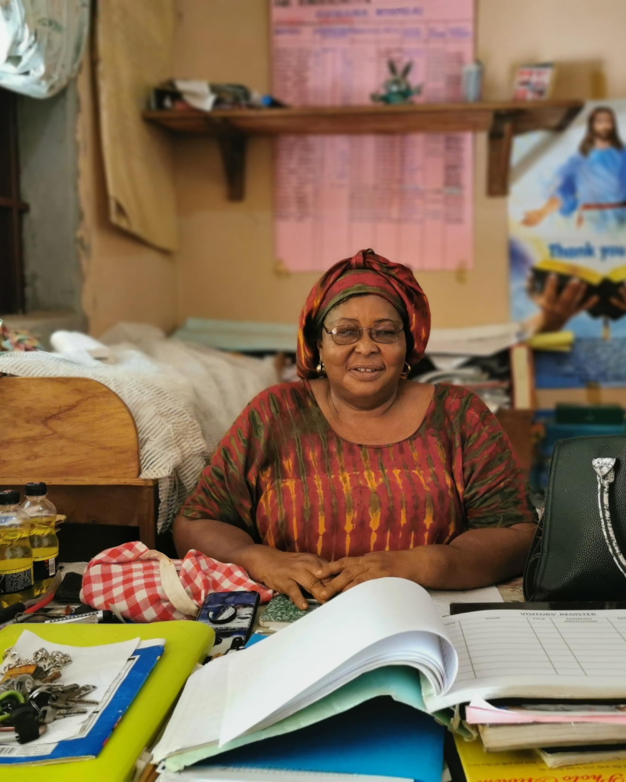
THE GAMBIA
The World Mission Fund supports the Methodist Church The Gambia to carry out its educational ministry. This Methodist School in Brikama continues to leave a legacy of Methodism in education, ecumenicalism and interfaith relationships.

Slide 27
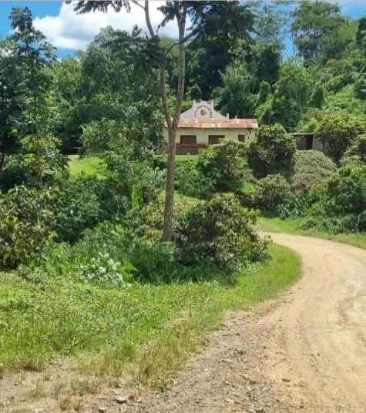
BOLIVIA
The World Mission Fund supports the Evangelical Methodist Church in Bolivia in distributing medicine, school uniforms, school equipment and smartphones to vulnerable communities affected by Covid-19.

Slide 28
SRI LANKA
The World Mission Fund supports the Methodist Church, Sri Lanka in providing food and medical supplies for families affected by the economic crisis in Sri Lanka, as rising prices and shortages make essential goods, such as food, cooking gas and medicine, harder and harder to obtain.

Slide 29
HOW TO SUPPORT THE WORLD MISSION FUND
You can give online at:
www.justgiving.com/mcfworldmission/donate
You can also send a cheque
(made payable to 'Methodist Church World Mission Fund') to:
Methodist Church World Mission Fund
Methodist Church House, 25 Marylebone Road
London NW1 5JR
Thank you very much – your generosity is greatly appreciated.
The Methodist Church. Registered charity no. 1132208. © Trustees for Methodist Church Purposes 2022.

