Slide 1
These slides accompany Service 1
There are explanatory notes for the leader in the Global Relationship Worship Resource Pack, which you can download from the Methodist Church website.
You can edit and delete slides depending on which materials you have selected. You can insert hymn lyrics if you have the appropriate CCLI licence for your church or venue.

Slide 2

God’s table: an invitation for all
Worship on the presidential theme 2021/2022

Slide 3
Call to worship
“Ho, everyone who thirsts, come to the waters; and you that have no money, come, buy and eat! Come, buy wine and milk without money and without price”.
Isaiah 55:1 (NRSV)
Let us come to God in worship and thanksgiving.

Slide 4
Opening Hymn/song
Choose from:
As the deer pants for the water
(StF 544)
Great is thy faithfulness
(StF 51 or H&P 66)

Slide 5
Prayers of praise and confession [1 of 7]
Prepared by Barbara Easton, the Vice-President of the Conference
Let us pray together:
Holy and gracious God
Divine mystery, wisdom and truth
You draw us to you in love and gather us together around your Son
We come to you as a church, together, with our work and our story.

Slide 6
Prayers of praise and confession [2 of 7]
We come to you as a community, together - sisters and brothers, siblings, ‘watching over one another in love’
We come to you as ourselves, in this moment, known and loved within your great family
We open our lives before you

Slide 7
Prayers of praise and confession [3 of 7]
Holy and gracious God
God most gracious and most holy
Hear our lament:
For sadnesses that are almost too big to grasp.
For a world that is not as you created it to be;
For society that is not as you purpose it to be;

Slide 8
Prayers of praise and confession [4 of 7]
For this strange last year, when strangeness and sadness have sometimes threatened to overwhelm us.
[Silence]
Hear our confession:
We have struggled to love our neighbour - and we’ve sometimes struggled to love ourselves

Slide 9
Prayers of praise and confession [5 of 7]
We have sought reassurance in the old wineskins rather than the New Wine
We have shied away from your ‘more excellent way’, as ourselves and as your people in the world
We have turned from the prophetic voice

Slide 10
Prayers of praise and confession [6 of 7]
And so we repent:
We repent of our exclusion and inhospitality; of making your church a place for some and not for all
We repent of turning from your prophets, of watering down your radical call on our lives.
We repent. We seek your transformation

Slide 11
Prayers of praise and confession [7 of 7]
Be at peace. Your sins are forgiven.
You are held in love and wrapped in grace.
He who calls you holds you. And he who holds you sends you, and Warms your hearts
You are made new again. In the name of Jesus,
Amen.

Slide 12

All-Age talk: ‘A basket of fruit’

Slide 13
Reading
1 Corinthians 12:12-26

Slide 14
Hymn
Choose from:
What shall our greeting be
(StF 691 or H&P 806)
He’s got the whole world
(StF 536 or H&P 25)

Slide 15
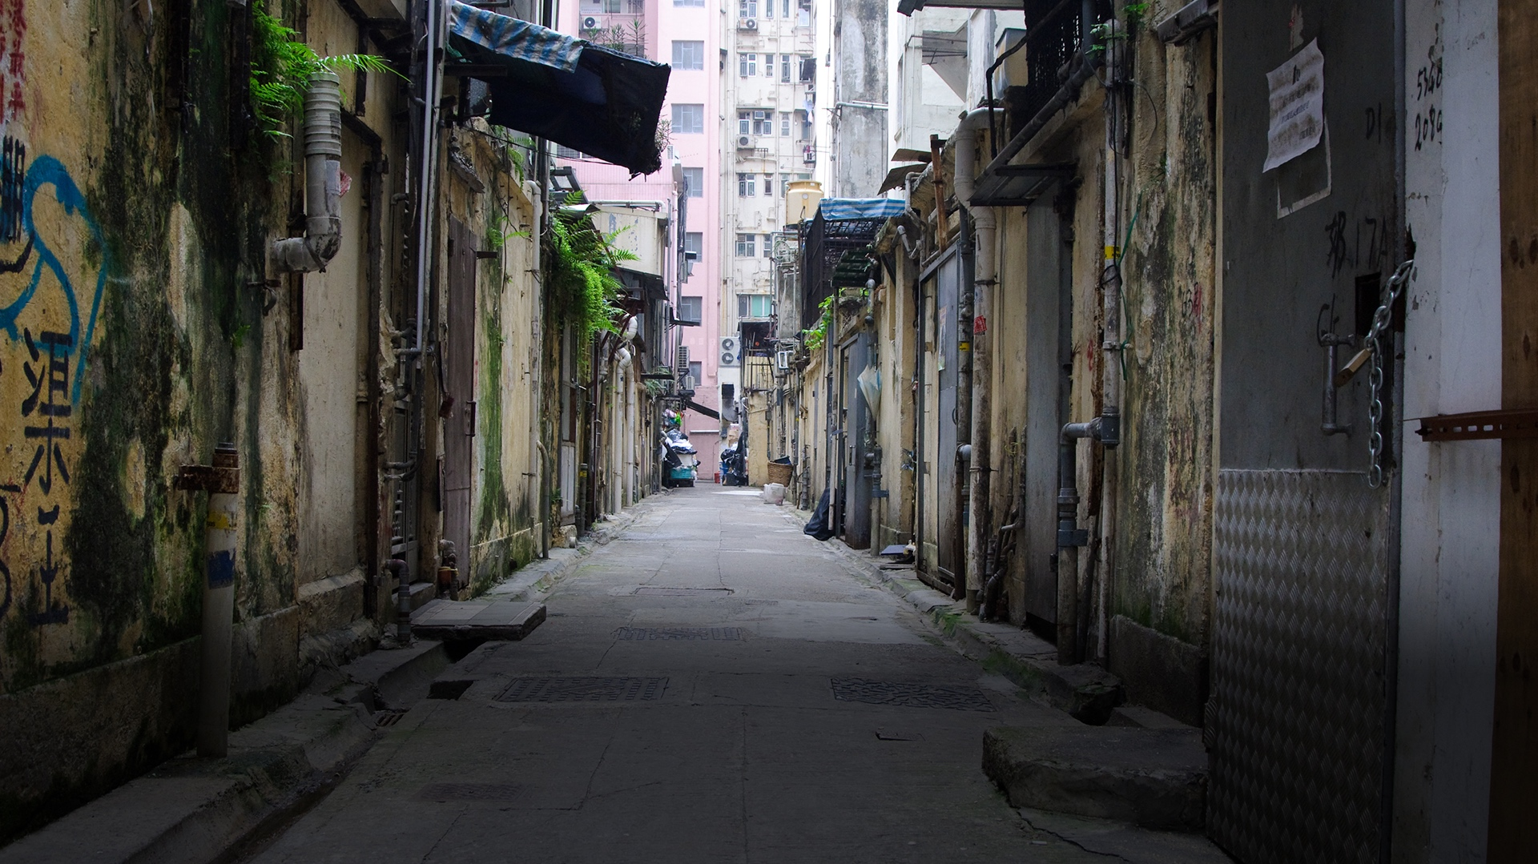
All-Age talk: ‘A table in Hong Kong’

Slide 16
Story Card 1
Christmas day is a time that we celebrate as Christians.
What does your Christmas day look like?
Have you ever had an invitation to a celebration or event you were surprised to be invited to?
If yes, what was it? And how did it feel to be invited?

Slide 17
Story Card 2
When the disciples gathered they ate fish and shared their experiences of the day. They would also listen to Jesus talking and sharing.
Have you received an invitation to be with other people to talk and listen? If yes, what did you talk about?
What do you think Jesus and the disciples would have spoken about?

Slide 18
Story Card 3
The story from Hong Kong Methodist Church shares an experience on Christmas day when a person walked past a group enjoying food together in the street, and they were invited to join in.
Have you ever been invited to a party, picnic or BBQ with people you didn’t know or didn’t know well?
Tell us about your experience.

Slide 19
Story Card 4
The Big Lunch was launched by Eden Project in 2009. Its aim is to encourage local communities across the UK to stop, gather and host a street party in the first week of June.
If your church ran a Big Lunch for your community, what would your invitation to the community say?
How would you get to know the community
around you?

Slide 20
Story Card 5
The story of the feeding of the five thousand is in John’s Gospel in the Bible. Crowds gathered to listen to Jesus talk. It became late and they were hungry.
A boy had five loaves and two fish, which he offered to share. Jesus broke the bread and the fish and they shared it amongst the crowd. And the miracle was everybody shared the food and felt full.

Slide 21
Story Card 5 [continued]
During the pandemic we have not been able to share food in church or outside our homes.
Who will you look to share food with once the pandemic restrictions are lifted?
What food will you have to share and how many people can you feed?

Slide 22
Story Card 6
Jesus and the disciples welcomed all when they gathered together. Jesus went to and always invited the people who were not included in things.
What makes you feel welcome at your church?
Who are the people who are left out in your community?
How can you make everybody feel welcome?

Slide 23
Reading
Ruth 2:5-14

Slide 24
Hymn
Choose from:
Shalom Chaverim
(StF 414)
Come sinners to the gospel feast
(StF 401 or H&P 460)

Slide 25
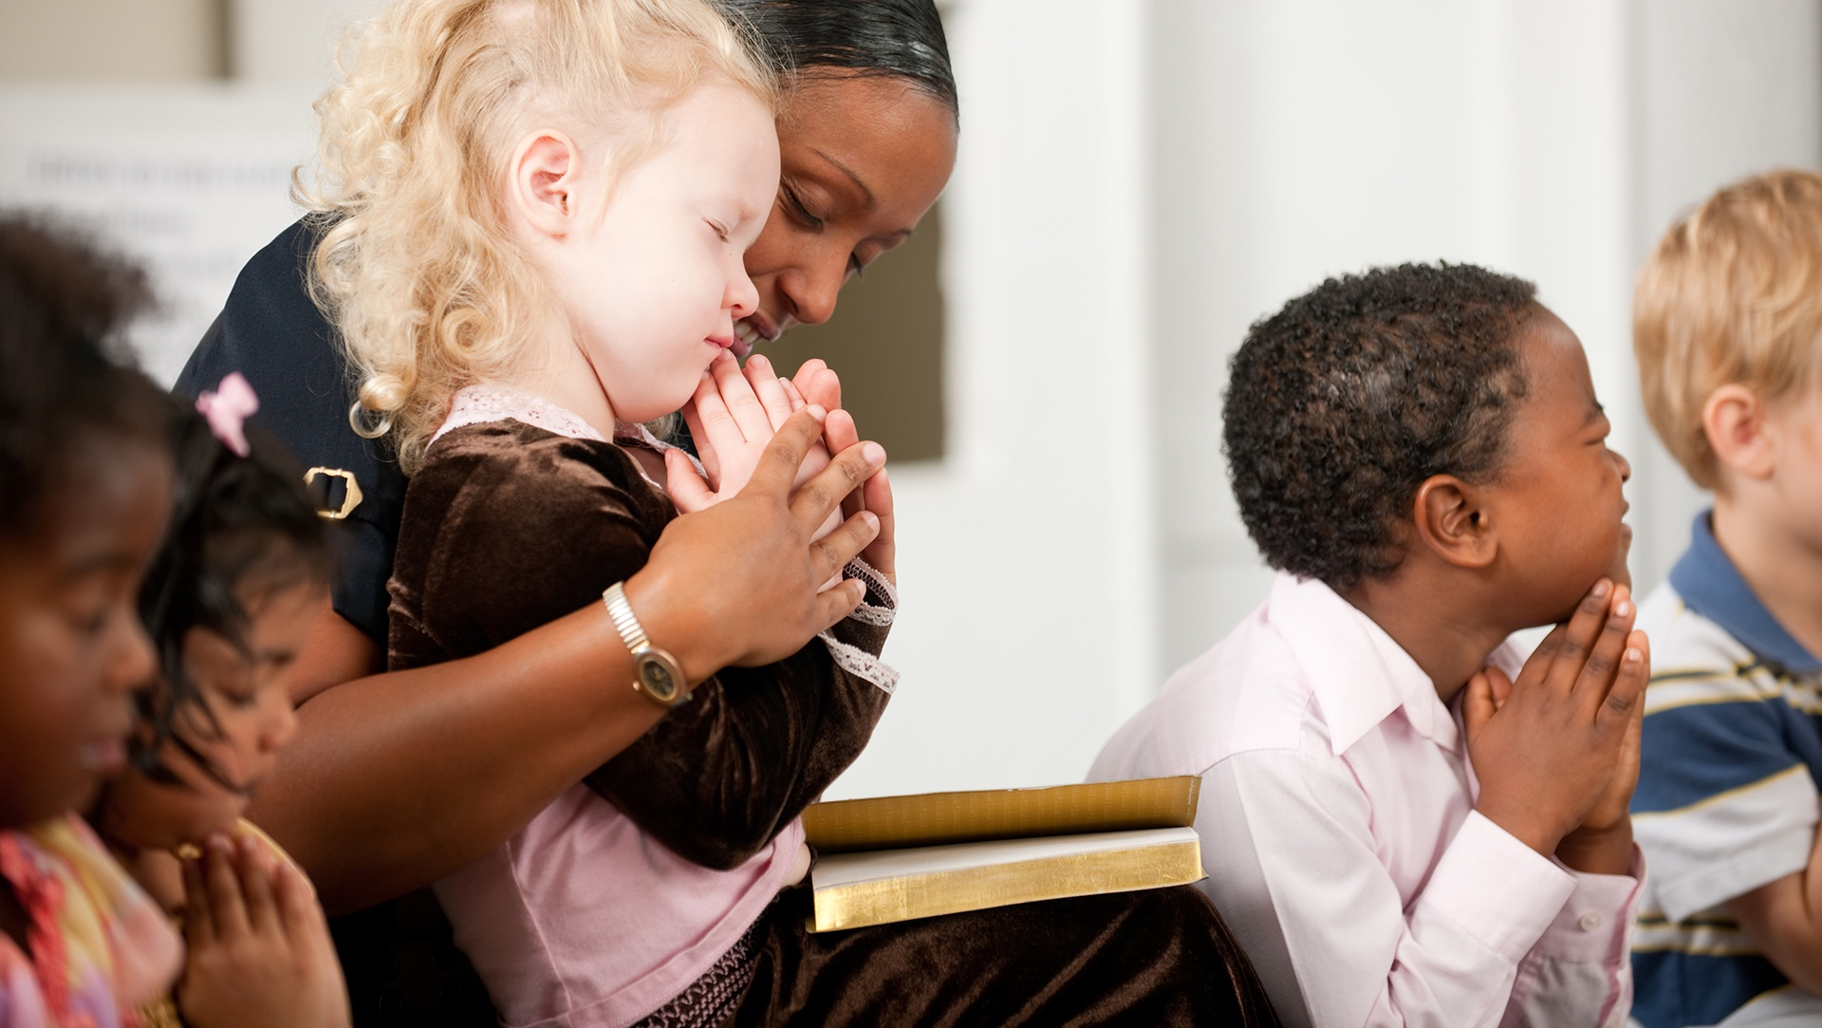
Junior Church begins

Slide 26
Reading
Luke 14:12-24

Slide 27
Hymn
Choose from:
I, The Lord of sea and sky
(StF 663)
Come, let us sing of a wonderful love
(StF 443 or H&P 691)

Slide 28

Sermon

Slide 29
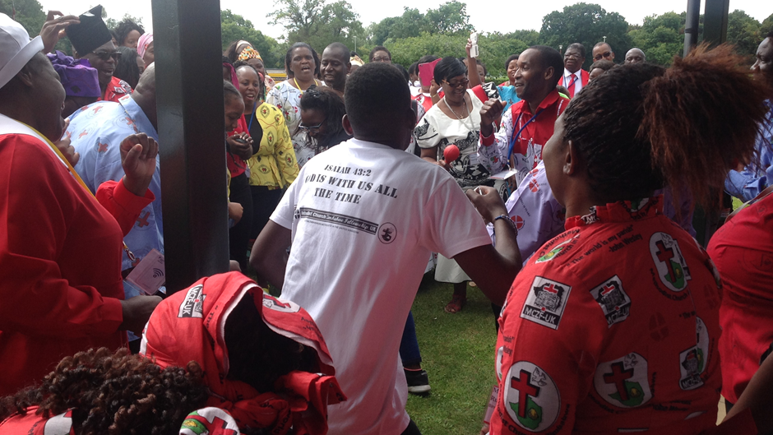
A reflection from Zimbabwe

Slide 30
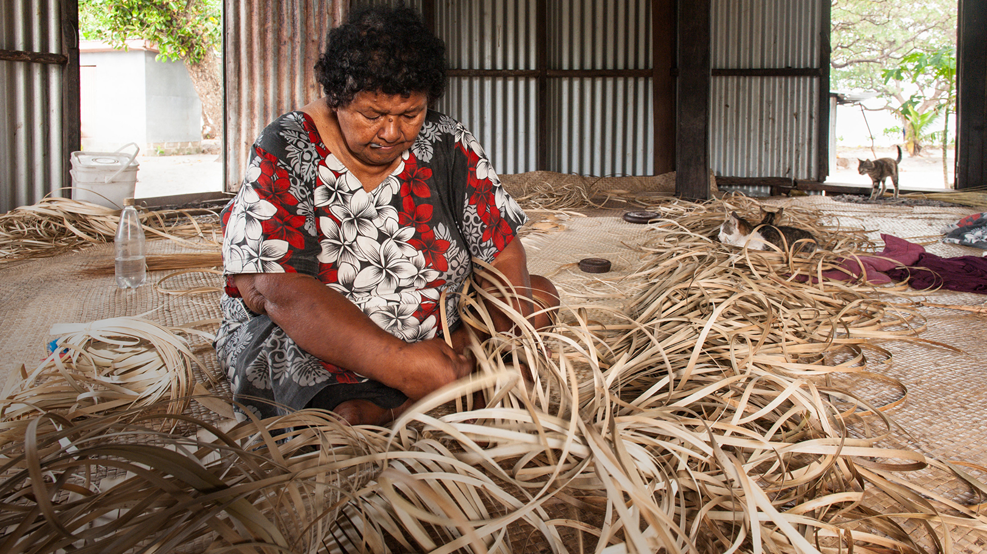
A reflection from Fiji

Slide 31
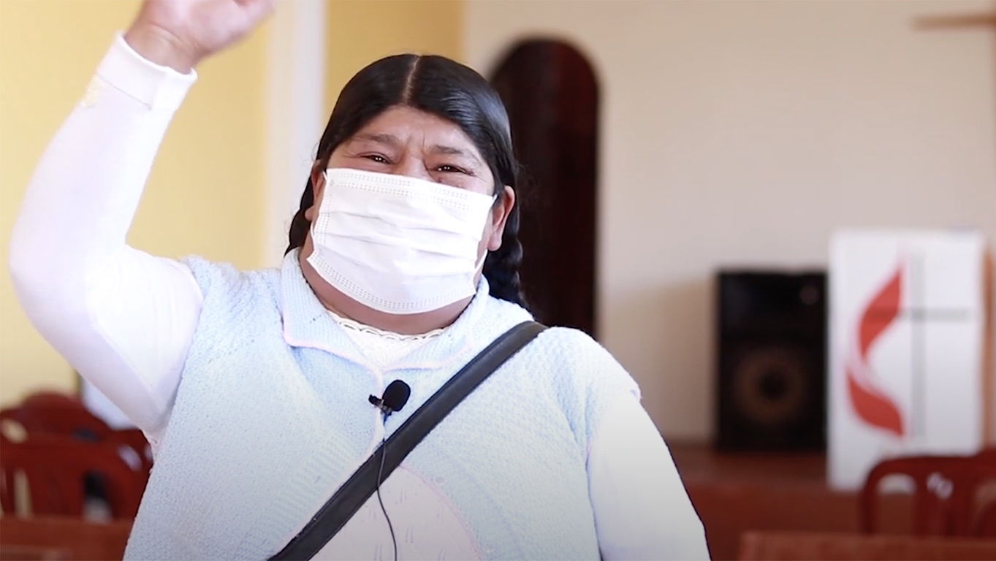
The World is my parish
Notes:
El mundo es mi parroquia - VIDEO PROMOCIONAL
https://www.youtube.com/watch?v=HJ0NmO-BnQw

Slide 32
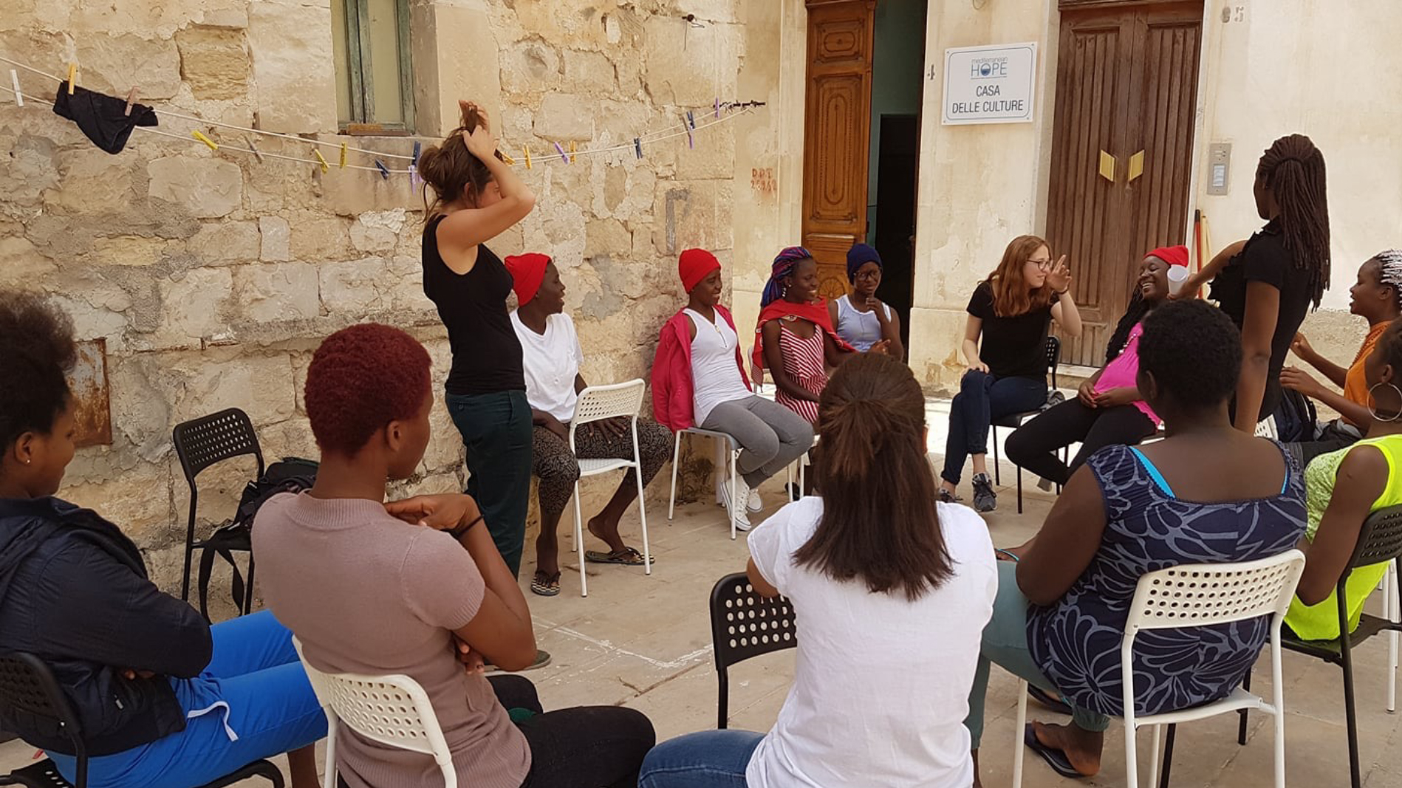

A reflection from Italy

Slide 33
Hymn
Choose from:
Let us build a house where love can dwell
(StF 409)
There’s a spirit in the air
(StF 398 or H&P 326)

Slide 34
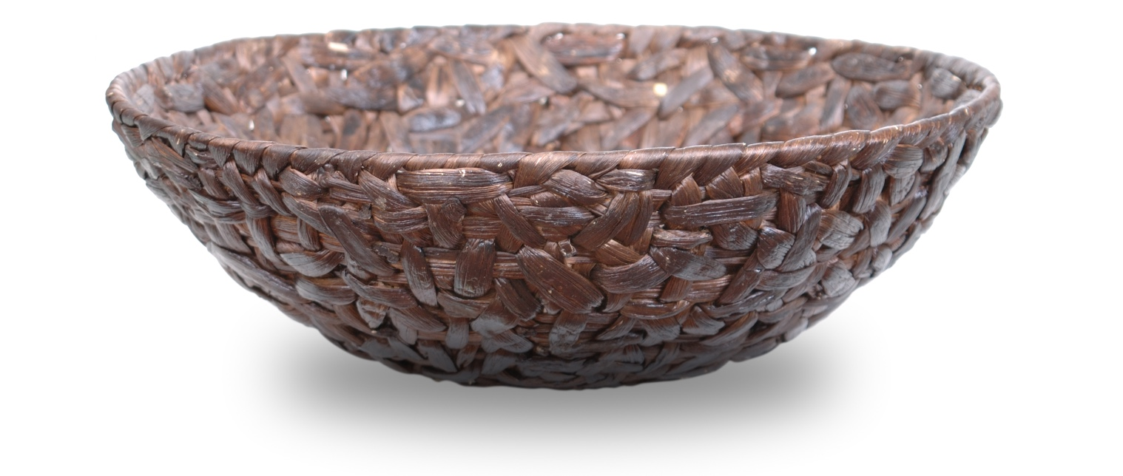
Offering

Slide 35
Prayers of intercession [1 of 4]
Prepared by the Methodist International Church Hong Kong
Let us Pray
Invitational God,
You spread a table before us and invite us to come.
Come, eat and drink, find refreshment, nourishment and life.
Come sit together with friend and stranger, share your stories, listen and speak, learn and rejoice, laugh and sing.

Slide 36
Prayers of intercession [2 of 4]
You spread a table for all, but sometimes we exclude people by our prejudices, by our unwillingness to learn, by our failure to be open to new possibilities and sometimes unknowingly.
Forgive us and help us to learn from Jesus how to cook fish and welcome the tax collector, the sinner, the outcast, the forgotten, the lost, the foreigner, the widow and the orphan.

Slide 37
Prayers of intercession [3 of 4]
Sometimes we want to keep the feast to ourselves, a secret where only the knowing and the known may sit at the table. Behind high walls we sit and eat quietly and politely with friends.
But you, God, burst into the world with a loud cry of jubilee – upending tables of prejudice, greed and division and declaring that this is the day of the Lord’s favour; and come, eat and drink and rejoice – let streets, avenues and lanes burst with feasting and laughter, let many peoples come together, let their language be one of love, of life.

Slide 38
Prayers of intercession [4 of 4]
We pray for all who feel excluded from the table of the Lord, for places of war, division and mistrust. For migrants, and those who feel they have no home, for those in poverty and all who suffer injustice. We pray for those who look at the high walls of the church and feel there is no way in, no place at the table.
Let windows be opened, doors flung wide, tables set up in the streets and sweet smelling food fill the air with the mouth-watering aroma of welcome, embrace and the love of the invitational God. Amen.

Slide 39
Hymn
Choose from:
Will you come and follow me
(StF 673)
The right hand of God is writing in our land
(StF 715 or H&P 408)

Slide 40
Blessing
Go out from this place entrusted with the good news of God’s welcome for all in Christ Jesus, whose disciples you are.
And may the blessing of the Father, the Son, and the
Holy Spirit, be with you and remain with you always.
Amen.

Slide 41
Global Relationships and the
World Mission Fund
Methodists have always shared God’s love and their faith with those they meet and work alongside across the world.
For more information visit:
www.methodist.org.uk/global-relationships

Slide 42
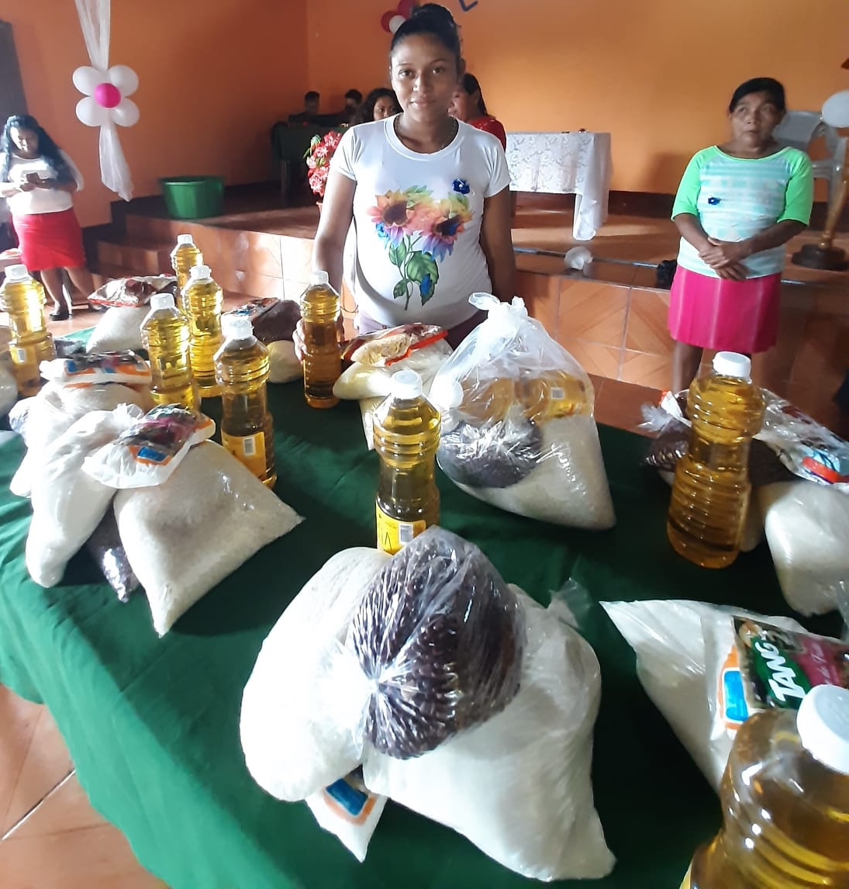
Nicaragua
The World Mission Fund supports the National Evangelical Methodist Church in Nicaragua. During the pandemic the church has been able to distribute essential food packages to 23 communities linked to their local churches.

Slide 43
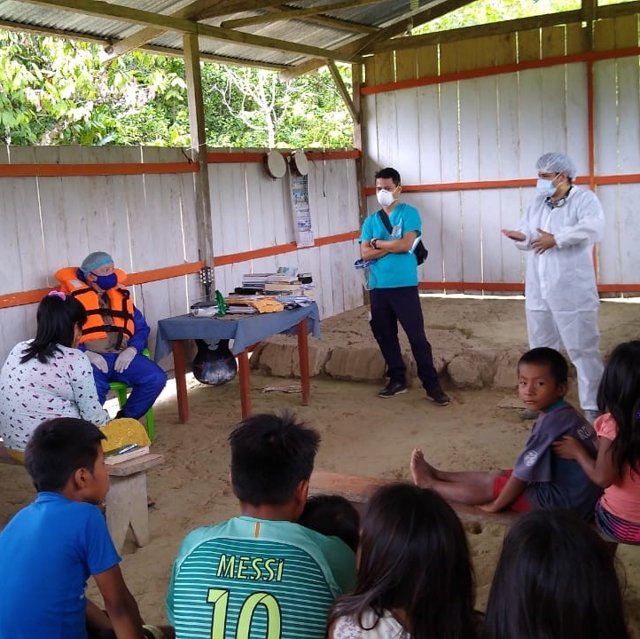
Peru
A General Grant from the World Mission Fund has enabled the Methodist Church in Peru to work with 43 indigenous communities to open nine community pharmacies, offering low- cost medicine and basic health consultation services. 50,000 people will benefit from this vital piece of work.

Slide 44
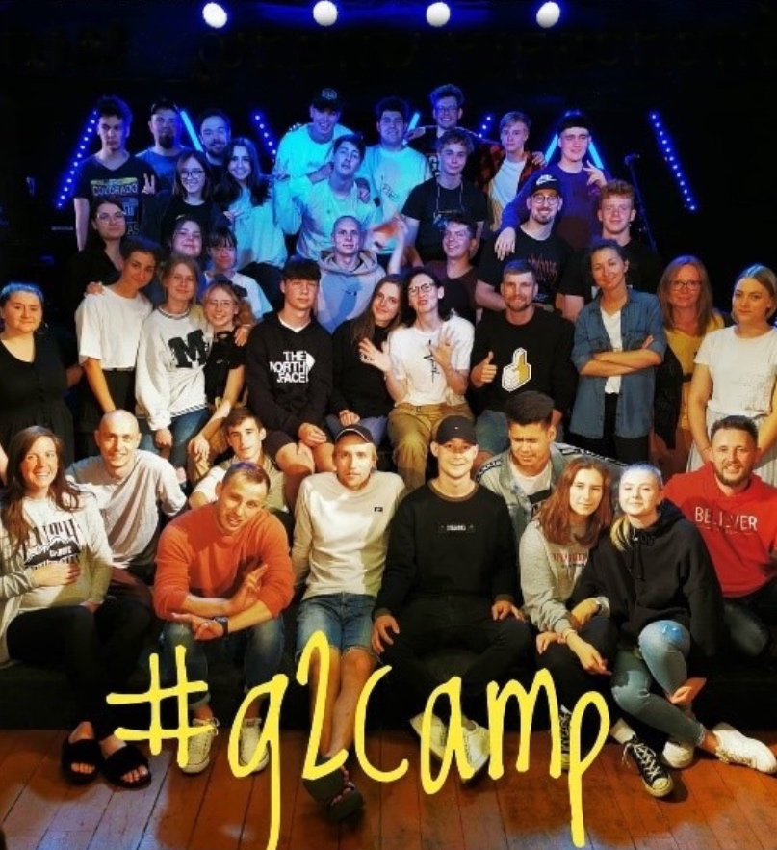
Estonia
The leader of the Estonian United Methodist Church Youth Board is Ele Paju, a National in Mission Appointment supported by the World Mission Fund. She has developed a youth team, teenage ministry and a youth camp. They are also developing young leaders through training.

Slide 45
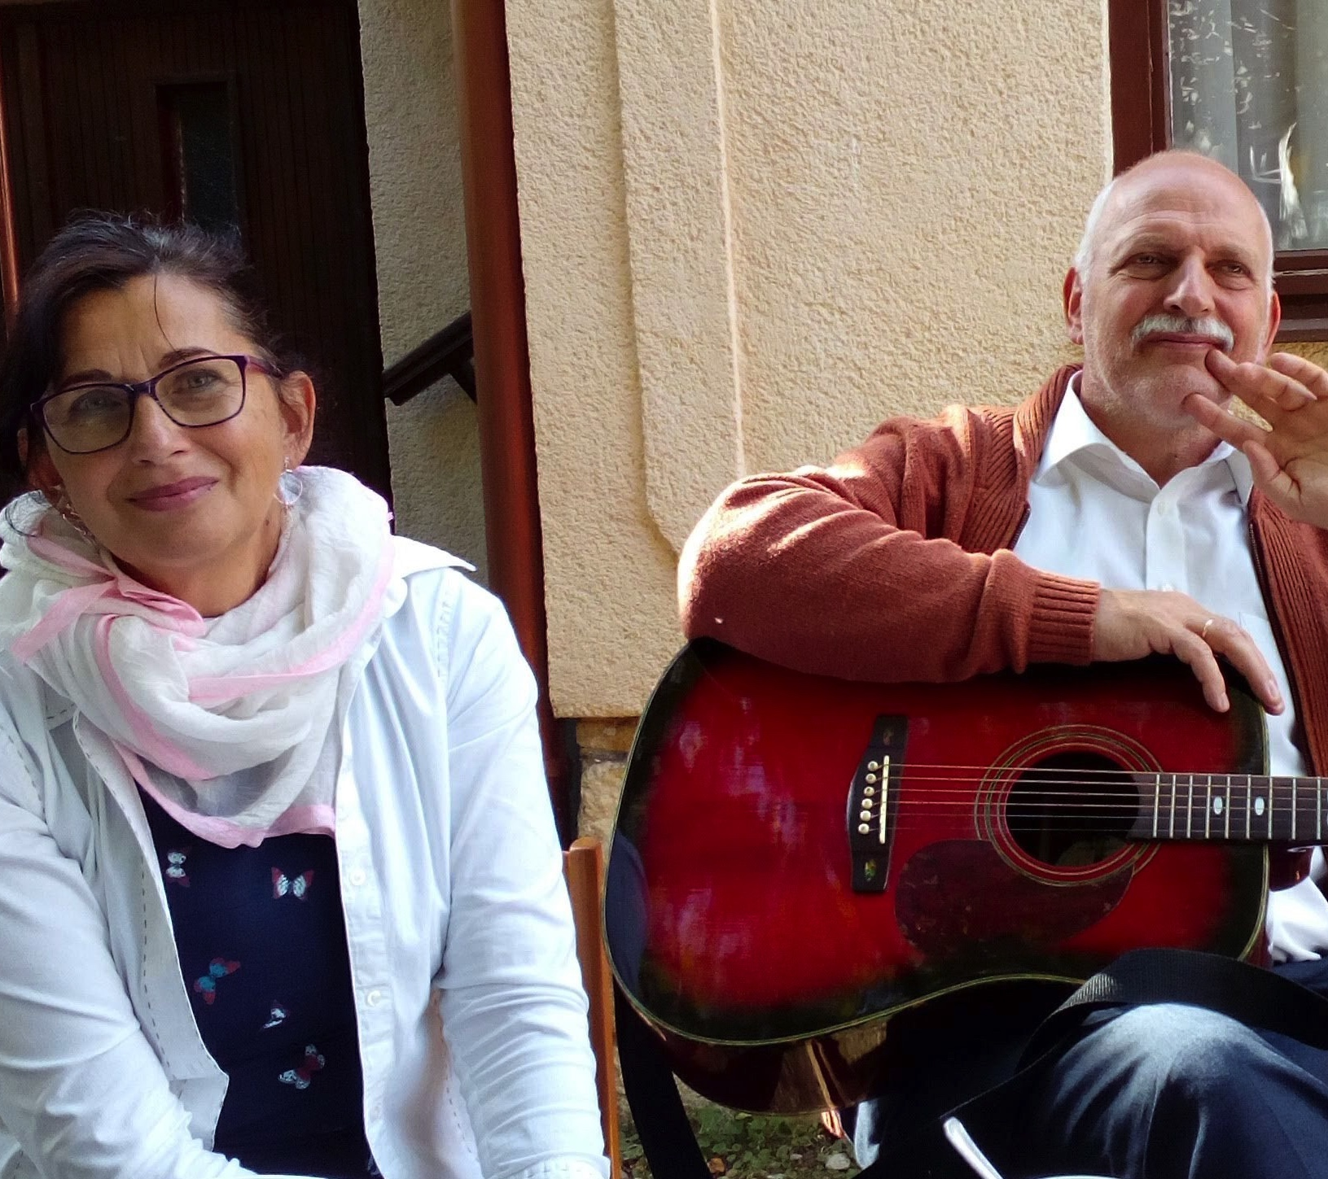
Hungary
Zoltán Kurdi has been pastor of the UMC in Hungary for 21 years. He and his wife Ericka work with members of the Roma minority who face extreme prejudice. This work in Hungary is supported by the World Mission Fund.

Slide 46
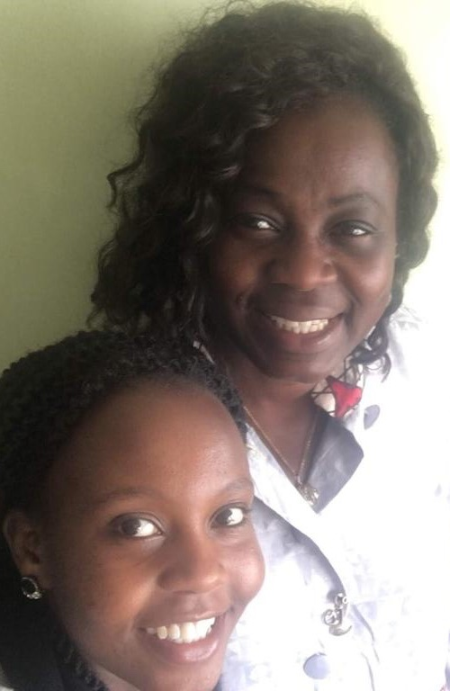
Kenya
The World Mission Fund supports the work of Intern Coordinator and Program Assistant, Jennifer Muthoki Mutua, as a National in Mission Appointment. Her work has seen growth in the Student Christian Movement of Tanzania and Uganda, and the revival of the Student Christian Movement of Kenya.
Jennifer is pictured bottom left, with Africa Partnership Co-ordinator Bunmi Olayisade.

Slide 47
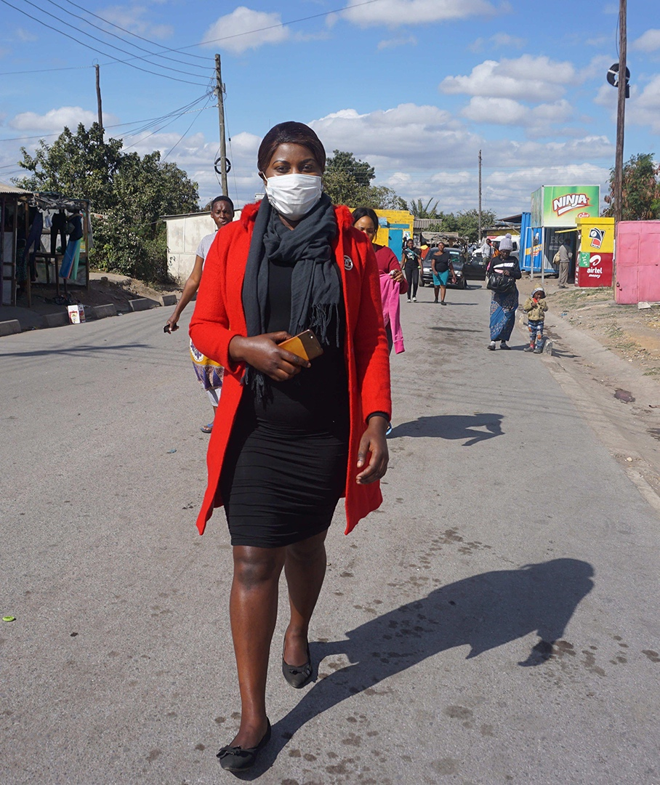
Zambia
United Church of Zambia Health Institutions have been supporting communities throughout the pandemic. Although sadly they have seen deaths, these have been numbered in tens, not hundreds or thousands. The World Mission Fund gave a grant for the purchase of medical and oxygen supplies for UCZ health centres.

Slide 48
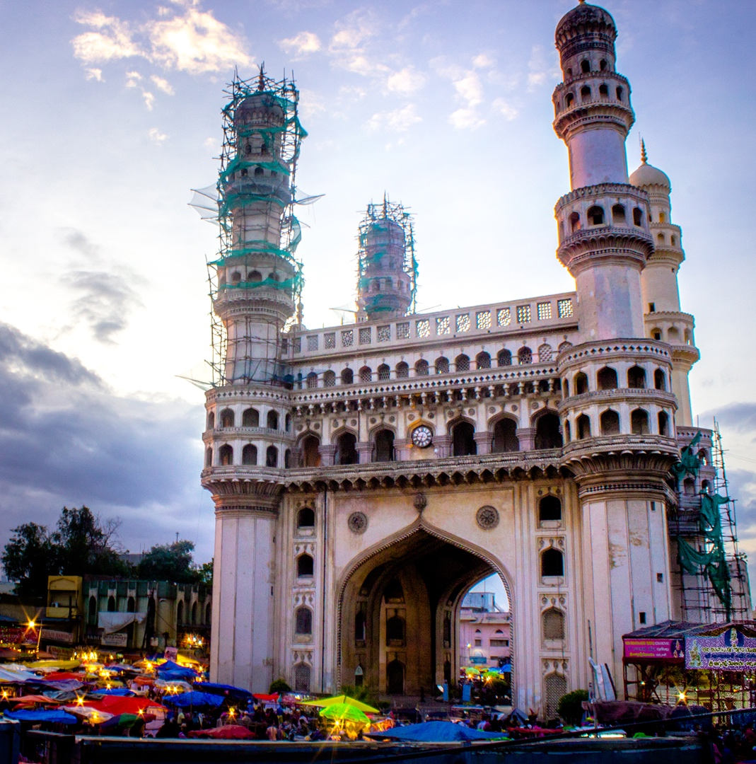
India
Based in Hyderabad, The Henry Martyn Institute (HMI) supports diversity and inclusion. It facilitates interfaith dialogue and peace building, transforming conflict situations and promoting inter-faith and multicultural harmony. It has also responded to the Covid-19 pandemic.

Slide 49


The World Mission Fund
The World Mission Fund helps over 100 Partner Churches
and organisations in Africa, Europe, Latin America,
the Caribbean, Asia and the Pacific.
Junior Mission for All (JMA)
Children and young people raise funds for JMA. 80% goes to the World Mission Fund.
The Easter Offering also supports World Mission Fund, raising £38,000 in 2020.

Slide 50
How to support the World Mission Fund
You can give online at: www.justgiving.com/mcfworldmission/donate
You can also send a cheque
(made payable to 'Methodist Church World Mission Fund') to:
Methodist Church World Mission Fund
Methodist Church House, 25 Marylebone Road,
London NW1 5JR
Thank you very much – your generosity is greatly appreciated.

