Slide 1
These slides accompany Service 1.
There are explanatory notes for the leader in the Global Relationship Worship Resource Pack, which you can download from the Methodist Church website.
You can edit and delete slides depending
on which materials you have selected.
You can insert hymn lyrics if you like.

Slide 2

Worship for the presidential
theme 2020/2021

Slide 3
Call to Worship
The Lord says:
“I am about to do a new thing;
I will make a way in the wilderness
and rivers in the desert.”
(Isaiah 43:19)
Let us come to God in worship and thanksgiving.

Slide 4
Opening hymn/song
Choose from:
O sing to the Lord (StF 42)
As the deer pants for the water (StF 544)
God is love, let heaven adore him (H&P 36)
He’s got the whole world (StF 536 or H&P 25)

Slide 5
Prayers of praise and confession [1 of 3]
Let us pray together:
Dear God, we are glad to be in your presence, singing your praises, joining our voices with the saints and angels in heaven and with your people across the world.
You are a God of immeasurable love. You made us in love.
You delight in us and we delight in you.
[continued]

Slide 6
Prayers of praise and confession [2 of 3]
Our hearts sing a beautiful song when we think about Jesus.
In him, we see you: your grace, your welcome, your everlasting commitment to us. In Jesus, we know that you are with us always.
We thirst for love and we find our thirst quenched in you;
and we worship you.
[continued]

Slide 7
Prayers of praise and confession [3 of 3]
We are sorry for the times when we have been slow to praise you, and trust you, and speak of you to others. For all the times we have let you down and not put you first, we are sorry.
[A brief moment of silence]
We thank you that Jesus is risen and stands before us this day, saying to each of our hearts: “Your sin is forgiven; go in peace”.
So may we leave this place filled with your peace, your spirit and your joy. In Jesus’ name, Amen.

Slide 8
All-age option 1: ‘Shade and Fresh Water’
Reading
Do not remember the former things, or consider the things of old. I am about to do a new thing; now it springs forth, do you not perceive it?
I will make a way in the wilderness and rivers in the desert.
The wild animals will honour me, the jackals and the ostriches; for I give water in the wilderness, rivers in the desert, to give drink to my chosen people, the people whom I formed for myself so that they might declare my praise. Isaiah 43:18-21

Slide 9
‘Shade and Fresh Water’
Hymn
Choose from:
Alleluia, alleluia (StF 295)
Holy, holy, holy (StF 779)
Sent by the Lord am I (StF 239)
What a friend we have in Jesus (StF 531 or H&P 559)
Lord your church (StF 410 or H&P 774)

Slide 10
All-age option 2: ‘Light of the world’
Reading
You are the light of the world. A city built on a hill cannot be hid. No one after lighting a lamp puts it under the bushel basket, but on the lampstand, and it gives light to all in the house. In the same way, let your light shine before others, so that they may see your good works and give glory to your father in heaven. Matthew 5:14-16

Slide 11
‘Light of the World’
Hymn
Choose from:
This little light of mine (Hymnary.org)
Longing for light (StF 706)
Christ is the world’s light (H&P 455)

Slide 12
Reading
Choose from:
Isaiah 43:18-21
Philippians 4:4-8
Matthew 5:14-16

Slide 13
Hymn
In the Lord I’ll be ever thankful (StF 776)
Holy, holy, holy (StF 779)
What a friend we have in Jesus (StF 531 or H&P 559)

Slide 14
Sermon

Slide 15
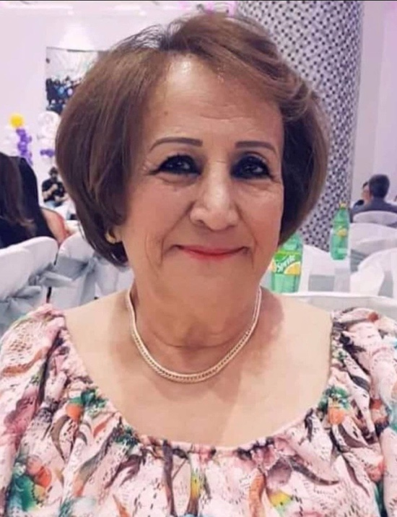
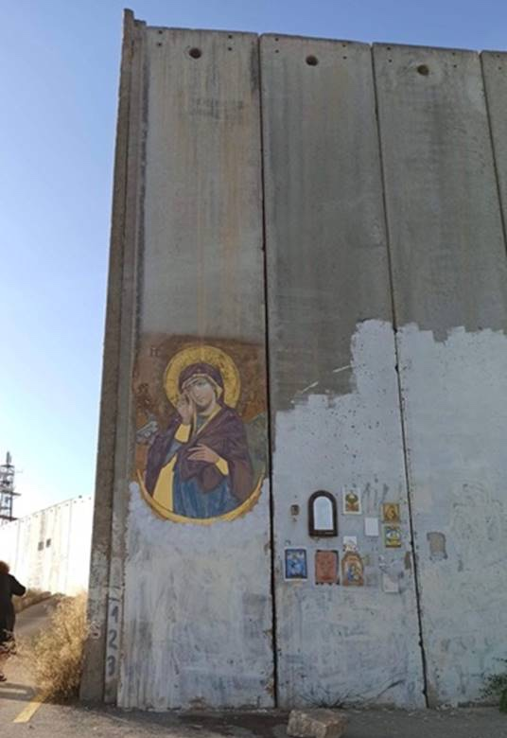
Point 1: God is with us
in times of challenge
Clemence
Wall of separation

Slide 16
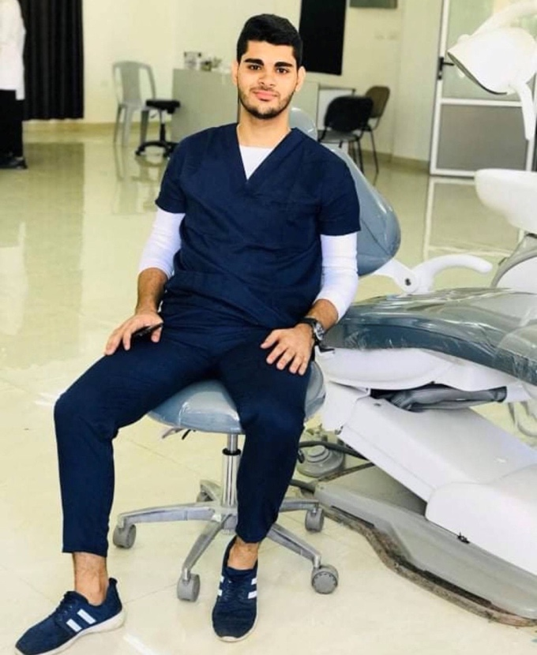
Point 1: God is with us
in times of challenge
Boolos is a 21-year-old Christian living under siege in Gaza.

Slide 17

Point 1: God is with us
in times of challenge
Pacific Theological College

Slide 18
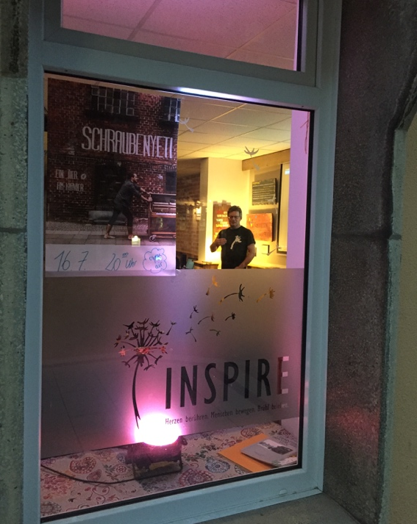
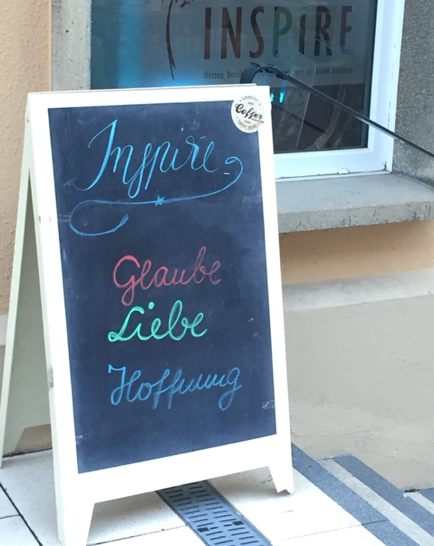
Point 2: God is with us
in our growth as disciples
of Jesus
INSPIRE, a fresh expression of church in the
East German city Chemnitz.

Slide 19
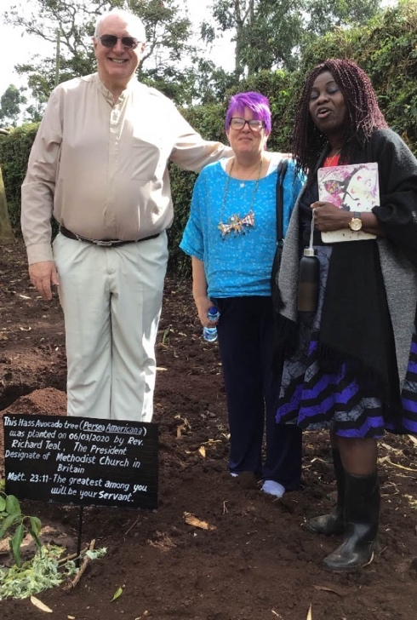
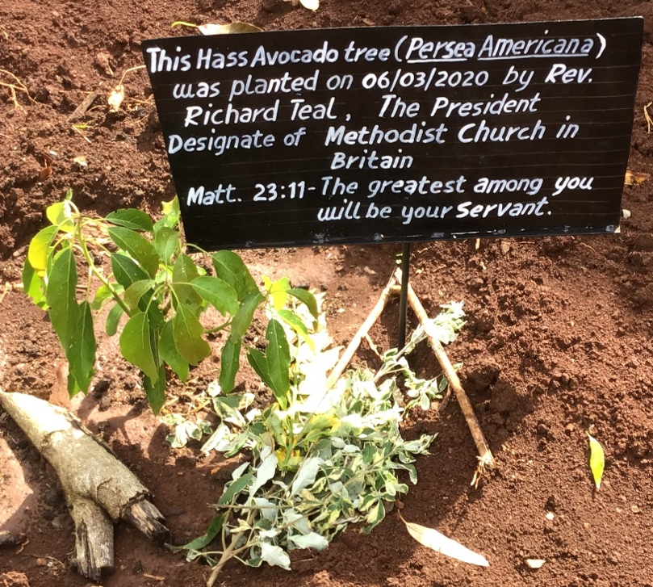
Point 3: God is with us
in our sharing the good
news with others
Richard was asked to plant seedlings wherever he went. This one is
very special. It is an old seedling with a new seedling grafted into it.

Slide 20
Hymn
Choose from:
Sent by the Lord am I (StF 239)
Lord, your Church on earth is seeking (StF 410)

Slide 21

Offering

Slide 22
Prayers of intercession [1 of 4]
Note to leader: You could say these prayers and/or use the ‘Prayer map’ activity (see slide 28).
In our prayers of intercession today, we call to mind the parting words of St Paul in his letter to the Philippians: “Finally, beloved, whatever is true, whatever is honourable, whatever is just, whatever is pure, whatever is pleasing, whatever is commendable, if there is any excellence and if there is anything worthy of praise, think about these things.” (Philippians 4:8)

Slide 23
Prayers of intercession [2 of 4]
Let us pray
Lord God, we pray for your Church and for Christians throughout the world. We give thanks for the story we have heard today, and ask for your blessing on [Sara and Leo, Daniel and Grace Pratt Morris-Chapman, Richard Teal and Upolu Lumā Vaai – choose the name of the person(s) mentioned in your service and include here any other appropriate petitions.]

Slide 24
Prayers of intercession [3 of 4]
Direct [them and] all your people in the ways of justice and peace, raising up leaders who are pure of heart. Lord, in your mercy, hear our prayer.
Lord God, we pray for our local church and community. [Include here any appropriate petitions.] Inspire us to be a light in [name of your neighbourhood], sharing the joy and pleasure of the gospel with others, and working for your kingdom. Lord, in your mercy, hear our prayer.

Slide 25
Prayers of intercession [4 of 4]
Lord God, we remember with love, all those who have died. [Include here any appropriate specific remembrances.] We give thanks that they have been gathered into your eternal kingdom by your son Jesus, who is excellent and most worthy of praise. And we pray that you keep our hearts and minds turned towards him, until we too can share in that everlasting joy. Through Christ our Lord, Amen.

Slide 26
Interactive intercessions: world map [1 of 3]
Let us pray for the world.
Think of a part of the world where there is need. Hold that place in your mind before God as you place a sticker on the map as a symbol of your prayer.
We say together: Almighty creator God, we pray for
all the places we have held before you. Bless the
work of the Church in those places, sharing your
love and light so that the world may be transformed.

Slide 27
Interactive intercessions: world map [2 of 3]
Let us pray for our nation.
Wonderful loving God, we thank you for what we have learnt
today from sisters and brothers around the world. Help us follow their example in sharing your love in this nation.
We bring to mind places and people across this
nation who need to know your love. Transform
us and help us to be the hands and feet of Jesus
who will share your light.

Slide 28
Interactive intercessions: world map [3 of 3]
Let us pray for ourselves.
Ever close and intimate God, we come needing to know your love. We reflect deeply on the messages from around the world. Comfort us where there is pain. Challenge us where
we need to serve you. From the youngest to the
oldest, may we see your light and become your light.
Help us to share your love with gentle confidence in
Jesus, so that we may all experience your growth.
In the name of Jesus, Amen.

Slide 29
Hymn
Choose from:
The right hand of God is writing in our land (StF 715 or H&P 408)
Let us build a house where love can dwell (StF 409)

Slide 30
Blessing
Go out from this place and let your light shine before others, so that they may see your good works and give glory to your Father in heaven.
And may the blessing of the Father, the Son, and the Holy Spirit, be with you and remain with you always. Amen.

Slide 31
Global Relationships and the World Mission Fund
Methodists have always shared God’s love and their faith with those they meet and work alongside across the world. For more information visit www.methodist.org.uk
[Note to the Leader: the following slides have a selection of the work the WMF supports and the final slide shows how to give money, if wished]

Slide 32
World Mission Fund (continued)
Colombia
The WMF supports the Ecumenical Social Centre for Communications in Latin America (CEPALC), based in Colombia. Carlos Daniel Silva Quecán works with Colombian children from different ethnic groups, including Afro-Colombians and Indigenous Colombians. He helps them learn about building peaceful communities, about their rights as children living in Colombian society and how to use media to have a voice.

Slide 33
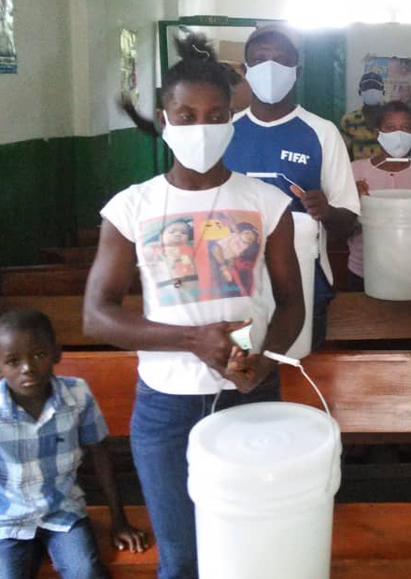
World Mission Fund (continued)
Haiti
The WMF supported the Haiti District of the Methodist Church in the Caribbean and Americas (MCCA) with a general (solidarity) grant for preventative healthcare activities in five Methodist clinics. The clinics teach local communities how to protect themselves from Covid-19 and give PPE and cleaning products to vulnerable communities.

Slide 34
World Mission Fund (continued)
Latvia
The WMF supports the Hope Centre, which provides a refuge to young single mothers and mothers-to-be. They stay until their child is born and they have enough experience and knowledge to live independently. The Centre provides learning opportunities and counselling and mentoring. They encourage women to finish their education or to attend a professional training school, so they have the self-esteem and knowledge to raise their children independently, and are able to support themselves financially.

Slide 35
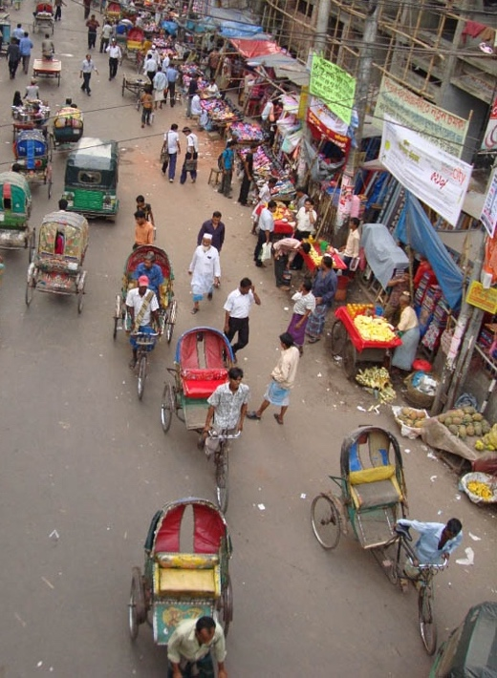
World Mission Fund (continued)
Cameroon and Bangladesh
The WMF supports the work of the Presbyterian Church in Cameroon. In Bangladesh the WMF made two grants this year: £25,000 to the Church of Bangladesh for its 30,000 members; and £20,000 to its social development organisation ‘Shalom’ which reaches 120,000 of the most vulnerable people in all faith communities.

Slide 36
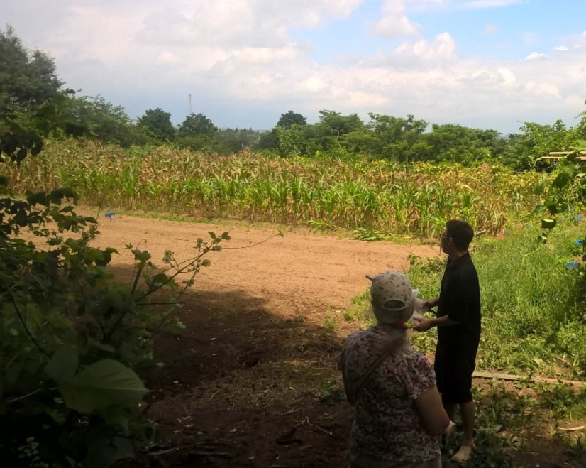
World Mission Fund (continued)
Japan
The Asian Rural Institute is a training centre for rural community leaders, set in a six-hectare farm in Northern Japan. WMF scholarship grants last year enabled three people from African and Asian Partner Churches to attend its annual course.

Slide 37

World Mission Fund (continued)
Junior Mission for All (JMA)
Children and young people raise funds for JMA.
Last year, they raised over £97,000. Of this, 80%
went to the World Mission Fund to help over
100 Partner Churches and organisations in Africa,
Europe, Latin America, the Caribbean, Asia and
the Pacific.
The Easter Offering also supports WMF, raising £370,000 in 2019.

Slide 38
How to support WMF
You can give online at: www.justgiving.com/mcfworldmission/donate
You can also send a cheque (made payable to 'Methodist Church World Mission Fund') to:
Methodist Church World Mission Fund
Methodist Church House
25 Marylebone Road
London NW1 5JR
Thank you very much – your generosity is greatly appreciated.

