Slide 1
These slides accompany
Service 2: A Local Arrangement Service.
There are explanatory notes for the leader in the Global Relationship Worship Resource Pack, which you
can download from the Methodist Church website.
You can edit slides and insert hymn lyrics if you like.

Slide 2

Worship for the presidential
theme 2020/2021

Slide 3
Call to Worship
Rejoice in the Lord always;
again I will say, Rejoice.
(Philippians 4:4)

Slide 4
Hymn
Choose from:
Be still for the presence of the Lord (StF 20)
Sing to the Lord a joyful song (H&P 17)

Slide 5
Prayers of praise and confession [1 of 2]
Let us pray:
Dear loving God,
We praise you for your love. In love you made this beautiful world. You made us and have blessed us with life. When we made wrong choices, you did not abandon us, but you called out to your people and you sent Jesus to bring us home. In Jesus we know that you are always with us.
[continued]

Slide 6
Prayers of praise and confession [1 of 2]
We are sorry for the wrong choices we have made: for the wrong decisions we took in our lives and for the times when we turned from you. We thank you that you will never leave us or forsake us, that you forgive us and that in Jesus we are with you forever.
In his holy name we pray. Amen.

Slide 7
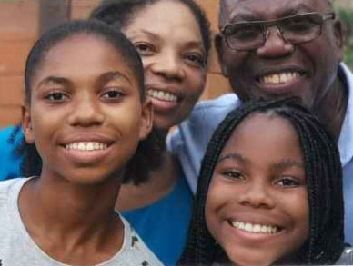
First (all-age) address: ‘God you never left’
Michael and Joanne Tettey with their daughters, Joelle and Janelle

Slide 8
Hymn
Choose from:
Give thanks to the Lord (StF 77)
Now thank we all our God (H&P 566)

Slide 9
Reading
Who is to condemn? It is Christ Jesus, who died, yes, who was raised, who is at the right hand of God, who indeed intercedes for us. Who will separate us from the love of Christ? Will hardship, or distress, or persecution, or famine, or nakedness, or peril, or sword? As it is written, “For your sake we are being killed all day long; we are accounted as sheep to be slaughtered.”
No, in all these things we are more than conquerors through him who loved us. For I am convinced that neither death, nor life, nor angels, nor rulers, nor things present, nor things to come, nor powers, nor height, nor depth, nor anything else in all creation, will be able to separate us from the love of God in Christ Jesus our Lord. Romans 8 31–39

Slide 10
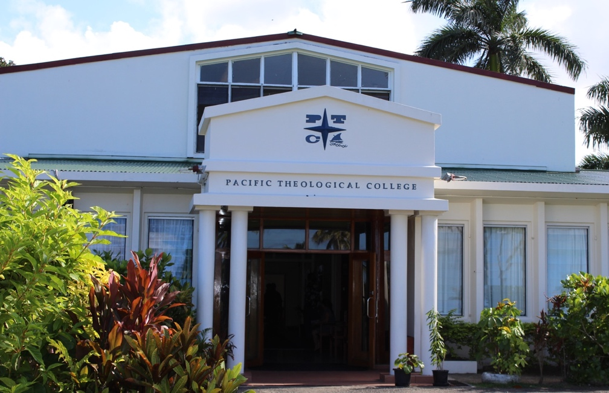
First testimony
The presidential theme this year is, “The best of all is, God is with us”. Hear a testimony from Asela Tuisawau, a student of the Pacific Theological College in Fiji.

Slide 11
Hymn
Choose from:
Longing for light, we wait in darkness (StF 706)
O love that wilt not let me go (H&P 685)

Slide 12
Reading [1 of 2]
Again he began to teach beside the sea. Such a very large crowd gathered around him that he got into a boat on the sea and sat there, while the whole crowd was beside the sea on the land. He began to teach them many things in parables, and in his teaching he said to them: ‘Listen! A sower went out to sow. And as he sowed, some seed fell on the path, and the birds came and ate it up. Other seed fell on rocky ground, where it did not have much soil, and it sprang up quickly, since it had no depth of soil.

Slide 13
Reading [2 of 2]
And when the sun rose, it was scorched; and since it had no root, it withered away. The seed fell among thorns, and the thorns grew up and choked it, and it yielded no grain. Other seed fell into good soil and brought forth grain, growing up and increasing and yielding thirty and sixty and a hundredfold.’ And he said, ‘Let anyone with ears to hear listen!’ Mark 4:1–9

Slide 14
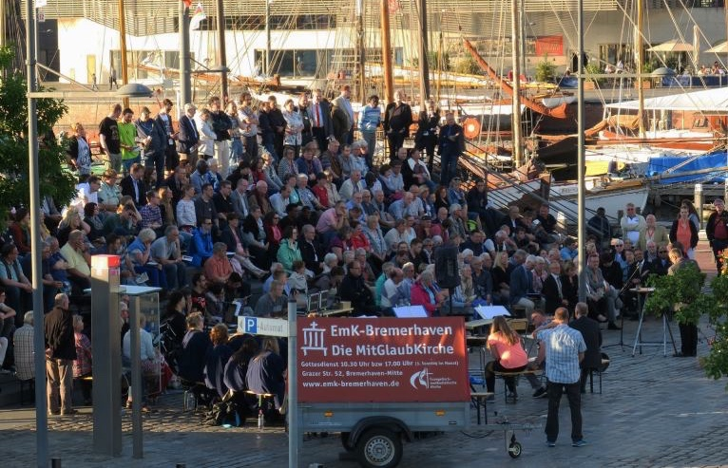
Second testimony
Hear a testimony about the Methodist Church in Bremerhaven, Germany
Click here.

Slide 15
Hymn
Choose from:
Let us build a house where love can dwell (StF 409)
Lord, thy Church on earth is seeking (H&P 774)

Slide 16
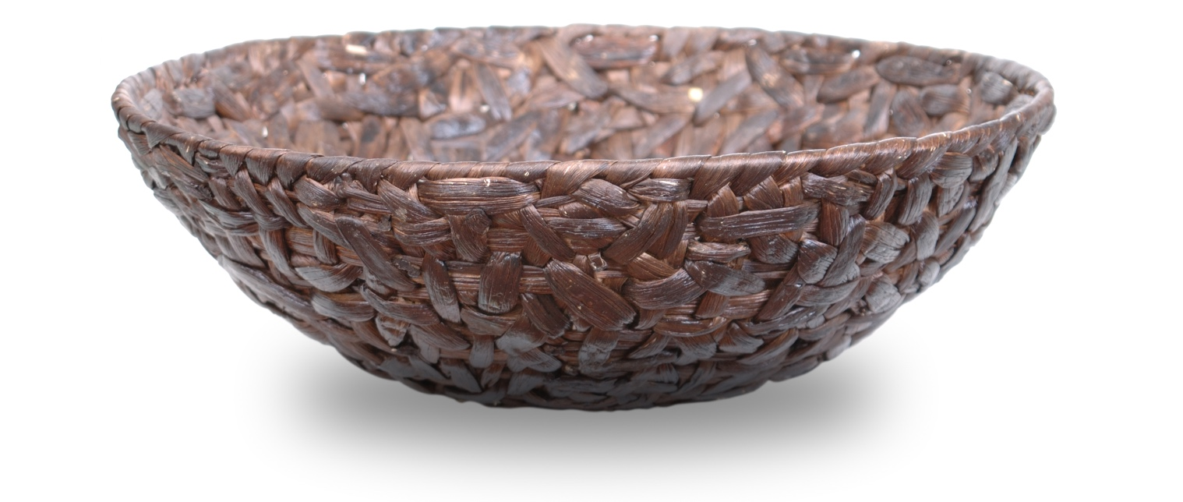
Offering

Slide 17
Prayers of intercession and the Lord’s Prayer
Let us pray together for the world.
When you hear: ‘The Lord hears our prayer’, would you please respond by saying, ‘Thanks be to God’.

Slide 18
Hymn
The right hand of God is writing in our land (StF715 or H&P 408)

Slide 19
Blessing
May the grace of our Lord Jesus Christ,
And the love of God,
And the fellowship of the Holy Spirit,
Be with us all, evermore.
Amen.

Slide 20
Global Relationships and the World Mission Fund
Methodists have always shared God’s love and their faith with those they meet and work alongside across the world. For more information visit www.methodist.org.uk
[Note to the Leader: the following slides have a selection of the work the WMF supports and the final slide shows how to give money, if wished]

Slide 21
World Mission Fund (continued)
Colombia
The WMF supports the Ecumenical Social Centre for Communications in Latin America (CEPALC), based in Colombia. Carlos Daniel Silva Quecán works with Colombian children from different ethnic groups, including Afro-Colombians and Indigenous Colombians. He helps them learn about building peaceful communities, about their rights as children living in Colombian society and how to use media to have a voice.

Slide 22
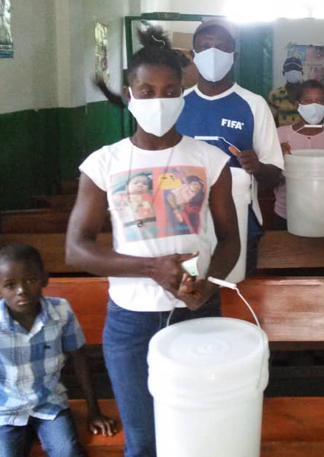
World Mission Fund (continued)
Haiti
The WMF supported the Haiti District of the Methodist Church in the Caribbean and Americas (MCCA) with a general (solidarity) grant for preventative healthcare activities in five Methodist clinics. The clinics teach local communities how to protect themselves from Covid-19 and give PPE and cleaning products to vulnerable communities.

Slide 23
World Mission Fund (continued)
Latvia
The WMF supports the Hope Centre, which provides a refuge to young single mothers and mothers-to-be. They stay until their child is born and they have enough experience and knowledge to live independently. The Centre provides learning opportunities and counselling and mentoring. They encourage women to finish their education or to attend a professional training school, so they have the self-esteem and knowledge to raise their children independently, and are able to support themselves financially.

Slide 24
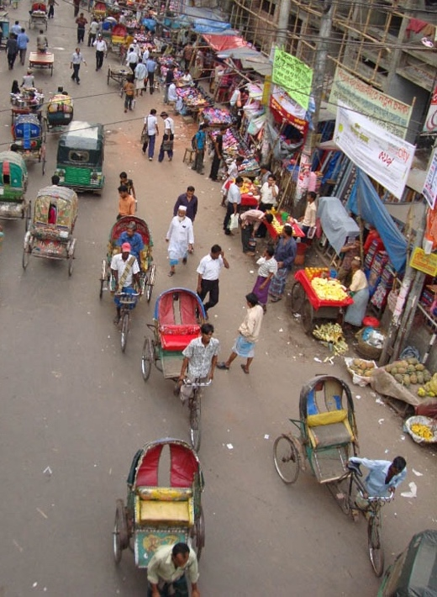
World Mission Fund (continued)
Cameroon and Bangladesh
The WMF supports the work of the Presbyterian Church in Cameroon. In Bangladesh the WMF made two grants this year: £25,000 to the Church of Bangladesh for its 30,000 members; and £20,000 to its social development organisation ‘Shalom’ which reaches 120,000 of the most vulnerable people in all faith communities.

Slide 25
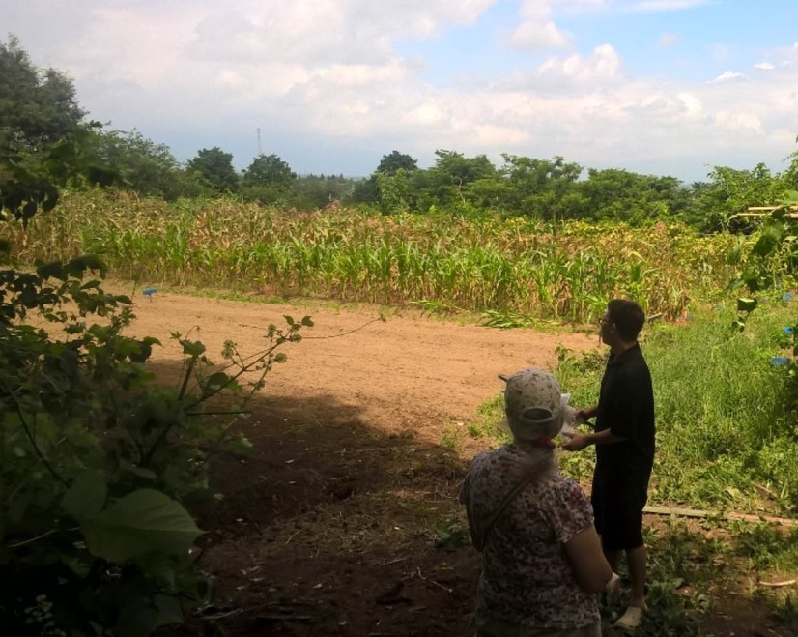
World Mission Fund (continued)
Japan
The Asian Rural Institute is a training centre for rural community leaders, set in a six-hectare farm in Northern Japan. WMF scholarship grants last year enabled three people from African and Asian Partner Churches to attend its annual course.

Slide 26

World Mission Fund (continued)
Junior Mission for All (JMA)
Children and young people raise funds for JMA.
Last year, they raised over £97,000. Of this, 80%
went to the World Mission Fund to help over
100 Partner Churches and organisations in Africa,
Europe, Latin America, the Caribbean, Asia and
the Pacific.
The Easter Offering also supports WMF, raising £370,000 in 2019.

Slide 27
How to support WMF
You can give online at: www.justgiving.com/mcfworldmission/donate
You can also send a cheque (made payable to 'Methodist Church World Mission Fund') to:
Methodist Church World Mission Fund
Methodist Church House
25 Marylebone Road
London NW1 5JR
Thank you very much – your generosity is greatly appreciated.

