Slide 1

Welcome
Creating Safer Space
Foundation Module
2020 Edition
For Trainers

Slide 2
Trainers:
Ann Howlett-Foster
Learning Network- East of England
Mel Argles
Connectional Safeguarding Team – South West

Slide 3
Trainers session
Familiarisation with FM training content
Consideration of learning styles used in FM training
Opportunity to explore new case studies
Additional resources for development of trainers

Slide 4
Revised Foundation Module
Feedback from across the connexion
Increasing participant engagement
Now in 6 Sections:
  Welcome and devotions
  Our church context
  Good practice
  4 steps to good practice
  Case studies
  close

Slide 5
Changes:
Addition of ‘Church Leaders, staff and volunteers’
2 key activities to help relate material to practice:
  Somewhere and Somewhere else Methodist Church
  Case Studies
Increased demand on facilitation skills

Slide 6
Foundation Module Resources
Participants | Trainers | Training for Trainers
Handbook | Trainer’s notes | T4T PowerPoint
Workbook | FM PowerPoint | Trainers Training Resources booklet
Feedback form | Signing in sheet | Participant workbook
Certificate | Privacy Notice

Slide 7
Train the trainers resources
In recognition of the different requirements for the range of those delivering the course, the resources have been targeted towards three distinct groups:
Designated Safeguarding Leads and Learning Network Representatives
Existing Foundation Module Trainers
Those new to Foundation Module Delivery.

Slide 8
Trainers Handbook
Getting ready for the session:
  Who delivers the training?
  Materials and equipment required
  Learning Activities
  On the Day – Checklist
  Question Park
  Participant workbook
  Participant handbook
  Safeguarding update
  Signing in sheet
  Reflection on, and planning for, resistance ***

Slide 9
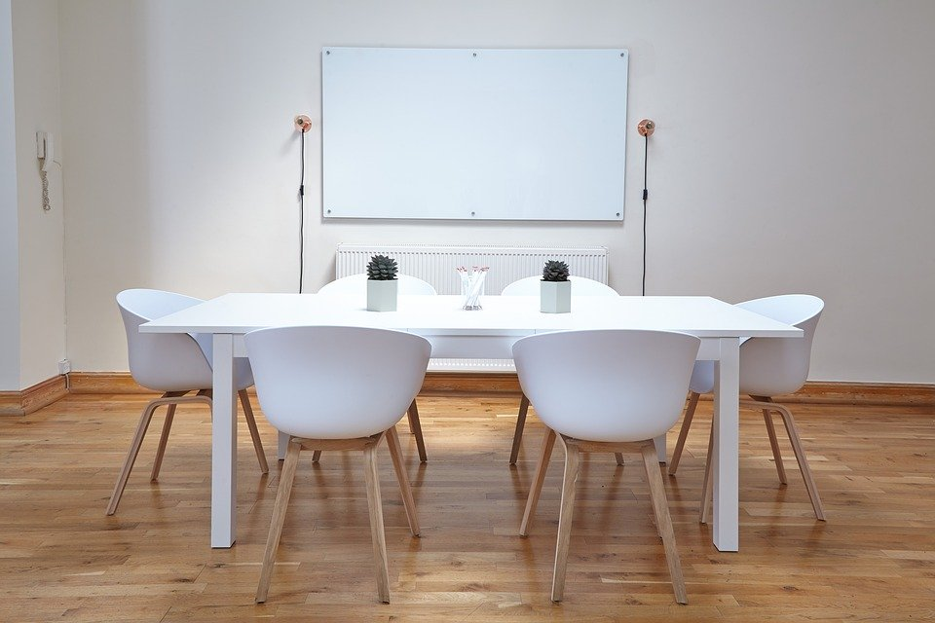
Group 3 - Activity
Preparing the space….
Notes:
Preparing the space (for 3 only)
Before the session set up the area you will use but do not set up the rest of the room. As participants arrive ask them to lay out the space as they feel it should be for a good Foundation Module (FM) session. Part way through provide a copy of this checklist from the FM Trainers notes for them to refer to.
‘Here is a check list to follow.
Both trainers should arrive early and check all the equipment.
Set up the room with a flip chart stand and have paper, pens (use black or blue for visibility) and post-it notes on each table. Some trainers use a resources table. This is empty at the start but gradually builds up with resources as they are used through the training.
Create a welcoming atmosphere. Put chairs around tables, café style – avoid straight rows if at all possible. Have refreshments ready for when people arrive. You could have flowers on the tables and music playing. Have sweets and water on tables as well as hot drinks available wherever appropriate for the venue.
If the venue has the facilities, you could set up a quiet room so that those who need to go out have a comfortable, safe space to use.
Ensure there is someone on the door to welcome people personally as they arrive and help them sign in. They may need to stay there after you have started, to welcome latecomers, help them sign in, and settle them into the group. ‘
Let the group settle and then ask what it felt like to arrive in a space that wasn’t prepared. What difference could it make to a FM participants experience if the room is set up well? How could you make the space feel safe for those attending?
The preparation on the day before the session and in the run up to the event is a key part of the event running well. Provide participants with handout x based on session 7 - I need to do this.

Slide 10

Group 3 - Activity
Basic Presentation Skills….
Notes:
Basic Presentation Skills (3 only)
Provide everyone with a copy of the presentation skills handout (the points below need going onto either a handout or a PPT slide) and run through together. (see below)
Talk naturally to your audience and only read from a script at appropriate times.
Stand, rather than sit.
Vary the tone, pitch and volume of your voice to add emphasis and maintain the audience’s interest.
Aim to speak loudly and clearly while facing your audience.
Make eye contact with your audience but avoid looking directly at any one person for more than a few seconds.
Find a way to keep your notes and handouts in one place.
Rehearse your talk and check your timings.
Answer any questions as honestly and concisely as you can, remembering that you won’t be able to answer all questions. If you don’t know the answer, record the question on the Question Park and offer to provide further information at a later date.
Have a glass of water available for you.
Breathe!
Allow time for the participants to put this into practice. Choose a familiar passage or poem (a well-known hymn often works well). Ask the participants to pair up and present this to each other following the guidelines you have just gone through. Some participants will feel they ‘present’ all the time but encourage everyone to have a go to support each other. Ask each pair to give each other constructive feedback to each other.

Slide 11

Group 2/3 - Activity
Facilitation skills ….
Notes:
Facilitation skills (2 and 3 only)
Place 3 large sheets of paper around the room headed ‘How to best facilitate the group’; ‘How to manage feedback’; ‘How to manage the time’. Allow 5 minutes for people to walk around the room adding their ideas to the sheets.
After 5 minutes look at each sheet in turn. Hand out the Facilitation Skills handout and look at this noticing anything not covered on the flip charts.
Facilitation Skills (need to be on a handout or PPT slide)
Create a welcoming space
Create a welcoming space as people arrive and make sure they are comfortable. A welcoming space is not just physical, it’s also about the way you engage with the group, building rapport and trust.
Set the context
Use the slides at the beginning of the Foundation Module to set the context for the training. Spend time on the Learning Agreement and return to this during the session if needed.
Encourage participation
Different people will participate in different ways and at different times within the Module. Be aware of anyone struggling to participate, this maybe an opportunity for the co trainer to come alongside them.
Give instruction clearly and briefly
Keep instructions short then get people to work on the task. As the groups are talking wander around, clarify questions and support the small groups in working together.
Take care of time and pace
Timings are laid out in the Trainers’ Notes, keep to these as far as possible. If you do go off time adjust further timings as necessary. Be aware of people’s energy levels and vary the pace. Sometimes it’s important to speed up, sometimes it’s important to slow down.
Avoid leading the group or the discussion
Facilitators have opinions! But during Foundation Module it is important not to lead the group down any particular path.
Handle difficult situations
Difficult situations can occur during Foundation Module so being prepared is important. If a situation is halting the session you could break for a coffee, ask the co trainer or chaplain to come alongside an individual, remind individuals of the Learning Agreement or ‘park’ the conversation on the Question Park.
Handle difficult people
If an individual is proving difficult, listen and understand before you respond to them. Use the tone and speed of your voice to try to calm and slow down the conversation. If necessary talk to that person in private, and both give them feedback on what they are doing and try to find out if there is a reason for their behaviour.
Take care of yourself
Leading Foundation Module can take a lot of effort and energy. Be aware of your own energy levels and the parts of the Module you find difficult to lead.
Work as a team
Foundation Module should always be led by 2 trainers. As you work together learn each other’s strengths, work out how to vary the pace of the session by using different trainers, notice sections you find particularly difficult and ask the other to lead them.

Slide 12
Timings
Section | 2.5hr | 3hr
Introductions and devotions | 11 | 11
2. Our Church Context | 25 | 25
3. Good Practice | 25 | 28
4. 4 Steps to Good Practice | After Break | 31 (Part A)
Break | 5 | 10
4. 4 Steps to good practice | 42 | 17 (Part
5. Case studies | 35 | 49
6. Reflection, evaluation and close | 9 | 9

Slide 13
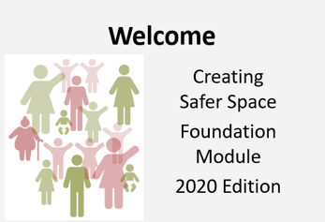
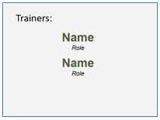
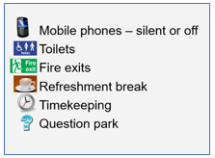
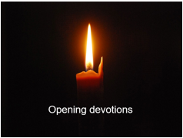
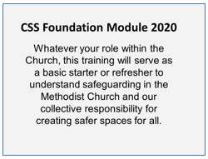
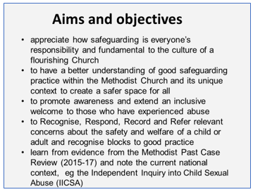
Section 1: Welcome and devotions (slides 1-9, 11 minutes)
1
2
3
4
5
6

Slide 14
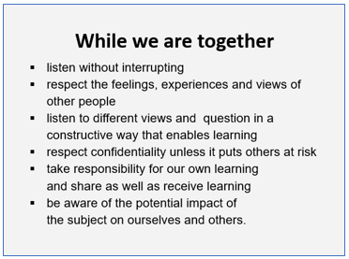
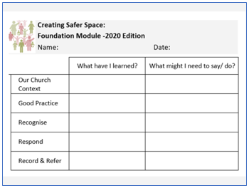
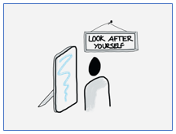
Section 1: Welcome and devotions (slides 1-9, 11 minutes)
7
9
8
4

Slide 15
Section 2: Our Church Context (slides 10–24, 25 minutes)

Slide 16






What makes the
church unique?
Children and
Young People
Vulnerable Adults
Church
leaders, staff
and volunteers
Those who may be a risk to others
Those
who have
experienced abuse

Slide 17
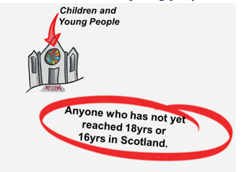
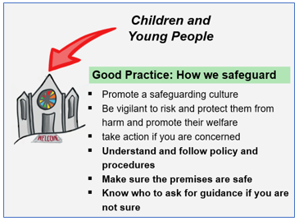
Section 2: Our Church Context (slides 10–24, 25 minutes)
11
12
Children and Young People

Slide 18

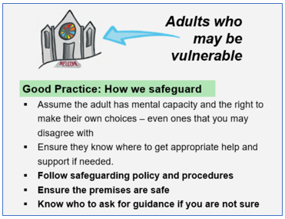
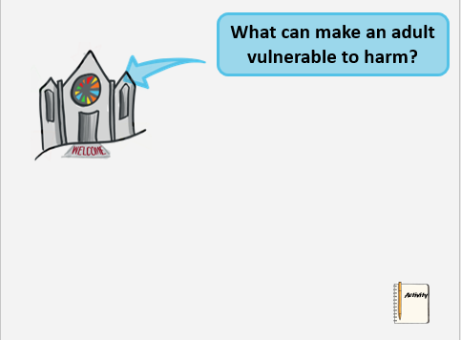
Section 2: Our Church Context (slides 10–24, 25 minutes)
15
13
14
Adults who may be vulnerable

Slide 19
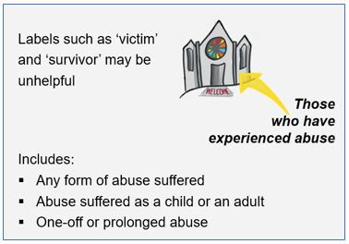
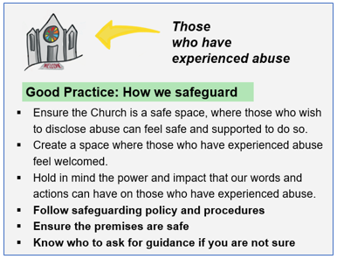
Section 2: Our Church Context (slides 10–24, 25 minutes)
17
16
Those who have experienced abuse

Slide 20
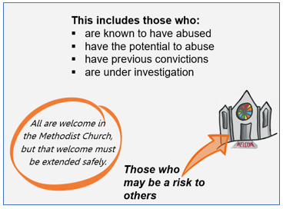
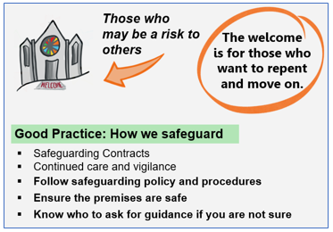
Section 2: Our Church Context (slides 10–24, 25 minutes)
18
19
Those who may pose a risk to others

Slide 21
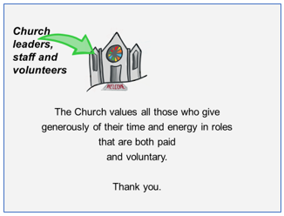
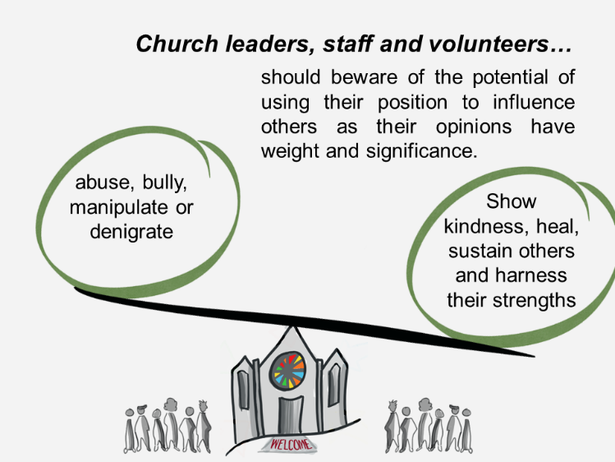
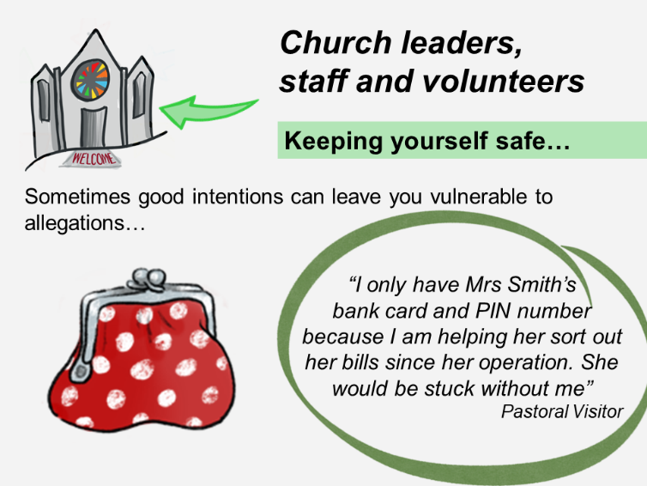
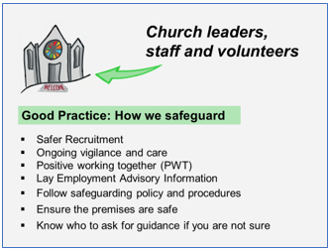
Section 2: Our Church Context (slides 10–24, 25 minutes)
20
21
22
23
Church leaders, staff and volunteers

Slide 22
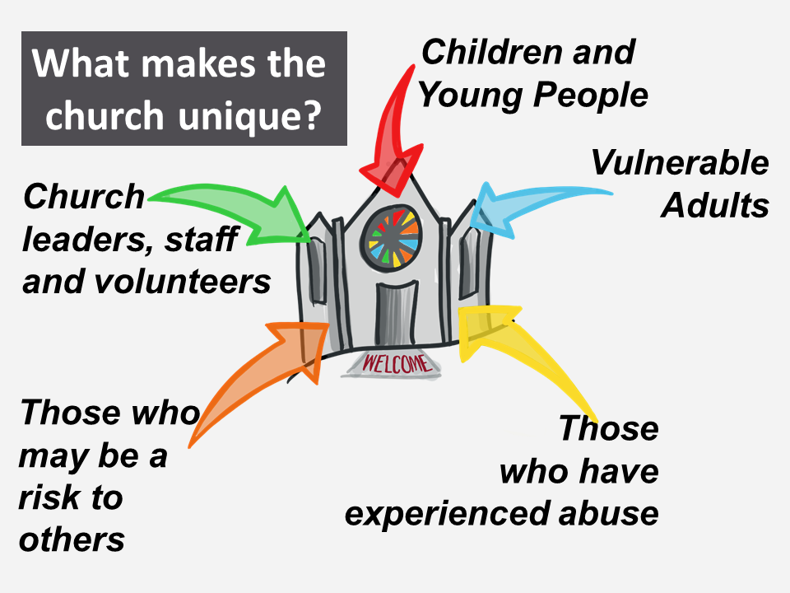
Section 2: Our Church Context (slides 10–24, 25 minutes)
24
Summary

Slide 23
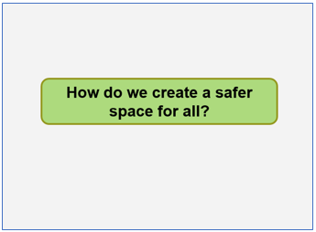
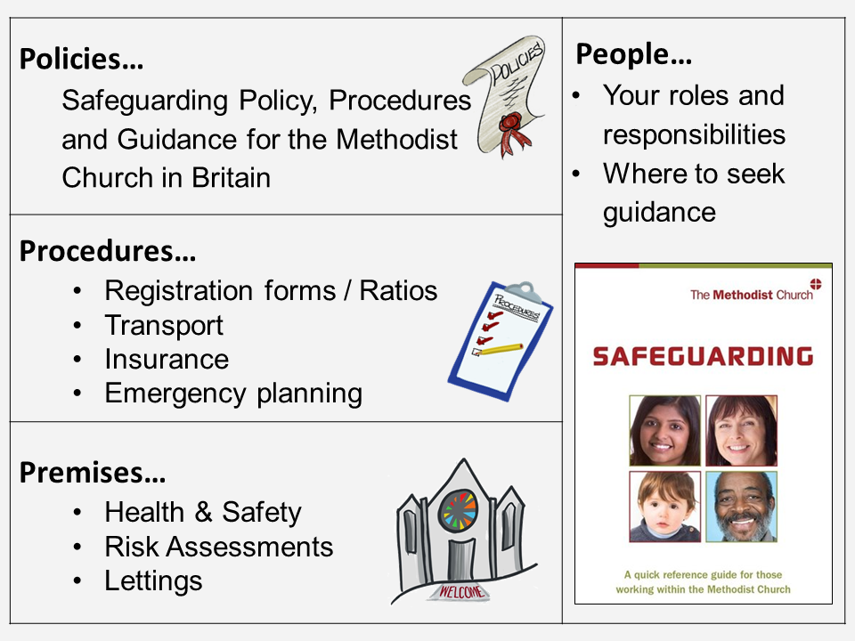
Section 3: Good Practice
(Slides 25 – 27, 23 or 28 minutes*)
25
26

Slide 24

Section 3: Good Practice
(Slides 25 – 27, 23 or 28 minutes*)
27

Slide 25
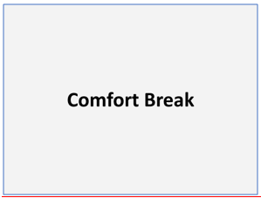
Comfort Break (Slide 28; 5 or 10 minutes)
28
Notes:
When running a three hour session it may be beneficial to put the break after slide 31, and allow delegates to carry on with the activity in the break. This will give you a more even split in terms of timing, and allow delegates greater opportunity to move around the room and comment on the sheets they are completing.

Slide 26
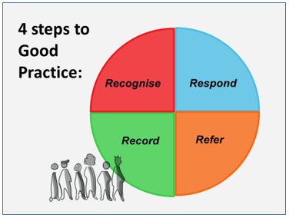
Section 4: 4Steps to Good Practice (slides 29–37; 42 or 48 minutes)
29

Slide 27
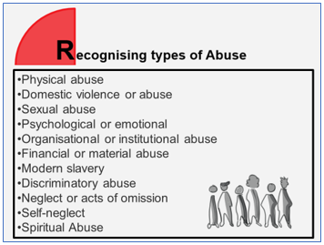

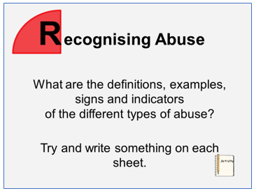
Section 4: 4 Steps to Good Practice (slides 29–37; 42 or 48 minutes)
30
32
31

Slide 28
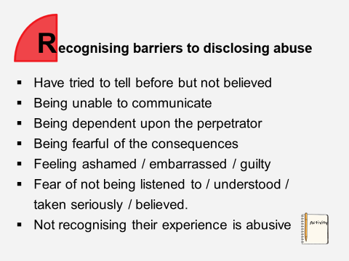
Section 4: 4 Steps to Good Practice (slides 29–37; 42 or 48 minutes)
33

Slide 29
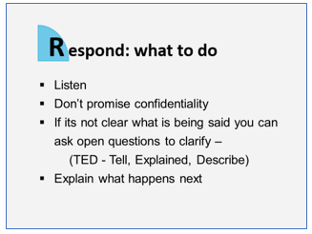
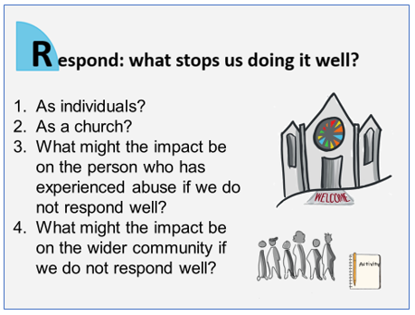
Section 4: 4 Steps to Good Practice (slides 29–37; 42 or 48 minutes)
34
35

Slide 30
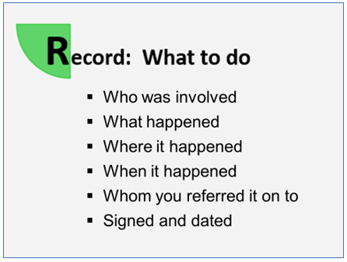
Section 4: 4 Steps to Good Practice (slides 29–37; 42 or 48 minutes)
36

Slide 31
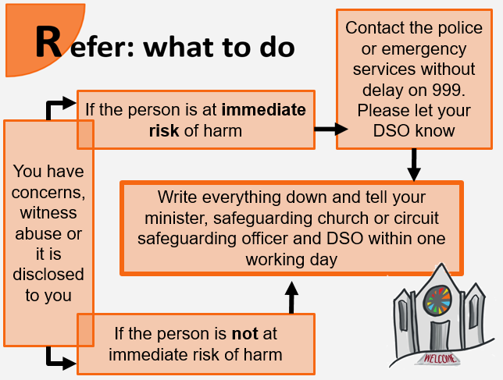
Section 4: 4 Steps to Good Practice (slides 29–37; 42 or 48 minutes)
37
Notes:
Safeguarding officer

Slide 32
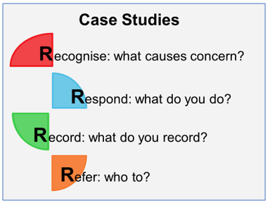
Section 5: Case Studies
(slide 38, 35/49 minutes)
38

Slide 33
Have a go…
Anna
June and Sally
Doris
Abdul
Desmond

Slide 34
Case Studies
 | Name | Issue |  | New
1 | Anna | Non-recent Child Sexual abuse | Pastoral Visiting | New
2 | Tasha | Boundaries, confidentiality, disclosure | Youth Work | part
3 | June & Sally | Domestic Abuse, Suicide, confidentiality | Pastoral Visiting - Minister | New
4 | Edward | Indecent images of children | Local Preacher | part
5 | James | Those who may pose a risk | Monitoring and Support Group | Same

Slide 35
Case Studies
 | Name | Issue |  | New
6 | Rebecca | Domestic Abuse & children | Local Preacher, Pastoral visitor | Same
7 | Doris | Key holders, external lettings, lone working | Key holder, lettings | New
8 | Dawn | Grooming, Risk assessments, ratio’s | Youth work | Same
9 | Rita | Financial abuse, domestic abuse | Pastoral visitor | Part
10 | Abdul | Spiritual abuse, sexual abuse, abuse of power | Church Steward, Youth worker, Minister | New

Slide 36
Case Studies
 | Name | Issue |  | New
11 | Grace | Institutional Abuse | Pastoral Visiting | New
12 | Josh & Ben | Online Grooming | Youth Work | part
13 | Kyle & Asher | Neglect | Steward, Minister Youth work | New
14 | Desmond | Financial and online abuse | Congregant, pastoral visitor | New
15 | Kim | Modern Slavery | Steward | New

Slide 37


Section 6: Reflection, Evaluation and Close (slides 39-44, 10 mins)
37

Slide 38
How does it fit together?
Notes:
38

Slide 39
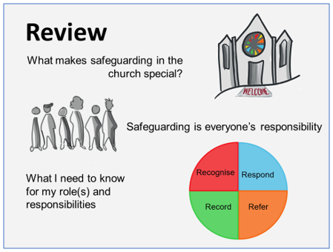

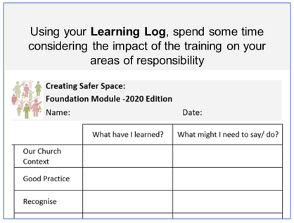
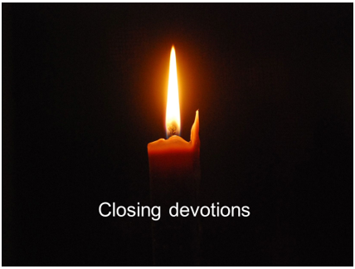
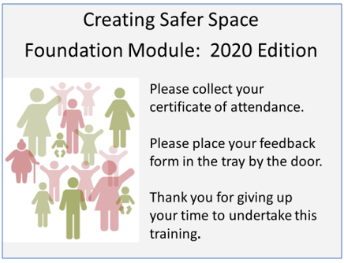
Section 6: Reflection, Feedback and Close (slides 39-44, 10 mins)
42
41
40
43
44

Slide 40
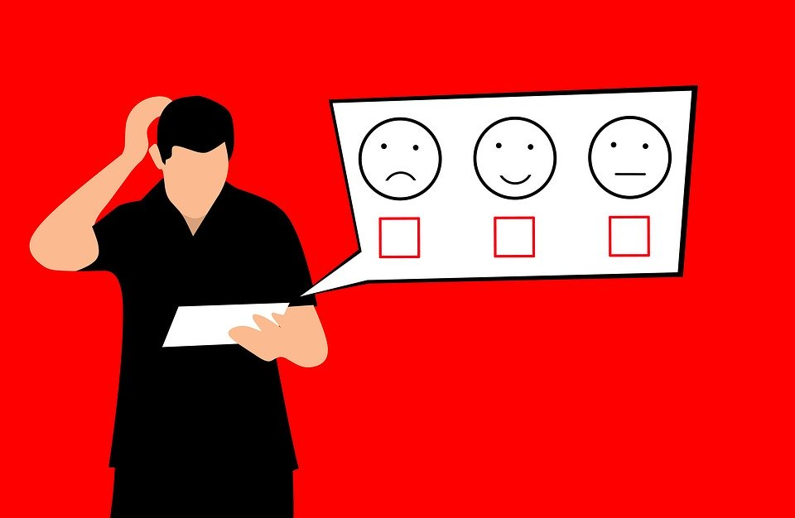
Group 1, 2 & 3 - Activity
Reflection….
Notes:
Groups 1, 2 & 3 – Reflection.
Create time during the Training the Trainers session to focus on reflection and evaluation so that it becomes an integral part of the FM trainer’s role.
Ask everyone to take a blank piece of paper and jot down notes and action points from the following discussion.
Remind participants of the importance of reflecting on and learning from each session. To do this it is important that trainers spend time as a team / pair of trainers honestly reflecting on the session. This means that before any delivery they need to work out how they are going to do this.
If a FM session finishes at 9.30pm is this the right time to meet and reflect? It maybe that meeting another time would be better. What would work best for you?
If meeting straight away works well then book a little extra time in the room you are using (and maybe bring some cake!). If it isn’t pencil in a time to meet but get into a habit of booking this in your diary when you book in the session in.
How will you create an environment where you can be honest about yourself and about your co-trainer? The following questions could be used as a basis for discussion.
What has gone well in this session?
What have you each learned from your experience in delivering the Module this time?
What could each of you do differently in the future to further improve the Module? (answer both for yourself and for your colleague)
Is there any knowledge, technical skills or 'soft' skills / behaviours that could be improved moving forward?
Provide everyone with a blank copy of the feedback forms which will enable trainers to reflect on the session. Again trainers need to decide when is best to look at the forms. Some people will want to look straight away, others will want to wait. What would work best for you? How will you respond to positive feedback on the form, how will you respond to negative feedback?
If you are working with a group of potential or existing trainers who will train together spend 5 minutes in pairs discussing how they will build reflection into their work.

Slide 41
Action Plans for Role Out
Published material will be available ….
Course to be delivered from….
Numbers for Foundation….

Slide 42
Foundation Trainers area
https://www.methodist.org.uk/for-ministers-and-office-holders/safeguarding/training/safeguarding-trainers-foundation-only/
Username: safeguardingtrainersfoundation
Password: STraf76388

