Slide 1

Opening Devotions

Slide 2
Reflection on the Welcome
Welcome each person by name
Make sure people have the correct name displayed
Complete the signing in sheet
Help people settle in
Ensure everyone can be seen
Encourage conversation as people arrive
Mute when the training begins

Slide 3



Who delivers the session?
Trainers x2
Chaplain/Pastoral Support
Zoom Coordinator

Slide 4

Being a Chaplain

Slide 5
Being a Chaplain

Slide 6
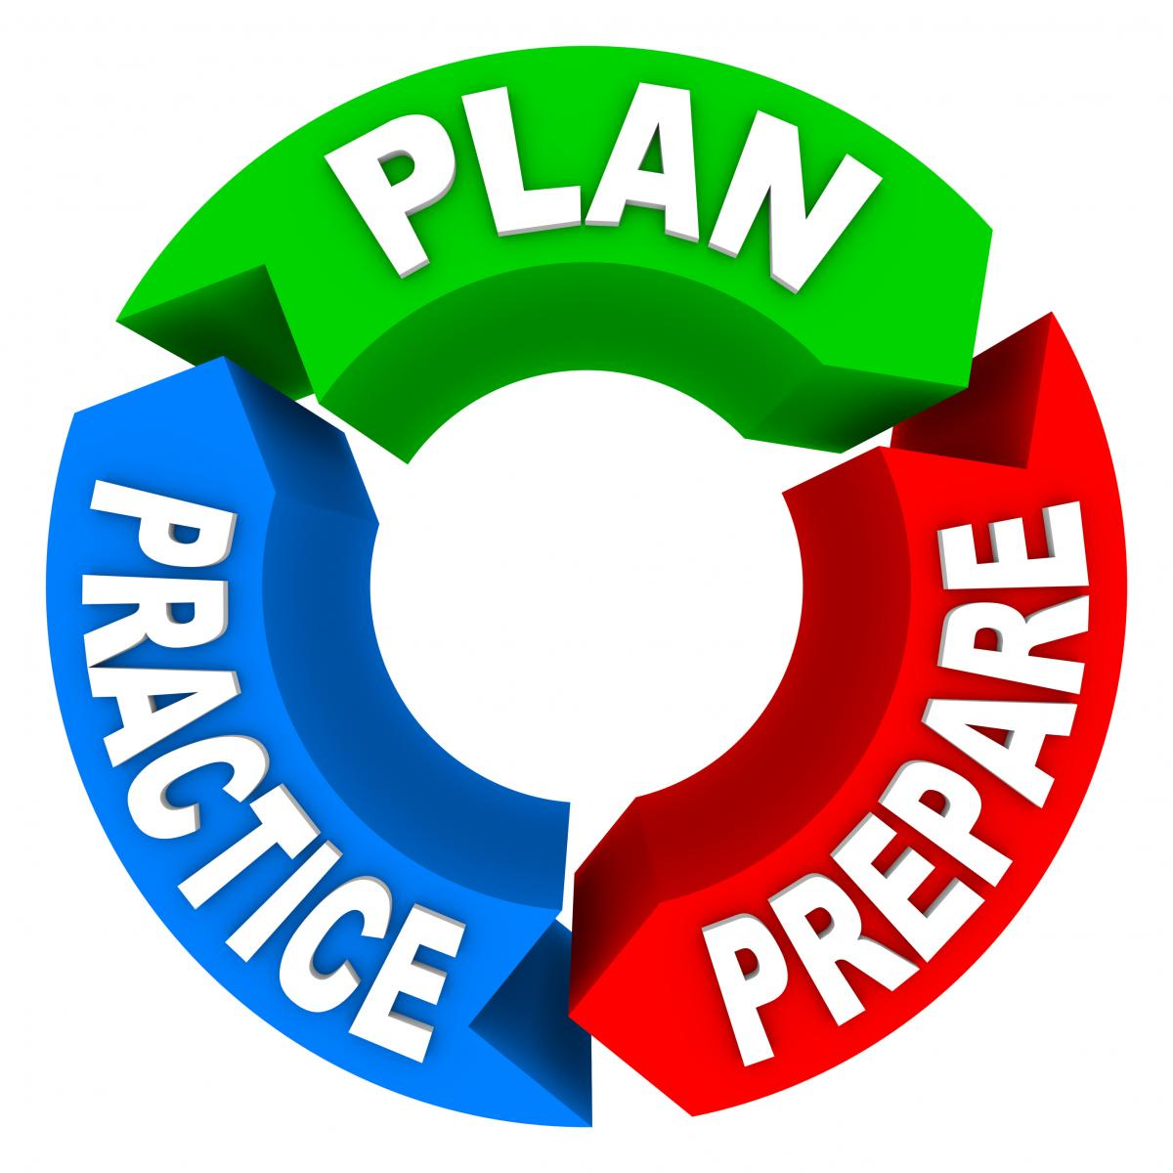
What needs to happen before a session?
Participant’s details
Handbook, Workbook and Pocket Card
Privacy Notice
Signing In Sheet
Breakout Room Allocation Sheet
PowerPoint
Who is going to screenshare
How to indicate to change slides
Log in early to check it all works!

Slide 7
The On-line Session
Welcome and Devotions
Breakout Room Introductions
What makes the Church unique?
Somewhere & Elsewhere Methodist Churches
Break
4Rs – Recognise – Respond – Record – Refer
Case Studies
Endings

Slide 8
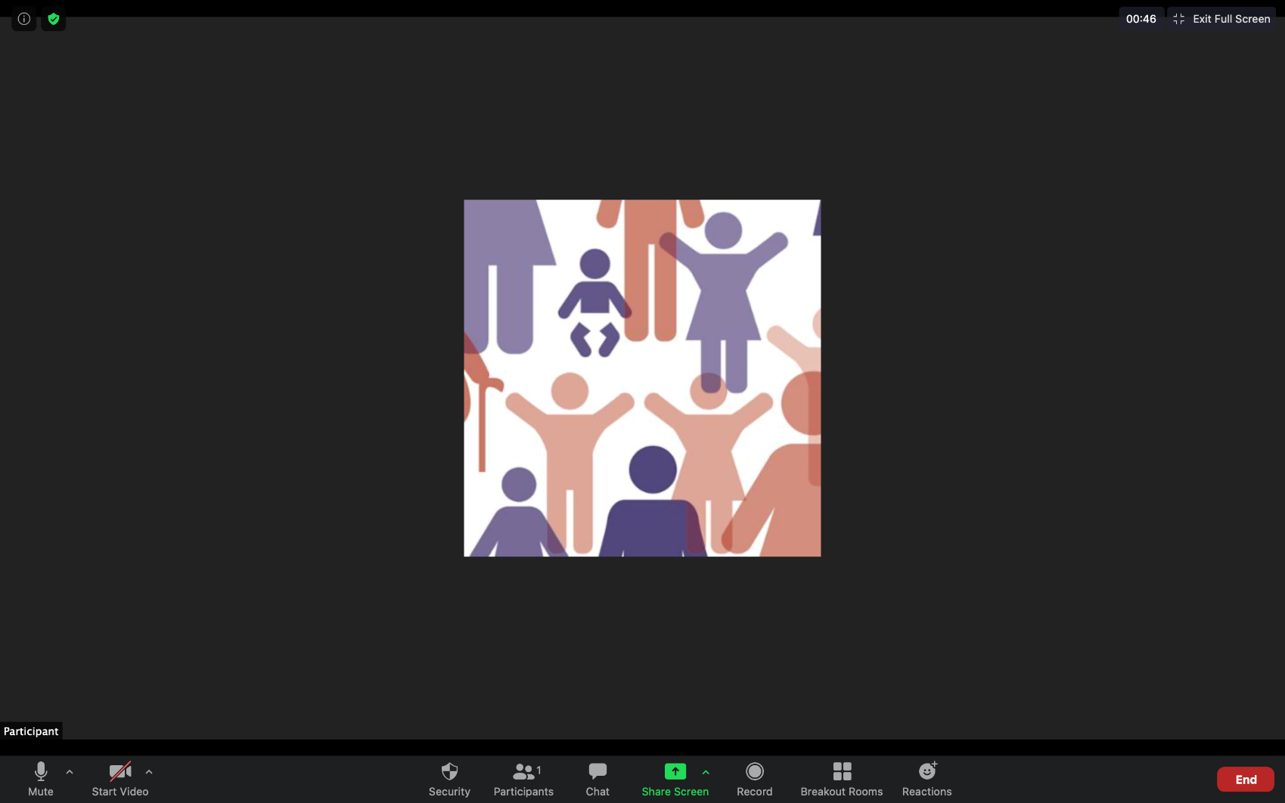
How Zoom works on different devices – desk/laptop

Slide 9

How Zoom works on different devices – iPad

Slide 10
How Zoom works on different devices – iPad

Slide 11
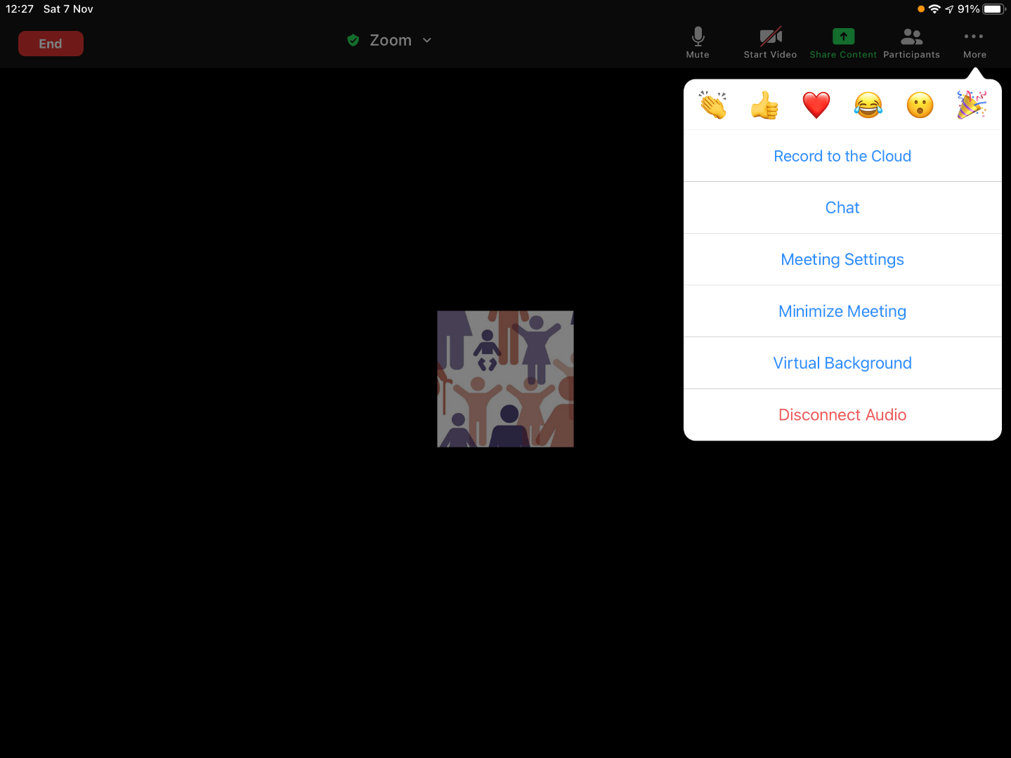
How Zoom works on different devices – iPad

Slide 12
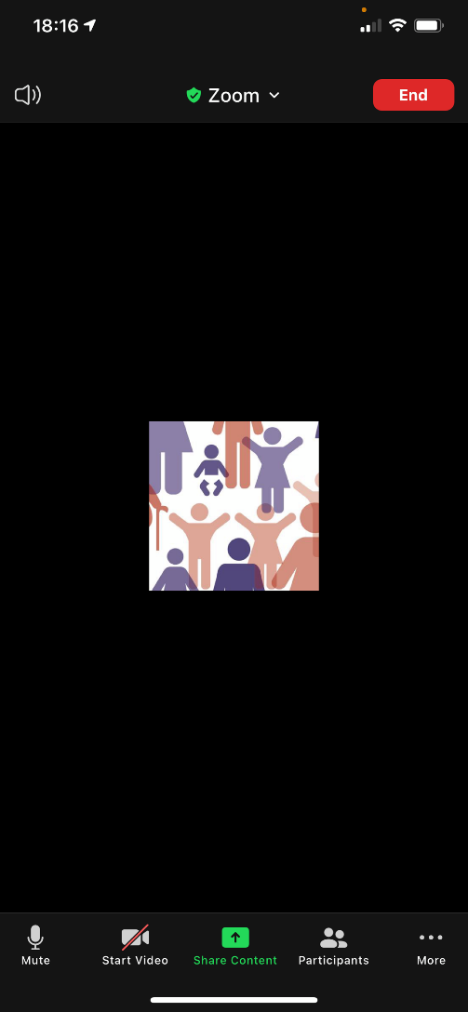
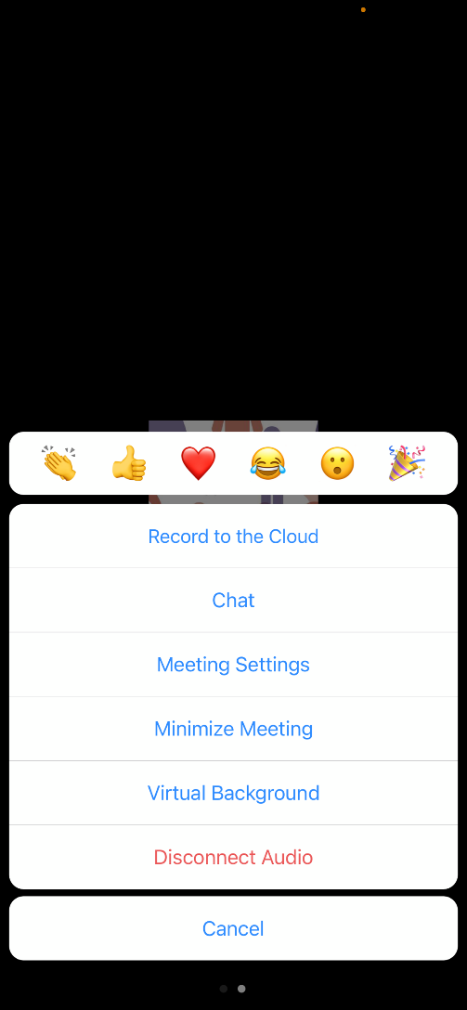
How Zoom works on different devices – iPhone

Slide 13
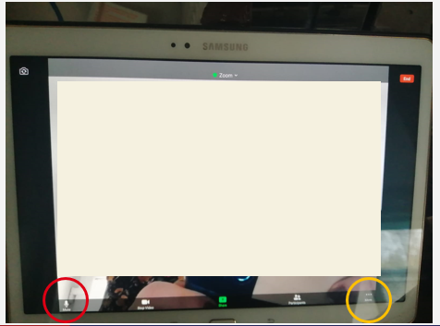
How Zoom works on different devices – Android tablet

Slide 14
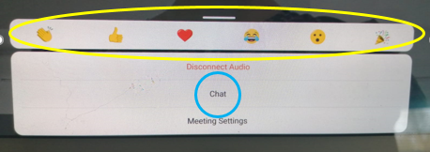
How Zoom works on different devices – Android tablet

Slide 15
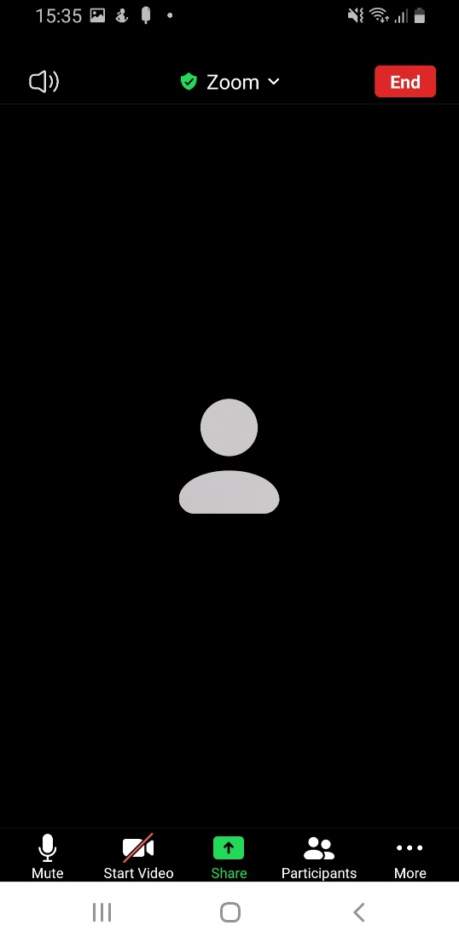
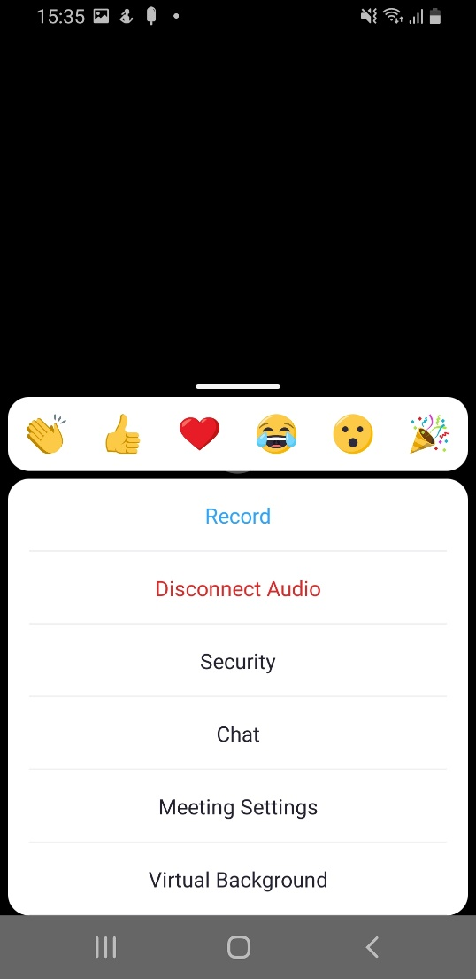
How Zoom works on different devices – Android Phone

Slide 16

Changing your settings on Zoom

Slide 17
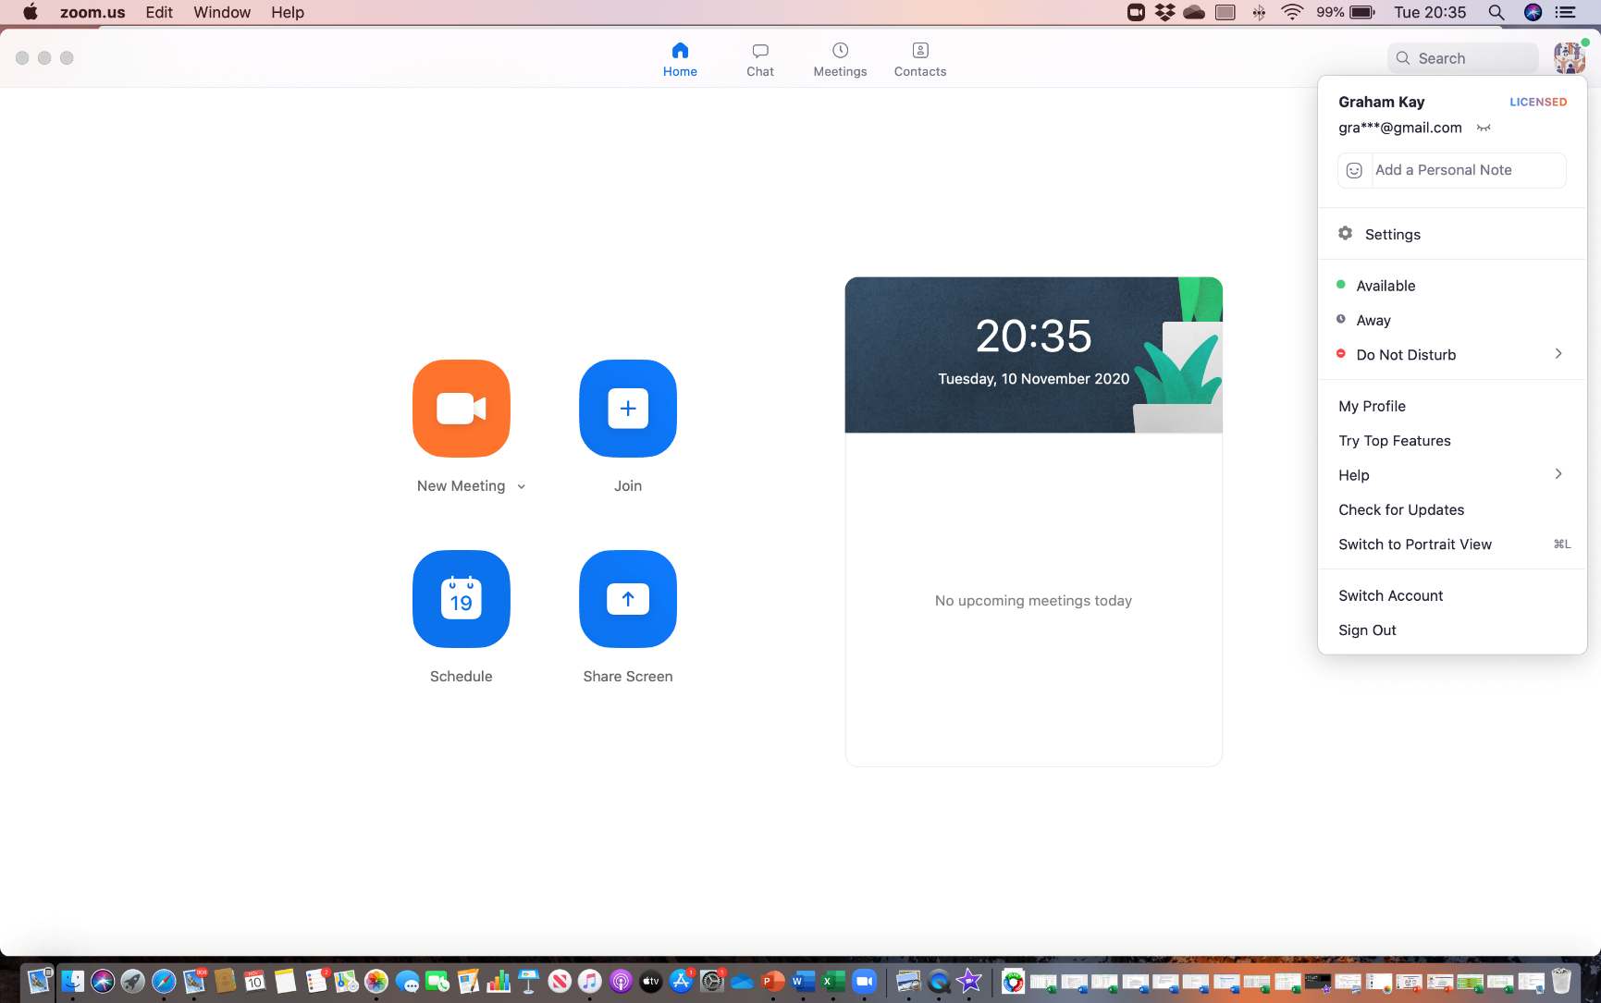
Changing your settings on Zoom

Slide 18
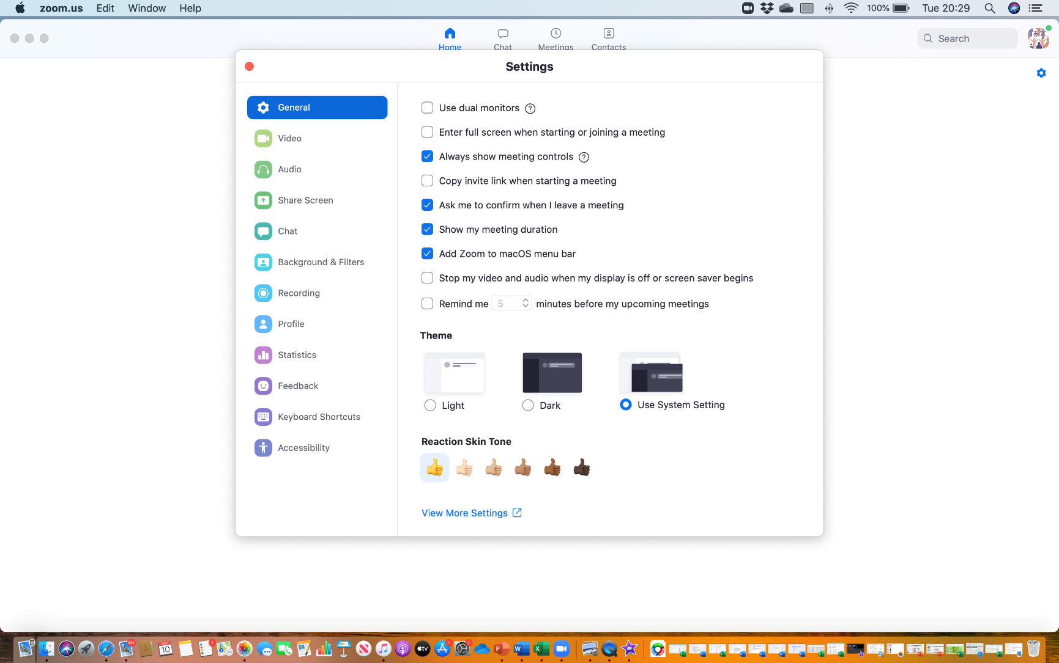
Changing your settings on Zoom

Slide 19
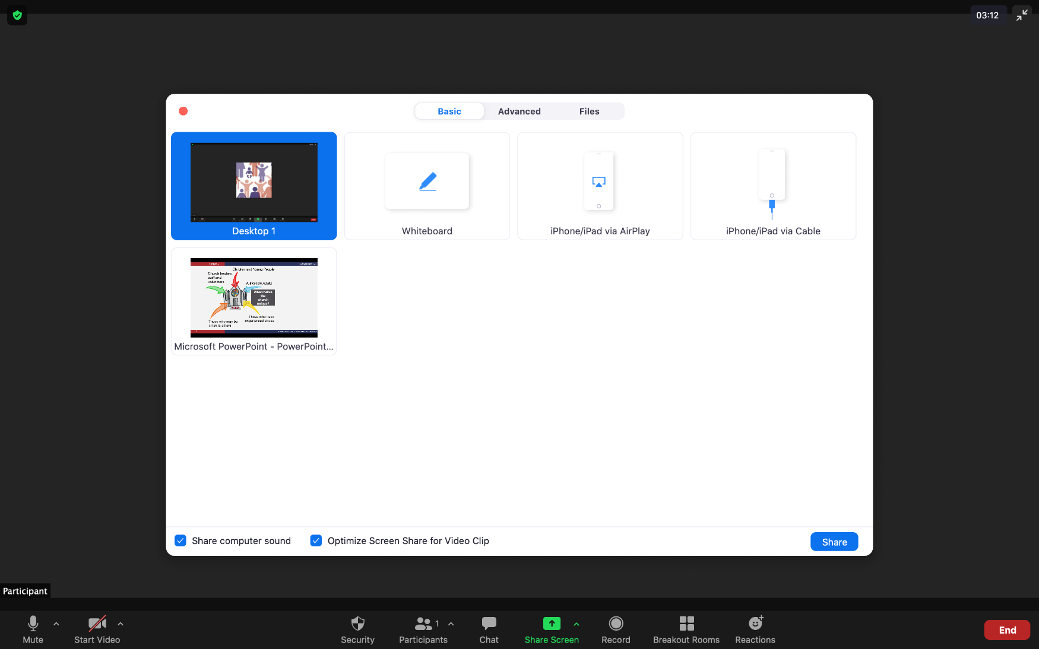
Showing the video clips and PowerPoint

Slide 20

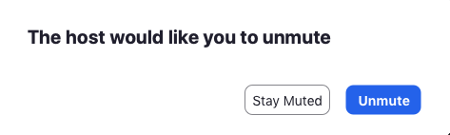
Mute or Unmute

Slide 21


Using the Chat function as the Question Park

Slide 22
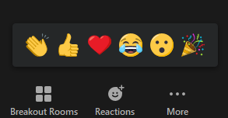
Using Reactions

Slide 23
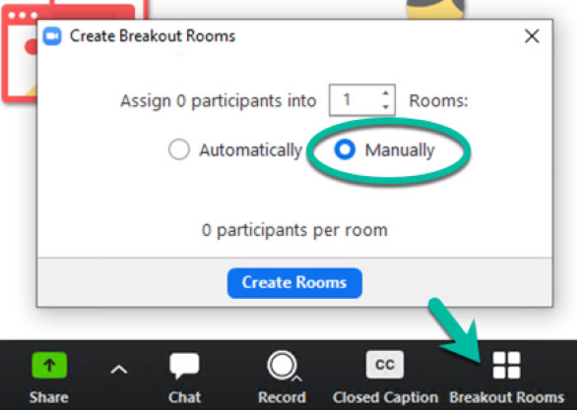
The Breakout Rooms as tables

Slide 24
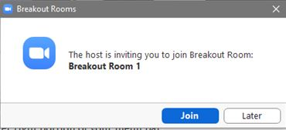
The Breakout Rooms as tables

Slide 25
The Learning Log & Feedback
Creating Safer Space:
Foundation Module – 2020 Edition
Name: Date:

Slide 26

Any Questions
Please stay online at the end and we will try and answer your individual questions

Slide 27
Thank You
Creating Safer Space
Foundation Module
Zoom Confidence

