Slide 1
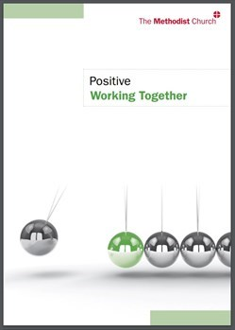
This Positive Working Together has the power to change the church!
So you’ve recognised the importance of Positive Working Together.

Slide 2
How do I help others to engage with the materials, so we have a shared understanding of what Positive Working Together means?
You’re not the only leader or person who has the opportunity to influence others.

Slide 3
Circuit Leadership Team
Local Preachers and Worship Leaders
Circuit Meeting
Local Church Councils
Staff Team
Church Groups

Slide 4
Transformational Leadership

Slide 5
Leaders of Worship and Local Preachers:
Continuing Local Preacher Development Session
1 hour interactive session which begins to engage local preachers and leaders of worship in the content of Positive Working Together.
Ideal for use at a LPWL meeting.
To be made available on the Methodist Website.

Slide 6
Reflection Task
Who are the leaders and influencers in your churches? How might you engage them in the Positive Working Together materials?

